Slide 1
D2Refine Usability Study Introduction to Test Environments
Deepak Sharma
August 2017

Slide 2
Agenda
Purpose of this slideshow:
Basic understanding of Task Environments
Prepare you for the ‘Task Session’
Notes:
The purpose of these slides is to introduce and help you understand some of the basic actions that you need to perform to accomplish
the requested tasks planned for this the ‘task session’ phase of this usability study.
We have screenshots of three environments in this slide deck which you can review and make yourself aware of the user interface (UI)
elements and it will hopefully make it easier for you to perform these tasks.

Slide 3



Introduction (1/3)
Three environments:
D2Refine
OntoMaton
RightField
Notes:
Three comparable environments are chosen to perform same tasks on each of them
D2Refine, OntoMaton and RightField

Slide 4
Introduction (2/3)
All three environments:
Present spreadsheet/spreadsheet-like interface
Similar to Microsoft Excel
Notes:
All three environments (D2Refine, OntoMaton and RightField) present their UI using spreadsheet or spreadsheet like interface.
The user interface is either Microsoft Excel or very similar. The information is presented as rows and columns.

Slide 5
Introduction (3/3)
Environments are already installed
We will use a Windows 10 Machine
Notes:
We have installed and configured three environments, on a Windows 10 machine, for you to use:
D2Refine, OntoMaton and RightField.
Additional Information:
We are planning to provide you all three environments ‘up-and-running’ to enable you to finish tasks in the given amount to time.
This slide shows the icons that are created on desktop for you to invoke the application and get started, if not already running. You can also use them to restart the environment, if running instance of the application crashes or fails to works, for any reason.
If you need some additional information about these three environments that you want to explore, after viewing these slides:
Please send an email to Deepak Sharma at “sharma.deepak2@mayo.edu”.

Slide 6
3 Planned Tasks
Create Data Dictionary
Update Data Dictionary
Search and Link variables
Notes:
You will receive all steps to perform the tasks in the Task Session. You have to read the steps and follow it to the best of your ability and knowledge that gain after viewing these slides. You are free to use any existing knowledge and familiarity to all or any of the environments.
We request you to perform three quick tasks:
Create Data Dictionary – An Empty data dictionary with no variable definitions will be provided for you to get started. You will have add variable definitions to it.
Update Data Dictionary – You will close/save the data dictionary that you create in previous step and edit it to add or edit variables of the data dictionary.
Search and Link variable(s) – You will employ search mechanism in each environment and find a suitable term that matches variable name(s) and link it to the variable definition. This activity standardize the variable, so that a user of this data dictionary knows, what the variable means.

Slide 7
Task 1 - Create Data Dictionary
An empty DD is provided
DD ➔ Collection of variables
Variable (Name, Type, Description, Range,…)
Notes:
In the first task, we request you to create a data dictionary.
An Empty data dictionary is provided with just column headers.
Just to reiterate the terminology –
A Data Dictionary is grouping or collection of variables.
These variables define what the instance data (of the data dictionary) is all about.
A variable definition may include:
An Identifier,
A name,
A data type (e.g. integer, date, boolean,…),
A description,
A Range of values (minimum and maximum values, for example a variable about patient’s weight may include range restriction with minimum and maximum values).
A Reference, remark, or any other property,….

Slide 8
Task 2 - Update Data Dictionary
Open or Re-Open the DD
Edit one or more variable
Notes:
In the second task, we request you to edit the data dictionary that you created in the first task.
You may be asked to close and re-open or access the data dictionary (if not visible already)
And edit one or more variable definitions. This can also include removal of a variable from a
Dictionary and introduce a new one.
This slide show includes slides that will help you familiarize with performing these steps.

Slide 9
Task 3 - Search and Link variables
Find a matching term
Link the variable to it
Notes:
In the third and final task, we request you to search and decide on a term that matches with one or all variables and make a link.
In this task, the environment provide a search mechanism to lookup terms in a controlled vocabulary.
Use the search mechanism and find a term that makes sense for a variable.
You may use variable name when searching to a suitable Match.
Environment will provide a way to link the standard controlled vocabulary term to the variable.
This slide show includes slides that will help you familiarize with performing these steps.

Slide 10
Study Tasks
using
D2Refine
Platform
Notes:
Following slides will show you how to do these tasks in D2Refine Platform.
Quick Information (optional):
D2Refine is developed on top of OpenRefine Platform (formerly known as Google Refine).
D2Refine extends OpenRefine with it’s extensible plug-in framework.

Slide 11
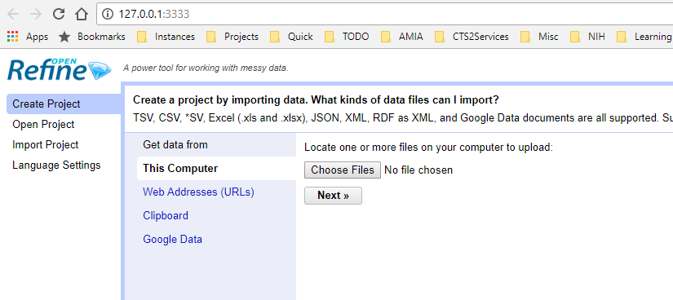
Task 1 – Create DD
We Choose this option to create a DD with no variable definitions
Notes:
In D2Refine, data dictionary is created by creating a project.
A Project can be created and jump-started with some data that is available either from a file, clipboard or a web resource.
D2Refine supports data formats of TSV, CSV, XML, JSON,…. (the formats you see here on D2Refine UI)
We will Start our data dictionary with an empty data dictionary in an Microsoft Excel Spreadsheet. This empty data dictionary
Just have variable property headers as column headers. This is a common way of getting started with a data dictionary.

Slide 12
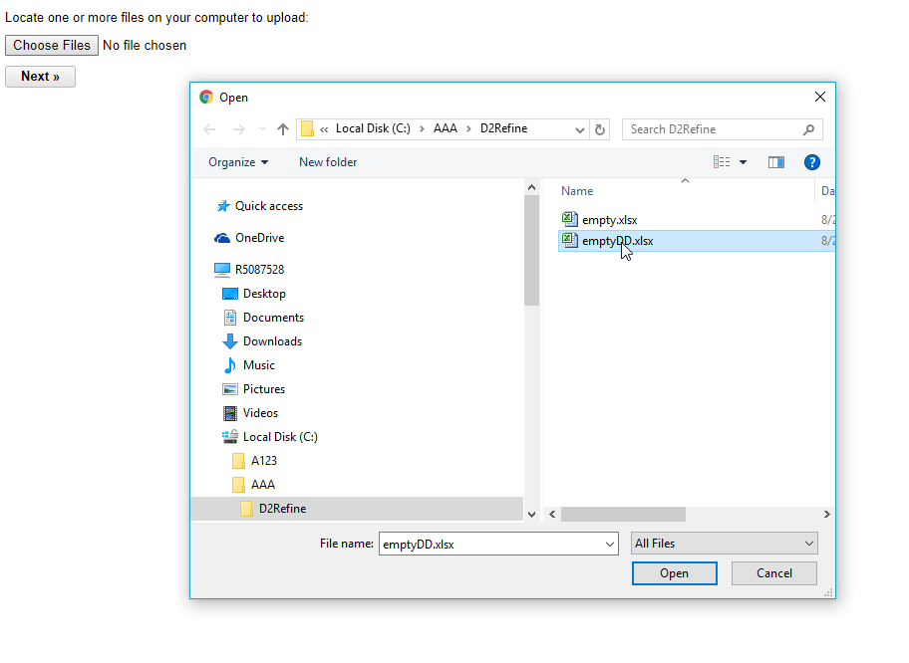
Task 1 – Create DD
Locate the file to import from your computer
Notes:
Locate the empty DD definition. In this study we will provide this file, which is a comma separate (CSV) file or a Microsoft Excel file.
This file will be empty except the column headers (first row in the file):
-- Variable id, name, type, description, min val, max val, a column for remark or references and some other column headers that might be useful.
Each row in this file will represent a variable definition – which we will manually create.

Slide 13
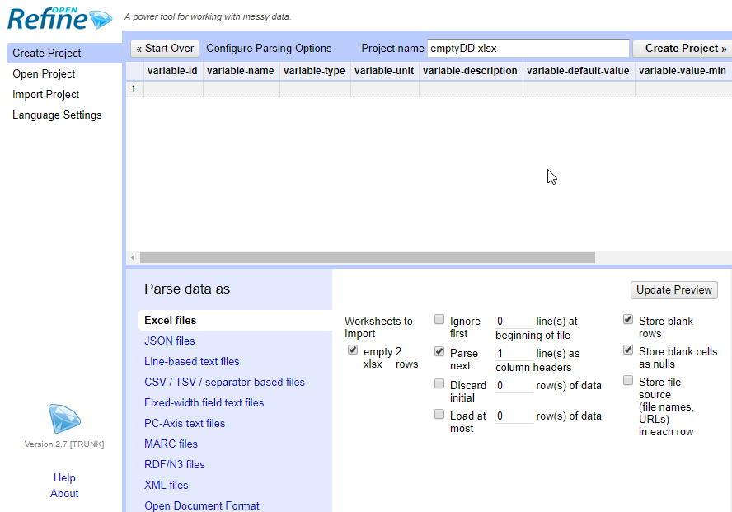
Task 1 – Create DD
Rename the Data Dictionary name, if you wish.
Otherwise it uses the file name as name of the data dictionary.
Notes:
You may wish to change the name of the data dictionary. Please remember in D2Refine, a project is a data dictionary and project name here is the name of the data dictionary.
Click on “Create Project” to see the newly created data dictionary.

Slide 14
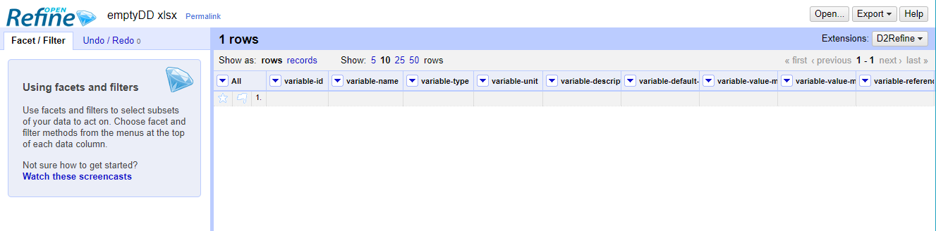
Task 1 – Create DD
This shows blank data dictionary with no variable defined
Notes:
It should show the column headers and first empty row (where you can define your first variable)

Slide 15
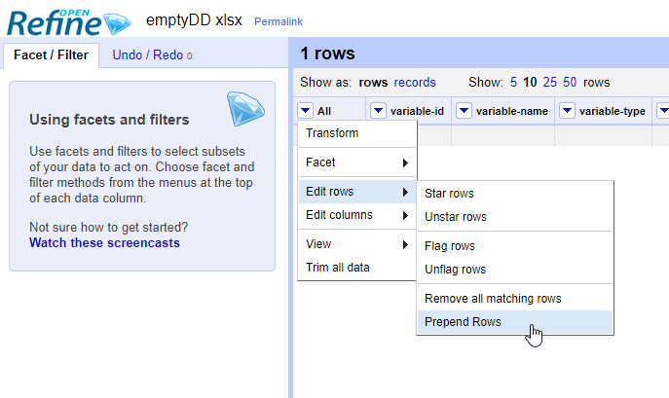
Task 1 – Create DD
Add rows using the menu option ‘Prepend Rows’
Notes:
Once you know how many variables you need, you can add rows for typing their definitions by prepending the rows to the existing one.
To prepend, go to the leftmost column “All” and use drop-down menu as displayed:
All → Edit rows → Prepend Rows

Slide 16
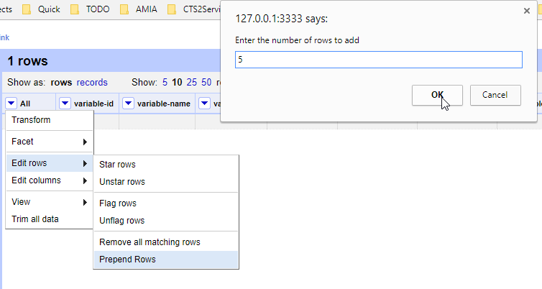
Task 1 – Create DD
Specify ‘how many additional variables’ by specifying how many additional rows you want to prepend.
Notes:
A dialog box comes, where you can specify the additional rows we might need to define variables in the data dictionary.
Please remember that this will prepend these rows to any existing rows.
In this example, we add 5 rows (for total of 6 variables; An empty spreadsheet gives you one row for a variable).

Slide 17
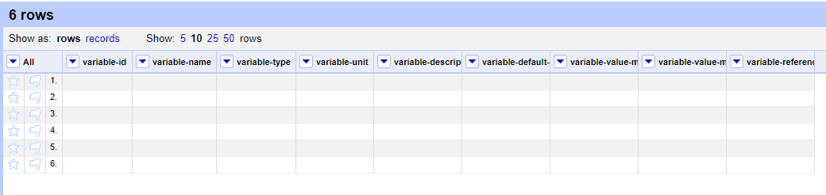
Task 1 – Create DD
Now we start editing the variable definitions – one each row
Notes:
Now we can enough space to define at most 6 variables.

Slide 18
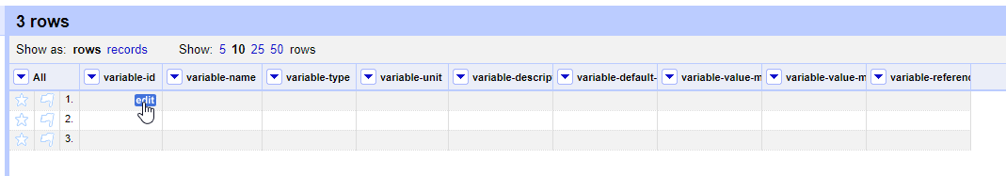
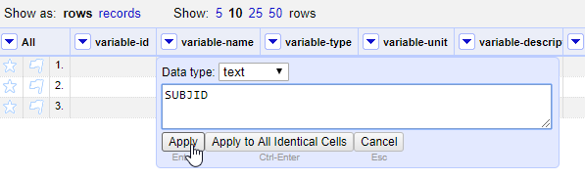
Task 1 – Create DD
Click on ‘edit’ to change a cell value
Notes:
We can use ‘edit’ icon for each cell to change it’s content. We will use this to type in the definition of the variables.
Each edit will present a dialog box to edit the value and click “Apply” button.
Optional Information about D2Refine:
D2Refine is created for cleaning up and managing messy data. You may see some interesting options and buttons as you
Work in this user interface, but we will ignore and not use those for the task session of this usability study.

Slide 19
Task 1 – Create DD
An Example of a DD with 3 variable definitions
Notes:
Here we show a data dictionary with 3 variable definitions completed.

Slide 20
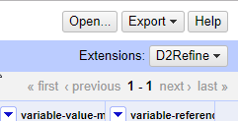
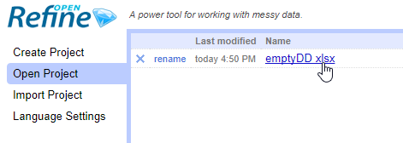
Task 2 – Update DD
Click on ‘Open’ to access the start page of D2Refine
Click on a project to re-open
Notes:
Closing and re-opening is easy.
When working at a data dictionary, you can click on “Open” button in the upper right hand side menu.
This will take you to the start page of D2Refine, where you can re-open the data dictionary again
Or at a later time to work with it.

Slide 21
Task 2 – Update DD
Click on ‘edit’ to change a cell value
Notes:
Updating a DD is identical to creating cell values that we saw when we created variables.
Just click on ‘edit’ icon for a cell value and type a new value.

Slide 22
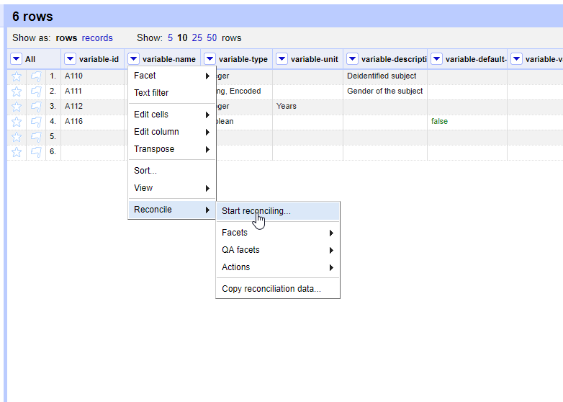
Task 3 – Search and Link
Search for matching term for all cell values of a column
Notes:
A cell value in D2Refine can be used as a search phrase to find a match.
In this exercise we will use ‘variable name’ column values to find a suitable term.
The ‘term’ would come from a controlled terminology (e.g. NCI Thesaurus or SNOMED CT).
Find a term in D2Refine is accomplished by a ‘reconciliation’ operation – The process of reconciling a cell value with a controlled terminology concept.
We can trigger search for all column values in one operation by using column header menu.
Search for matching term for all cell values of a column can be triggered from a column header menu:
Variable-name → Reconcile → Start reconciling…

Slide 23
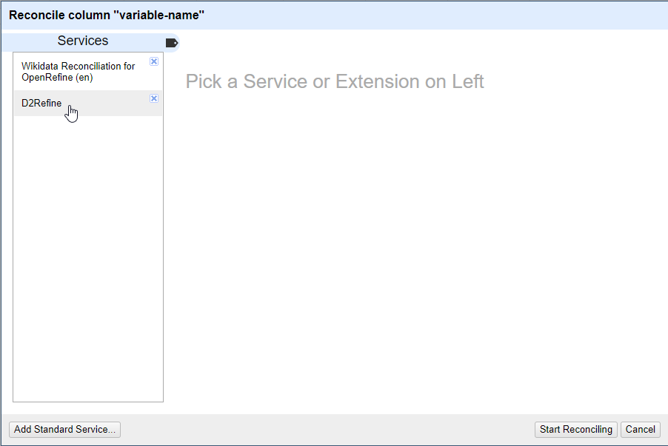
Task 3 – Search and Link
Choose the default service ‘D2Refine’. Click ‘Start Reconciling’.
Notes:
D2Refine comes a built-in reconciliation service – ‘D2Refine’.
You can select that and click “Start Reconciling”.
---------
Additional Information (Optional):
The built-in service in D2Refine connects to NCI Thesaurus at National Cancer Institute (NCI) service.
The matches returned by search are NCI Thesaurus concepts.
You could add additional services and configure them for search,
but that activity is outside the scope of this usability study.

Slide 24
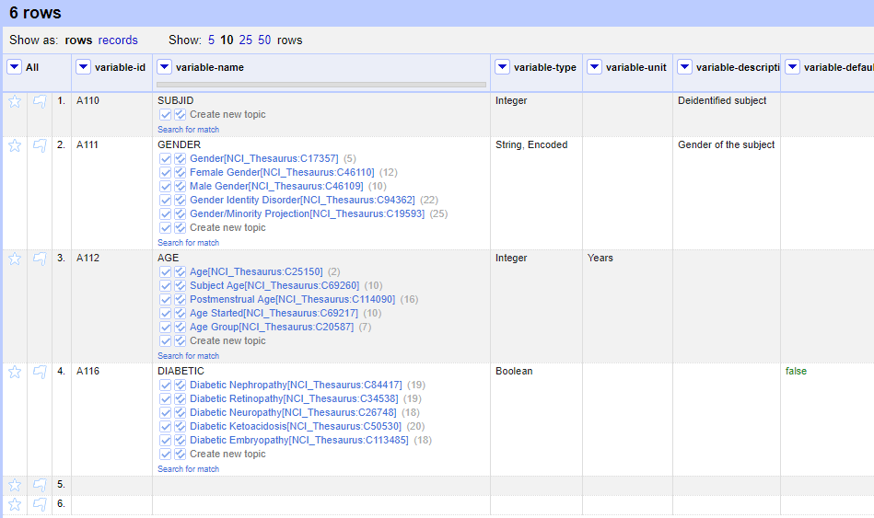
Task 3 – Search and Link
Reconciliation takes few seconds and it should show the potential matches
Notes:
The results of reconciliation operation returns up to top 5 choices.

Slide 25
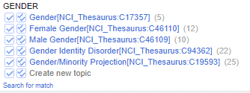
Task 3 – Search and Link
Selects value for the cell
Launches manual search operation
Notes:
We can link them to the cell value by just clicking on any of the check boxes (single or double check marks).
If you are not satisfied by any of the results (or no match is found), a manual search can be invoked by clicking “Search for match” link.

Slide 26
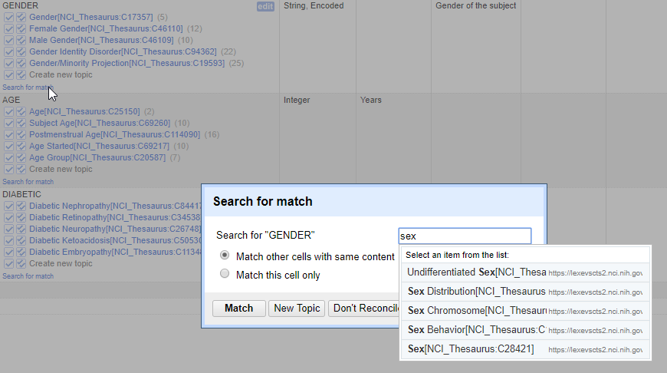
Task 3 – Search and Link
manual search operation
Notes:
Manual Search presents you a search box, where you can type for a search phrase and it searches using chosen service (built-in search in NCI Thesaurus in this case).

Slide 27
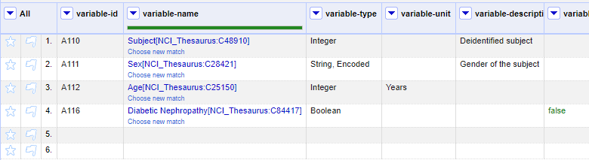
Task 3 – Search and Link
Reconciled matches replace cell values with preferred term name and code. Please note that cell value is not lost and still available (when link is removed).
Notes:
This is how reconciled (linked terms) to the variables look like.

Slide 28
Study Tasks
using
OntoMaton
Platform
Notes:
Following slides will show you how to do these tasks in D2Refine Platform.
Quick Information (optional):
D2Refine is developed on top of OpenRefine Platform (formerly known as Google Refine).
D2Refine extends OpenRefine with it’s extensible plug-in framework.

Slide 29
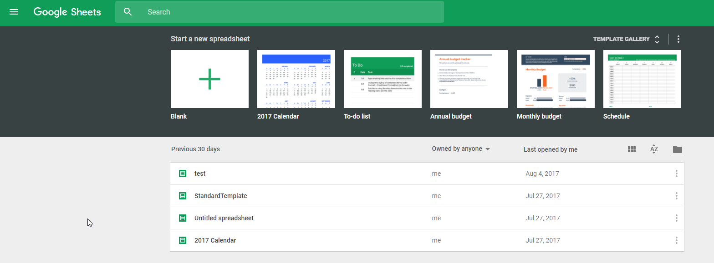
Task 1 – Create DD
Start page to work with OntoMaton
Notes:
OntoMaton is an extension app to Google Sheets.
Here we use the same sample empty data dictionary by uploading it to Google Sheets.
Optional Information:
We can start with a blank spreadsheet and manually create columns.

Slide 30
Task 1 – Create DD
Upload your spreadsheet – by clicking this folder icon. We will use this.
Creates a blank spreadsheet
Notes:
OntoMaton is an extension app to Google Sheets.
Here we use the same sample empty data dictionary by uploading it to Google Sheets.
Optional Information:
We can start with a blank spreadsheet and manually create columns.

Slide 31
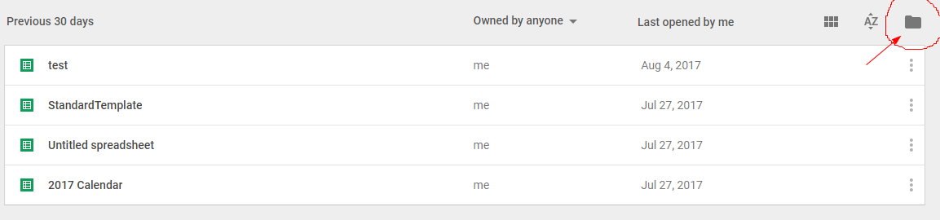
Task 1 – Create DD
Click on Folder icon to start
Notes:
Start the upload by clicking to the “folder” icon

Slide 32
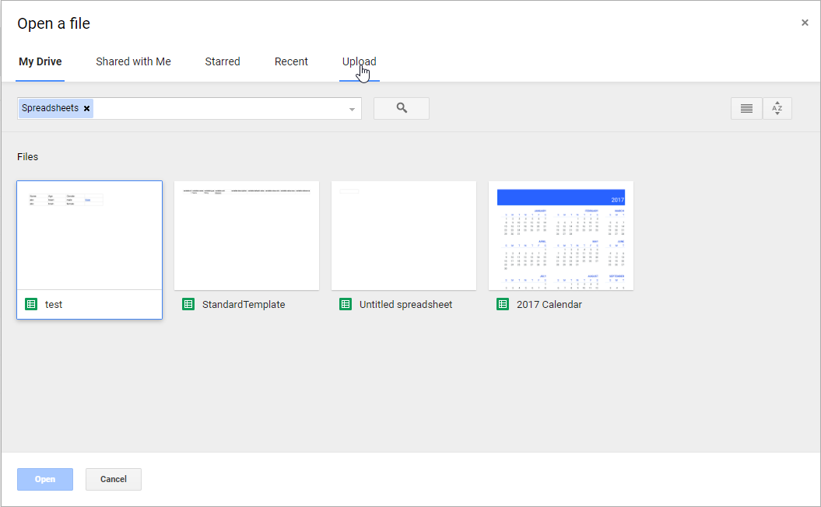
Task 1 – Create DD
Click ‘Upload’ Tab to upload the empty data dictionary file
Notes:
Click on “Upload” tab

Slide 33
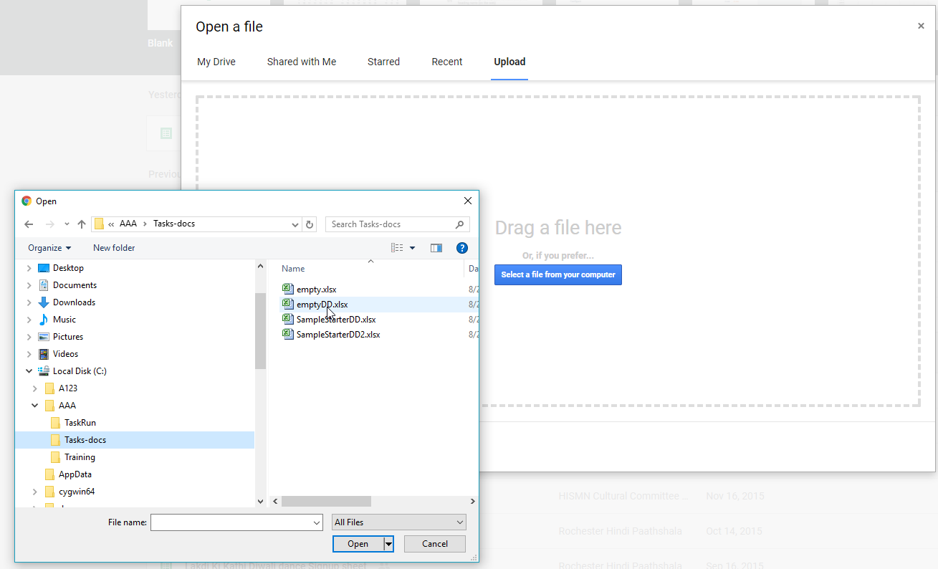
Task 1 – Create DD
Locate the file on the computer.
Notes:
Select the provided file to get a blank data dictionary (same file we opened in D2Refine). Click ‘Open’.

Slide 34
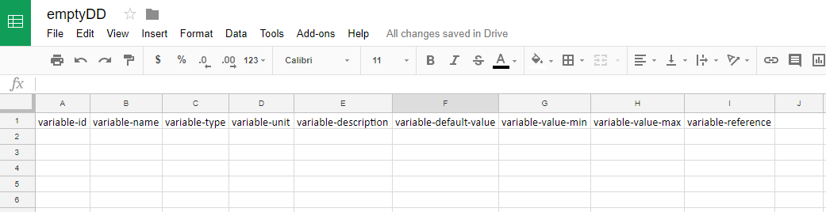
Task 1 – Create DD
It opens the empty DD
Notes:
It opens the data dictionary spreadsheet

Slide 35
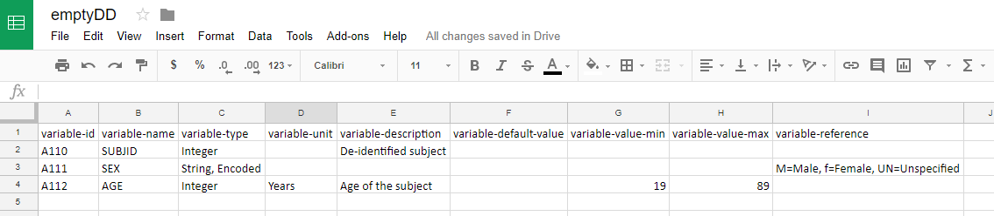
Task 1 – Create DD
Define variables by adding them here. Just type …
Notes:
You can simply type the details of variables to the data dictionary.
Since this is Google Spreadsheet, it is automatically saved.

Slide 36
Task 2 – Update DD
When done, click this to go to the main page.
Notes:
Opening a data dictionary here is simple. Just click on the data dictionary spreadsheet that we created and update it.

Slide 37
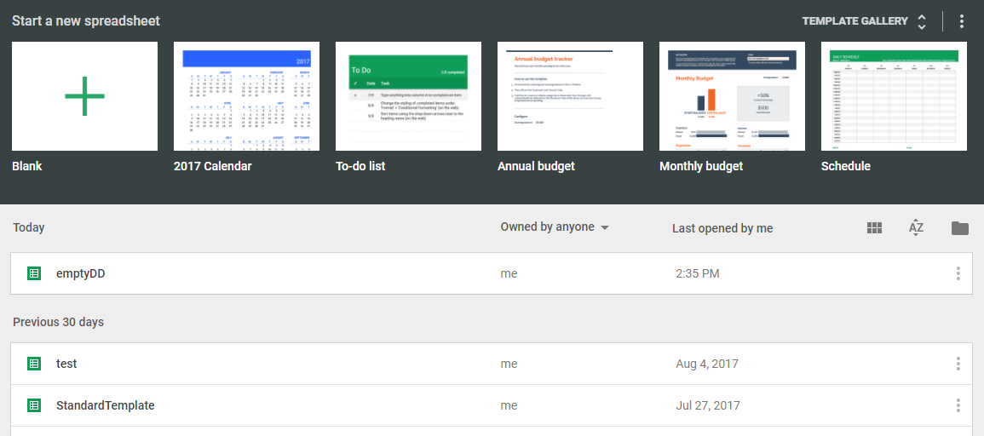
Task 2 – Update DD
Now the DD is now listed. You can re-open it by clicking on it.
Notes:
Opening a data dictionary here is simple. Just click on the data dictionary spreadsheet that we created and update it.

Slide 38
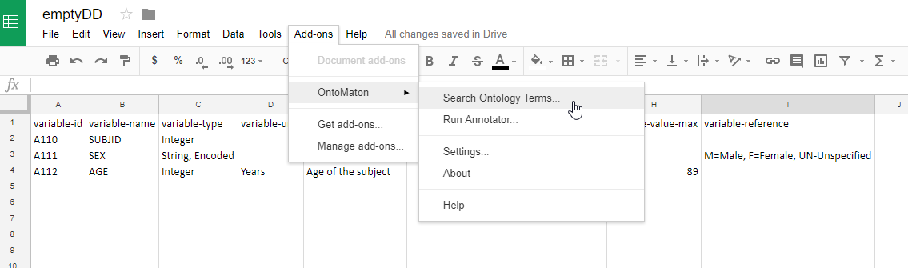
Task 3 – Search and Link
You start searching using OntoMaton in ‘Add-ons’ menu
Notes:
To use OntoMaton tool to search and link controlled terminology values to variable names – please use the ‘Add-ons’ menu.
OntoMaton should be listed.
Add-ons → OntoMaton → Search Ontology Terms…
-----------
Additional Information (Optional):
OntoMaton is a google extension to its sheets and can be installed (if not installed already) by using “Get add-ons…” sub-menu.
For this exercise, it should be installed and configured for you to use.

Slide 39
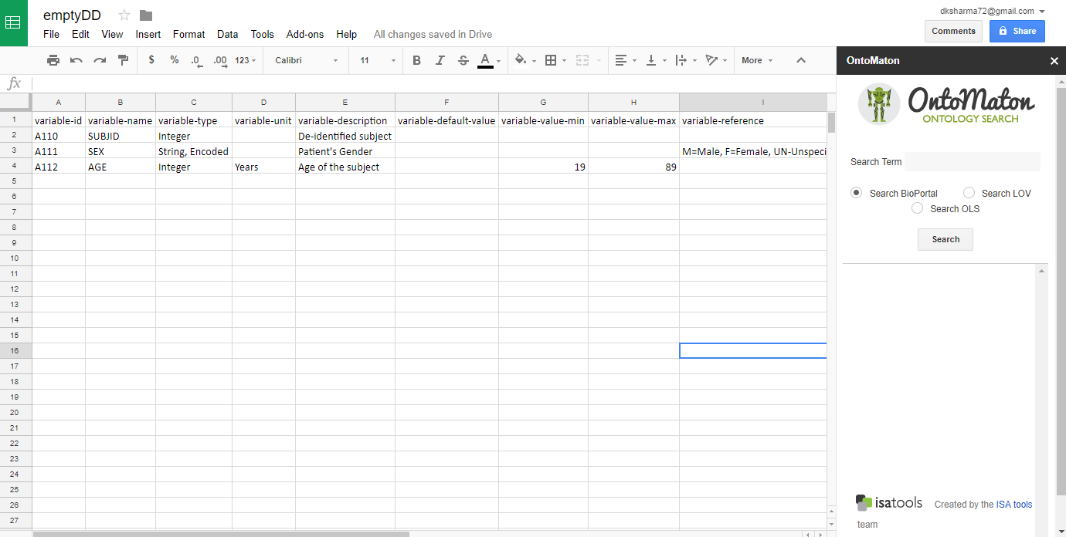
Task 3 – Search and Link
You should see a search Panel to search for terms
Notes:
This will show OntoMaton Ontology Search panel on the right side.
You can type a serach term and it will search it using Bioportal Service.
Additional Information (Optional):
Bioportal is a service created by National Center for Biomedical Ontologies (NCBO) for public consumption.
It has hundreds of ontologies served through its web-service, to which OntoMaton connects for search.

Slide 40
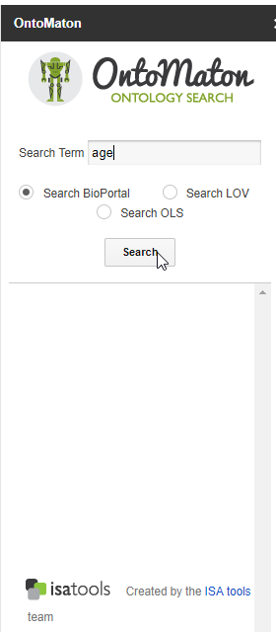
Task 3 – Search and Link
Searching for matching terminology concepts for “age” (using Bioportal)
Notes:
You can search for an item. For example – we search for “age” and click “Search” button.

Slide 41
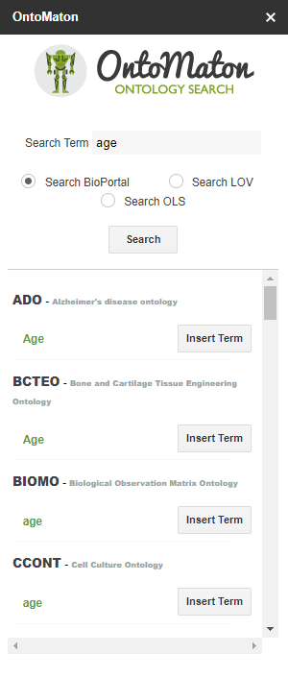
Task 3 – Search and Link
Matching terminology concepts for “age” in different ontologies
Notes:
The results are listed based on which ontologies they were found in.
Here we see matching results for “age” in 4 different ontologies at Bioportal.

Slide 42
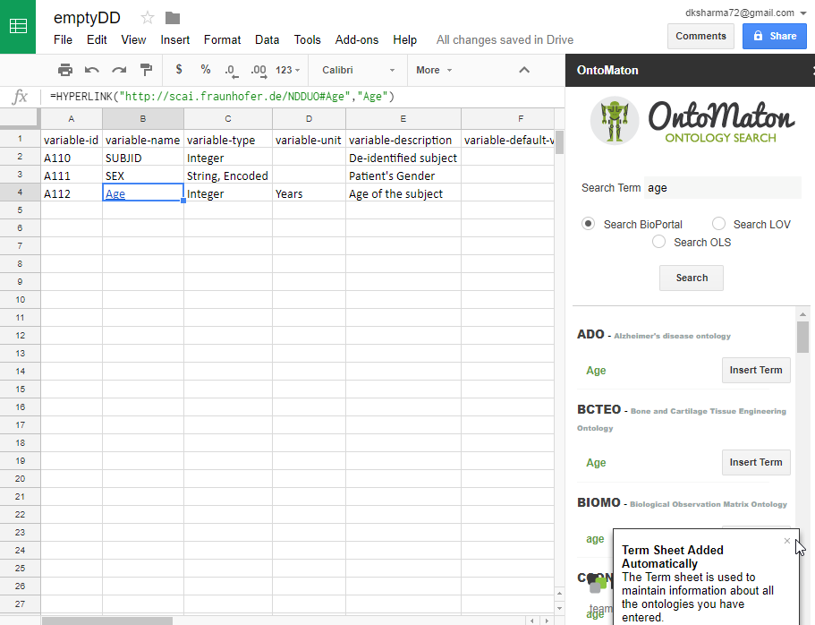
Task 3 – Search and Link
Notes:
When you choose a term and click on “Insert Term” button, a link is made and cell value will contain link to the controlled terminology term.
Additional Information (Optional):
This is stored as Hyperlink value of that cell.

Slide 43
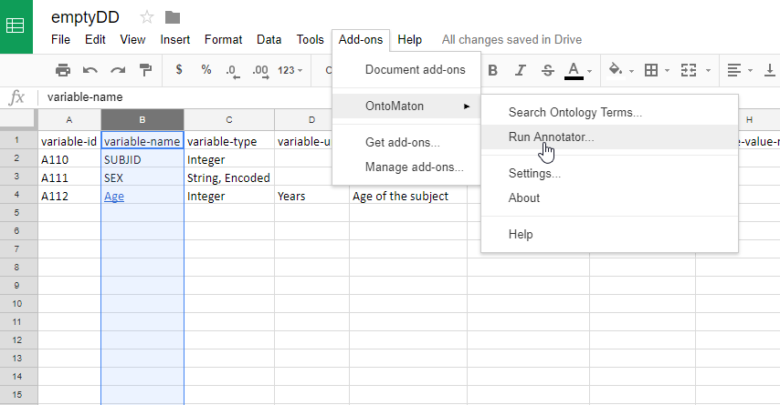
Task 3 – Search and Link
You can run Annotator for searching for multiple selected cell values in DD
Notes:
You can invoke “Annotator” that will search and find matches for multiple cell values (selected ones) in one step.

Slide 44
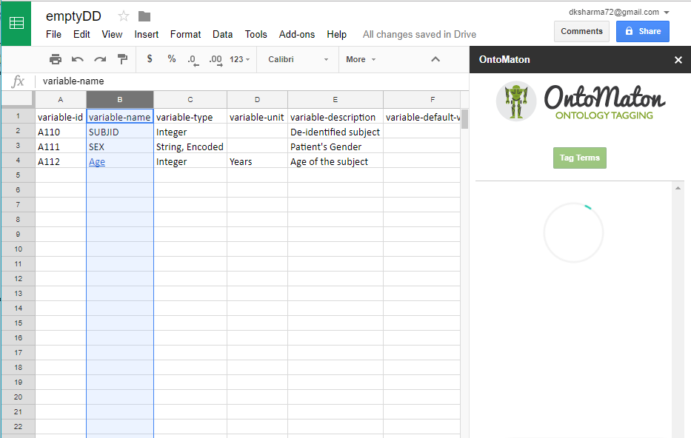
Task 3 – Search and Link
Select values and click “Tag Terms”
Notes:
Once the search is over, then you can tag the results found to the selected values.

Slide 45
Study Tasks
using
RightField
Platform
Notes:
Following slides will show you how to do these tasks in D2Refine Platform.
Quick Information (optional):
D2Refine is developed on top of OpenRefine Platform (formerly known as Google Refine).
D2Refine extends OpenRefine with it’s extensible plug-in framework.

Slide 46
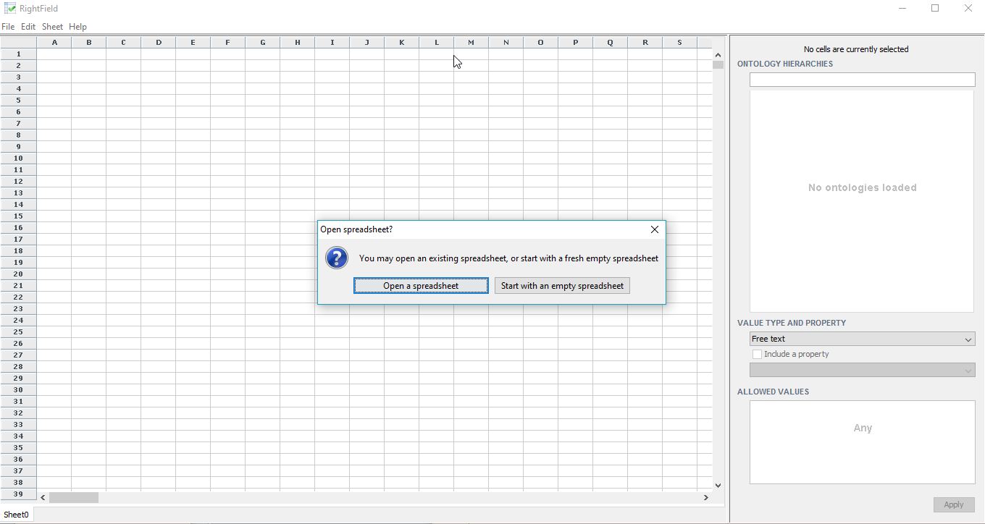
Task 1 – Create DD
Choose “Open a spreadsheet”
Notes:
When you start RightField, it asks if you would like to start with an empty spreadsheet or open an existing one.
Here we will choose the empty DD spreadsheet (just like we did with D2Refine and OntoMaton)

Slide 47
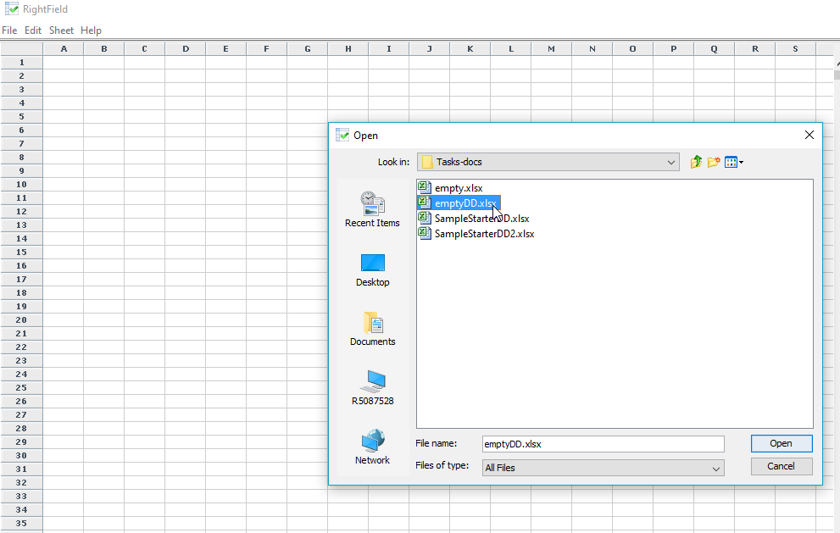
Task 1 – Create DD
Notes:
Choose the empty DD file.

Slide 48
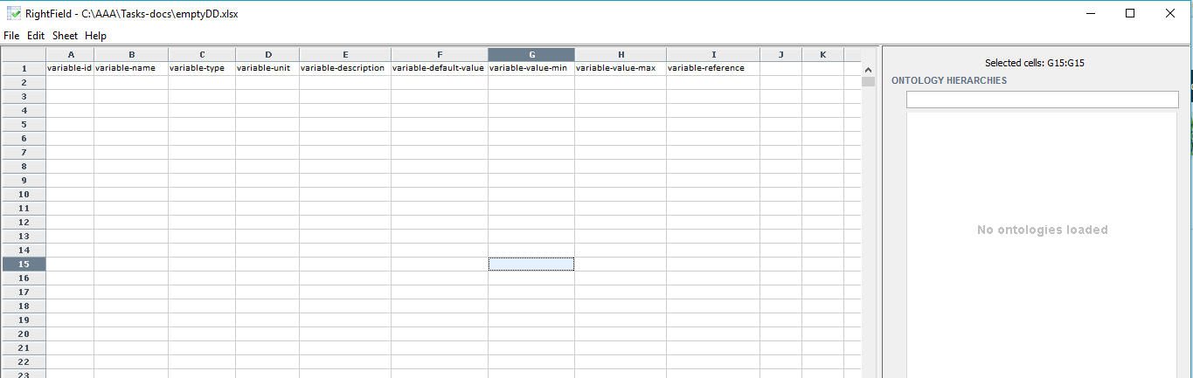
Task 1 – Create DD
File opens with an empty data dictionary with only column headers
Notes:
It should open the file/spreadsheet with just column headers – ready for typing the variable definitions …
Additional

Slide 49
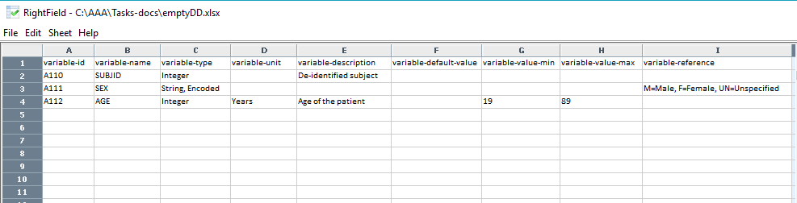
Task 1 – Create DD
Type in the variable definitions

Slide 50
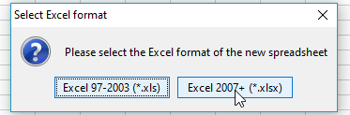
Task 2 – Update DD
Data dictionary can be saved in two MS Excel formats
Notes:
Optional Information:
RightField application works directly with the MS Excel files. So when we save the dictionary, it modifies the original file.
If you do not want original empty data dictionary file, then you can save it with a different name.
When you are working with RightField, you are actually working on the spreadsheet, unlike D2Refine and OntoMaton, where
You had to upload it to the application, before you were able to edit.

Slide 51
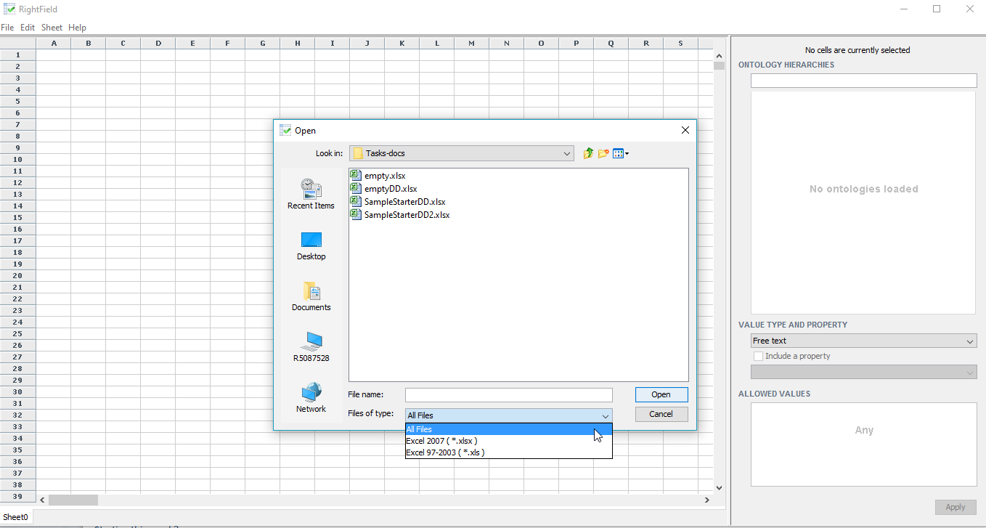
Task 2 – Update DD
Reopen the Data dictionary
Notes:
You can reopen the data dictionary spreadsheet and edit like a normal MS Excel spreadsheet

Slide 52
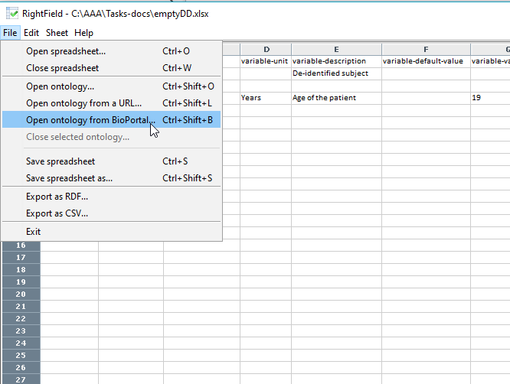
Task 3 – Search and Link
Invoking the search from Bioportal
Notes:
RightField allows us to load and/or open ontology from a URL or local file.
Just to be consistent with the process of searching and linking a controlled terminology term, we will use bioportal.

Slide 53
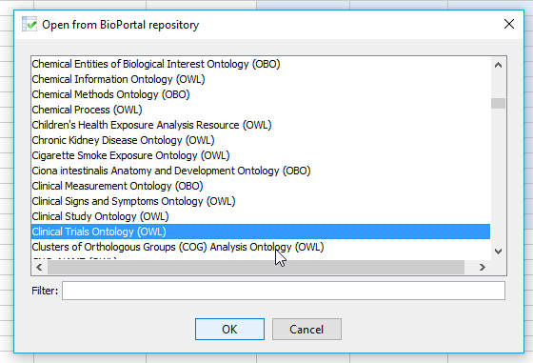
Task 3 – Search and Link
Pick an ontology (here we choose “Clinical Trials Ontology(OWL)”
Notes:
This will present a list of ontologies that Bioportal offers. User has to choose an ontology.
For this exercise, we will use Clinical Trial Ontology (OWL)

Slide 54
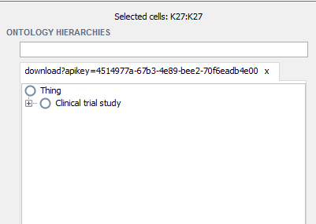
Task 3 – Search and Link
Shows ontology hierarchy on the right side ontology pane
Notes:
When choose an ontology to search – it updates the right side Ontology Hierarchies pane.

Slide 55
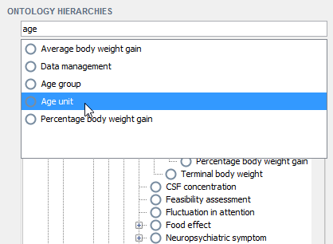
Task 3 – Search and Link
Search for a term by typing the search phrase
Notes:
As you start typing the search phrase, it will start showing the potential matches… you can select one … and

Slide 56
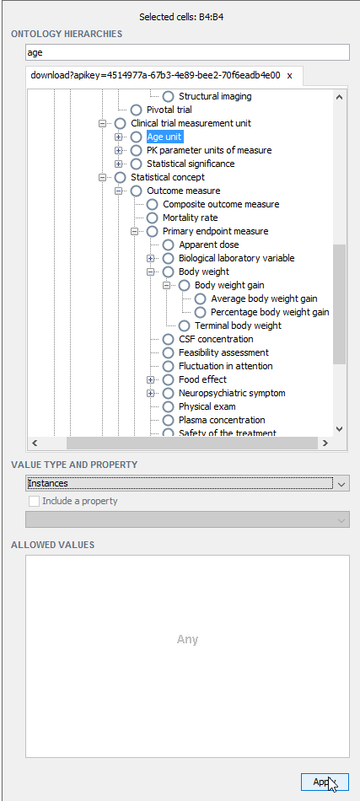
Task 3 – Search and Link
Takes to the position of the matched term in the ontology hierarchy

Slide 57
Task 3 – Search and Link
Select ‘instances’
Notes:
Select ‘instances’ from drop-down list for value-type.
It shows how the values should match once we have instance data of this data dictionary variable.
Select “age” variable (by selecting the cell value for ‘variable name’) and Click “Apply”.

Slide 58
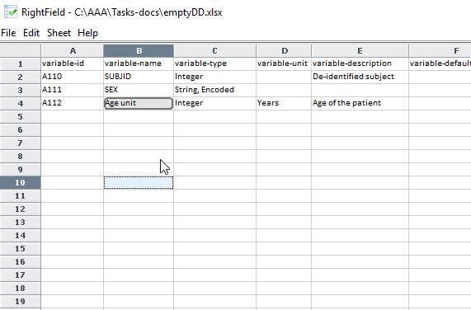
Task 3 – Search and Link
Variable ‘age’ is linked to the term ‘Age unit’
Notes:
Now the ‘age’ variable is linked to the term “Age unit” in ‘Clinical Trial Ontology (OWL)”

Slide 59
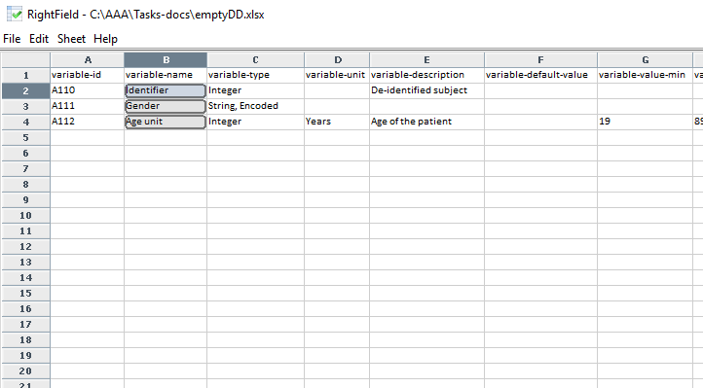
Task 3 – Search and Link
Repeat the process to link all three variables

Slide 60
What we learned
How to use three environments for three tasks:
Create Data Dictionary
Update Data Dictionary
Search and Link variables
Notes:
You will receive all steps to perform the tasks in the Task Session. You have to read the steps and follow it to the best of your ability and knowledge that gain after viewing these slides. You are free to use any existing knowledge and familiarity to all or any of the environments.
We request you to perform three quick tasks:
Create Data Dictionary – An Empty data dictionary with no variable definitions will be provided for you to get started. You will have add variable definitions to it.
Update Data Dictionary – You will close/save the data dictionary that you create in previous step and edit it to add or edit variables of the data dictionary.
Search and Link variable(s) – You will employ search mechanism in each environment and find a suitable term that matches variable name(s) and link it to the variable definition. This activity standardize the variable, so that a user of this data dictionary knows, what the variable means.

Slide 61
Tutorial Session DONE!
You are DONE!
Please send me your questions BEFORE we conduct the ‘Study Task Session’ to complete it in 30 Minutes.
-- Deepak Sharma
sharma.deepak2@mayo.edu

