Slide 1
Predicting Movie Success
Is a Big Budget Enough?

Slide 2
Proposal
Is it possible to use a movie’s production budget and critic scores to determine if it will be a hit or miss?
Does a high budget always mean movie success?

Slide 3
Data Sources
The Movie Database (TMDB) 5000 Movie Dataset
  Available on Kaggle as a CSV download
  Includes: title, budget, production company, revenue and some critic metrics
Open Movie Database (OMDb)
  API RESTful web service
  Requires API key
  Includes: IMDb ID, title, plot, type, Rotten Tomato scores, ratings, votes and award info

Slide 4
Risks and Ethical Implications
All assumptions were documented during analysis
  $0 budget and $0 revenue entries were removed
OMDb API
  Follow attribution guidelines
  Utilized API key and kept within the 1,000/calls a day limit
Created new column, Simplified_Title, for matching movie titles across the datasets

Slide 5
Model Choice & Metrics
Using Regression Modeling to predict box office revenue
  Based on budget and critic scores
Evaluation for Regression Models focuses on the error
  Mean Absolute Error (MAE): the average of the absolute differences between the actual and predicted values
  Root Mean Squared Error (RMSE): Square root of the average of squared differences between actual and predicted values
  R-Squared: The coefficient of determination that shows how well the independent variables explain the variability of the dependent target variable

Slide 6
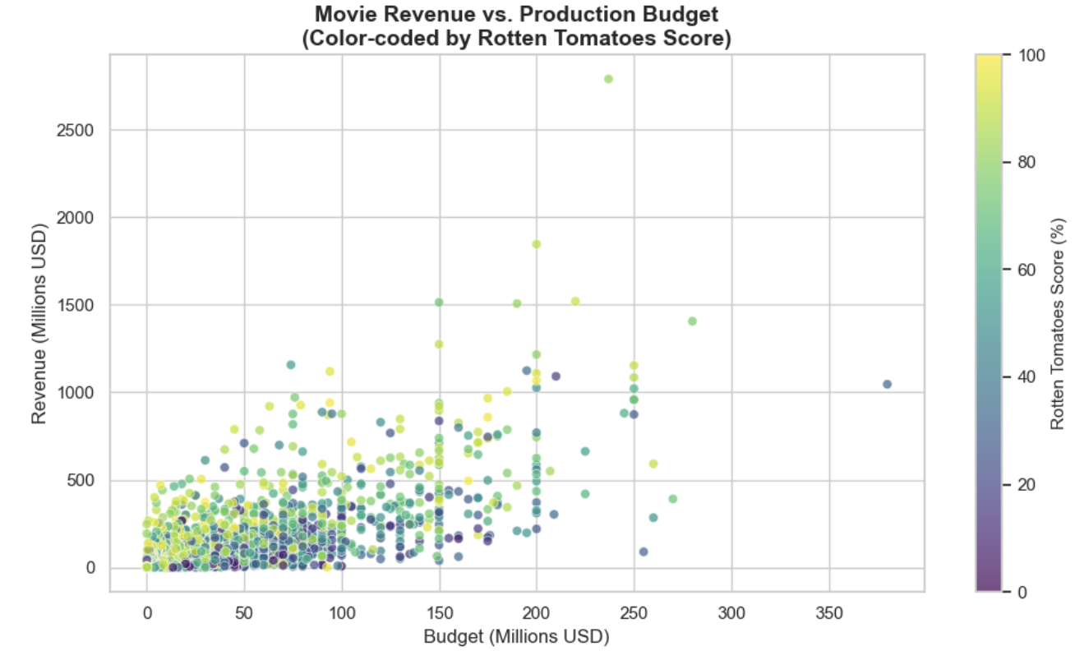
Exploratory Data Analysis and Visualizations

Slide 7
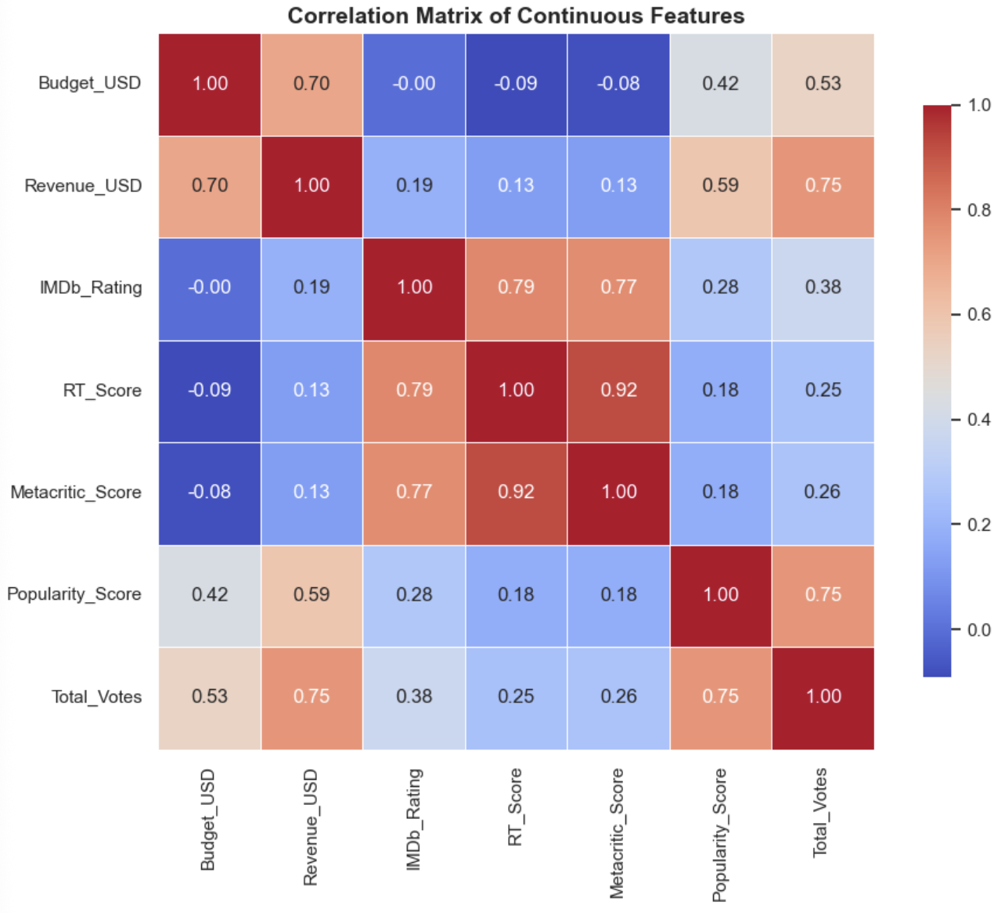
Assessing Multicollinearity
Focused Matrix to Budget, Revenue, IMDb Rating, Rotten Tomatoes Score, Metacritic Score, and Popularity Score
Metacritic Score and Rotten Tomatoes Score show a high coefficient variance at 0.92
Lead to new feature engineering of a Combined Score
$$Combined_Score=\frac{Metacritic_Score+RT_Score}{2}$$

Slide 8
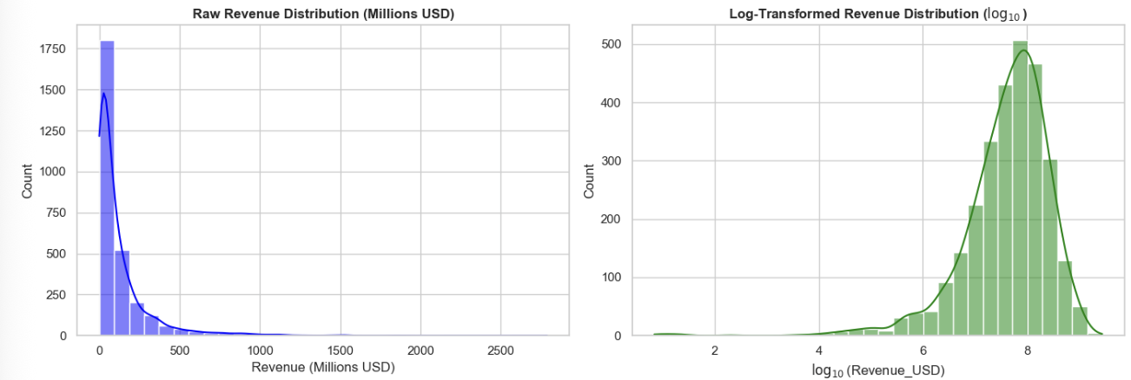
Validating Distribution of the Revenue
Revenue is highly right skewed
Log Revenue is more even with a longer left-skew tail

Slide 9
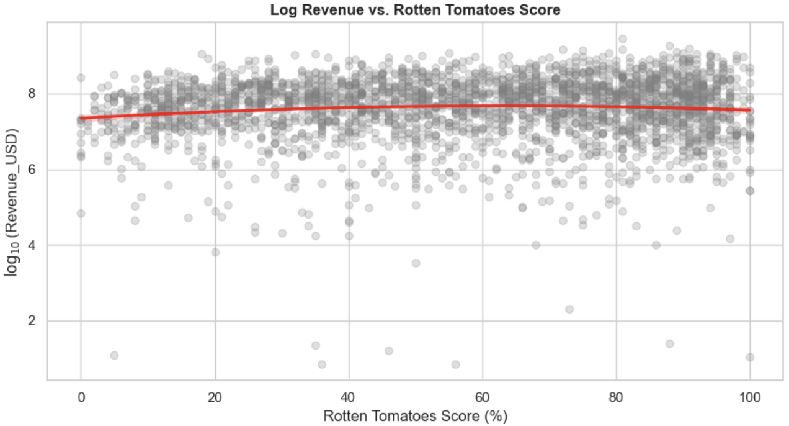
Validation for Linearity of Feature and Target Variable
Log Revenue and Rotten Tomatoes Score
Linear assumption is reasonable for this data

Slide 10
Multiple Linear Regression
Results: R^2: 0.3802 | MAE: $525.26M | RMSE: $5896.79M
Uses multiple independent features to predict the target variable of revenue
Trained using log transformed numbers to minimize the gap between smaller films and blockbuster hits
Inverse transformed log values using Duan’s Smearing Factor to report in actual dollar amounts

Slide 11
Optimized Decision Tree Regressor
Results: R^2: 0.6610 | MAE: $64.58M | RMSE: $122.28M
Handles non-linearity and feature interactions
  i.e. high budget may yield a high revenue only if it’s paired with high audience engagement
Tree model makes decisions using step-wise threshold splits
Included hyperparameter tuning using a 5-fold cross validation grid search
  The highest R-Squared value on the training data was used for the unseen test data

Slide 12
Random Forest Regression
Results: R^2: 0.7252 | MAE: $57.90M | RMSE: $110.10M
Ensemble of multiple independent decision trees on bootstrapped subsets of the data and then averages their predictions
Provides better results through elimination of variance issues in single decision trees due to bagging
Handles non-linear feature interactions well and robust to multicollinearity
Feature Importance
  Total Votes: 58.4%
  Budget: 29.6%
  Popularity: 5.6%
  Combined Score: 3.6%
  IMDb Rating: 2.8%

Slide 13
Random Forest Regression with Tuning and Optimizations
Results: R^2: 0.7393 | MAE: $58.54M | RMSE: $107.25M
Optimal Parameters: Max Depth: 10 | Max Features: 0.4 | Minimum Samples Leaf: 1 | Minimum Samples Split: 2 | N Estimators: 500 | Duan Smearing Factor: 1.2965
Tuning with randomized search to sample broadly across the wide parameter distributions
Log transformed: Revenue, Budget, and Total votes to compress the skewed predictors for more granular splits
Engineered new Features
  $$Budget_Per_Vote=\frac{Budget}{Total_Votes+1}$$
  $$Critic_User_Diff=Combined_Score-(IMDb_Rating×10)$$

Slide 14
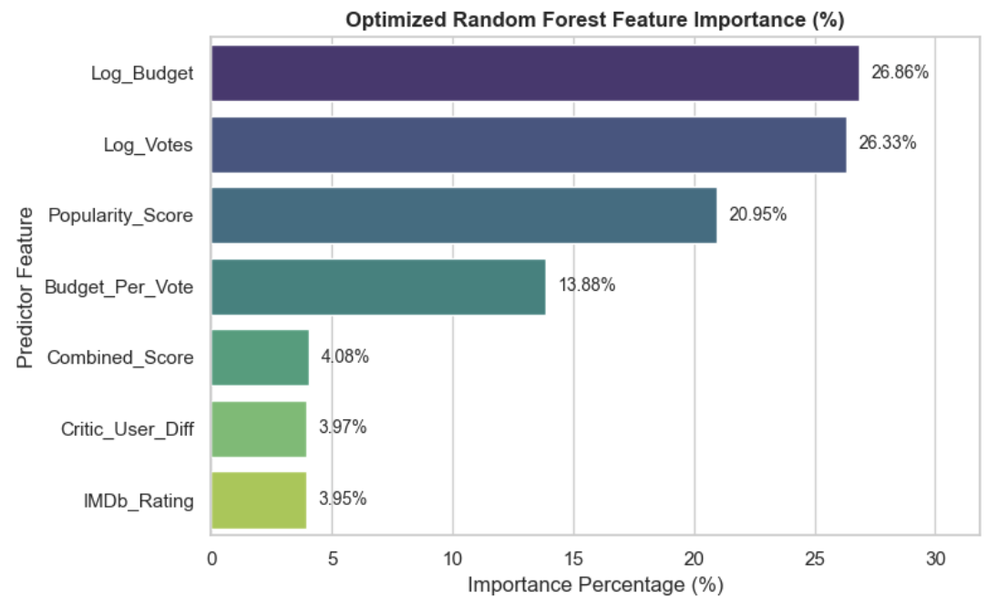
Random Forest Regression with Tuning and Optimizations
Feature Importance
Feature Importance:
  Log Budget: 26.86%
  Log Votes: 26.33%
  Popularity Score: 20.95%
  Budget Per Vote: 13.88%
  Combined Score: 4.08%
  Critic User Diff: 3.97%
  IMDb Rating: 3.95%

Slide 15
Conclusion & Recommendation
Budget alone is not enough to predict the financial success of a film
Audience engagement is a large predictor of film success
Optimized Random Forest could be used, while critical limitations must be considered
Reliable tool for mid-tier studio with post-release tracking

