Slide 2
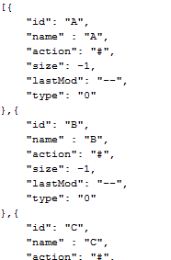
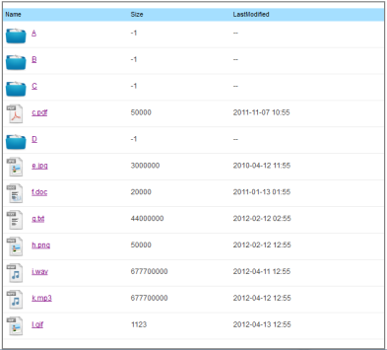

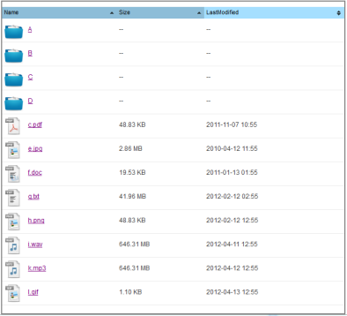
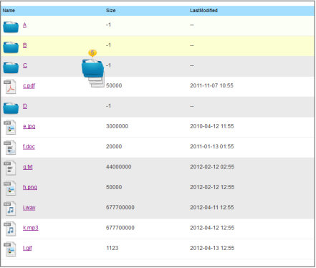
JsonData
Table
Table
$.itriCSSJsonParser
$.tablesorter
$.itriFileBrowser
Table + Sortable
Table +
Selectable +
Draggable
Table

Slide 3

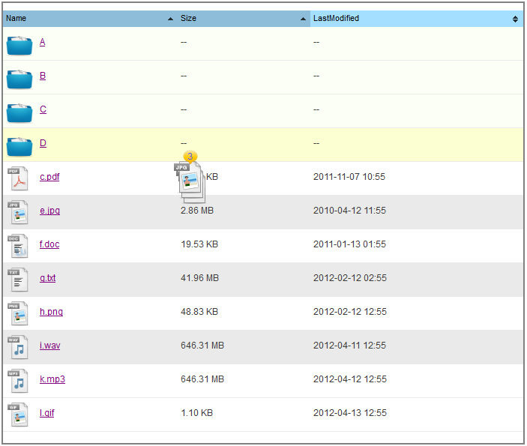
JsonData
$.itriCSSJsonParser
$.tablesorter
$.itriFileBrowser
File List
Table +
Sortable + Selectable +
Draggable

Slide 4
JsonData
$.JsonParser
$.tablesorter
Event List and Account List
Table +
Sortable

