Slide 1
Backbone JS
Jose Chang

Slide 2
你要經常想著，那個最終維護你代碼的人可能將是一個有暴力傾向的瘋子，並且他還知道你住在哪裡。
— 裡克.奧斯本

Slide 3
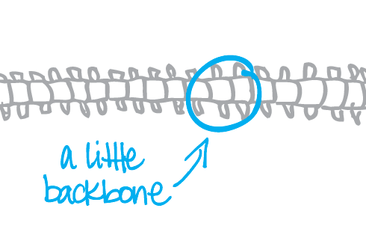
Reference
http://documentcloud.github.com/backbone/
http://www.csser.com/tools/backbone/backbone.js.html
http://www.youtube.com/watch?v=OQlAiOOsvcs

Slide 4
特色
Front-End Framework , not a UI library
輕巧 5.6kb
靈活 不需用到所有Backbone類別
學習容易 會jQuery 就行了

Slide 5
類別行為
Event – 讓非DOM 物件也能有自訂事件
Model – 存取Data，可用Ajax或LocalStorage
Collection – Model的集合
View – 接收輸入或更新UI
Router – 控制網址，並處理Model與View的互動
Router
Local
Storage
Model or
Collection
Server
View
Ajax

Slide 6
上路
載入underscore.js
可以只用Event, Model或View
使用View，需搭配Dom Library (jQuery)
資料同步不一定要用到Database

Slide 7
基本流程
定義ui及Template
定義Router
定義View及事件
定義Model (Collection)
整合所有類別
執行程式

Slide 8
程式碼 基本形式 (index.html)
<!DOCTYPE html>
<html>
<head>
<link href="css/style.css" media="screen" rel="stylesheet" type="text/css" />
</head>
<body>
<script type="text/template" id=“View-template">
…
</script>
<script src="js/jquery-1.7.2.min.js"></script>
<script src="js/underscore-1.3.1.js"></script>
<script src="js/backbone.js"></script>
<script src="js/backbone.localstorage.js"></script>
<script src="js/app.js"></script>
</body>
</html>

Slide 9
Router
var App = Backbone.Router.extend({
routes: {
'': 'home',
'add' : 'addState',
'edit/:name' : 'editState'
},
home: function(){
console.log('home');
},
addState: function(){
console.log('add');
},
editState: function(id){
console.log('edit ' + id);
}
});

Slide 10
View
$(“<div></div>”)
var TableView = Backbone.View.extend({
template: _.template($("#View-template").html()),
render: function(){
this.$el.html(this.template(this.model.toJSON()));
return this;
},
events: {
'click #submitBtn': ‘doSomething'
},
doSomething : function(e){ … }
});

Slide 11
Model
var User = Backbone.Model.extend({
defaults: {
id: null,
name: '',
phone: ''
},
validate: function(attrs) {
if (attrs.name === '') {
return "'name' cannot be empty";
}
});
CRUD | http request | Backbone method
Create | Post | save
Read | Get | fetch
Update | Put | Save
Delete | Delete | destroy
Var user = User({“aa”: 1});
url.save();

Slide 12
Collection
var Users = Backbone.Collection.extend({
model: User
});

Slide 13
Demo

Slide 14
優點
View 的切換，支援”上一頁”
Model的操作與驗證方便
使用localstorage方便前端開發與測試
使用template生成Dom Tree簡單快速

Slide 15
More…
Refactoring With Backbone.js
http://www.jaceju.net/blog/archives/refactoring-with-backbone-dot-js/

