Slide 1
File Browser Plugin
Jose Chang

Slide 2
jQuery plugin
Html:
<div id=‘panel’><div>
$.pluginType1(…);
$(“# panel”).pluginType2(…);
arg1, arg2, …
{
option1: “XXX”,
option2: “OOO”,
callback1: function(){ },
callback2: function(){}
}

Slide 3
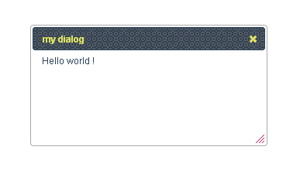
Html:
<div id=“dialog” style='display:none;'>
Hello world !
</div>
$( "#dialog" ).dialog({title: "my dialog"});

Slide 4
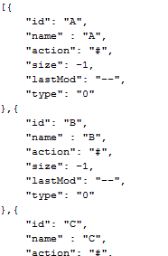
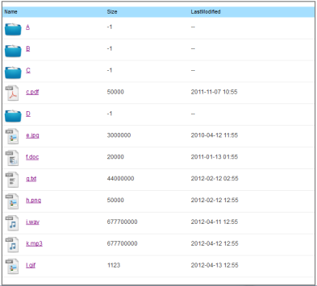

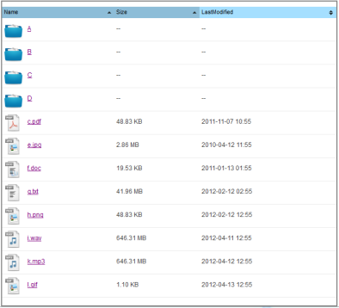
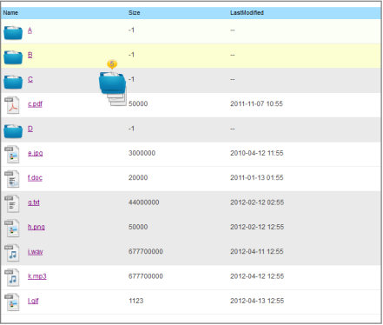
JsonData
Table
Table
$.itriCSSJsonParser
$.tablesorter
$.itriFileBrowser
Table + Sortable
Table +
Selectable +
Draggable
Table

Slide 5

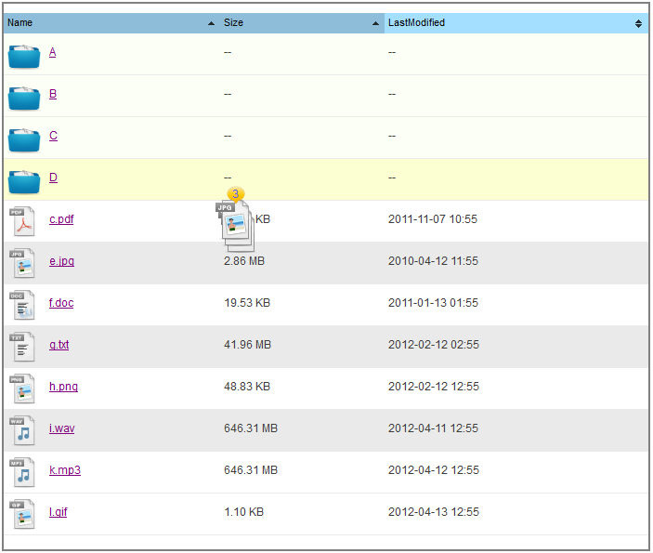
JsonData
$.itriCSSJsonParser
$.tablesorter
$.itriFileBrowser
File List
Table +
Sortable + Selectable +
Draggable

Slide 6
JsonData
$.JsonParser
$.tablesorter
Event List and Account List
Table +
Sortable

Slide 7
Thanks

