Slide 1
Three.js Tutorials Part 3 (20~29)
References:
http://threejs.org/examples/

Slide 2
Graphics Topics to Cover
Geometry type: buffer geometry, fan, strip, …
Line style (line stipple)
Point style; point sprite
Depth buffer setting (linear vs logarithmic style?!)
Viewport animation
glClipPlane
Rgb vs. hsv; conversion
Blending
Polygon offset
Fog (in progress)
Embedded Html
As static texture (not so great)
Multitexture (GLSL)
Texture environment, filters, mipmap, texgen
Environment map, cubemap
Picking (CPU version: raytest)
Refraction, reflection

Slide 3
Future Works
Animated models: md2
Steer; agent “class”
Perlin/simplex noise
Leapmotion, kinect

Slide 4
Ongoing
Seat booking system
HTML Template for threejs + notes
What’s in threejs but NOT in OpenGL
CSS, HTML5, …
Jquery, jquey-ui
Role of <div> in html

Slide 5
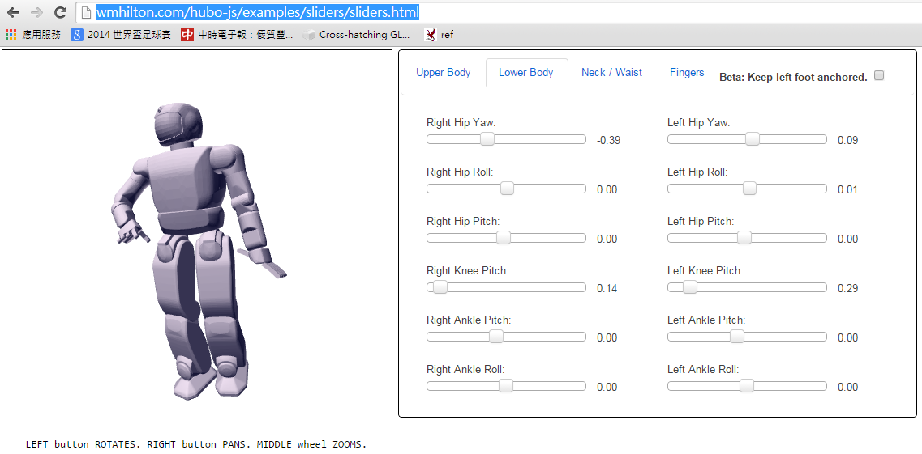
Robot example
http://wmhilton.com/hubo-js/examples/sliders/sliders.html

Slide 6
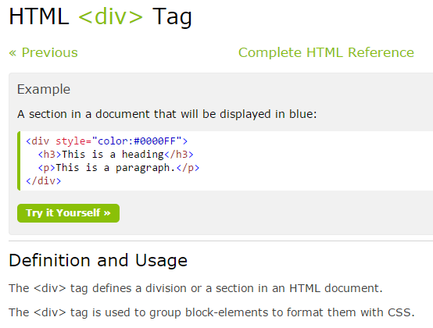

Slide 7
Javascript debugging
F12 to bring up console
Console.log
“printf” counterpart
Debugger
Set up break point

Slide 8
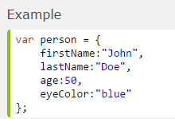
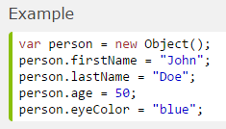
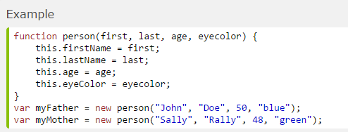
Javascript “Object” (ref)
Like class/struct in C/C++

Slide 9
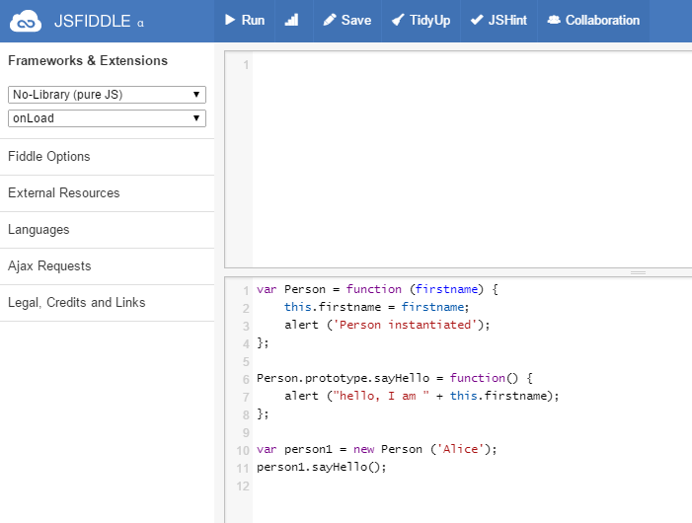

Slide 10
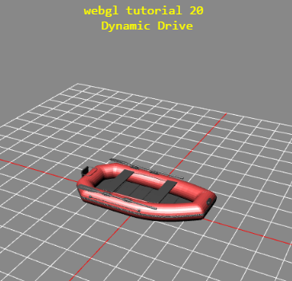
Tuts 20 &20-1

Slide 11
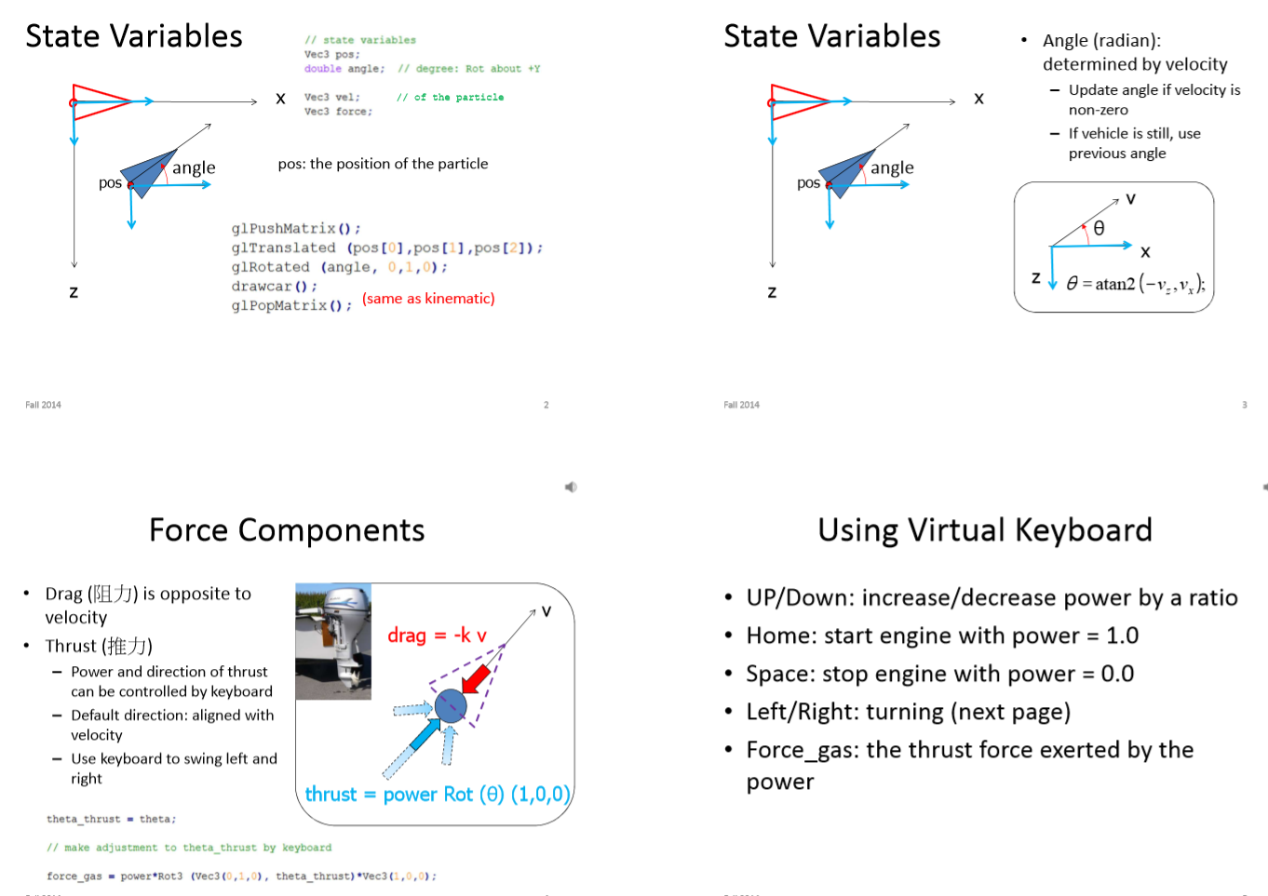

Slide 12

http://archive3d.net/?a=download&id=66ced0dc

Slide 13
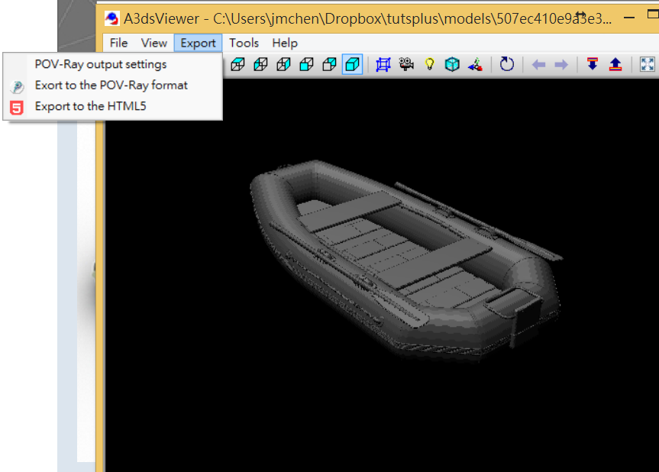
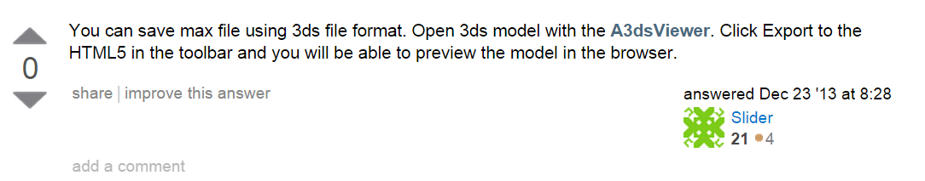
http://stackoverflow.com/questions/7931039/import-model-from-3dstudiomax-into-three-js

Slide 14
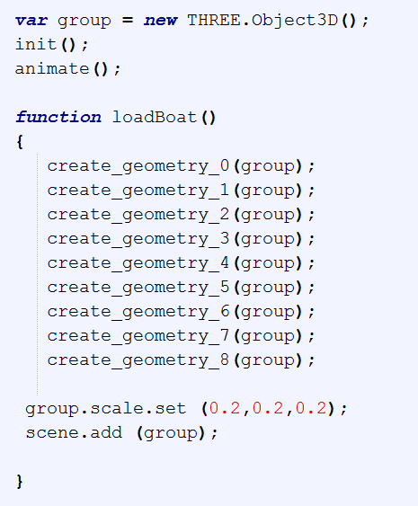
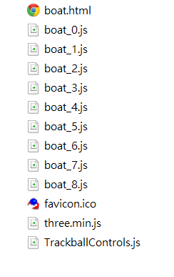
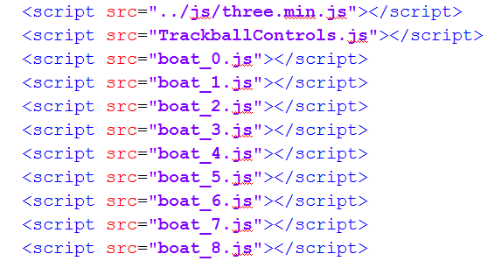
R63 works, but r69 failed

Slide 15
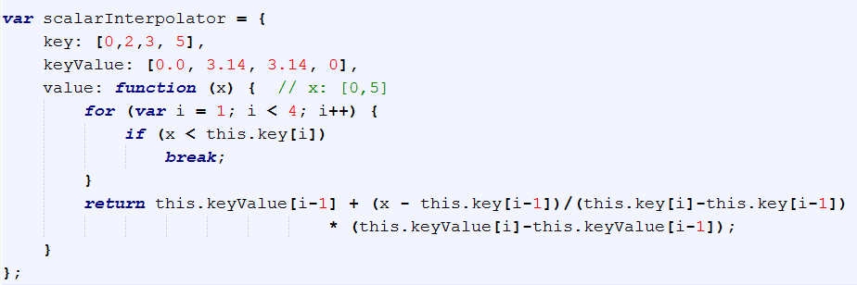
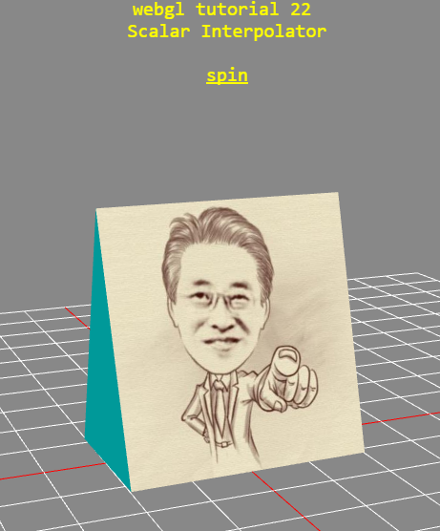
Tuts 21 ScalarInterpolator
For keyframe interpolation (PER 吳岱融 REQUEST)

Slide 16
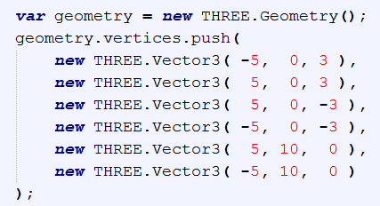
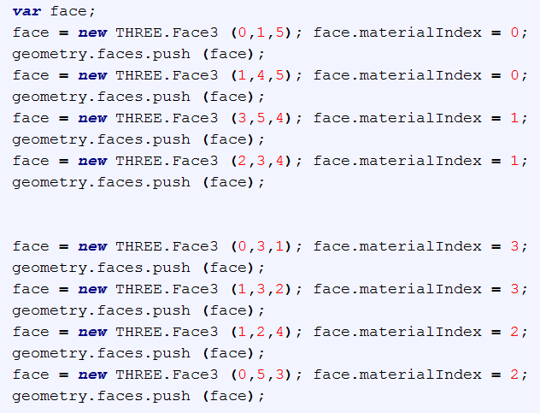

Slide 17
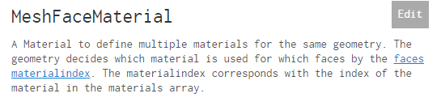
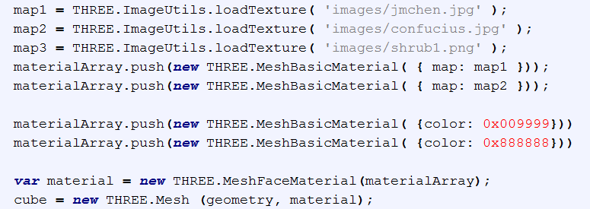

Slide 18
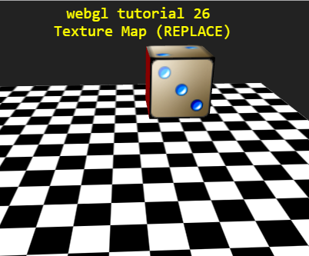
Tuts 22: Texture Map (REPLACE)

Slide 19
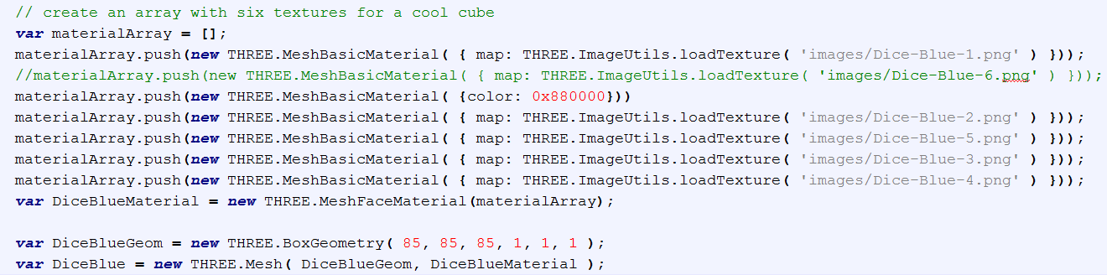
Hw: physics + dice for games!

Slide 20
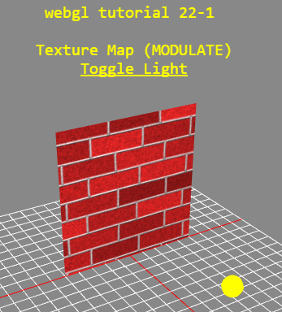
Tuts 22-1 Texture Map (MODULATE)

Slide 21
Tuts 23: Physics engine
Physijs: http://chandlerprall.github.io/Physijs/
Documentation: https://github.com/chandlerprall/Physijs/wiki/Basic-Setup
Other alternative:
Oimo.js: http://lo-th.github.io/Oimo.js/

Slide 22
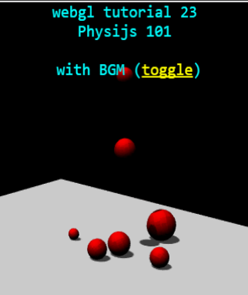
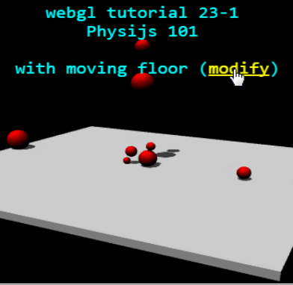
<audio>: background music
Alter scene parameters

Slide 23
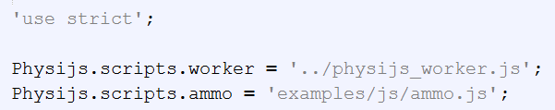
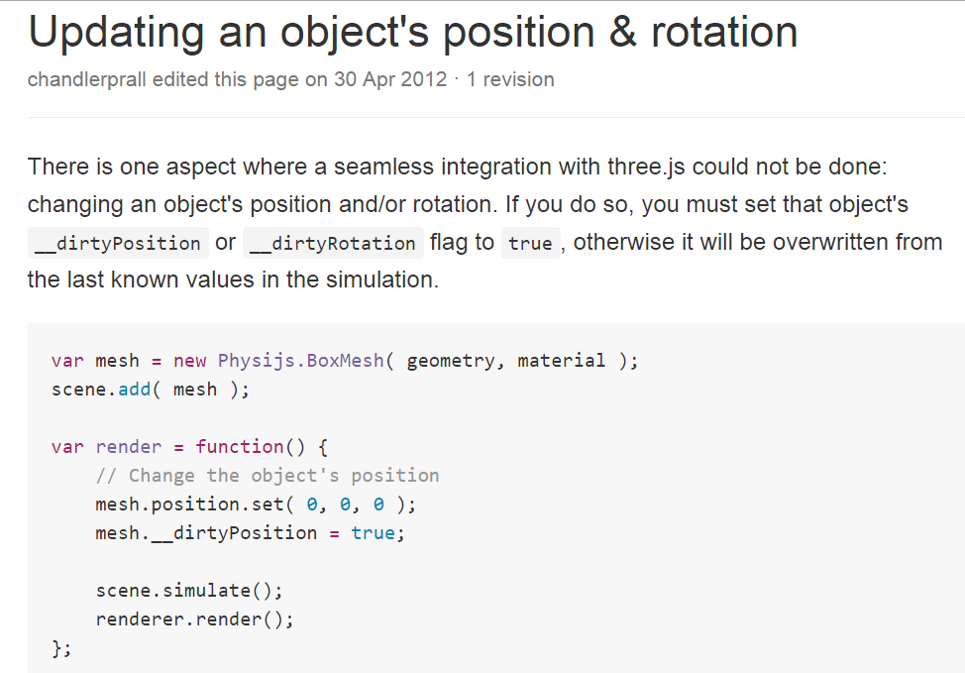
details
http://www.w3schools.com/js/js_strict.asp
Strict mode makes it easier to write "secure" JavaScript.
Strict mode changes previously accepted "bad syntax" into real errors.
The "use strict" directive is only recognized at the beginning of a script or a function.

Slide 24
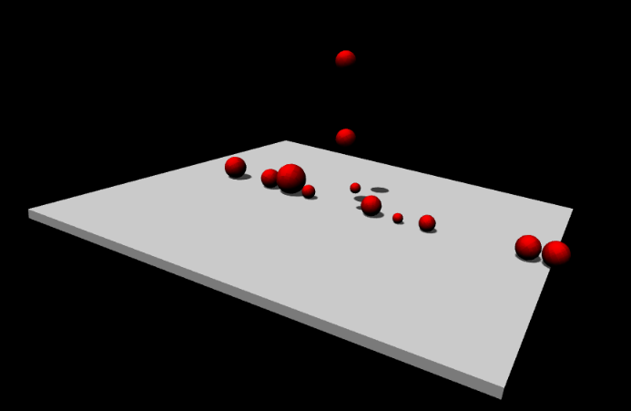
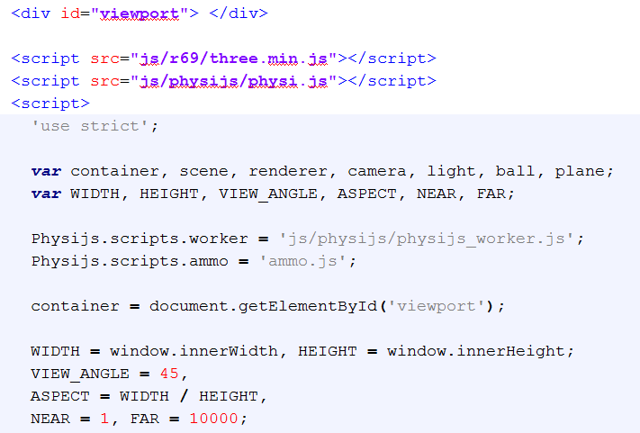
Case study (url)

Slide 25
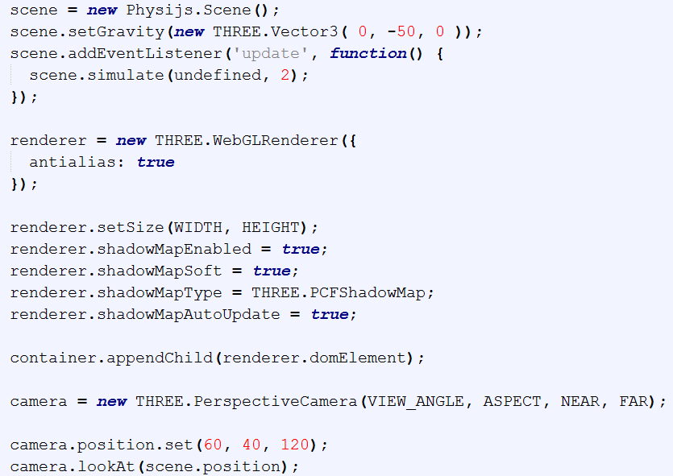
// timeStep, maxSteps

Slide 26
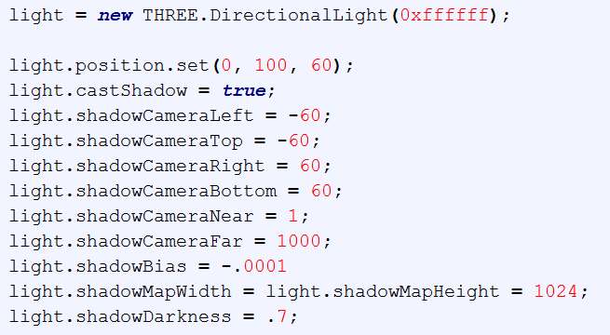
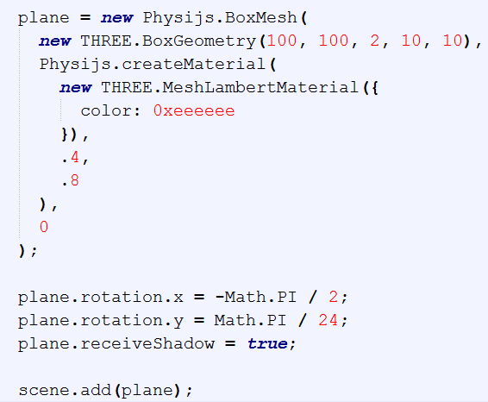

Slide 27
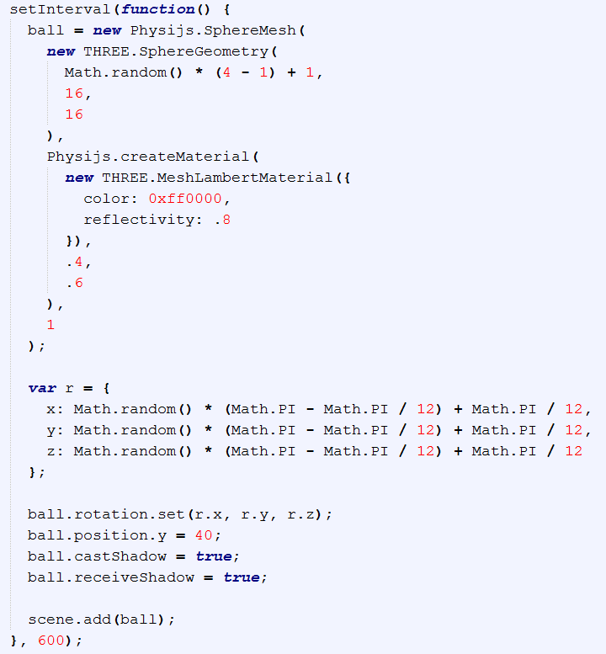

Slide 28
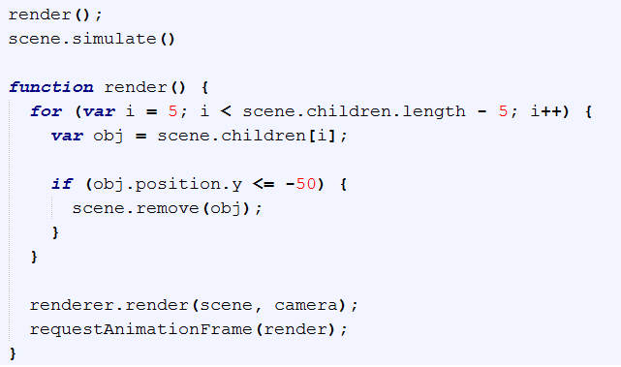

Slide 29
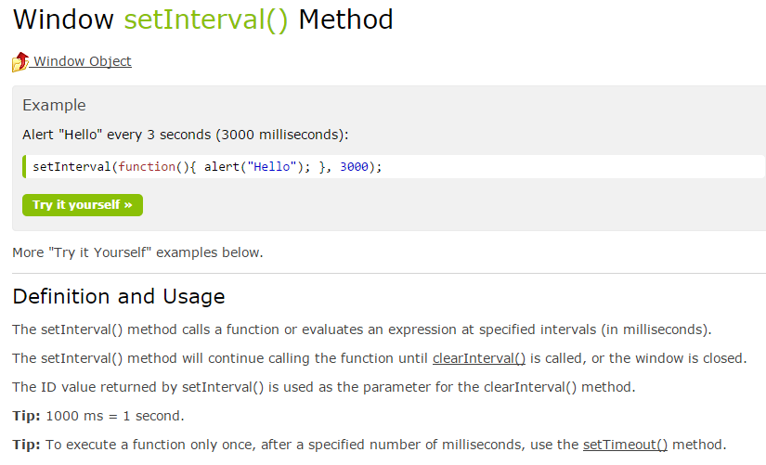
Cp: setTimeout
http://www.chandlerprall.com/2012/06/requestanimationframe-is-not-your-logics-friend/

Slide 30
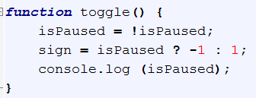
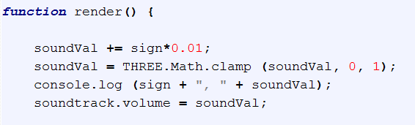
soundVal: constantly keep updating
But clamped between 0 & 1;
Toggle() to switch the increment/decrement

Slide 31
Tuts 23-2
Platform with walls

Slide 32
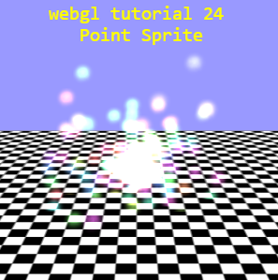
Tuts 24 Point Sprite

Slide 33
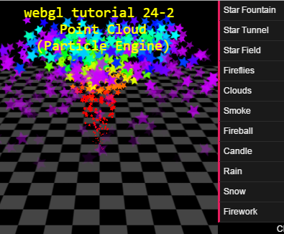
Tuts 24-2 Particle Engine

Slide 34
Particle Suite (Stemkoski)
sprite,
Dynamic attributes with shader
Particle engine (smoke, fire, …)
Using THREE.PointCloud

Slide 35
Tuts 25: Fog

Slide 36
Tuts 26: Agent (Seek,Arrival,Collision)

Slide 37
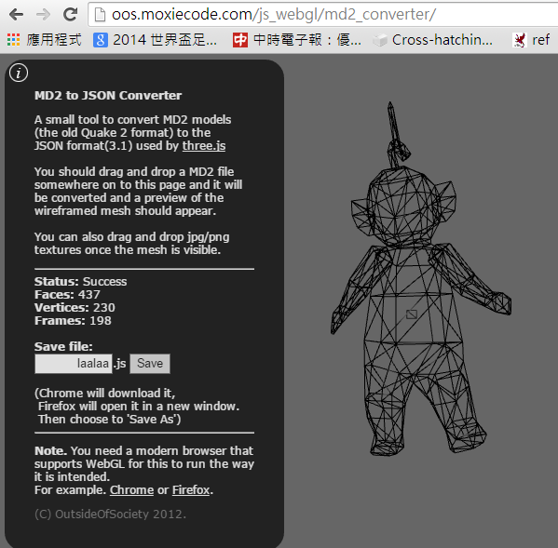
Tuts 27 MD2

Slide 38









MorphAnimMesh

Slide 39
Tuts 27-1 How to use MD2

Slide 40
Tuts 27-2 Collada
THREE.AnimationHanlder.update (deltaT);
Different from md2’s
Mesh.updateAnimation
AnimMesh vs. SkinnedMesh …
Need move in-depth study
Mixamo output cannot work (some kind of syntax problem…)

Slide 41
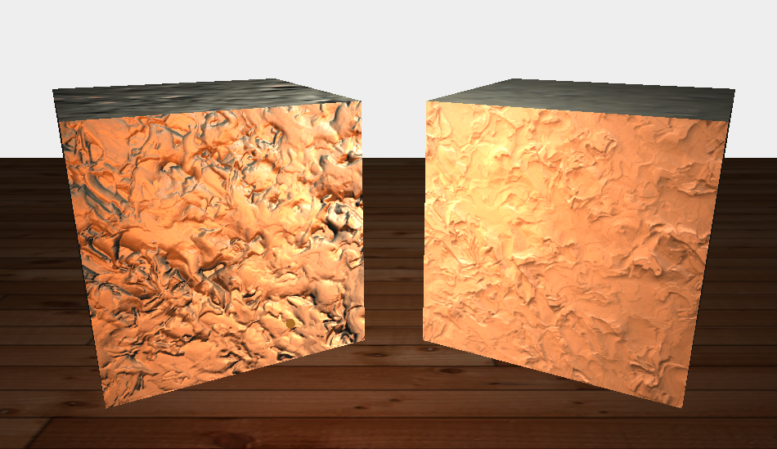
Tuts 28 Normal map
Use THREE.ShaderLib [ “normalmap” ]
Own geometry?!

Slide 42
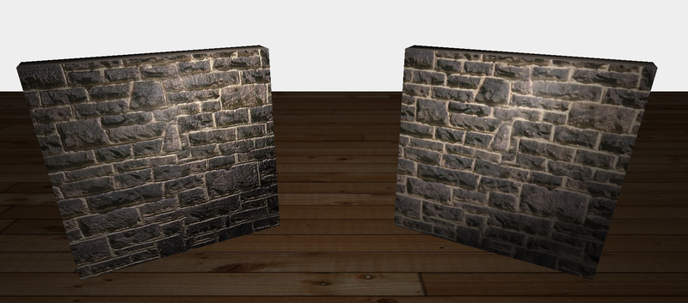
Tuts 29 Bump map
No shader
Wonder how the bumpmap is done …

Slide 43

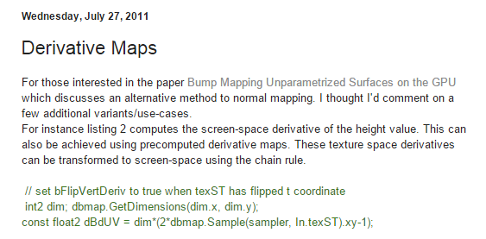
url

Slide 44
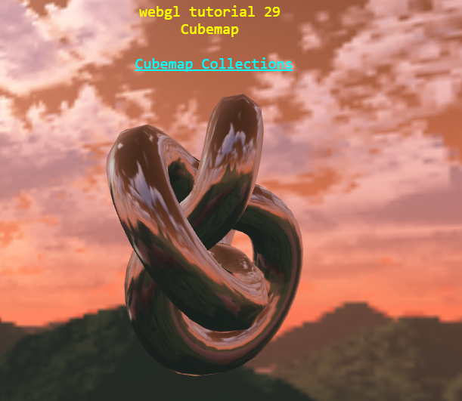
Tuts 30 Cubemap

Slide 45
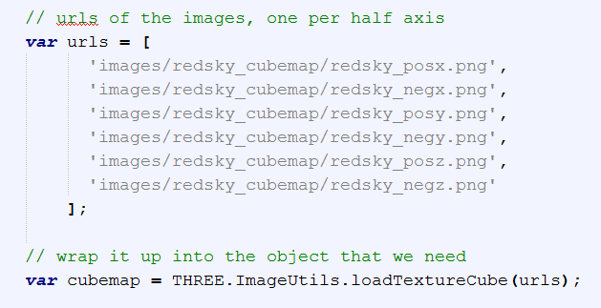
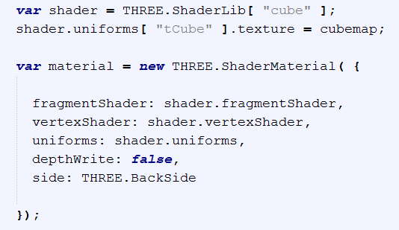

Slide 46
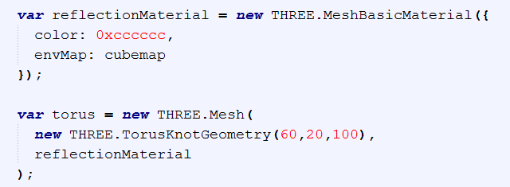

Slide 47
Booking system
http://jsfiddle.net/caa1211/1fd8dyhs/20/
http://stackoverflow.com/questions/3107543/what-is-the-symbol-used-for-in-javascript

Slide 48
Noise stuff
http://www.clicktorelease.com/blog/experiments-with-perlin-noise
Ashima noise (follows simplex noise)
http://alteredqualia.com/three/examples/webgl_terrain_dynamic.html (already in shaderLib)
https://github.com/ashima/webgl-noise/wiki
http://www.clicktorelease.com/blog/vertex-displacement-noise-3d-webgl-glsl-three-js
http://grahamweldon.com/posts/view/3d-terrain-generation-with-three-js (error)
http://jsperf.com/simplex-noise-comparison (error)
Course with threejs: http://math.hws.edu/eck/cs424/

Slide 49
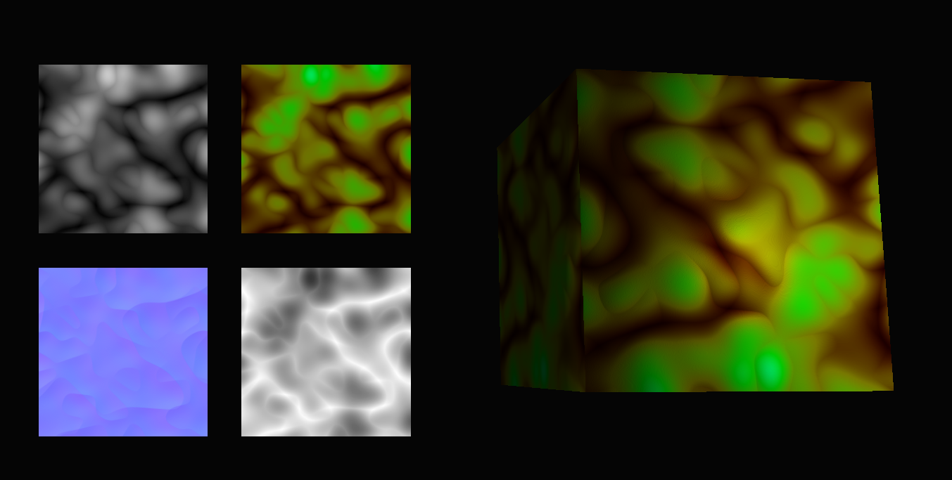
http://alteredqualia.com/three/examples/webgl_shader_slime.html
See how this page is done:
Noise stuff; 3D & 4 2D

Slide 50
Developing codes using jsFiddle
Testing pieces of code

