Slide 1
Three.js Tutorials Part 4 (S- shader)
References:
http://threejs.org/examples/

Slide 2
Shader Topics to Cover
Filter
Bumpmap
RTT and mosaic
Per pixel shading
Ambient occlusion
Depth texture output (RTT)?!

Slide 3
Tuts S-0
Shader version: 150?! (still oldschool, with some modification towards 330)
Shader material
Toon shading
Teapots, some JSON models
Contains some shader passes (js):
http://joshondesign.com/p/books/canvasdeepdive/chapter10.html
http://www.realtimerendering.com/erich/udacity/exercises/unit3_toon_solution.html

Slide 4
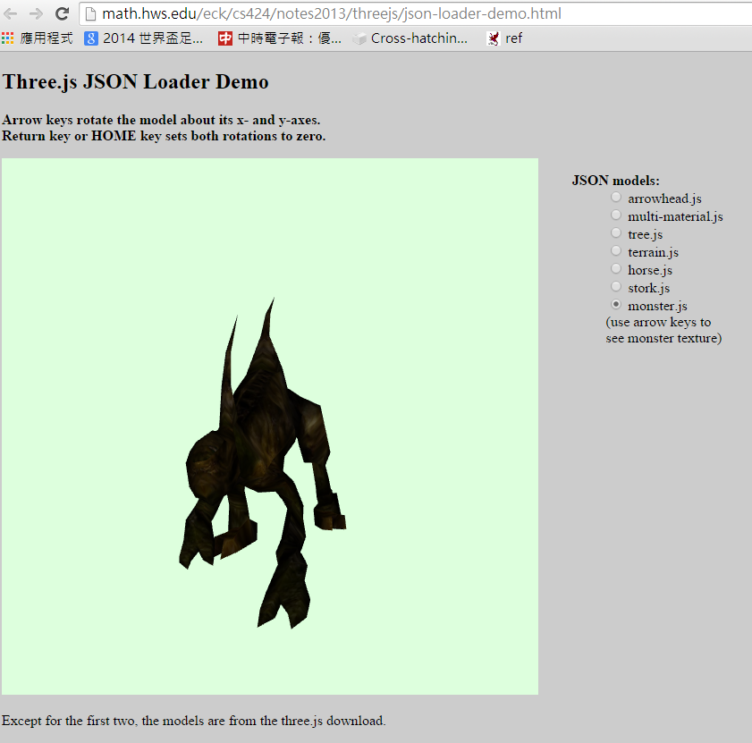

Slide 5
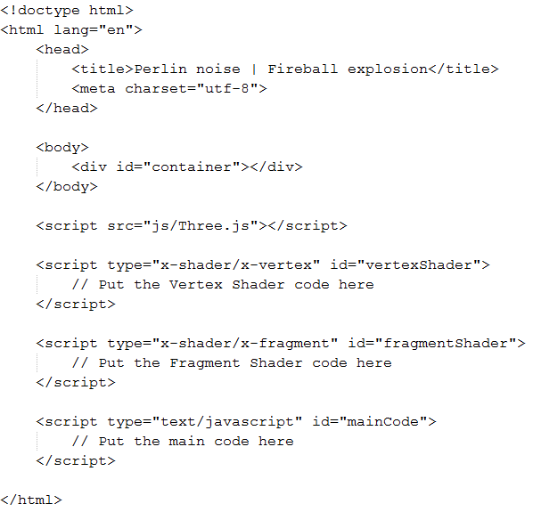
Shader template

Slide 6
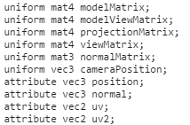
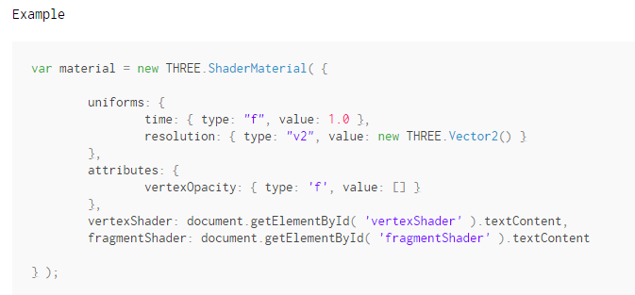
Shader Uniforms

Slide 7
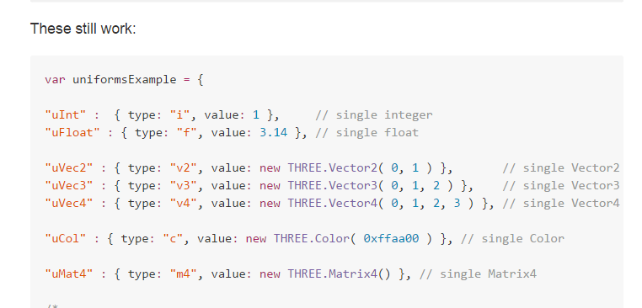
Uniform data type (url)

Slide 8
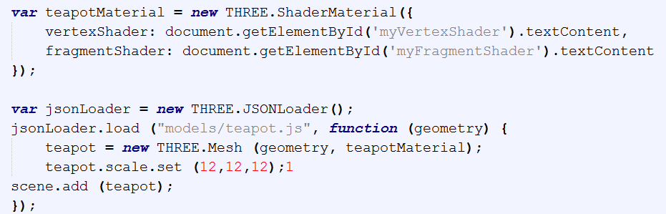

Slide 9
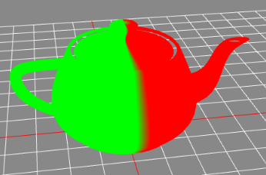
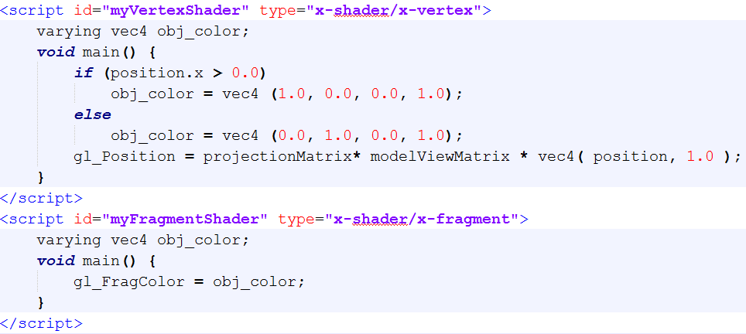

Slide 10
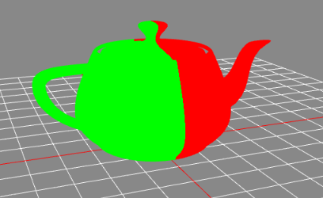
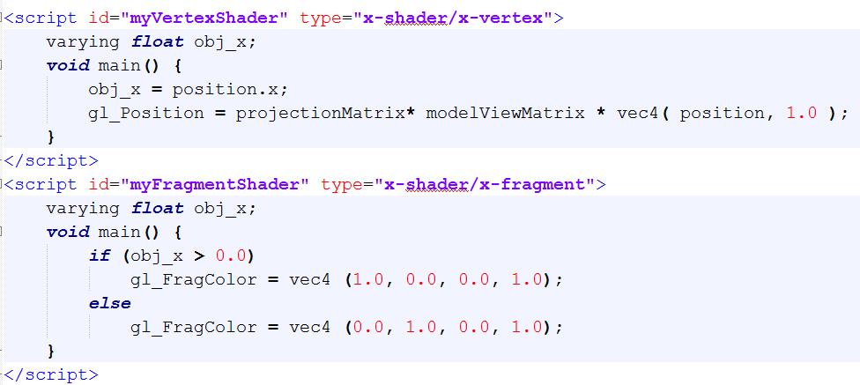

Slide 11
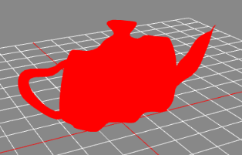
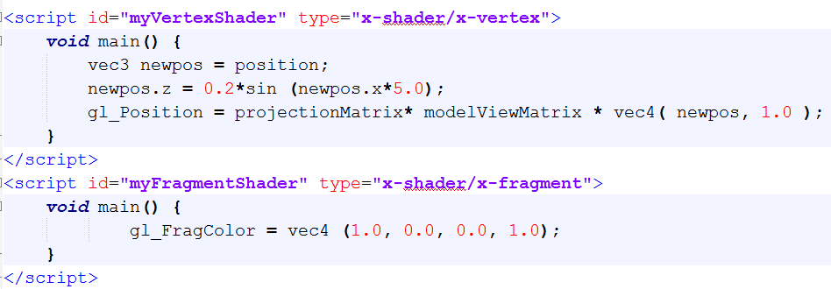
+ wavy animation
Shadermaterial + LambertMaterial??
Modulate: dat-gui

Slide 12
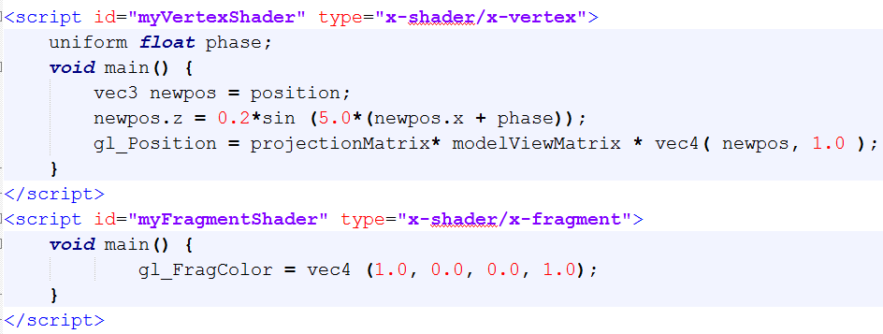
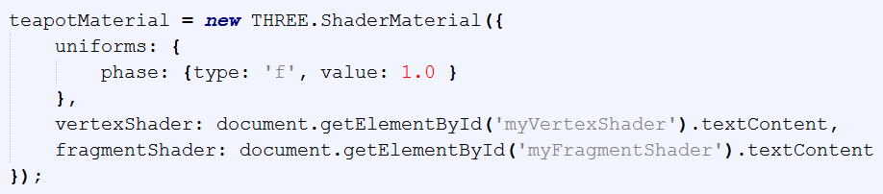
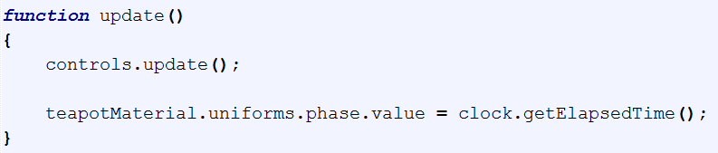

Slide 13
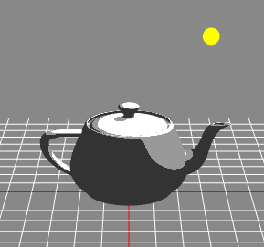
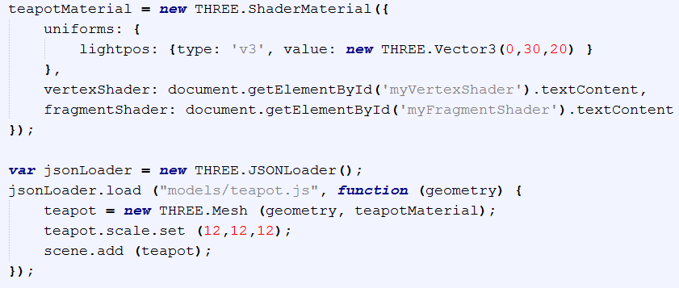
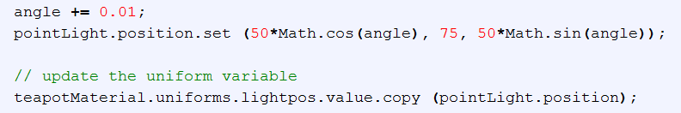
Tuts S-1 Toon Shading

Slide 14
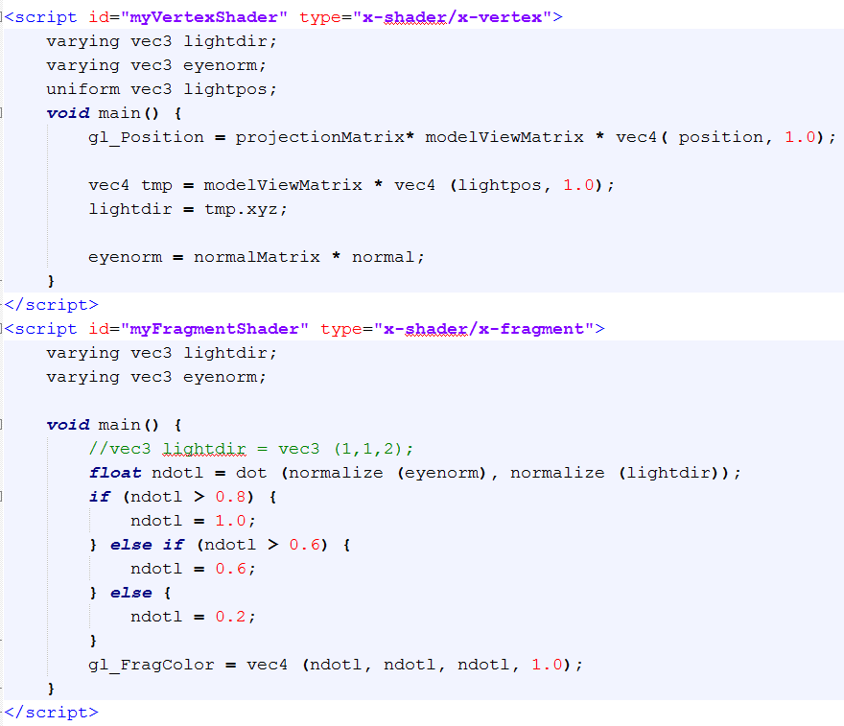

Slide 15
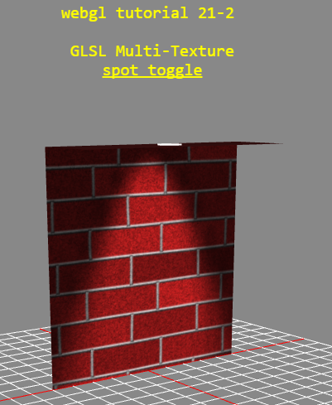
Tuts S-2 (GLSL: Multitexture)

Slide 16
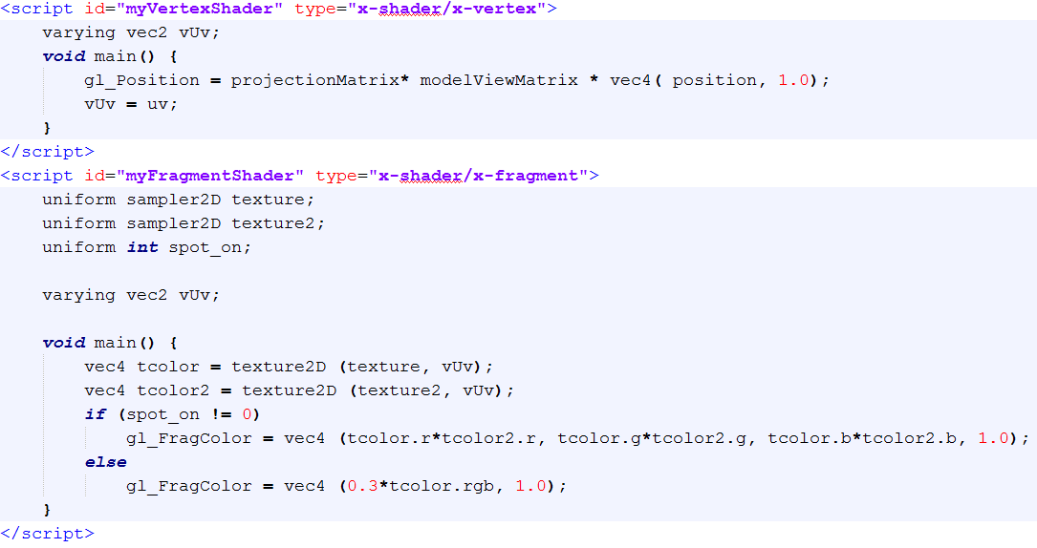
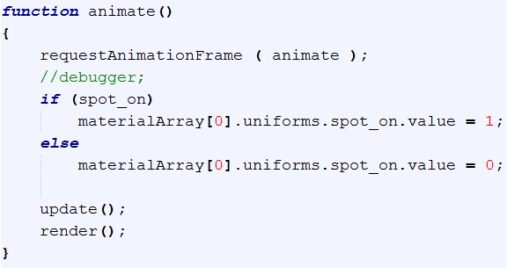

Slide 17
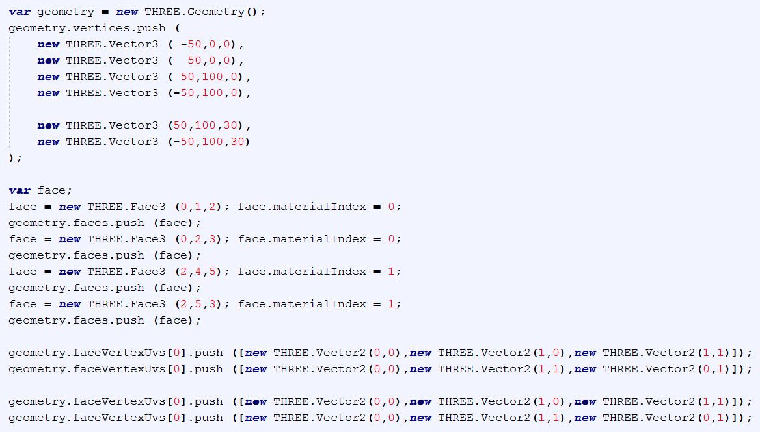
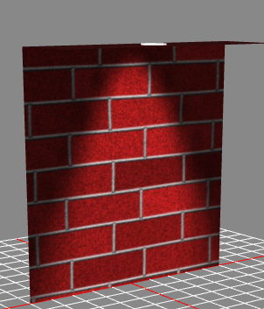

Slide 18
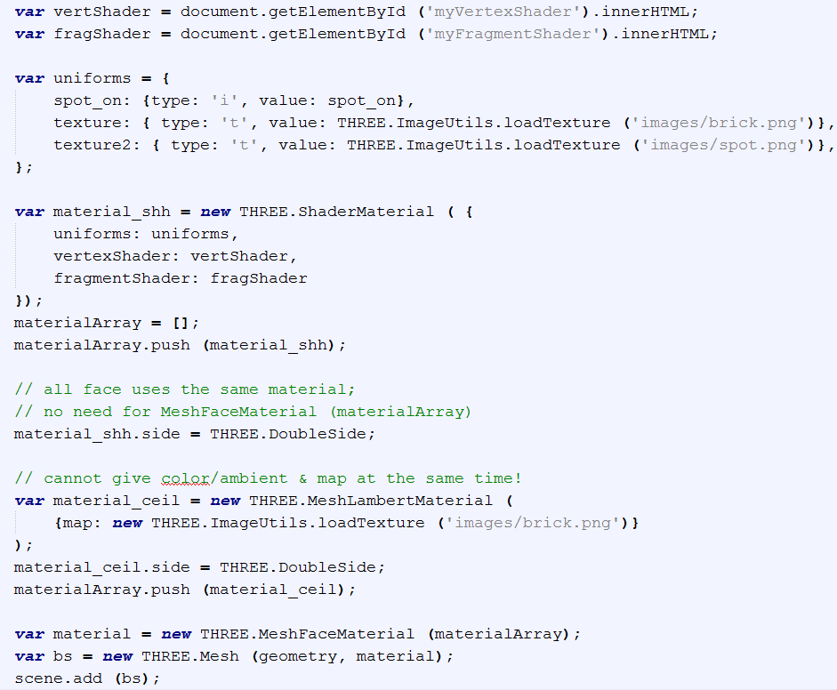

Slide 19
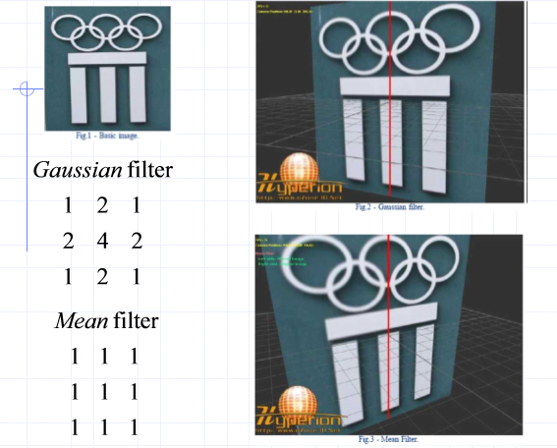
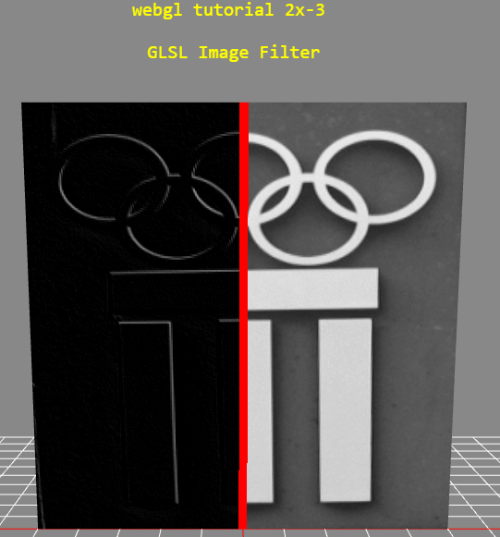
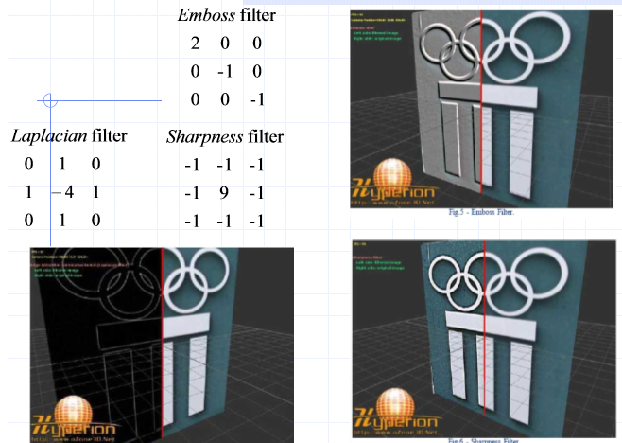
Tuts S-3 Filter

Slide 20
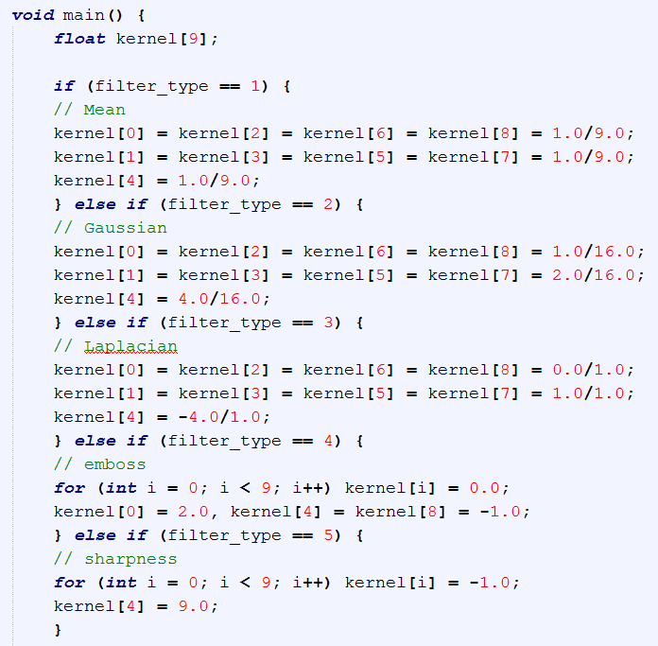
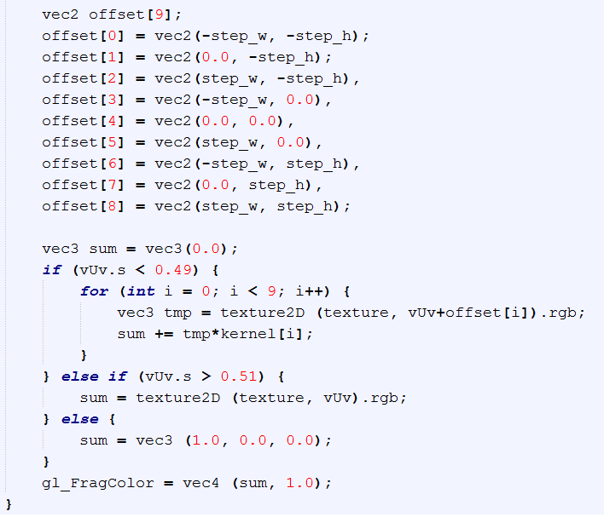
Fragment Shader

Slide 21
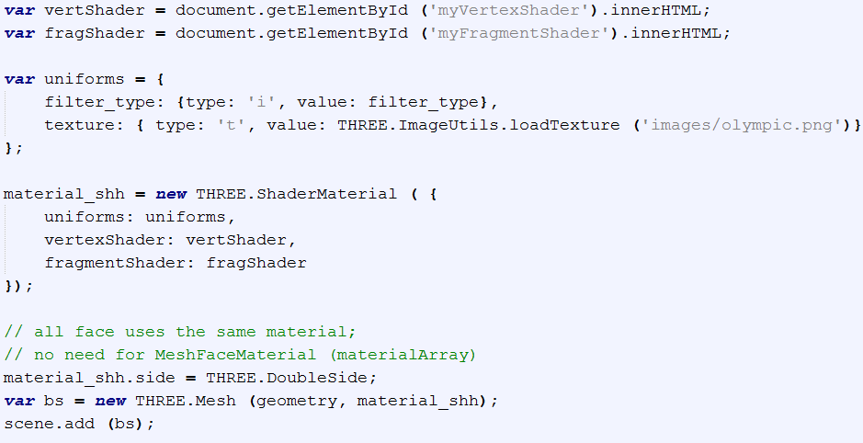

Slide 22
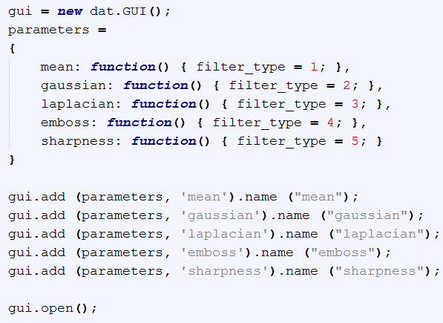
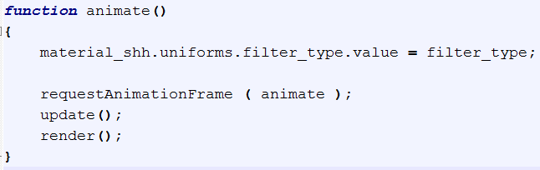

Slide 23
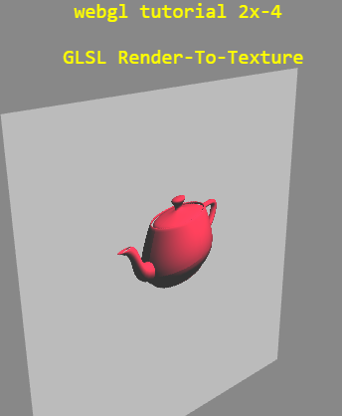
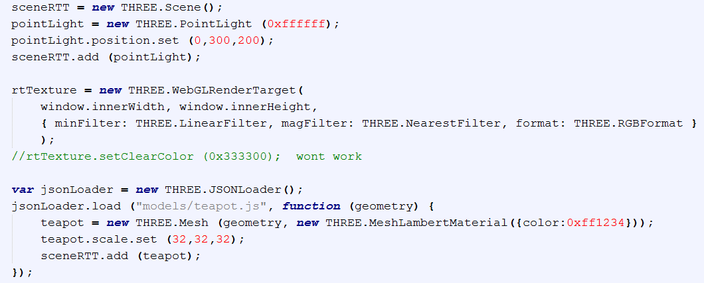
Tuts S-4 RTT (url)

Slide 24
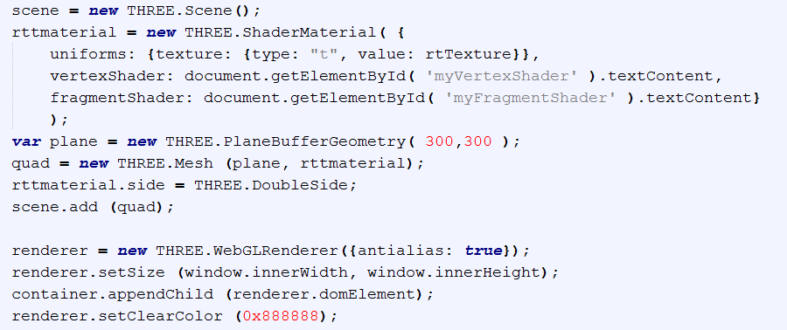

Slide 25
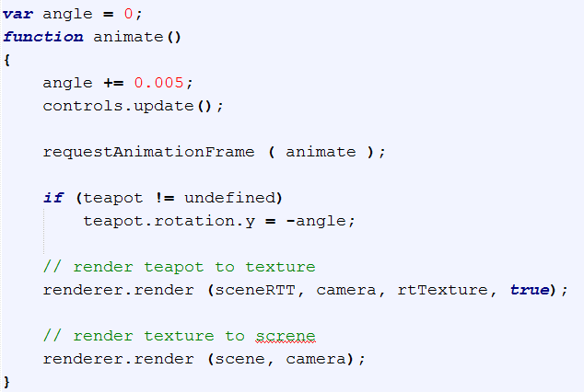

Slide 26
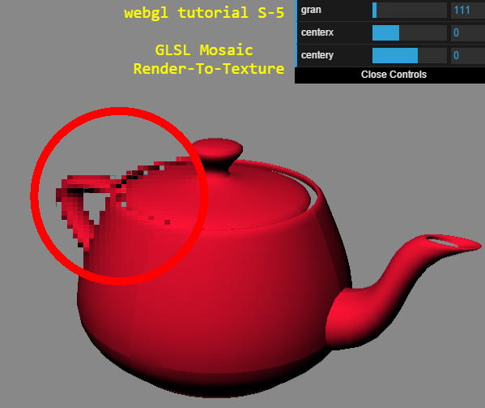
S-5 Mosaic

Slide 27
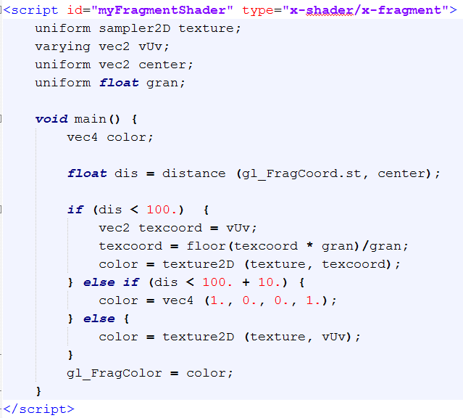

Slide 28
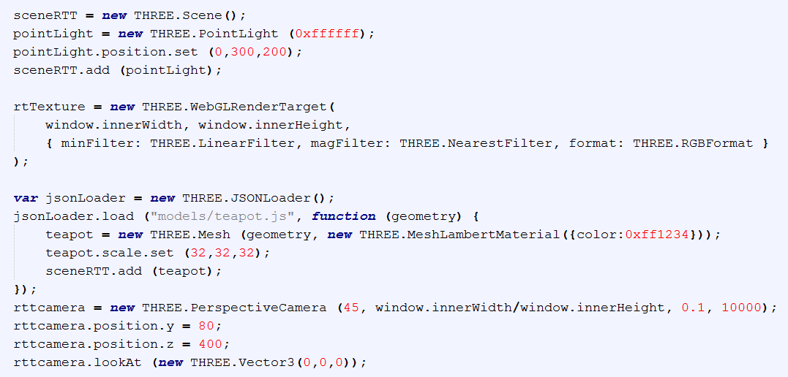

Slide 29
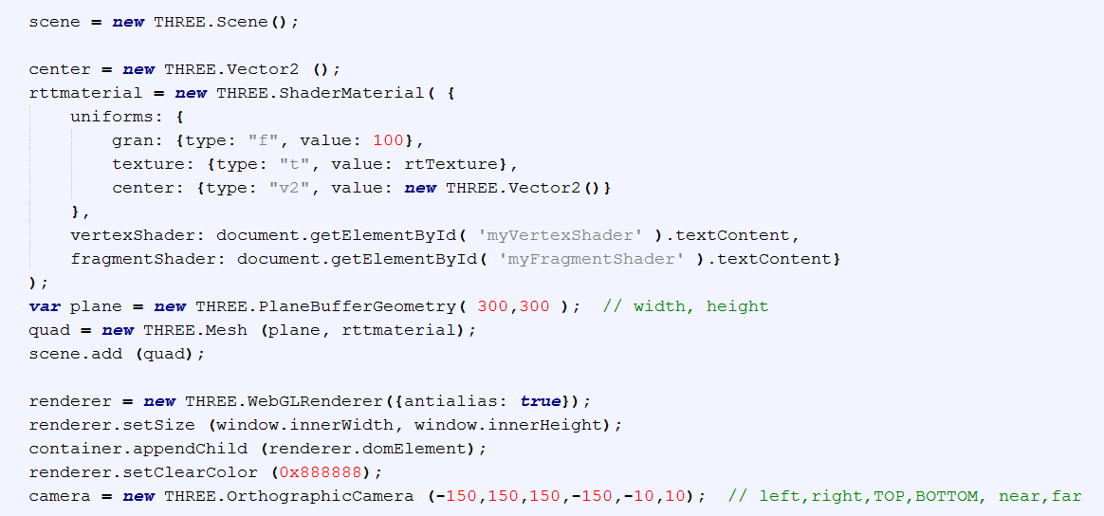

Slide 30
Bump map
How threejs implements bump map?
Pretty good outcome, rgb map, …

Slide 31
web3D killer application
initially the idea to fully display and navigate Web sites using 3D
now refers to all interactive 3D content which are embedded into web pages html, and that we can see through a web browser
Web3d consortium: http://web3d2013.org/program.html
X3d, webgl

Slide 32
Vrml->x3d->x3dom

Slide 33
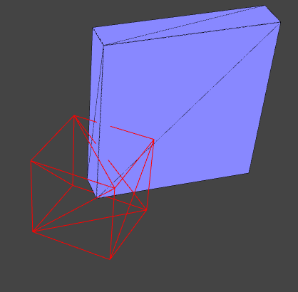
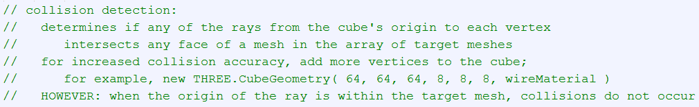
Ray caster
No-hit bug!
Picking
Collision detection (stemkoski)

Slide 34
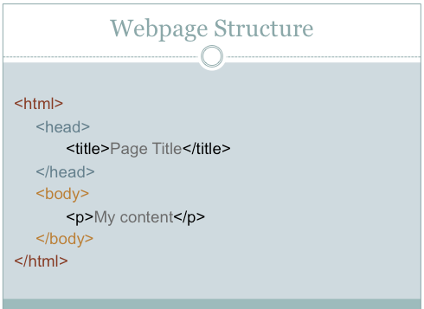
Q: html structure
Body.append
Container …
(tuts25)
http://multimedia.journalism.berkeley.edu/tutorials/html/

Slide 35
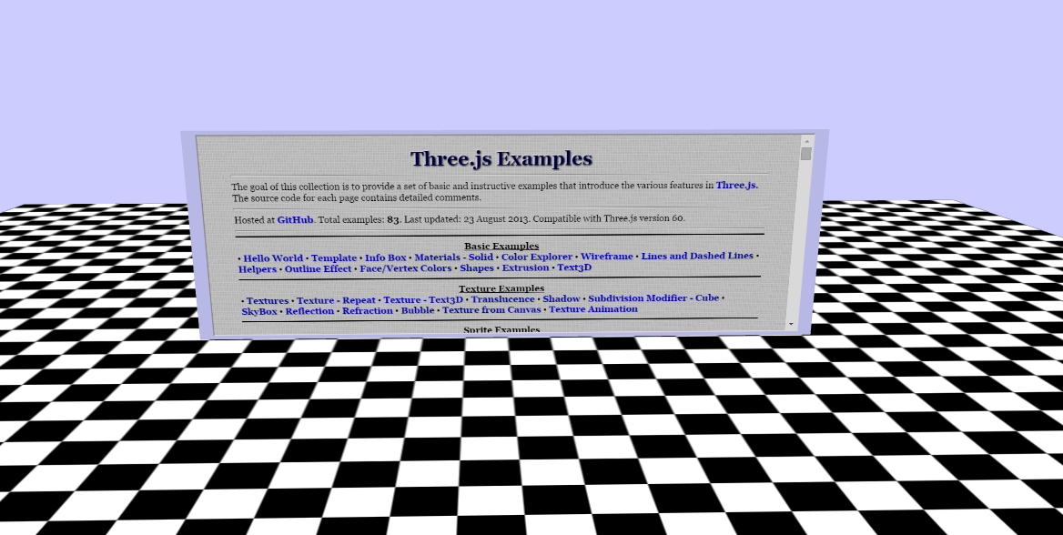
Embedded html (not very interesting, not interactive-able)
http://learningthreejs.com/blog/2013/04/30/closing-the-gap-between-html-and-webgl/

Slide 36
Webgl
3D concept + new shader
Web3d: data/info visualization
(compared with x3d) no file format, no markup language, no DOM
Threejs: the most popular webgl library.
(http://www.slideshare.net/auradeluxe/web-gl-its-go-time)
HUD: use html
http://stackoverflow.com/questions/10703212/recommended-way-to-make-a-2d-hud-in-webgl
https://github.com/mrdoob/three.js/issues/1959

Slide 37
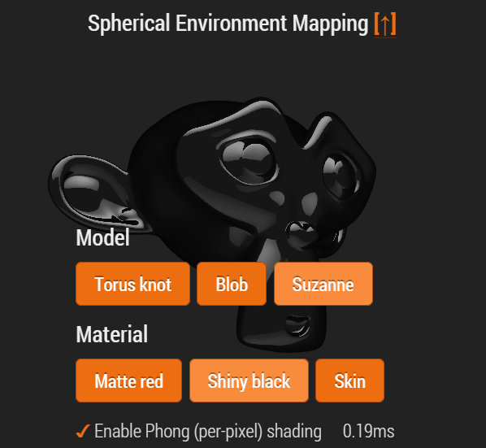
Environment
I like this html: http://www.clicktorelease.com/code/spherical-environment-mapping/

Slide 38
Deferred Lighting
Forward vs. deferred rendering http://gamedevelopment.tutsplus.com/articles/forward-rendering-vs-deferred-rendering--gamedev-12342
Area light
http://threejs.org/examples/webgldeferred_arealights.html

Slide 39
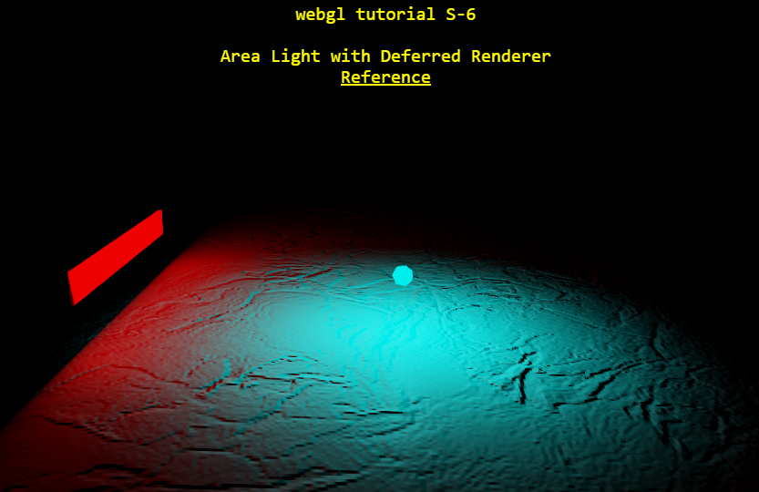
Tuts S-6

Slide 40
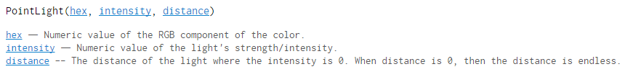
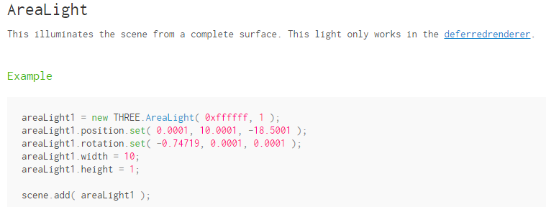
Deferred light
Bump map

Slide 41
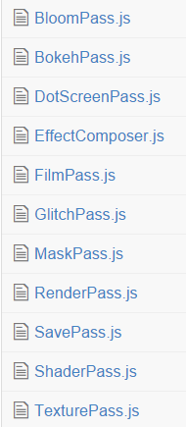


PostProcessing
shaders

Slide 42


Slide 43

No need for registering eventlistener

Slide 44
THREE. effectComposer, shaderpass, renderpass, …
Pixel shaders in threejs: http://www.airtightinteractive.com/2013/02/intro-to-pixel-shaders-in-three-js/
http://www.airtightinteractive.com/demos/js/shaders/preview/
Ssao:
http://alteredqualia.com/three/examples/webgl_postprocessing_ssao.html
Glsl sandbox: http://glslsandbox.com/
Deferred (point) lighting:
http://threejs.org/examples/webgldeferred_animation.html

Slide 45
PostProcessing Primer
Reference: http://mrdoob.github.io/three.js/examples/webgl_postprocessing.html
http://goo.gl/RzfwH

Slide 46

Tuts S-7 dotscreenshader

Slide 47





Slide 48


Slide 49

No light in the scene; all shading from SSAO

Slide 50






