Slide 1
Three.js Tutorials Part 2 (10-19)
References:
http://threejs.org/examples/

Slide 2
Javascript debugging
F12 to bring up console
Console.log
“printf” counterpart
Debugger
Set up break point

Slide 3
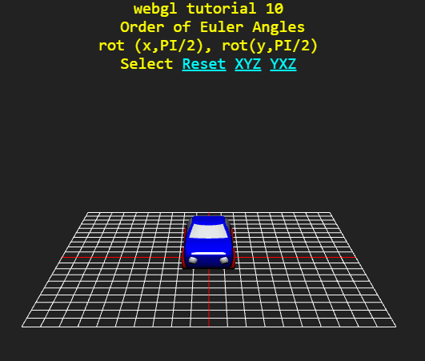
Tuts 10: rotation (Euler angles)

Slide 4
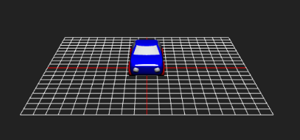
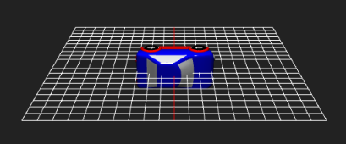
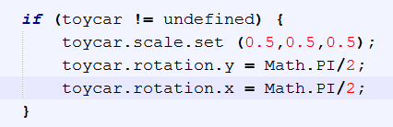
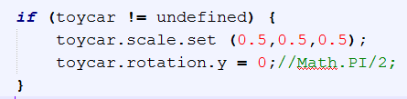
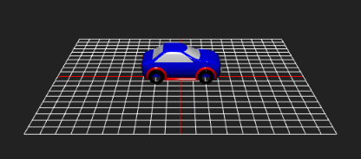
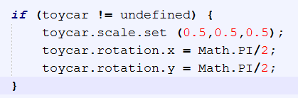
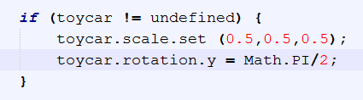
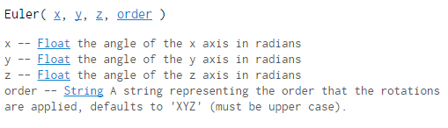
These two are the same;
Rotation is applied with the underlying (default) Euler order (‘XYZ’)

Slide 5
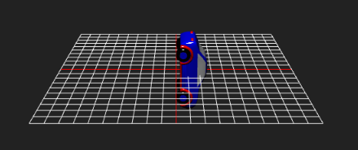
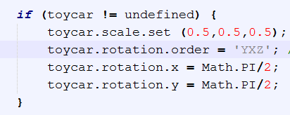
(default order: ‘XYZ’)

Slide 6
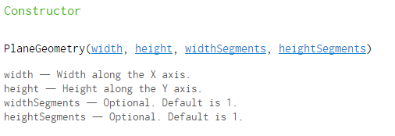
PlaneBufferGeometry
Number of segmented faces along the width of the sides.

Slide 7
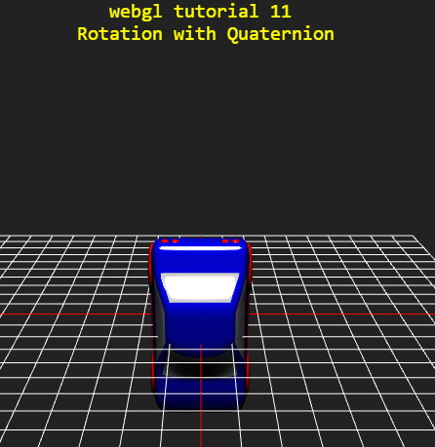
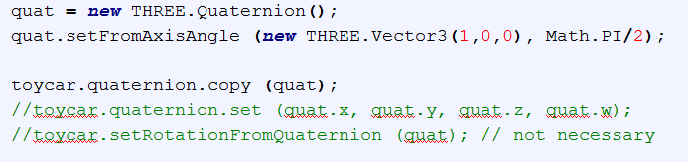
Tuts 11

Slide 8
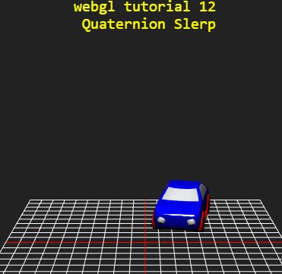
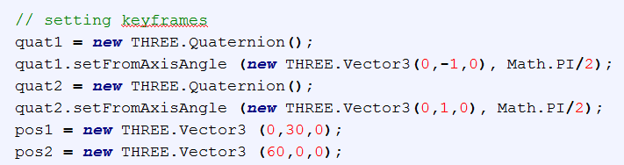
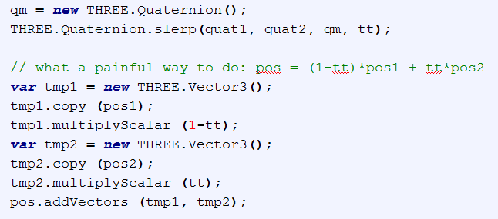
Tuts 12

Slide 9
Tuts 13: Left-or-Right Prototype
HUD to pick one cube
Initiate animation on the selected cube; increment the count in the log
“Local Storage” to keep a log on the history (ref)

Slide 10
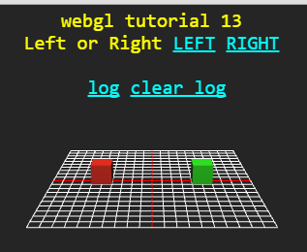
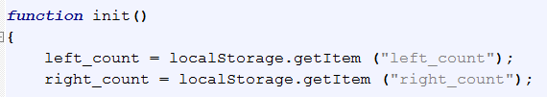
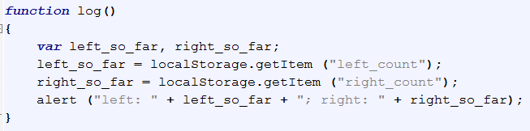
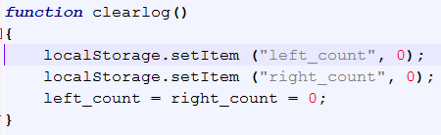
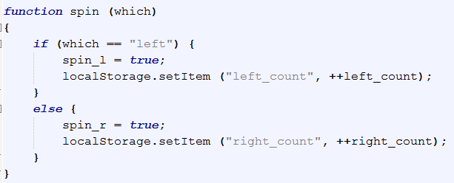

Slide 11
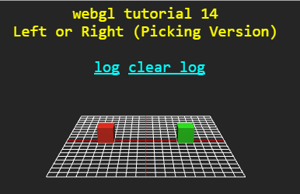
Tuts 14: Picking
Reference:
http://mrdoob.github.io/three.js/examples/#webgl_interactive_cubes
CPU version: use Raycaster

Slide 12
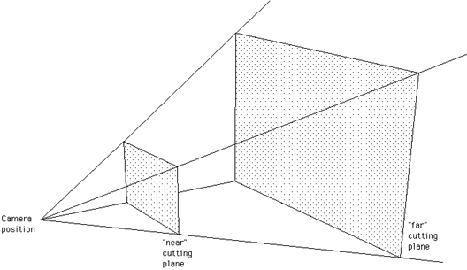

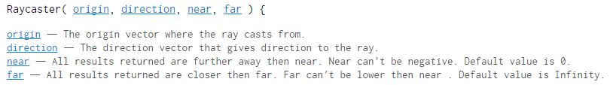

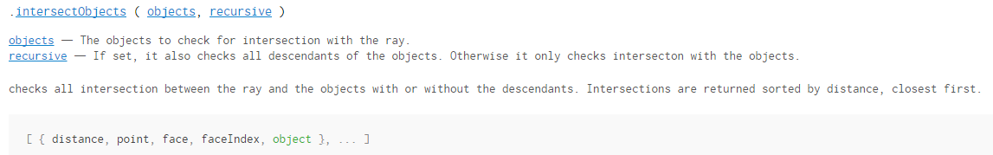
About Raycaster

Slide 13

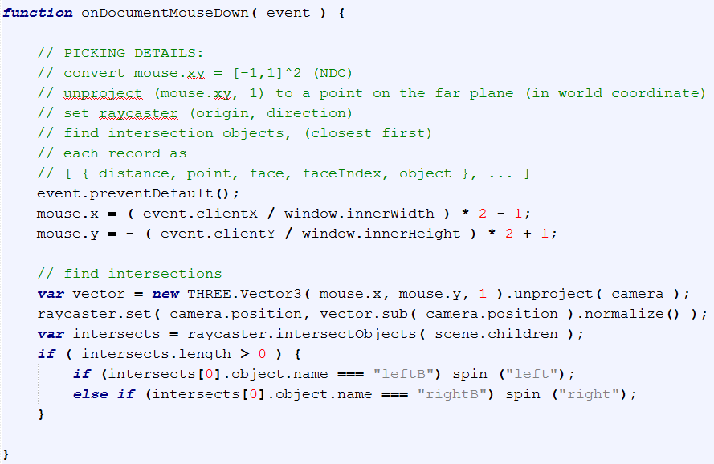
Picking Details

Slide 14
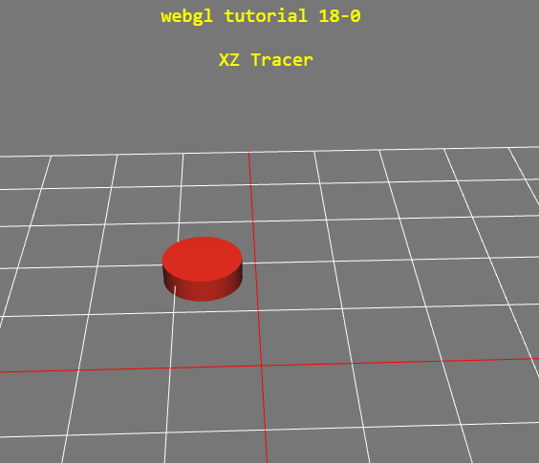
Also related to 19-0 (xz tracer)

Slide 15
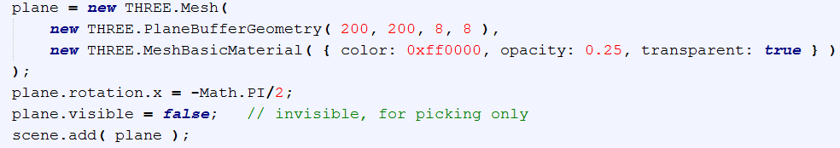
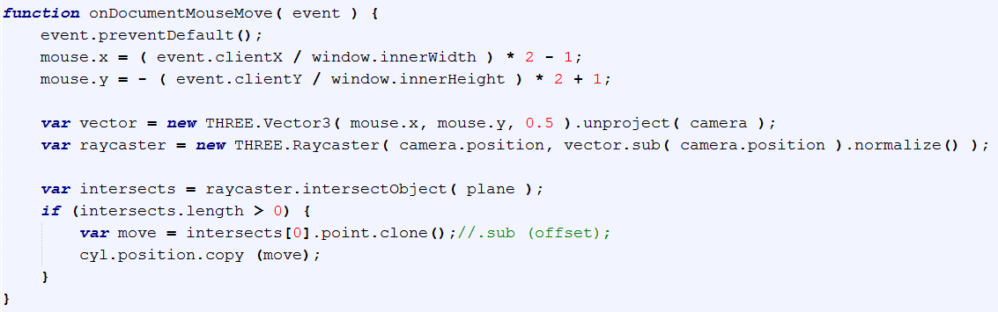

Slide 16
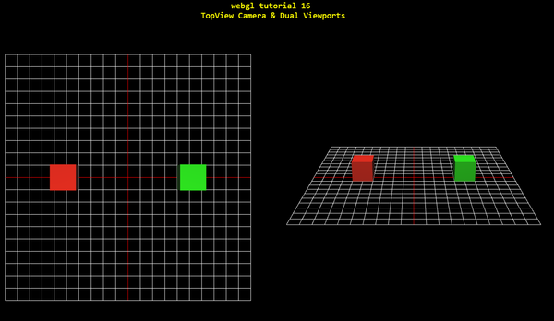
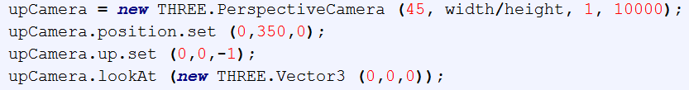
Tuts 15: TopView Camera & Dual Viewports
Reference:
http://stackoverflow.com/questions/15480910/three-js-way-to-change-the-up-axis

Slide 17
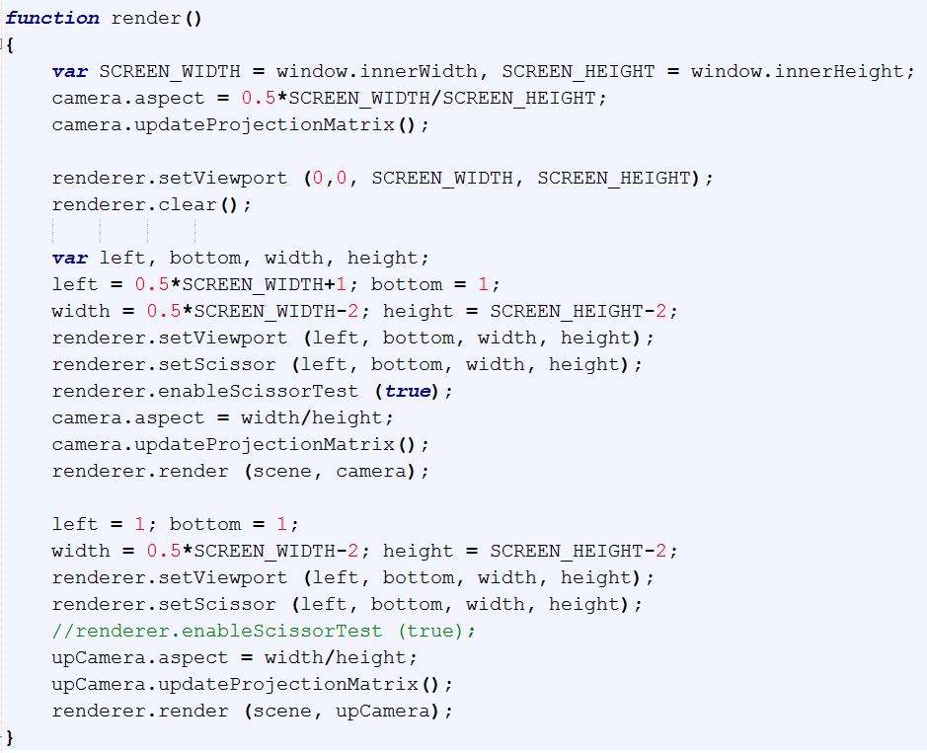

Slide 18

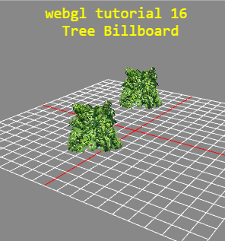
Tuts 16 Tree Billboard
Cutout texture
Loading a texture with alpha channel
Alpha test
Double-sided face mesh
Billboard

Slide 19
Something I learned while doing tuts 16
Using ‘var’ to declare variables is optional!?
http://stackoverflow.com/questions/2485423/javascript-is-using-var-to-declare-variables-optional

Slide 20
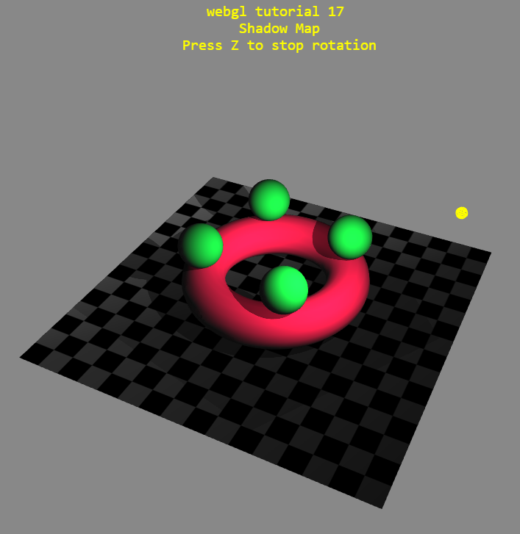
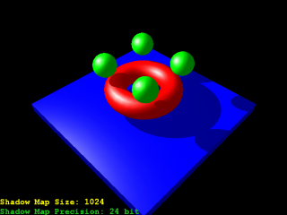
Tuts 17: Shadow Map
Model OpenGL classics

Slide 21

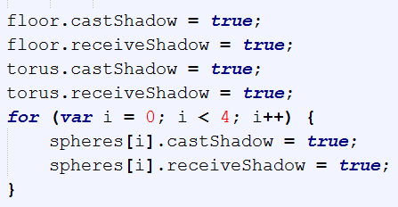
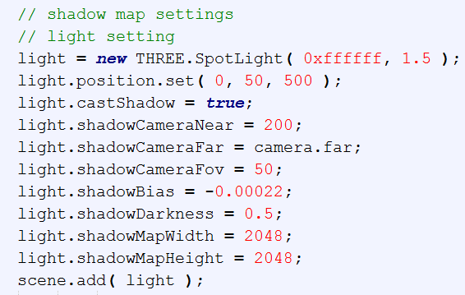

Slide 22
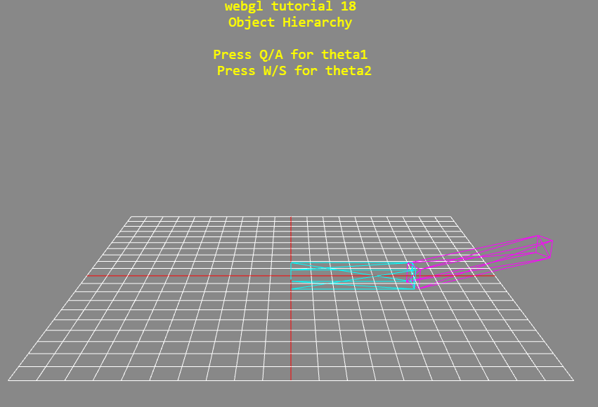
Tuts 18 Object Hierarchy
Wireframe
Hierarchical object

Slide 23
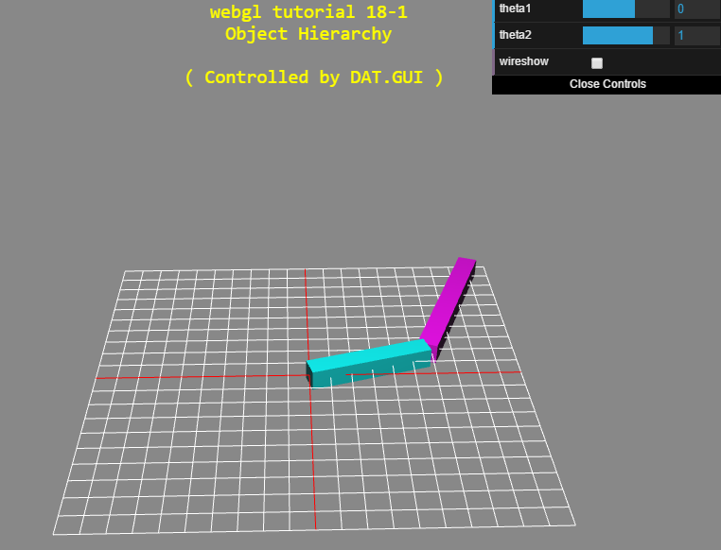
Tuts 18-1 Two-link with GUI
DAT-gui
Container-canvas, dat-gui concept
(NY) gui: demo button/function

Slide 24
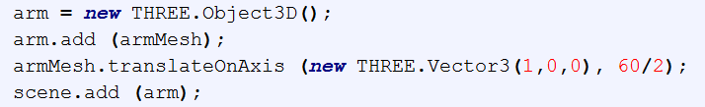
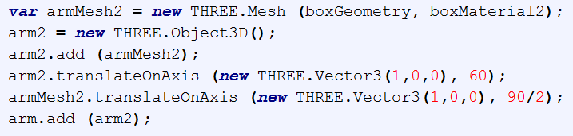
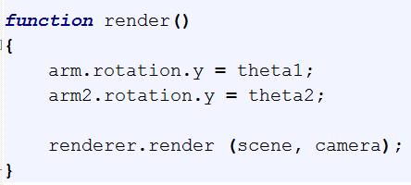
Tuts 18-2
OpenGL counterpart
glPushMatrix();
glRotatef(theta1,0,1,0);
drawarm1();
glTranslatef (L1,0,0);
glRotatef(theta2,0,1,0);
drawarm2();
glPopMatrix();

Slide 25
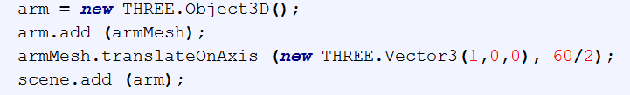
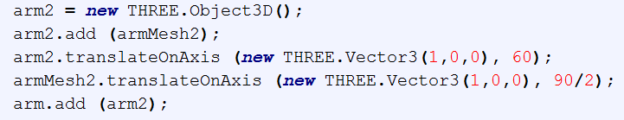

Slide 26
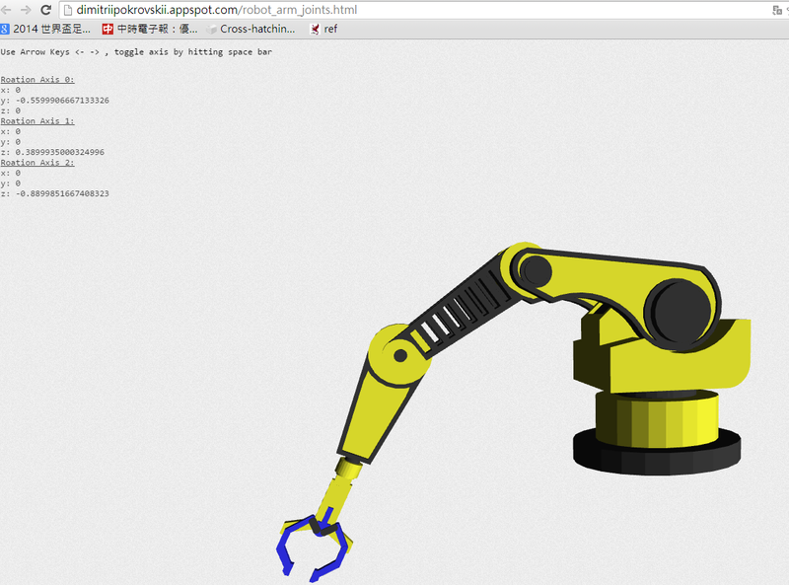
Multiple file example:
http://dimitriipokrovskii.appspot.com/robot_arm_joints.html

Slide 27
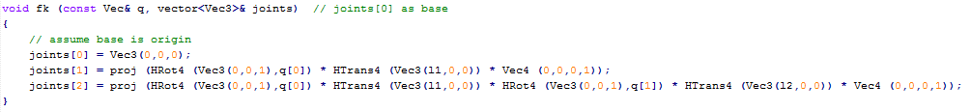
18-2p forward kinematics

Slide 28


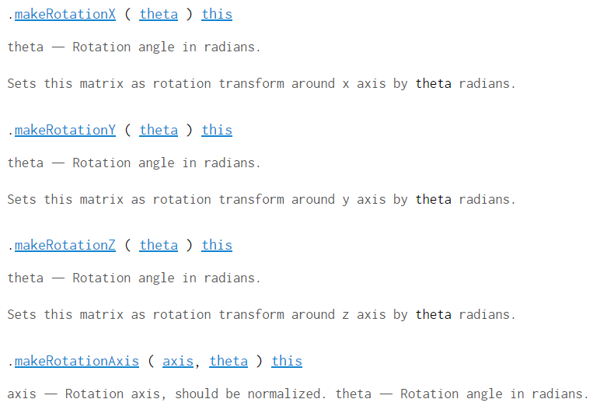
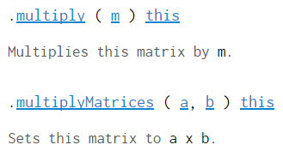
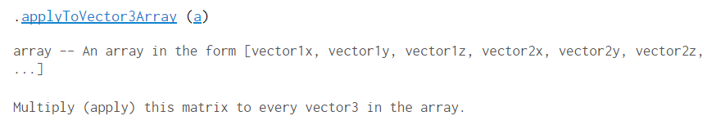
Matrix4

Slide 29



(set row-wise, stored in column major order)

Slide 30








Vector3

Slide 31





Vector3

Slide 32



Common error
http://stackoverflow.com/questions/509579/how-does-variable-assignment-work-in-javascript
http://stackoverflow.com/questions/6605640/javascript-by-reference-vs-by-value

Slide 33

Javascript emulator

Slide 34

Can run threejs too (r54)

Slide 35
Tuts 18-3 IK (CCD)
Multiple files (ccd_box in another file)
Quite straight forward
Try iteration debugging
No general “box” thing yet

Slide 36

Tuts 19
Reference: http://threejs.org/examples/webgl_interactive_draggablecubes.html
Draggable cube
Moving plane: mesh.lookAt ….
Mesh properties: check out base class “Object3D”
Div: specified in js
Size of plane limits the movement

Slide 37



Mouse move (on top of an object):
Set INTERSECTED;
set plane.position = INTERSECTED.position; orient towards the camera
Mouse down:
Set SELECTED; offset = object.point – plane.position
Mouse move (drag):
SELECTED.position = plane_hit - offset;
Mouse up:
SELECTED = NULL; plane.position = INTERSECTED.position;

Slide 38
Tuts 19-0 (xz tracer)

Slide 39

Tuts 19-1

Slide 40


