Slide 1
Three.js Tutorials Part 4 (31~)
References:
http://threejs.org/examples/

Slide 2
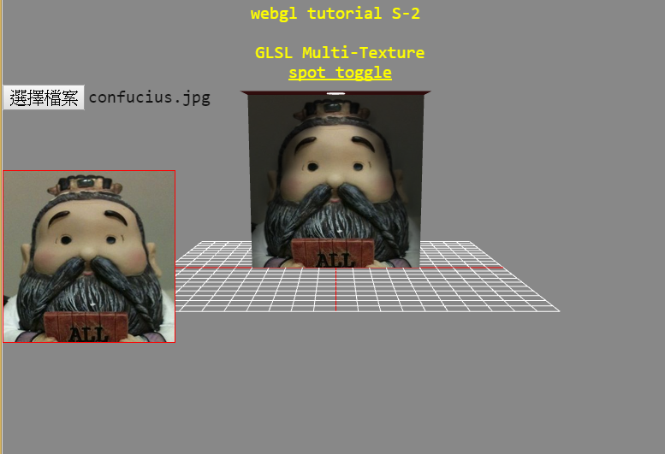
Javascript feature: FileReader

Slide 3
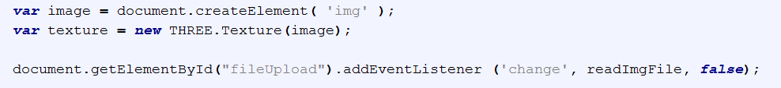
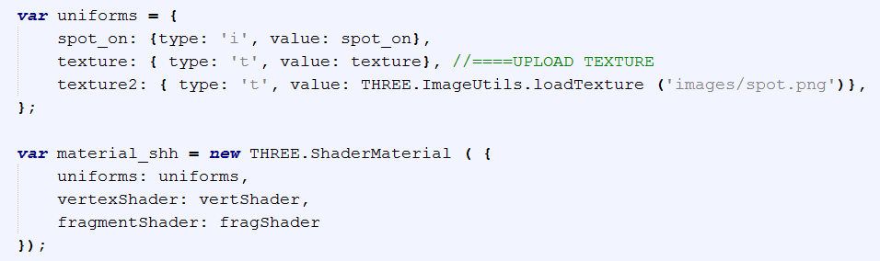

Slide 4
File reader
http://jsfiddle.net/u4vFe/
http://jsfiddle.net/0GiS0/Yvgc2/

Slide 5
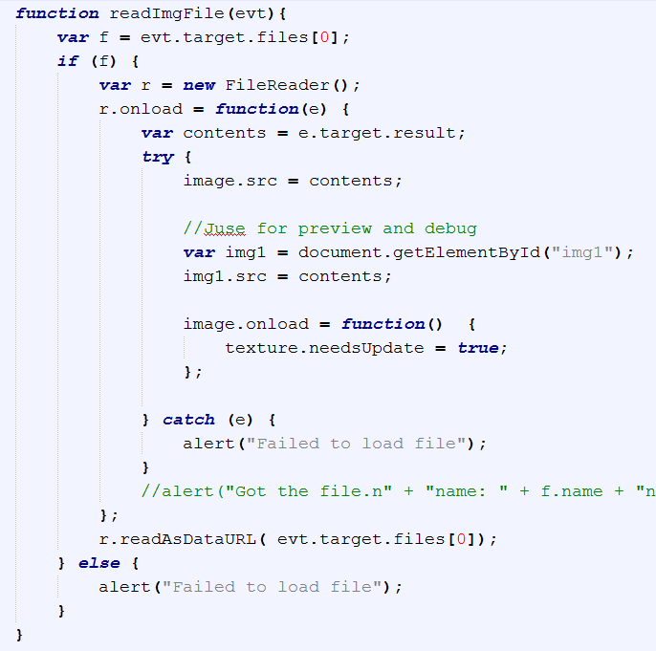

Slide 6
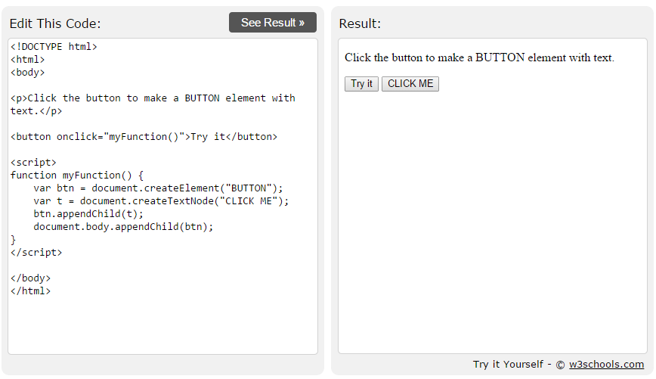
document.createElement

Slide 7
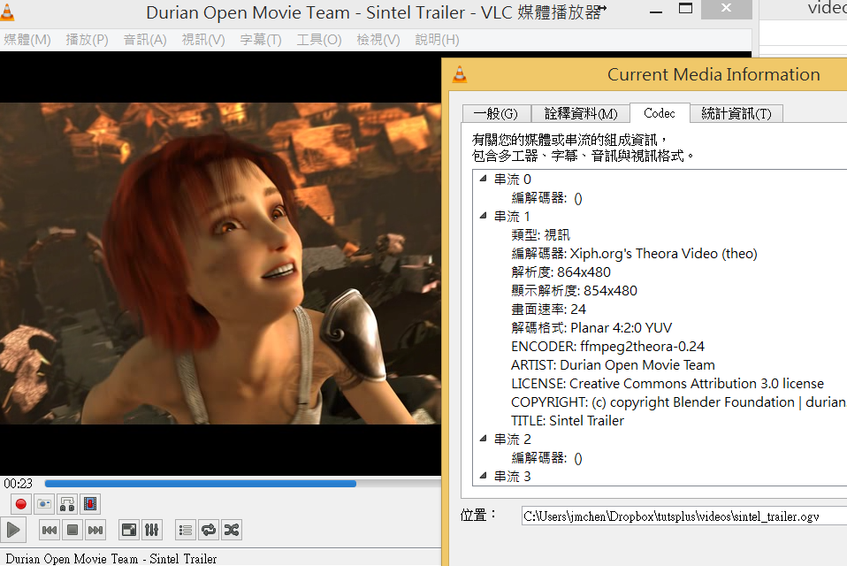
Tuts 32: Video Texture

Slide 8

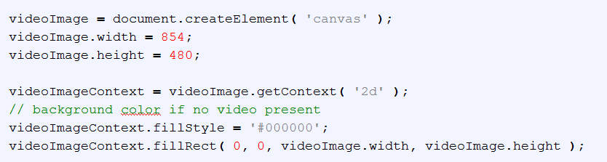

Slide 9

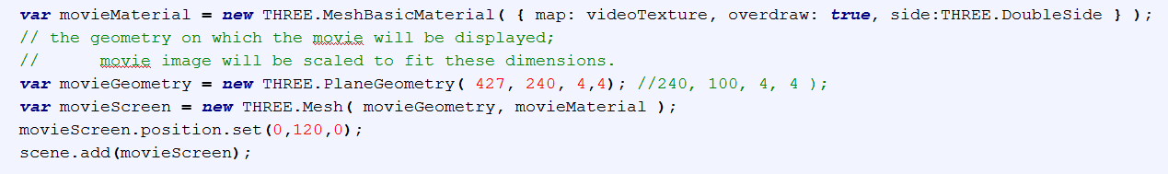

Slide 10
