Slide 1
YOUR NEW FAVORITE SONG

Slide 2


SONG
160k SPOTIFY DATABASE
PREDICTION MODEL
SONG
FEATURES
SONG
CLUSTER
SONG
INPUT SONG
OR
TOP 100 BILLBOARD
SONG
CHARTS
(updated weekly)

Slide 3
THE BEST PLAYLIST EVER

Slide 4
PLAYLIST
160k SPOTIFY DATABASE
PREDICTION MODEL
INPUT PLAYLIST
SONG
FEATURES
SONG
CLUSTERS
SONGS

Slide 5
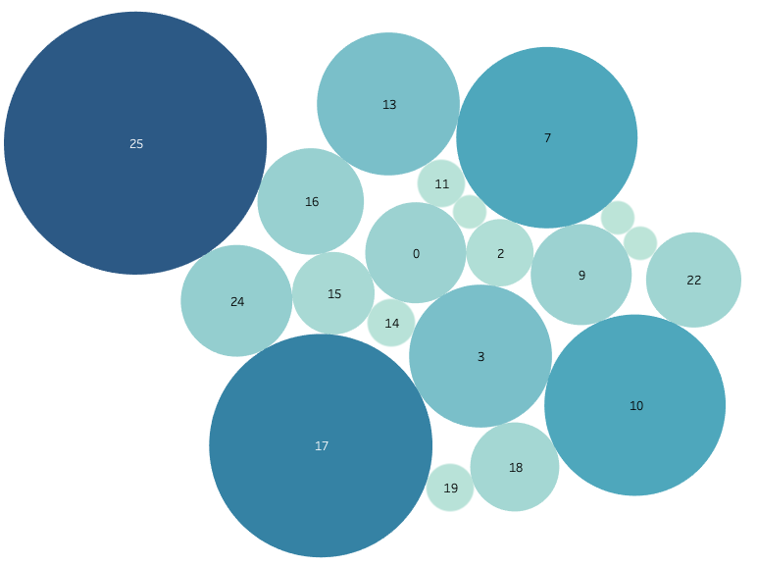
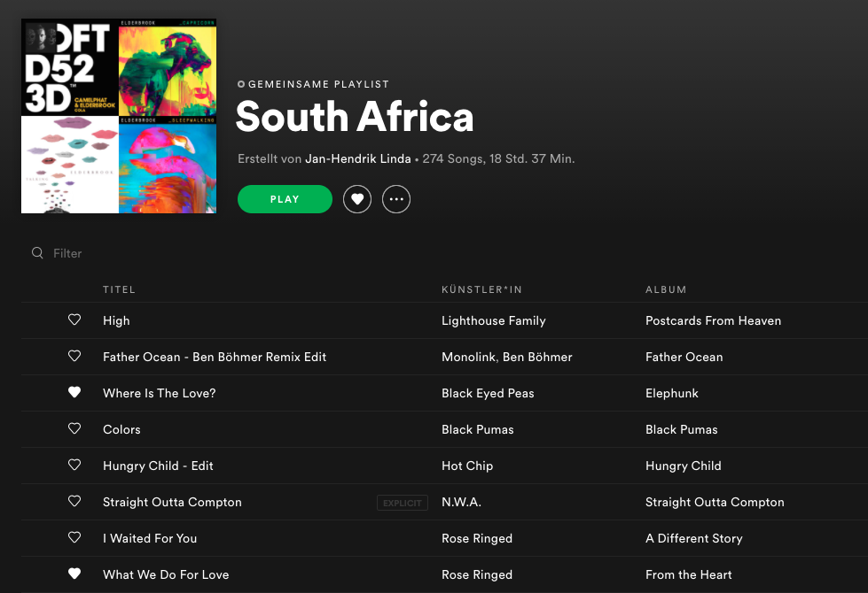
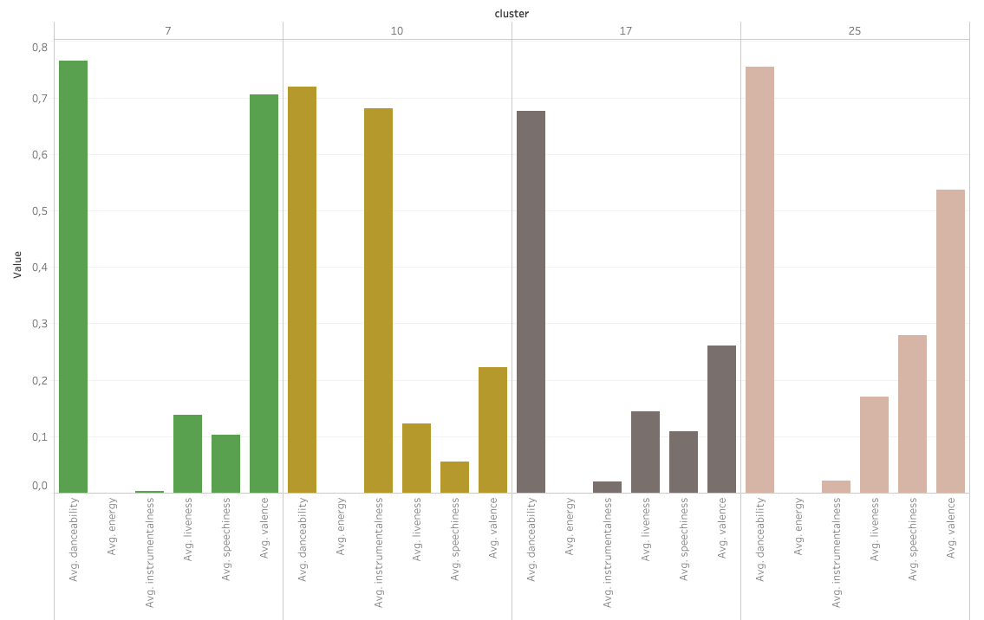

Slide 6

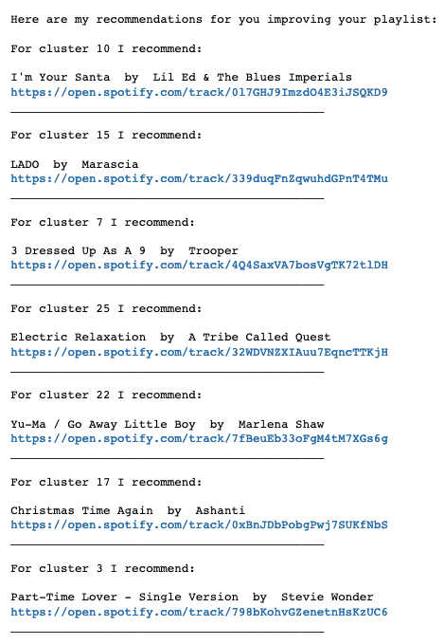
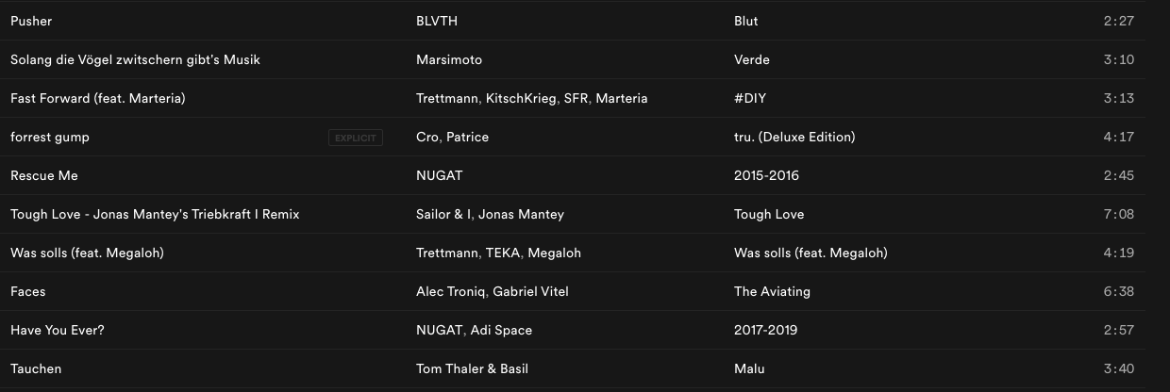
PROTOTYPE

