Slide 1


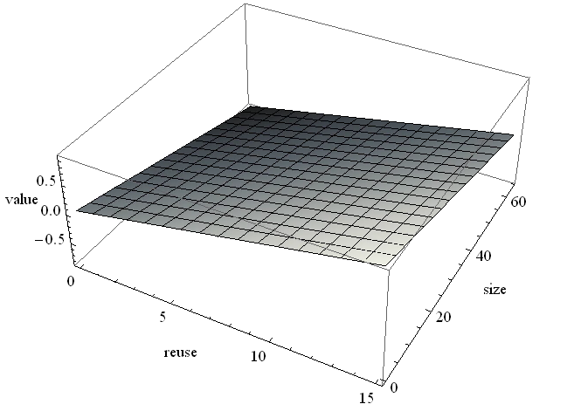
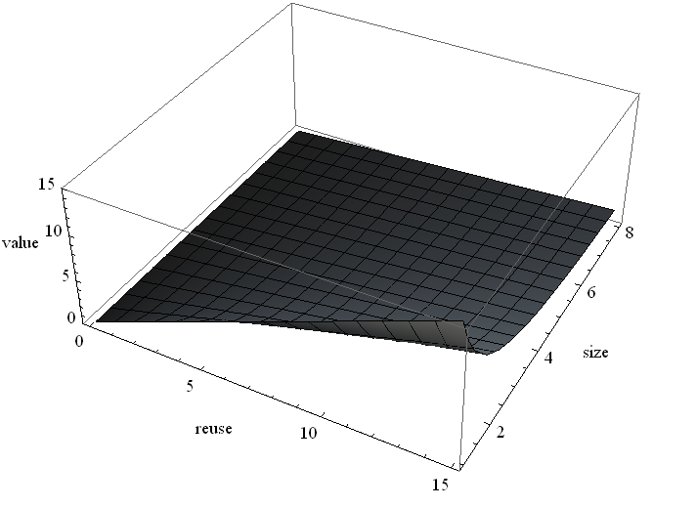
Enhanced Base-Delta Compression with Memory Pooling
Aditya Bhandaru, Gennady Pekhimenko, Onur Mutlu
Overview
Motivation
Base-Delta Compression [Pekhimenko et. al., PACT’12] proposes a promising technique for increasing on chip cache capacity using compression.
B+Δ offers good compression but incurs an additional access latency.
B+Δ suffers poor compressibility when adjacent data in memory have large value ranges.
Observation: Traditional compilers and memory-allocators are unaware of B+Δ cache compression in hardware.
Key Idea: Arrange data in memory to optimize B+Δ compressibility.
Solution: Recent literature on Memory Pooling and Data Splitting [Curial et. al., ISMM’08] and related work seem promising.
Problem: Can we mitigate low compressibility cases for B+Δ compression?
Increase viability for B+Δ implementation in hardware, and justify the extra access latency.
Proposals like Memory Pooling and Data Splitting already improve locality and reduce value range in adjacent data values.
But they have not yet been applied to B+Δ!
Figure 1. Each column shows the ratio block-types for B+D with and without splitting and pooling.
Notice the large increase in 1-byte all-zero blocks, and general decrease of large, uncompressed blocks.
Mechanisms
4x
Insert
2x
Assigning Values to Block
Value function: f(block reuse, block size)
Monotonically increasing with respect to block reuse
Monotonically decreasing with respect to block size
Plane (see figure) achieves these goals, but is complex to implement in hardware
Reuse/Size (see figure) approximates plane and is less complex
Probability of reuse predictor: RRIP [Jaleel et. al., ISCA’10] derivative
Insert
4x
Before Eviction
Assign Values
Sort
Replacement
LRU
Set 0
{70%,2x}
{50%,x}
{50%,x}
Set 0
4x
x
x
x
Before Eviction
Marking
Replacement
Set 0
35
50
50
Set 0
4x
x
x
x
Set 0
50
50
35
Set 0
4x
x
x
x
Set 0
x
x
2x
Policy 1: Min-LRU
Insight: LRU evicts more blocks than necessary
Key Idea: Evict only the minimum number of LRU blocks
Policy 2: Min-Eviction
Insight: Keeping multiple compressible blocks with less reuse may be more valuable than a single uncompressible block of higher reuse
Key Idea: Assign a value based on reuse and compressibility to all blocks and on replacement, evict the set of blocks with the least value
3D Plane Reuse/Size
Results
Conclusions
Min-LRU: 1% increase in IPC over LRU
Min-Eviction: 3% increase in IPC over LRU
IPC increase due to MPKI decrease
Min-Eviction: a novel replacement policy for the compressed cache
Outperforms current state-of-the-art replacement policies
First to consider both compressed block size and probability of reuse
Simple to implement
Further Work:
Global Min-Eviction: a global replacement policy for the compressed decoupled variable way cache that applies similar insight as Min-Eviction
Fairness in compressed cache replacement
Multi-core evaluation and analysis (see paper): 4% increase in normalized weighted speedup over LRU in heterogeneous workloads
2MB cache size, Base-Delta-Immediate compression scheme, 4Ghz x86 in-order, 1B instructions

