Slide 1


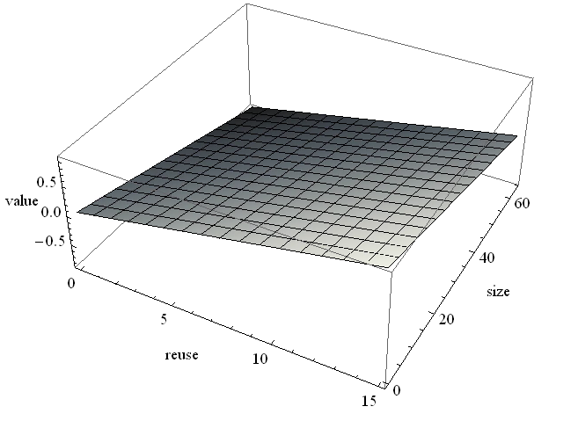
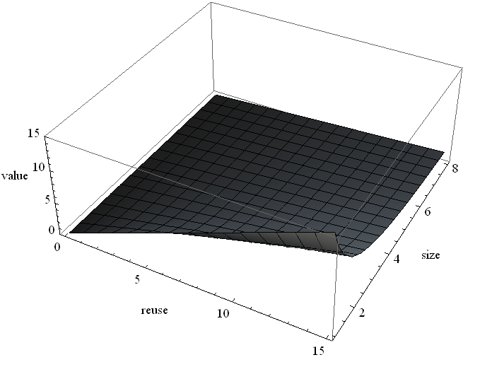
CARP: Compression Aware Replacement Policies
Tyler Huberty, Rui Cai, Gennady Pekhimenko
Overview
Motivation
Traditional cache replacement and insertion policies mainly focus on block reuse
Recent literature has proposed cache compression, a promising technique to increase on-chip cache capacity [Pekhimenko et. al., PACT’12]
In a compressed cache, block size is an additional dimension
Observation: The block most likely to be reused soon may no longer be the best block to keep in the cache
Key Idea: Use compressed block size in making cache replacement decisions
Solution: We propose three mechanisms: Min-LRU, Min-Eviction, and Global Min-Eviction
Problem: How can we maximize cache performance utilizing both block reuse and size?
No existing policy considers the many varied block sizes and potentials for reuse in making a replacement decision
We propose compression aware replacement policies
Example
4x
Insert
4x
4x
x
x
LRU
Set 0
x
Set 0
Set 0
4x
Shortcoming of Traditional LRU
LRU evicts more than necessary, underutilizing cache capacity
Distribution of Compressed Block Sizes (in bytes): potentially useful to replacement decision
Mechanisms
4x
Insert
2x
Assigning Values to Block
Value function: f(block reuse, block size)
Monotonically increasing with respect to block reuse
Monotonically decreasing with respect to block size
Plane (see figure) achieves these goals, but is complex to implement in hardware
Reuse/Size (see figure) approximates plane and is less complex
Probability of reuse predictor: RRIP [Jaleel et. al., ISCA’10] derivative
Insert
4x
Before Eviction
Assign Values
Sort
Replacement
LRU
Set 0
{70%,2x}
{50%,x}
{50%,x}
Set 0
4x
x
x
x
Before Eviction
Marking
Replacement
Set 0
35
50
50
Set 0
4x
x
x
x
Set 0
50
50
35
Set 0
4x
x
x
x
Set 0
x
x
2x
Policy 1: Min-LRU
Insight: LRU evicts more blocks than necessary
Key Idea: Evict only the minimum number of LRU blocks
Policy 2: Min-Eviction
Insight: Keeping multiple compressible blocks with less reuse may be more valuable than a single uncompressible block of higher reuse
Key Idea: Assign a value based on reuse and compressibility to all blocks and on replacement, evict the set of blocks with the least value
3D Plane Reuse/Size
Results
Conclusions
Min-LRU: 1% increase in IPC over LRU
Min-Eviction: 3% increase in IPC over LRU
IPC increase due to MPKI decrease
Min-Eviction: a novel replacement policy for the compressed cache
Outperforms current state-of-the-art replacement policies
First to consider both compressed block size and probability of reuse
Simple to implement
Further Work:
Global Min-Eviction: a global replacement policy for the compressed decoupled variable way cache that applies similar insight as Min-Eviction
Fairness in compressed cache replacement
Multi-core evaluation and analysis (see paper): 4% increase in normalized weighted speedup over LRU in heterogeneous workloads
2MB cache size, Base-Delta-Immediate compression scheme, 4Ghz x86 in-order, 1B instructions

