Slide 1


Mexico’s Current Political Context
ella.practicalaction.org
Janet Oropeza Eng
Fundar, Center of Analysis and Research

Slide 2
Goals of the presentation
Provide a brief presentation of the Mexican political context with an emphasis on current human rights situation
Notes:
I will divide the presentation in three parts. In the first I will talk about the 13 years in Mexico since our democratic transition in 2000. In the second part, I will talk about Mexico today providing some data on were we are on some social and economic indicators. Finally, in the third part I will talk about the human rights situation in Mexico. At the end, there will be time for questions and answers.
But first, I will like to maybe get two or three reactions from you. What struck you from the readings we sent you?

Slide 3
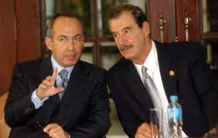
The long-awaited democratic transition
-In 2000, the National Action Party (PAN) won the presidency. The Institutional Revolutionary Party (PRI) left the presidency after holding it for 71 years.
-In those 71 years, Mexico was considered an authoritarian regime.
-Two presidents from the PAN ruled the country in the next 12 years: Fox from 2000 to 2006; and Calderón from 2006-2012.
-Both kept implementing a liberal economic model and deepened it. Economic growth was minimal. Natural resources and territories are considered as crucial elements of an extractive model.
-Informality increased with both of them.
Notes:
Authoritarian regime: Dissidence was not permitted (1968). Even though elections were held (allowing minimum opposition), the PRI controlled all political positions. Unions were loyal to the regime in exchange for political power or benefits.
Although both were from the same party, their regimes differed in many things. But let’s start with those things that they had in common.
Calderón approved Labor Reform. Critics said it undermined many of the labor rights that the Constitution protected.
Fox really tried to implement and enact reforms to open the decision-making process to citizens’ scrutiny.

Slide 4
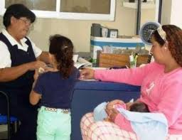

Fox and Calderon’s Presidential Terms
-In the social realm, there was an effort to implement reforms to improve citizens’ quality of life. Corruption, ineffectiveness, and the economic model undermined these reforms.
-In the political realm, Fox enacted reforms to open the decision-making process to citizens’ scrutiny. These reforms extended to Calderón’s term; however, we was not as open as Fox.
-Calderón made the security policy (war against drug cartels) the highlight of his presidential term. A wave of political violence throughout the country followed this decision.
Citizens’ dissatisfaction with Fox and Calderón brought the PRI back in 2012.
Notes:
Social reforms: Oportunidades was strengthened, the Popular Insurance and the Universal Pension for Elderly People were created.
Political reforms: Freedom of Information Act, Act to Support Civil Society Organizations’ Activities, Public Service Professional Career Service Act, etc. He opened institutional spaces for civil society participation.
Institutional spaces: citizen advisory committees; ministries consulting CSOs, etc.

Slide 5
Human Rights’ Development 2000-2006
-Fox made an effort to promote, advance and enforce human rights:
1) He ratified many international human rights treaties and covenants
2) A Human Rights Plan and a Human Rights Undersecretary’s Office were created
3) The voice and opinion of civil society was heard
4) Mexico acknowledged human rights violations and accepted international scrutiny and advice (UNHCHR office in 2002)
5) Mexico took an ambitious leadership in international HRs fora
6) Regarding Indigenous Rights, Fox enforced the “San Andrés Agreements” and in 2003 enacted the Linguistic Rights Law.
-Fox could not make progress on transitional justice; effective access to justice; full respect of human rights.
Notes:
Undersecretary (tried to solve cases before reaching the Inter-American HRs System)
San Salvador Atenco Case: human rights violations occurred.

Slide 6
Human Rights’ Development 2006-2012
-In Calderón’s term , there were important human rights setbacks:
-Human rights violations increased (forced disappearances, torture, wrong detentions, etc). 60,000 people died as a consequence of his war against drug cartels, many of them civilians. Country was militarized.
-The minimal transitional justice efforts of Fox were ended
-Calderón was not open to civil society’s input
-Public acts acknowledging State’s wrongdoings for some IAHRC rulings, but no structural reforms to avoid this happening again
Notes:
Justice reform: provinces have to draft and enact a Penal Code, train staff, create structures, protect in a greater way the rights of people being accused of a crime, victims’ rights are enhanced.

Slide 7
Human Rights’ Development 2006-2012
-Some of Calderón’s important human rights reforms:
Criminal Justice System Reform adopted: ambitious reform to improve justice system (progress has been slow). The law has an exception for people supposedly involved in organized crime
-The Supreme Court determined that cases involving the military and HRs violations should be ruled in a civil court.
-Reform to the Writ of Amparo (injunction)- It is enhanced, now communities can use it, the effect can be wider, etc.
-International HRs covenants at the same level as the Constitution, judges should use them when ruling.
-The term ”Individual guarantees” was replaced for HRs; it was establish that all HRs violations must be investigated, compensated, and punished.

Slide 8
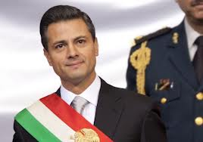
Where are we today?
-The PRI is back and a new President, Peña Nieto, is in power. He committed to approve many structural reforms (telecommunication, education, etc).
-Peña Nieto approved the Victims Law
-He will create a national gendarmerie still not clarity of the consequences of this

Slide 9
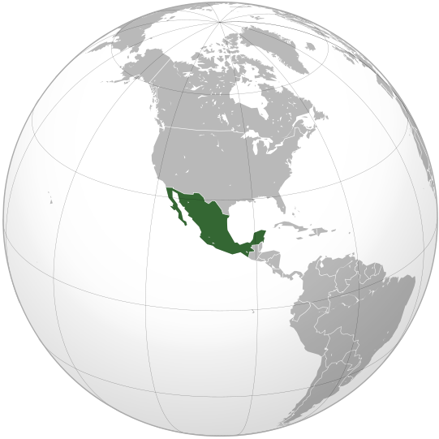
Mexico Today: Persistent Challenges
-The budget depends largely on oil exports; oil to disappear in some years.
-Private sector has been the real winner, while 40 million Mexicans (over 30% of the population) live under the poverty line. Regionalization of poverty.
-59% of people works in the informal sector, not entitled to social security and social services.
-80% of the population cannot fully access public social services .
-Indigenous communities are losing their lands, territories and natural resources in favour of large scale development projects.
-Inequality persists (Gini Coefficient 47.2 in 2010)
-HRs violations still occur, institutional, armed, and social violence persists; the country has been militarized; no real access to justice
Notes:
Human rights activists are killed
Miles de empresas cerradas (166 000 en 2011) o que están bajo extorsión

Slide 10

Q&A

Slide 11





ella.practicalaction.org
African and Asian coordinators:
Latin American Regional Centre of Expertise
Kenya, Zimbabwe, Nepal
Managed by:
Supported by:
With the participation of:

