Slide 1
Rethinking the Livestream Esports
By: Gabriel A., Umid T., Isaac N., James H., Nigel N.
Notes:
Gabe

Slide 2
Why Esports?
Notes:
Speaker: Gabriel

Slide 3
Why Esports?
We are passionate about games and their surrounding community
Notes:
Speaker: Gabriel

Slide 4
Why Esports?
We are passionate about games and their surrounding community
Esports is a new and exciting sports entertainment genre
Notes:
Speaker: Gabriel

Slide 5
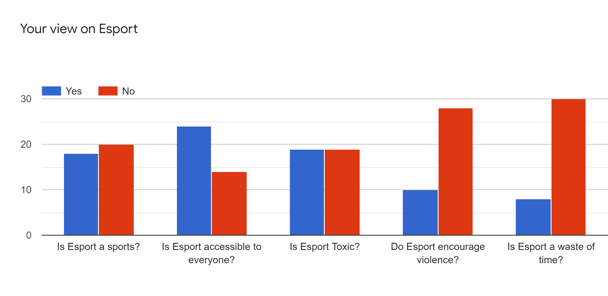
User Survey
Primary Research (Survey) Findings 44 participants
Notes:
Speaker: Owen
Why we did a survey
Target Audience

Slide 6
User Interviews
Avoiding toxicity was a priority
Online interactivity positively affected users
There were the two main platforms used to watch streams
The amount of time needed to watch something affected its viewership
Notes:
Speaker: James

Slide 7
What We Found
“Toxic”
“Time consuming”
“Limited streaming platforms”
Notes:
Speaker: Gabriel

Slide 8
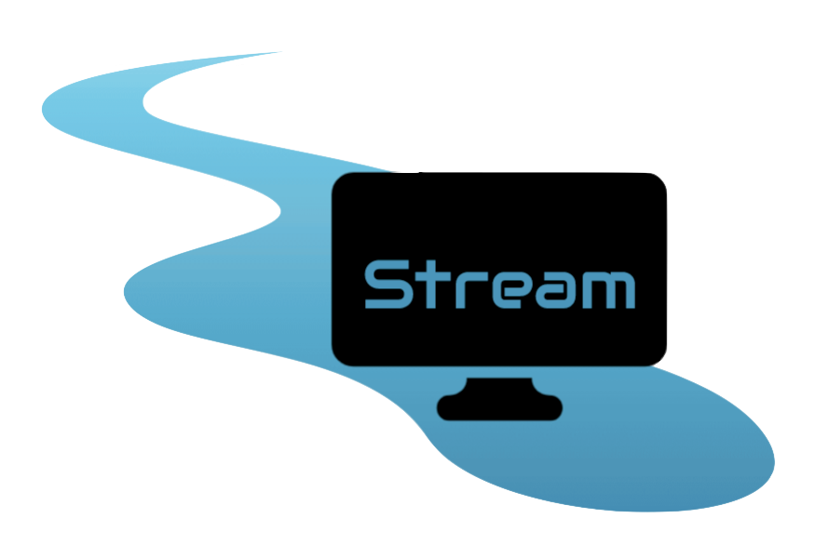
Notes:
Speaker: Gabriel

Slide 9
What is Stream?
Notes:
Speaker: Gabriel

Slide 10
What is Stream?
A new, web extension where users can easily watch all their favourite streams and videos
Notes:
Speaker: Gabriel

Slide 11
What is Stream?
A new, web extension where users can easily watch all their favourite streams and videos
An integrated time management system that allows users to be more productive
Notes:
Speaker: Gabriel

Slide 12
What is Stream?
A new, web extension where users can easily watch all their favourite streams and videos
An integrated time management system that allows users to be more productive
A reinvented chat system that promotes a more friendly and community focused experience
Notes:
Speaker: Gabriel

Slide 13
Demo
https://bit.ly/33F7hge
Notes:
Speaker: James

Slide 14
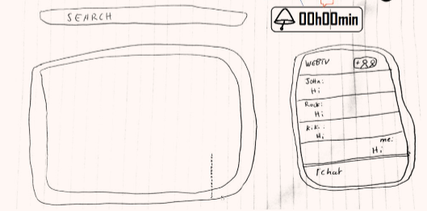
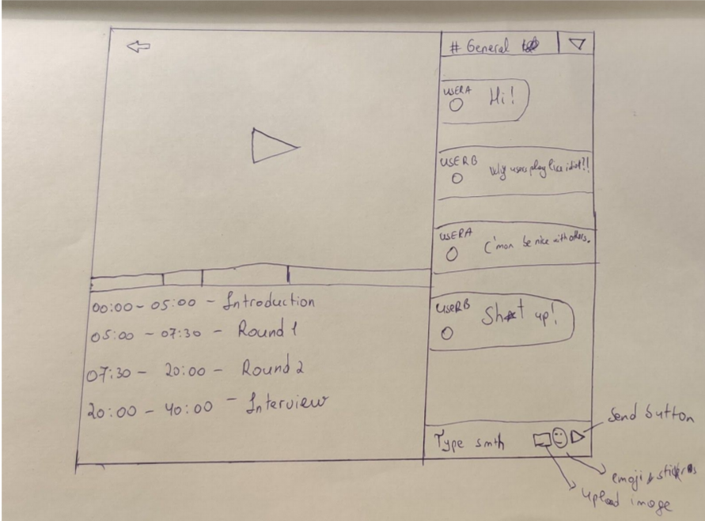
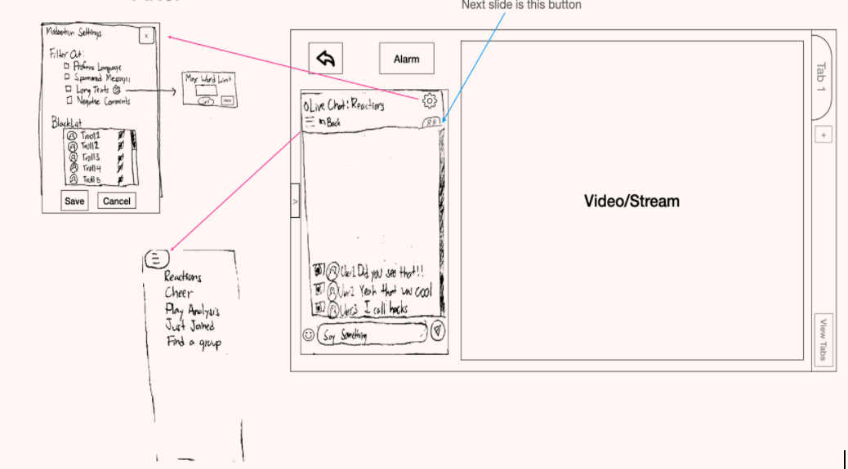
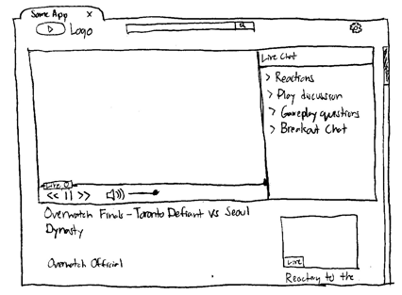
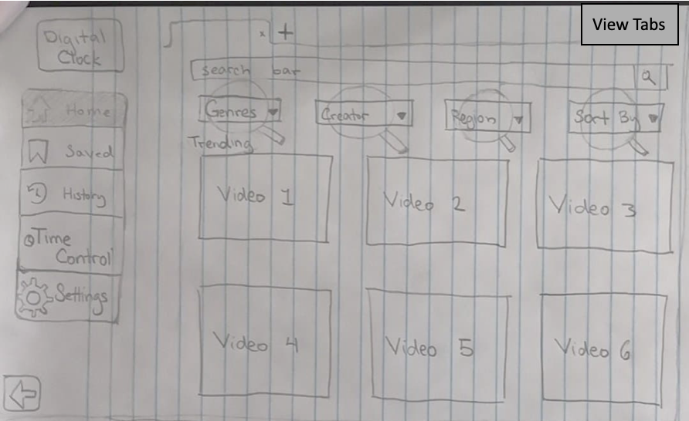
Iterative Design: Ideas to Design
From Individual Lo Fi prototype to combined Lo Fi- prototype
Based off Individual Usability Testing
Notes:
Speaker: James & Umid

Slide 15
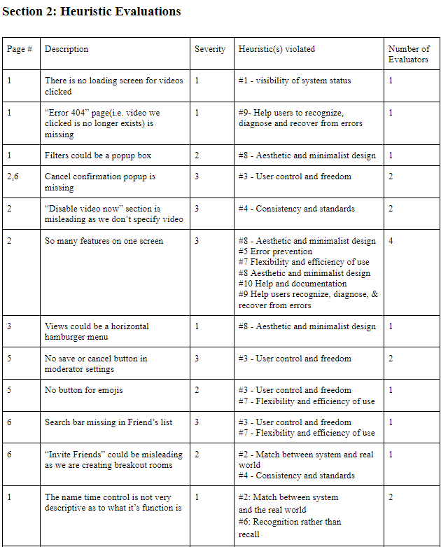
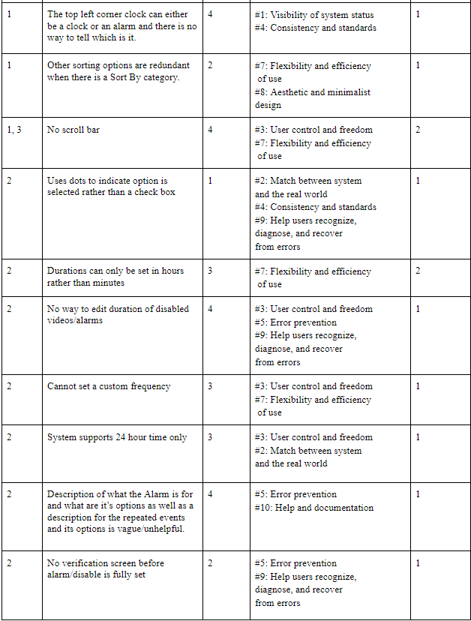
Iterative Design: Refine the Design
Cognitive Walkthroughs to think about the feelings of the user
Nielsen Heuristics Analysis to identify even more potential flaws
Notes:
Speaker: James & Umid

Slide 16
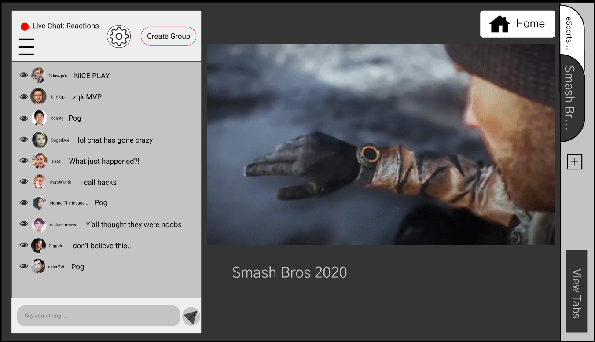
Iterative Design: Turning Design Into Reality
From Combined Low-fi Prototype to Hi-fi Prototype.
Based off of Nielsen’s 10 Heuristics for User Interfaces
Notes:
Speaker: James & Umid

Slide 17
What Our Users Have To Say
"This is a nice addition so that I don't have go to a different platform to discuss the event." –Participant 1
Notes:
Speaker: Owen

Slide 18
What Our Users Have To Say
"This is a nice addition so that I don't have go to a different platform to discuss the event." –Participant 1
"I think that's pretty cool to have a time managing app on the website." –Participant 1
Notes:
Speaker: Owen

Slide 19
What Our Users Have To Say
"This is a nice addition so that I don't have go to a different platform to discuss the event." –Participant 1
"I think that's pretty cool to have a time managing app on the website." –Participant 1
"If you want something more customized ... and you want to cater your experience yourself, I would recommend this." –Participant 2
Notes:
Speaker: Owen

Slide 20
Questions?
Notes:
Speaker: Isaac

Slide 21
Thank You!

