Slide 1
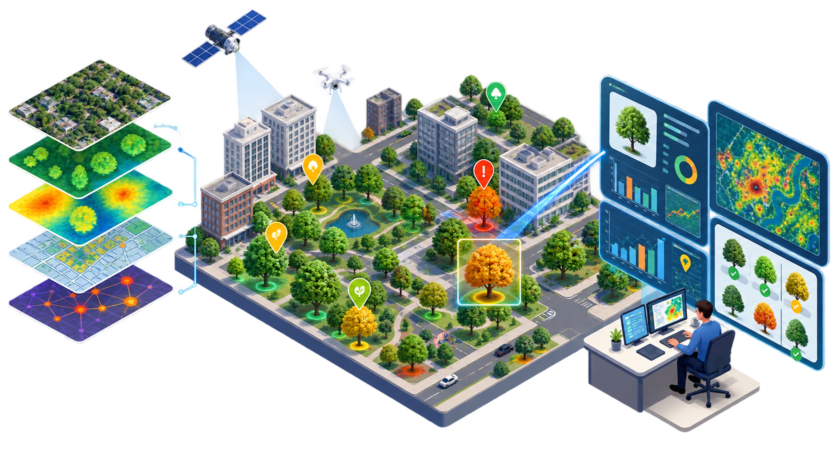
CanopyIQ
An AI-Assisted Decision Support System for Urban Tree Management and Community Prioritization
CSCN8040 - Case Studies in AI and ML | Final Team Presentation
Emmanuel Ihejiamaizu | Liggia Elena Taboada Cruz | Chao-Chung Liu | Zhuoran Zhang | Ce Chen
decision support, not automation
live demo included
CanopyIQ | Emmanuel
1
Notes:
Emmanuel: Open with the one-sentence story. CanopyIQ helps a municipal forestry team decide where to inspect, prune, plant, and explain the decision using evidence.

Slide 2
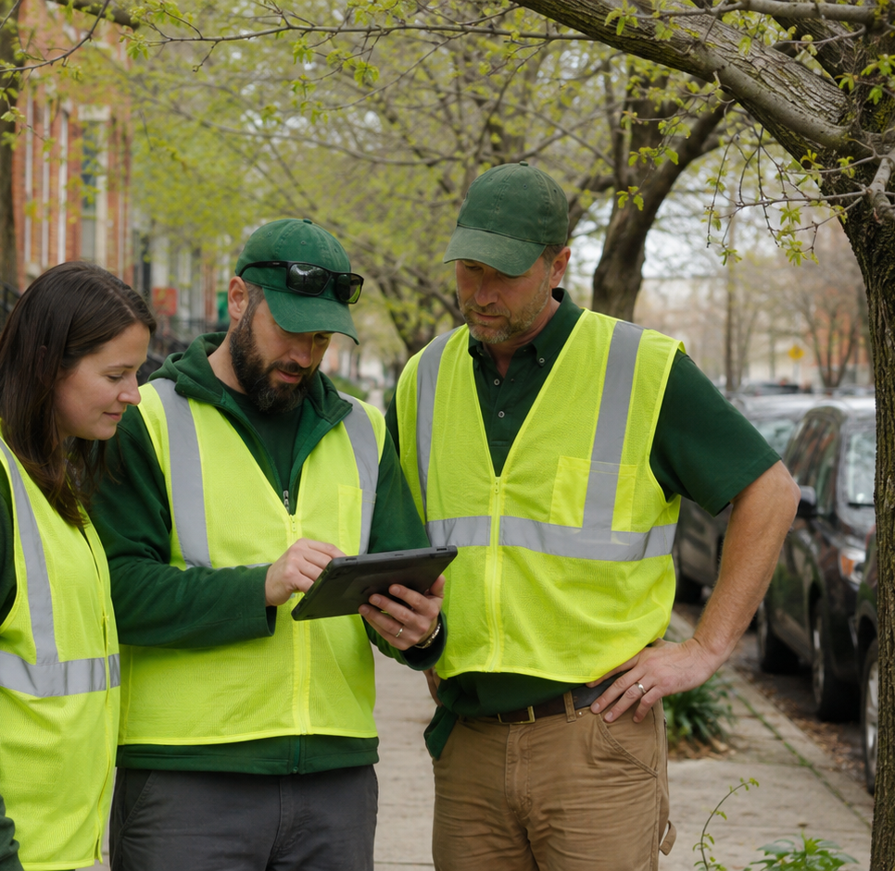
The city problem is not “more AI.”
It is how to defend difficult forestry decisions with limited time and budget.
A planner has to answer three questions:
•
Which communities need action first?
•
Why this area before another?
•
Can we explain the recommendation to council and residents?
CanopyIQ turns scattered tree records into an explainable priority list.
CanopyIQ | Emmanuel
2
Notes:
Emmanuel: Use a concrete municipal scenario: a councillor asks why Civic Centre is being prioritized, while a resident asks why their area is not.

Slide 3
Who is affected?
Canopy decisions shape budgets, work orders, resident trust, and climate adaptation.
Municipal planners
Arborists & crews
Need defensible rankings
Need field-review queues
Residents
Council
Experience shade, service, and risk
Needs a public explanation
The system must be explainable enough for public decision-making, not just accurate in a notebook.
CanopyIQ | Liggia
3
Notes:
Liggia: Emphasize that this is a mixed audience problem. A purely technical model is not enough; the system has to be understandable to non-technical municipal stakeholders.

Slide 4
Research question and hypothesis
The final report focuses on evidence we can defend.
Research question
Hypothesis
How can open municipal tree inventory and environmental data be integrated into a reproducible model to identify high-priority areas for urban forestry intervention?
Combining tree asset condition, canopy context, and operational indicators improves resource prioritization and makes forestry decisions easier to explain.
Final research hierarchy
Primary: transparent community index
Validation: baselines + Monte Carlo stability
Secondary: observed removal classifier
History: synthetic/budget/GenAI prototypes
CanopyIQ | Liggia
4
Notes:
Liggia: Say that the team deliberately moved away from treating constructed cost forecasts as final empirical evidence. The final paper is more defensible because it separates prototype history from verified results.

Slide 5
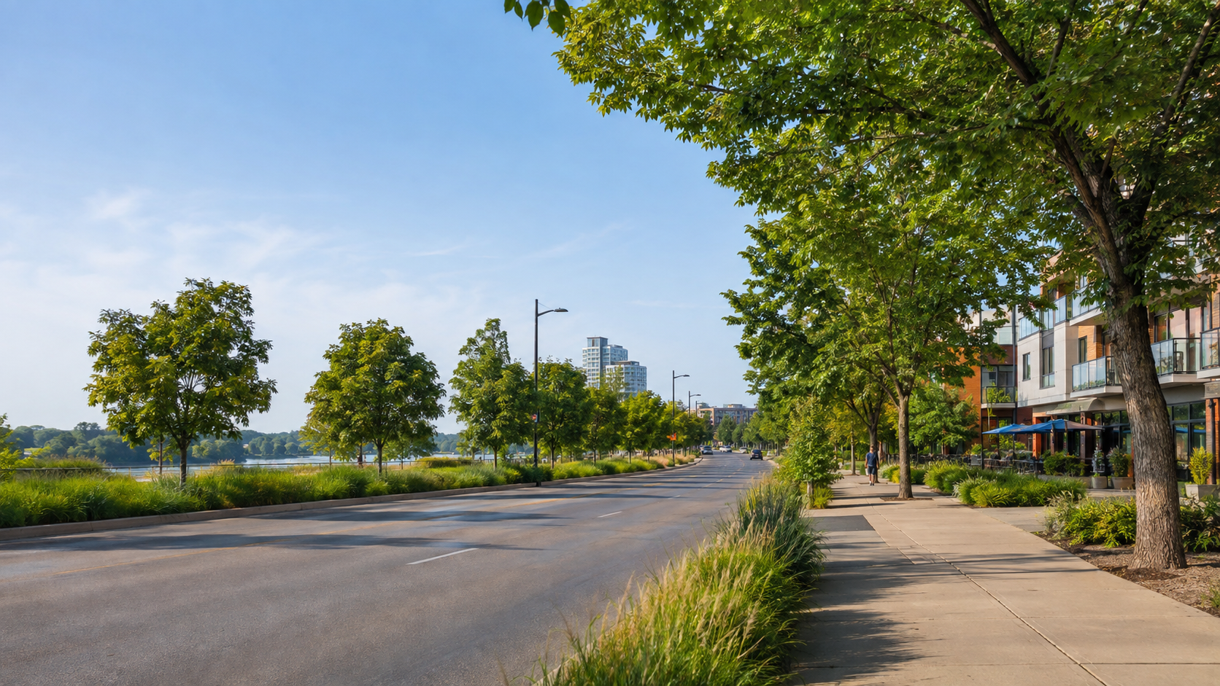
Data used in the final system
We combined municipal inventory records, planning boundaries, Census context, and real LST cache data.
152,233
145,326
55
51
raw municipal tree records
harmonized classifier records
planning boundary polygons
rankable communities
Source layers
•
Kitchener Tree Inventory
•
Waterloo Street Tree Inventory
•
Kitchener planning communities
•
2021 Census population/income
•
Landsat/GEE summer land surface temperature
CanopyIQ | Chao-Chung
5
Notes:
Chao-Chung: Call out that the four local files were verified and are the exact Git LFS objects expected by the repo. This supports reproducibility.

Slide 6
Methodology: from raw records to decision support
CRISP-DM helped keep the work connected to the municipal problem.
Business
Data
Prepare
Model
Evaluate
Deploy
Define forestry prioritization problem
Collect inventory, boundaries, Census, LST
Clean, harmonize, join spatial layers
Build index and classifier
Baselines, stability, transfer tests
Streamlit decision-support prototype
Core implementation
Python notebooks for analysis
GeoPandas/Shapely for geospatial joins
scikit-learn for evaluation
Streamlit app for live demonstration
CanopyIQ | Ce
6
Notes:
Ce: Keep this slide simple. The key is that deployment here means a functional prototype, not a production Cityworks/AWS implementation.

Slide 7
The CanopyIQ Index is intentionally transparent
Each community score is an equal-weighted average of four explainable indicators.
Score = 0.25D + 0.25A + 0.25M + 0.25B
D
A
M
B
Density deficit
Attrition
Monoculture
Backlog
Where living tree density is low
Where records show higher removal/loss
Where genus diversity is lower
Where inspection recency is weaker
Equal weights are a starting point, not a claim of neutrality. The final system should support stakeholder weight review.
CanopyIQ | Ce
7
Notes:
Ce: Explain each letter with one example. This slide is the bridge between data and the results.

Slide 8
Data integrity check: 55 boundaries became 51 scores
We explain the difference instead of hiding it.
55
52
51
planning-community polygons
communities with eligible tree records
currently rankable communities
Not represented by eligible tree records: Dundee, Pioneer Tower East, Victoria North
Excluded from final scoring because backlog was missing: South Plains
Result: final ranking is honest about missing data and scope.
CanopyIQ | Chao-Chung
8
Notes:
Chao-Chung: This slide is about credibility. The team caught the 52 vs 51 issue and resolved it. That is a strength, not a weakness.

Slide 9
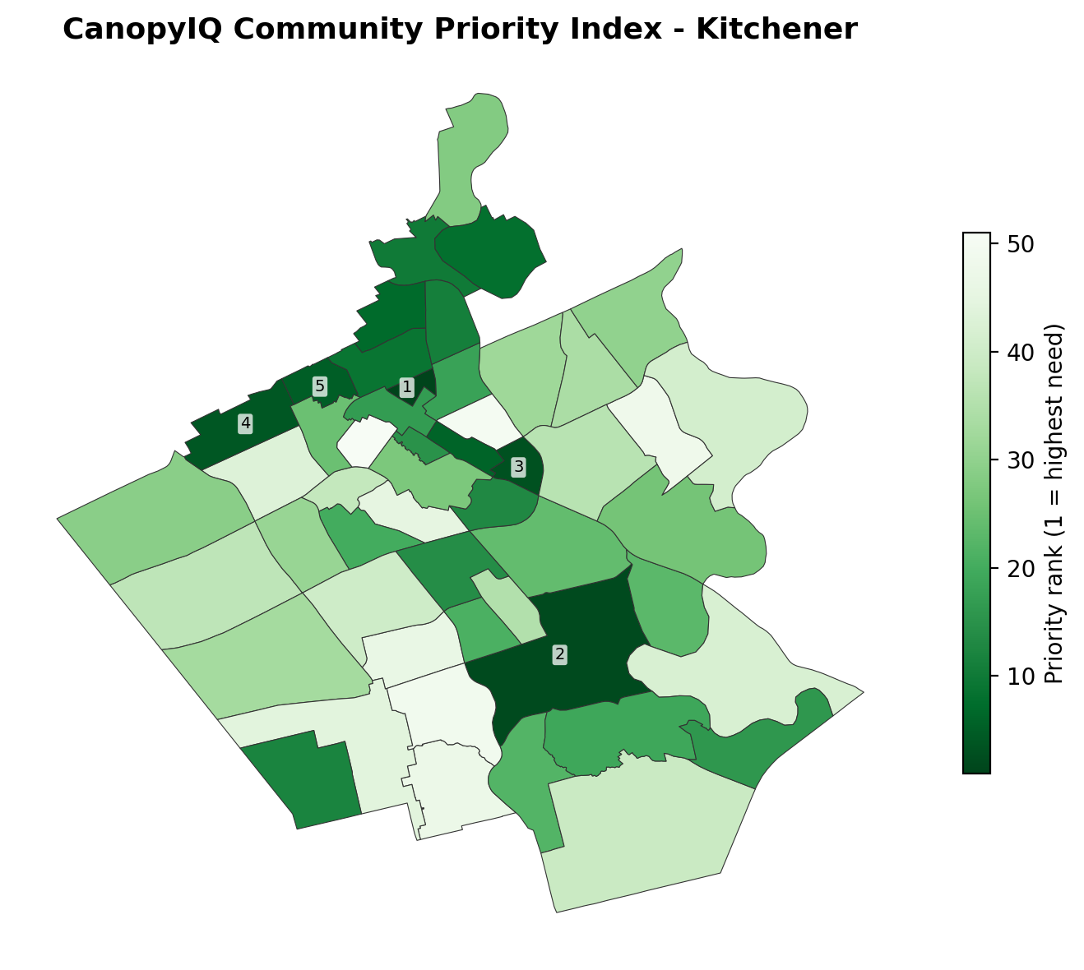
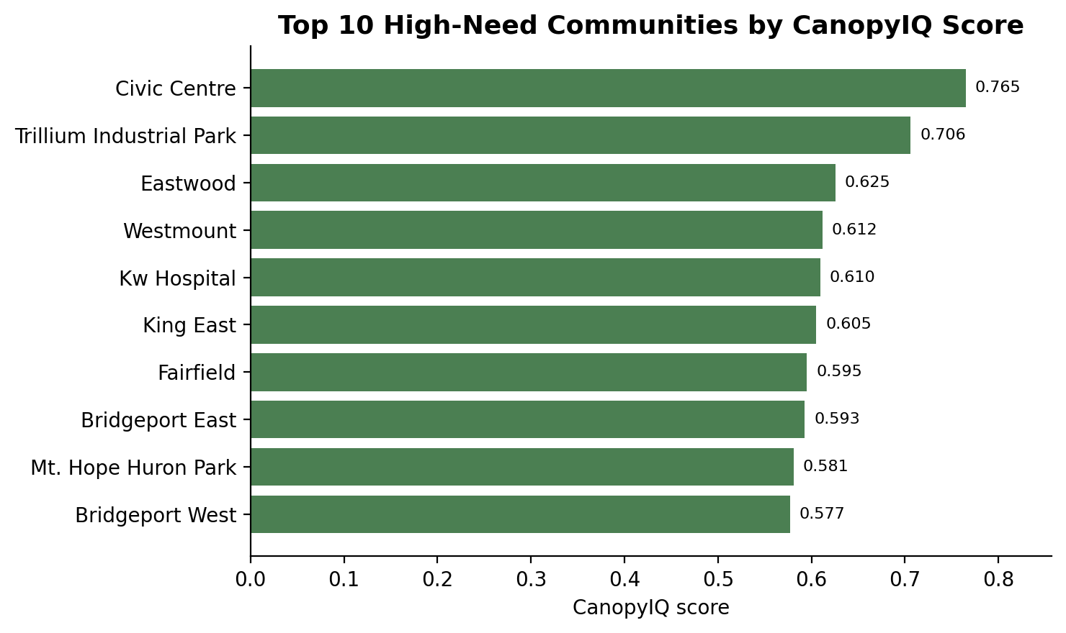
Result 1: community prioritization map
Civic Centre is rank #1 in the current scoreable output.
Civic Centre
0.765
highest-need community
CanopyIQ score
CanopyIQ | Zhuoran
9
Notes:
Zhuoran: Walk the audience through the map first, then the top 10 chart. Avoid reading the list; explain what the ranking is for.

Slide 10
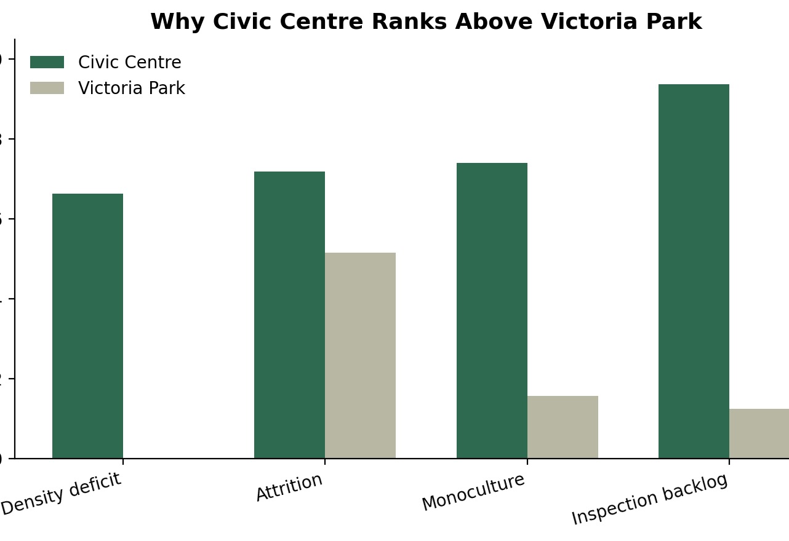
Result 2: the score is explainable
The app can show why one community ranks above another.
Civic Centre ranks high because it combines:
•
Long inspection backlog
•
High attrition signal
•
High monoculture risk
•
Lower tree density than many communities
That creates a defensible explanation, not just a number.
CanopyIQ | Zhuoran
10
Notes:
Zhuoran: Use Civic Centre versus Victoria Park as the example that will later appear in the live demo.

Slide 11
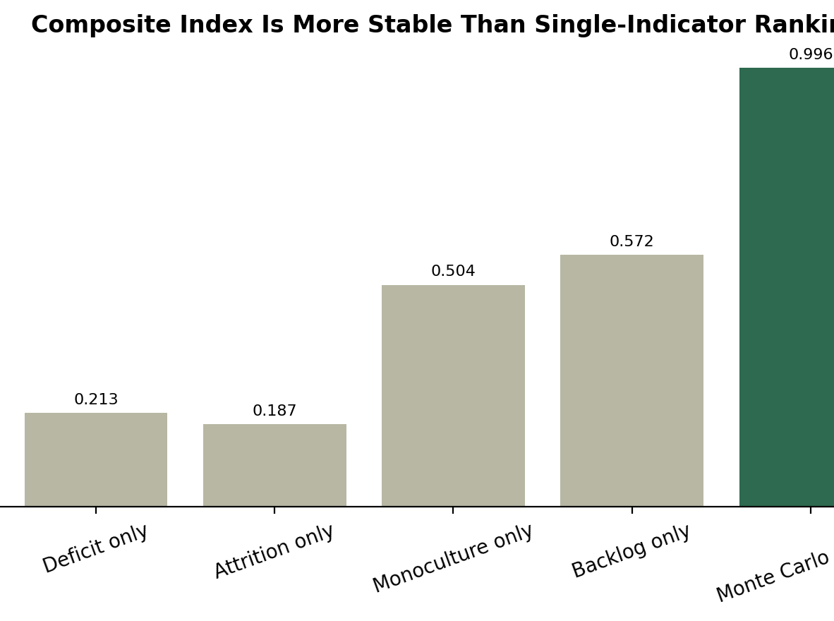
Result 3: the index is stable under weight changes
Monte Carlo testing reduces the risk that rankings are fragile.
1,000
0.996
Monte Carlo draws
median Spearman rho
0.990
100%
5th percentile rho
median top-15 preserved
Interpretation
Reasonable weight perturbations did not materially change the high-need group. The index is transparent and stable, but weights should still be reviewed by stakeholders.
CanopyIQ | Zhuoran
11
Notes:
Zhuoran: Explain Spearman rho in plain language: if it is close to 1, the order of communities stayed almost the same.

Slide 12
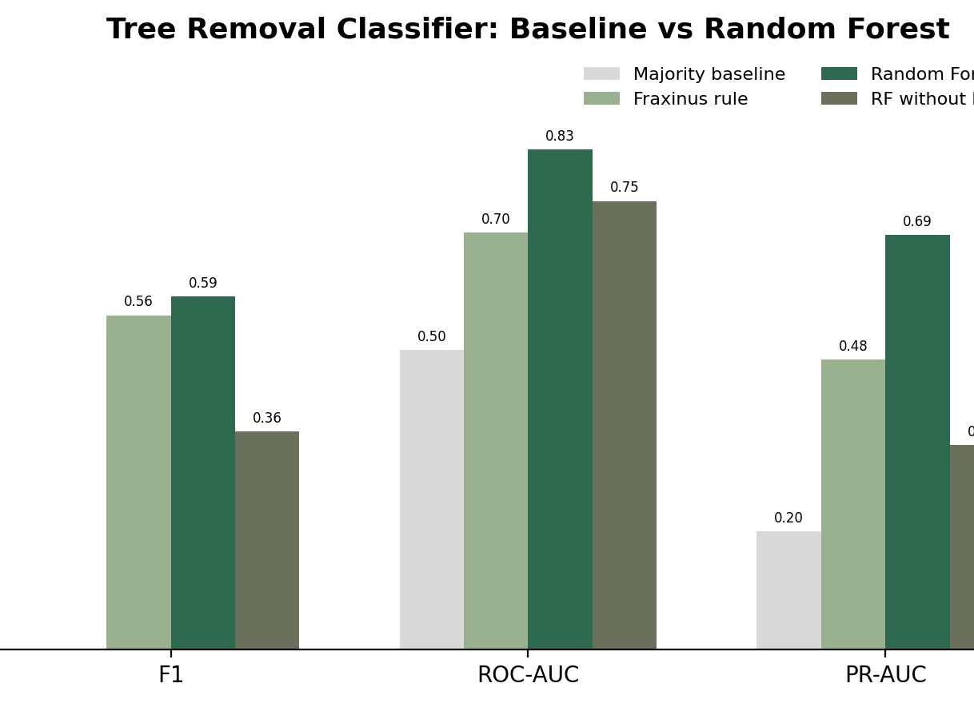
Secondary ML experiment: Random Forest improves over baselines
But it remains a planning signal, not an autonomous decision.
0.589
0.835
Pooled RF F1
Pooled RF ROC-AUC
0.692
0.558
Pooled RF PR-AUC
Fraxinus baseline F1
The Random Forest beats the simple Fraxinus rule on F1 and ranking quality.
This is useful, but not enough to authorize removals without field inspection.
CanopyIQ | Chao-Chung
12
Notes:
Chao-Chung: Mention why accuracy alone is not enough. The majority baseline has high accuracy but F1 zero.

Slide 13
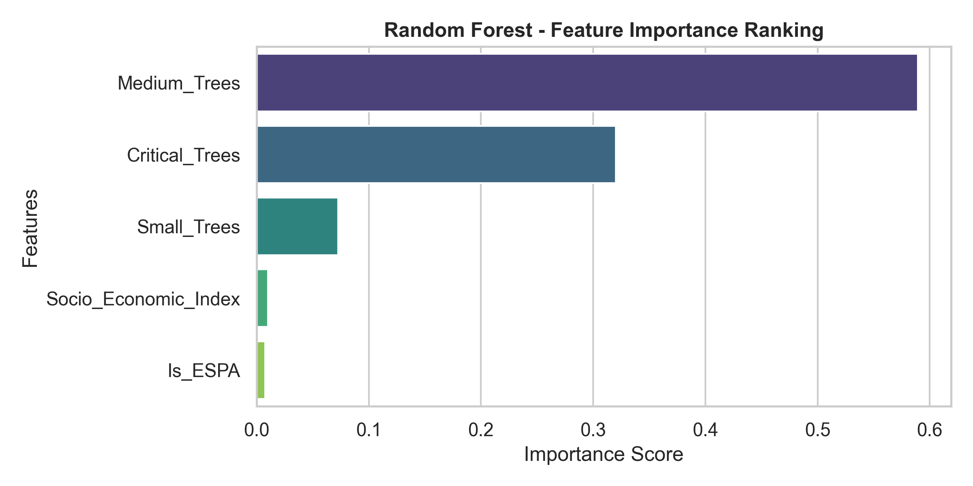
What the classifier taught us
It learns useful patterns, but those patterns are not universally portable.
No-Fraxinus test
Kitchener -> Waterloo
Waterloo -> Kitchener
ROC-AUC drops to 0.749 and PR-AUC to 0.341.
Transfer ROC-AUC = 0.773.
Transfer ROC-AUC = 0.664.
Conclusion
The model is useful for prioritizing review. It is not a general tree-mortality oracle. Species history and city-specific data practices still matter.
CanopyIQ | Chao-Chung
13
Notes:
Chao-Chung: This slide prevents overclaiming. Say the model supports inspection queues, not removal decisions.

Slide 14
Live demonstration: CanopyIQ prototype
Two minutes: map, community score, comparison, metrics, responsible AI.
1. Open Overview
2. Community Prioritization
3. Select Civic Centre
4. Compare with Victoria Park
5. Model Evaluation
6. Responsible AI
Demo rule: no fake production claims. This is a working decision-support prototype.
CanopyIQ | Emmanuel + Chao-Chung
14
Notes:
Emmanuel introduces the demo, then Chao-Chung drives it. Keep it controlled: do not click around randomly. End on Responsible AI.

Slide 15
Responsible AI design controls
The strongest governance principle is simple.
CanopyIQ advises. Arborists decide.
Accessibility
Privacy
Security
Table equivalent for map outputs
No income joins to individual tree coordinates
Schema validation, RBAC, audit logs
Equity
Human oversight
Monitoring
Data coverage flag + Green Equity KPI
Certified arborist inspection before removals
Drift checks and annual retraining
CanopyIQ | Emmanuel
15
Notes:
Emmanuel: Tie this directly to the ethics section of the report and the model card. The system is acceptable with controls, not as automation.

Slide 16
Limitations we do not hide
These are practical, specific, and fixable with better data and field feedback.
Incomplete inventory coverage
Missing indicator issue
Under-documented areas may appear lower need.
South Plains was excluded because backlog was missing.
Value-laden weights
Species/pest dependency
Equal weights need stakeholder review.
Fraxinus/EAB history affects the classifier.
Cross-city mismatch
Prototype scope
Transfer performance is asymmetric.
No live Cityworks or AWS integration yet.
CanopyIQ | Liggia
16
Notes:
Liggia: This slide shows honesty. Limitations are not excuses; they show what must be improved before a city pilot.

Slide 17
Future work: from prototype to pilot
The next version should improve data confidence, feedback, and municipal workflow fit.
1
2
3
4
5
Data coverage confidence flag
Stakeholder weight-setting workshop
Arborist feedback loop for retraining
Fairness review against heat and income context
Pilot with forestry staff and work-order integration
Goal: keep the system explainable while making it more useful in real forestry operations.
CanopyIQ | Ce
17
Notes:
Ce: Present future work as practical implementation steps, not vague ideas.

Slide 18
Key takeaway
CanopyIQ makes urban forestry prioritization more explainable, but it must remain decision support.
Transparent index. Verified baselines. Working demo. Human accountability.
questions
CanopyIQ | Emmanuel
18
Notes:
Emmanuel: Close by repeating the governance line: CanopyIQ advises; arborists decide. Then invite questions.

