Slide 1
Enhancing Urban Forestry Planning with an AI-Powered Tree Canopy Decision Support System
Emmanuel Ihejiamaizu
Liggia Elena Taboada Cruz
Chao-Chung Liu
Zhuoran Zhang

Slide 2
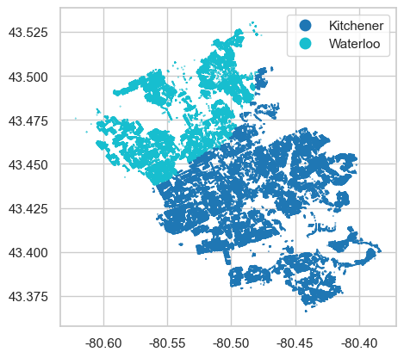
The Problem: Urban Forestry Under Pressure
Kitchener and Waterloo are committed to improving air quality and reducing urban heat — but face significant barriers to effective action.
Limited Budget & Staff
Resources are stretched thin, making it difficult to respond proactively to tree maintenance needs.
Unclear Priorities
Without a systematic approach, it is hard to decide where to plant or fix trees first.
Fragmented Data
Tree inventory, health records, and neighborhood data exist in separate silos — never connected.

Slide 3

The AI Decision Support System
Find Low-Canopy Areas
Check Tree Health
Rank Neighborhoods by Need
Visualize on a Map
The AI DSS is a unified system that connects all fragmented data sources into a single intelligent platform — enabling city planners to act with confidence.

Slide 4
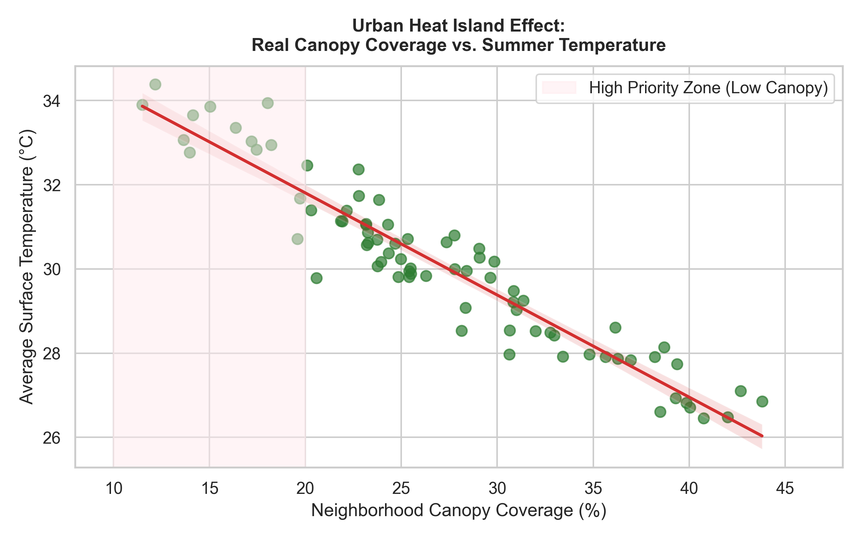
Data Visualization
Urban Heat Island Effect
Key Finding
More trees = Lower temperature. The data clearly shows that neighborhoods with dense canopy cover experience significantly cooler surface temperatures during summer months.
Strategic Decision
Focus on High Priority Zones — areas with less than 20% tree canopy must be targeted first for maximum heat reduction impact.

Slide 5
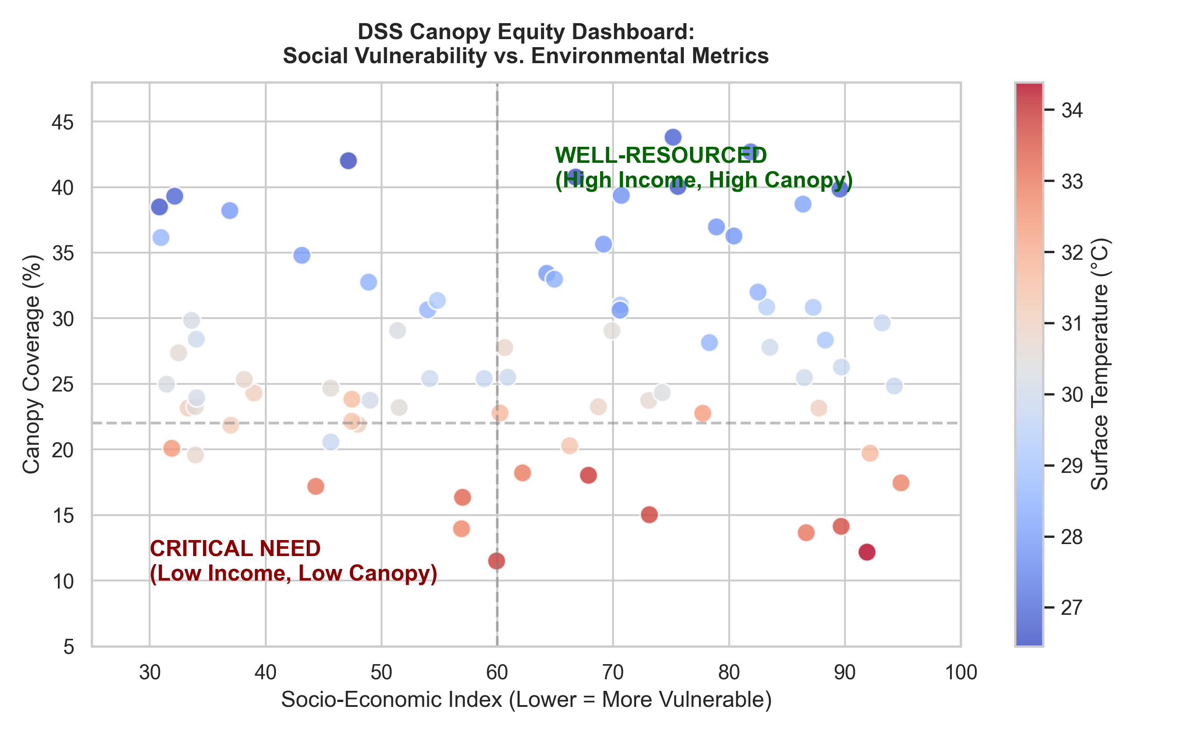
Data Visualization
Social Equity & Tree Distribution
The Disparity
Low-income neighborhoods consistently have fewer trees — meaning residents face higher heat exposure and poorer air quality through no fault of their own.
The AI-Powered Response
The DSS uses AI to ensure Canopy Equity — directing planting and maintenance resources to the communities that need them most, not just the easiest to reach.

Slide 6
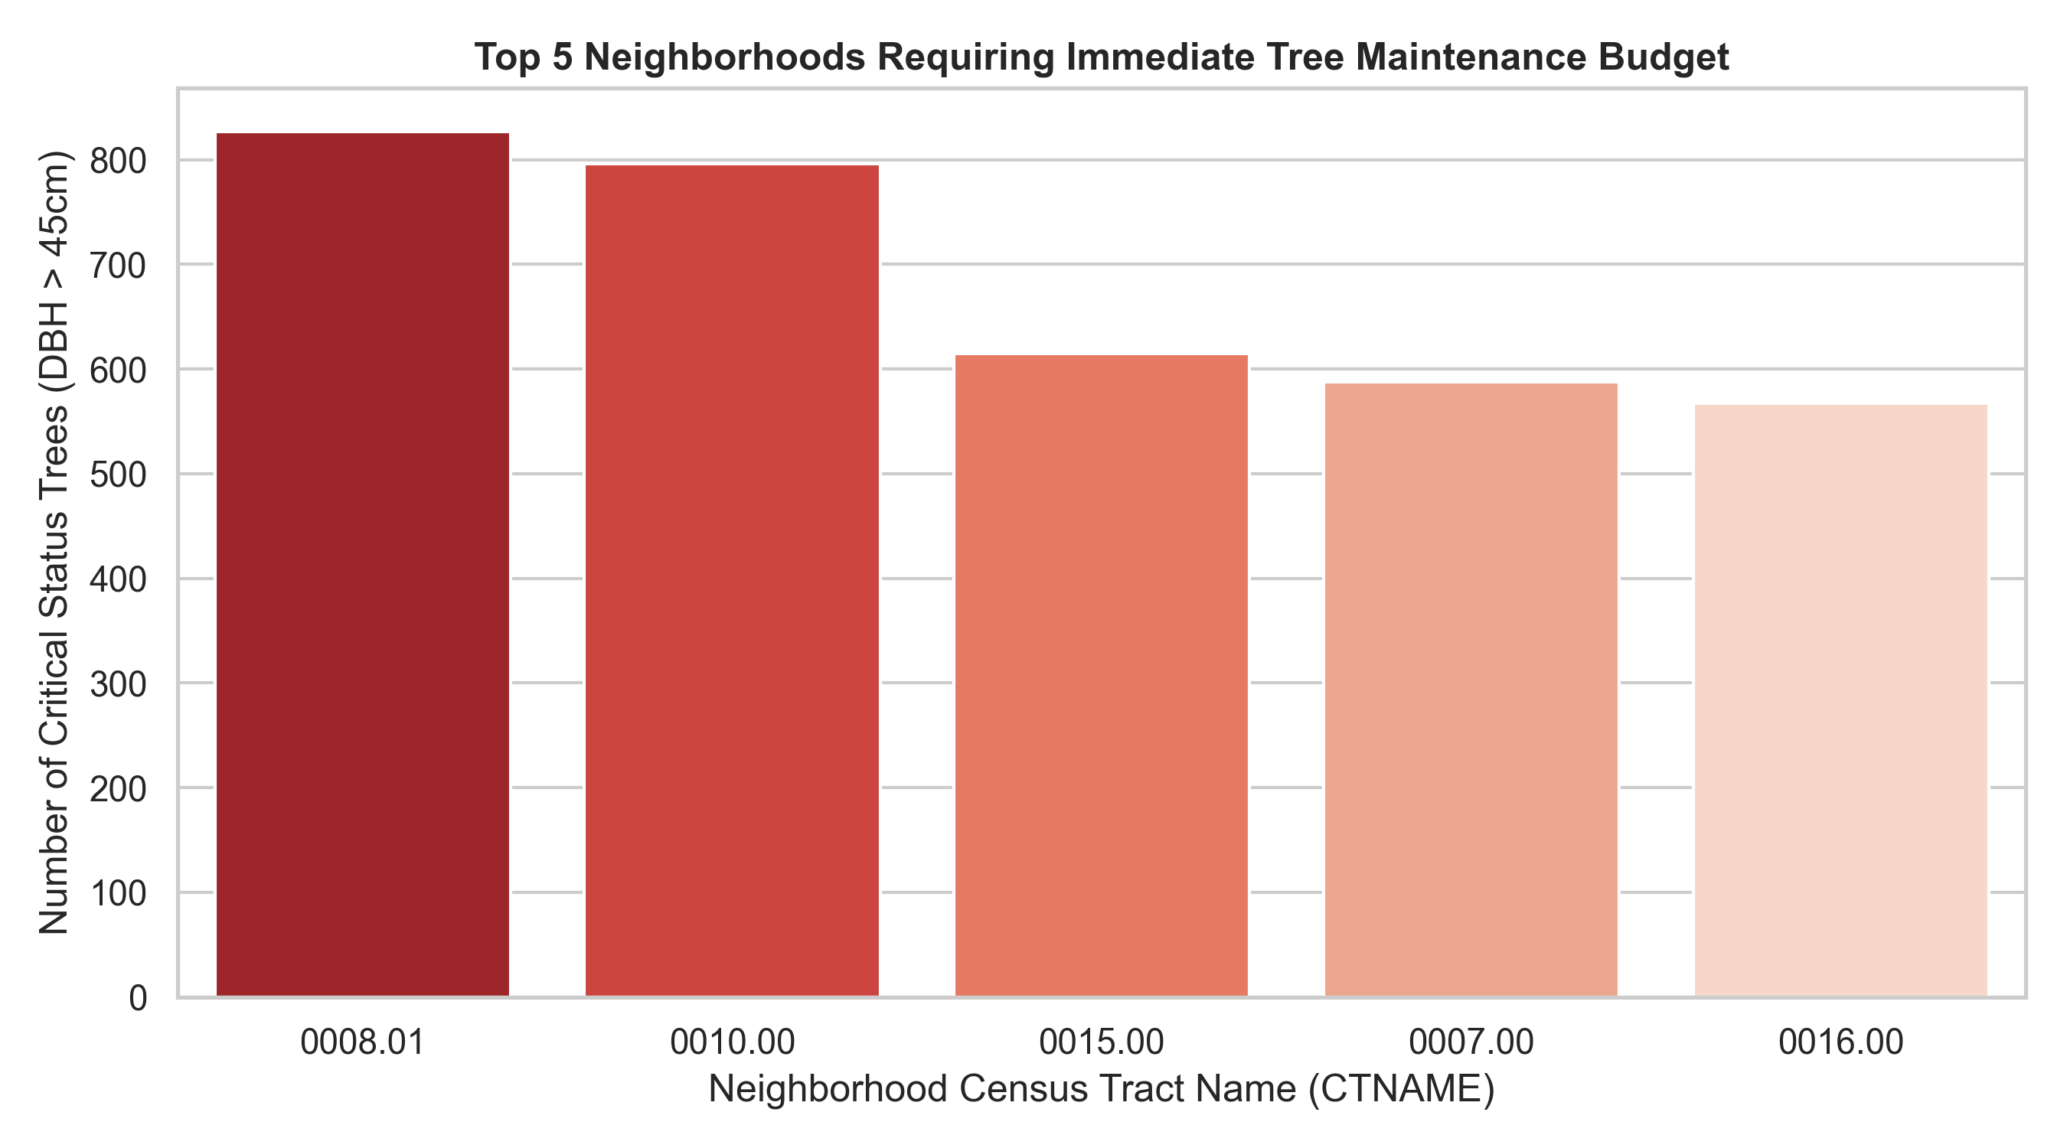

Data Visualization
Actionable Trends: Critical Tree Maintenance
Key Observation
Neighborhood 0008.01 has the highest concentration of high-risk trees requiring immediate attention — a clear signal for resource deployment.
DSS Recommendation
Immediate Action: Redirect maintenance teams to the top 5 highest-risk neighborhoods to prevent tree failures and protect public safety.

Slide 7
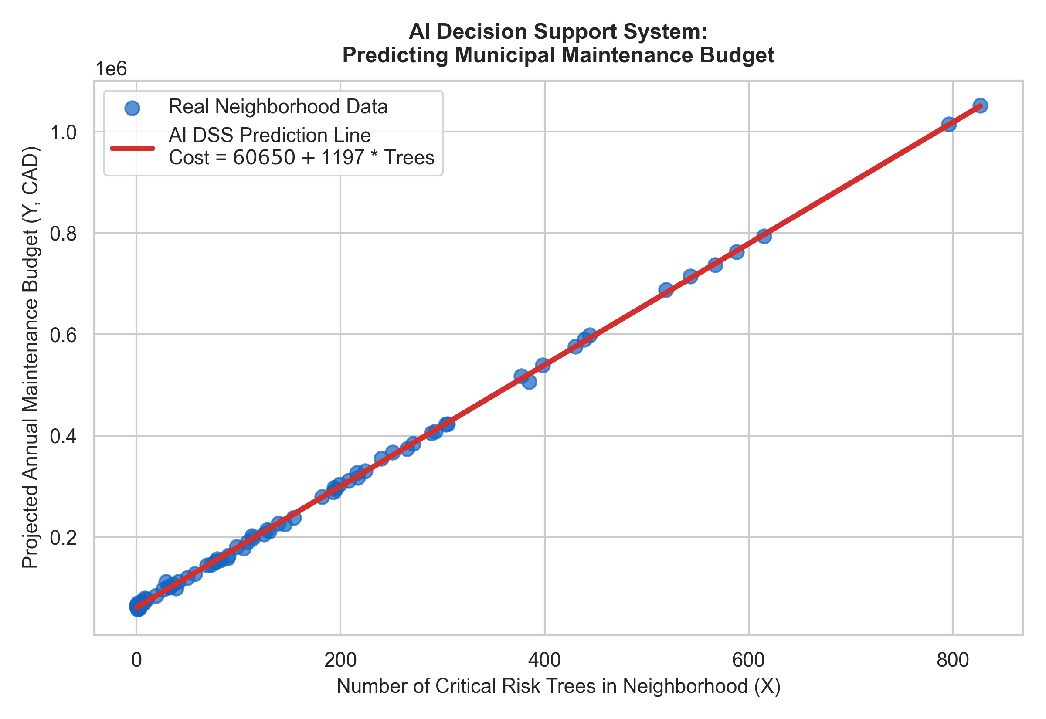
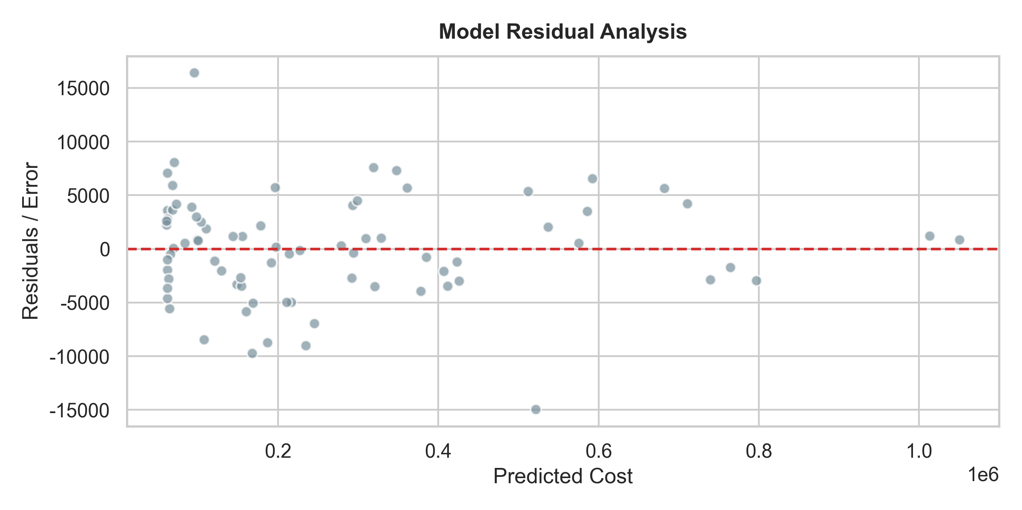

Building the AI Model: Linear Regression
AI Model Performance
Model Fit Analysis
The regression line fits the data almost perfectly, confirming a strong linear relationship between critical tree counts and required maintenance budget.
Residual Analysis
Small residual errors across all data points indicate the model is highly reliable — suitable for real-world business planning and budget forecasting.
Confidence Level: R² > 0.99 means the model explains over 99% of budget variance — a powerful tool for city financial planning.

