Slide 1
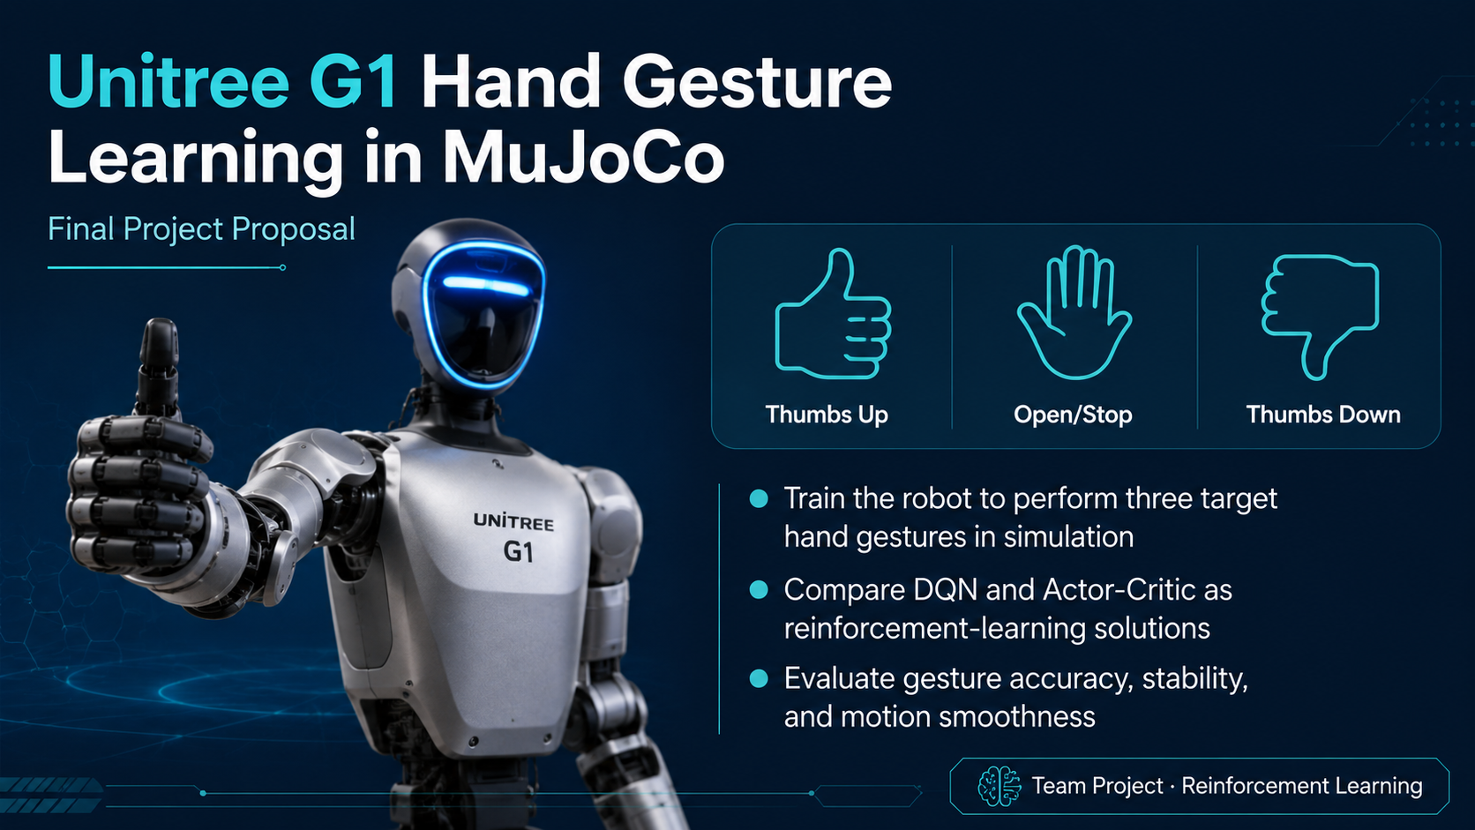
Team: Emmanuel • Liggia • Cemil • Chao

Slide 2
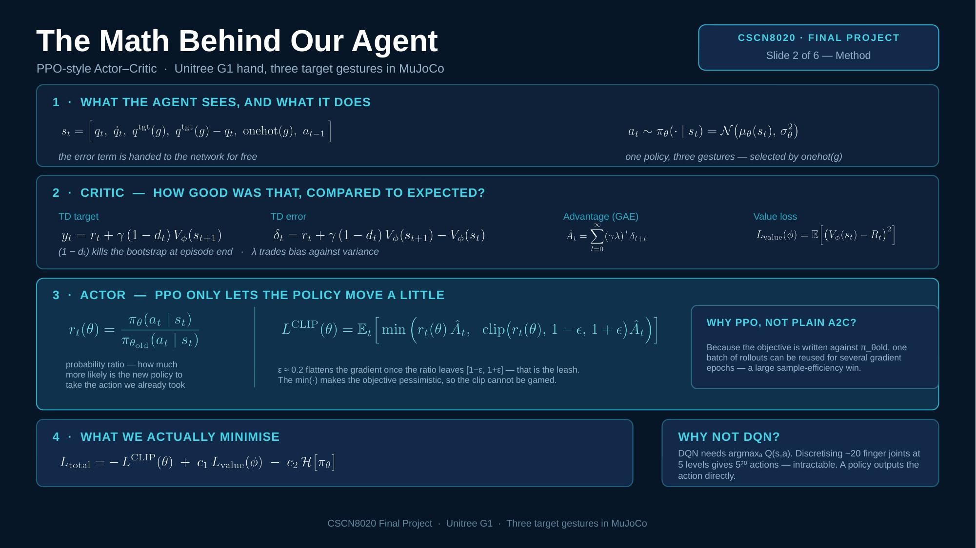
SLIDE 2 — MATH / ALGORITHM / CODE
Math → Algorithm → Code Mapping for PPO / Actor-Critic
The exact bridge David asked us to show during the next presentation.
Core equations
Current state
Actor policy
Selected action
Environmen t
Critic / target
PPO update
sₜ = [qₜ, q̇ₜ, q_target(g), q_target(g)-qₜ, one_hot(g), aₜ₋₁] yₜ = rₜ + γ(1-dₜ)Vϕ(sₜ₊₁) Âₜ = GAE(δₜ, γ, λ)
sₜ / obs
πθ(a|s)
aₜ
rₜ, sₜ₊₁
Vϕ, yₜ, Âₜ
losses
state vector + target
mu, std, action_dist
sample → scale / clip
reward + next_state
value, td_target, adv
actor / critic / entropy
Why PPO here? Continuous actions fit coordinated wrist-and-finger control better than discrete DQN actions.
What we will visibly show in the presentation and logs
Math concept
Algorithm step
Code variable / function
Visible evidence
Current state sₜ
env._get_obs()
obs / state
print normalized state + target ID
Actor policy πθ(a|s)
actor(obs)
action_dist, mu, std
print mean / std / sampled action
Reward + next state
env.step(action)
reward_total, next_obs
print reward components + next-state error
TD target / advantage
GAE or td_target - value_t
td_target, advantage
print V(sₜ), V(sₜ₊₁), advantage
PPO losses
ppo_policy_loss() / value_loss()
actor_loss, critic_loss, entropy
print loss values and update stats
CSCN8020 Final Project • Math → Algorithm → Code → Visible Log Evidence

Slide 3
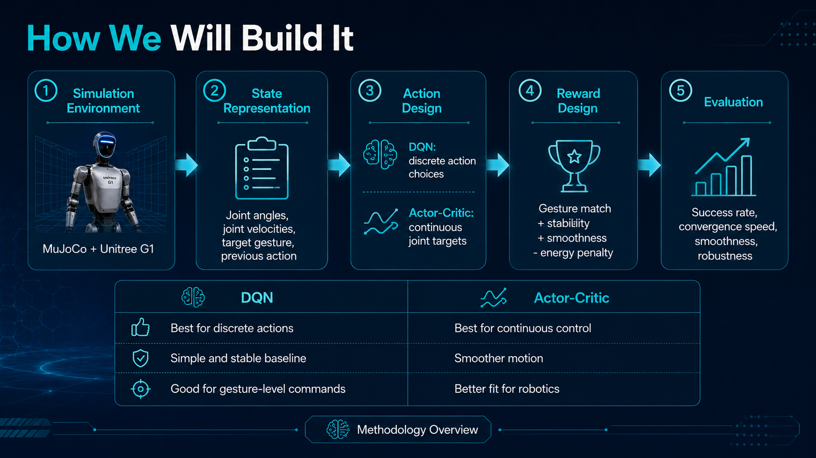
FINAL TARGET: PPO-style Actor-Critic

Slide 4
ROADMAP • DELIVERABLES • ROLES
Implementation Roadmap and Team Execution Plan
A disciplined plan from asset verification to a reproducible PPO result.
Phase-by-phase roadmap
Minimum viable deliverables
0. Model audit
verify the real three-digit hand, joint names, limits, and target poses
• one trained PPO / Actor-Critic checkpoint
• three verified target gesture poses and screenshots
• step_log.csv, update_log.csv, and episode_log.csv
• evaluation metrics + rendered demonstration video
• README, reproducible commands, and final report evidence
1. Environment migration
adapt the Assignment 3 environment to wrist + hand control
2. PPO skeleton
implement Actor, Critic, rollout buffer, GAE, and PPO updates
3. Logging + math mapping
print and store state, actions, values, targets, advantages, and losses
Team roles
Success metrics
• Emmanuel — math mapping, logs, presentation integration
• Liggia / Chao — environment + asset audit
• Cemil — PPO implementation + tuning support
• per-gesture success rate
• final pose + orientation error
• hold stability and smoothness
• joint-limit / safety violations
• wall-clock training time
4. Gesture-by-gesture training
debug each gesture before moving to one shared policy
5. Unified policy + evaluation
train on all three gestures and report success, smoothness, stability, and safety

Slide 5
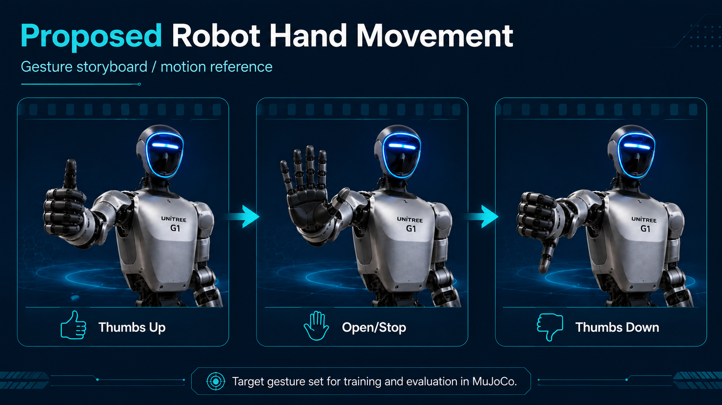
VISUAL TARGET GESTURE SEQUENCE
Animated motion reference (plays in slideshow mode)

