Slide 1
COMPUTERS

Slide 2
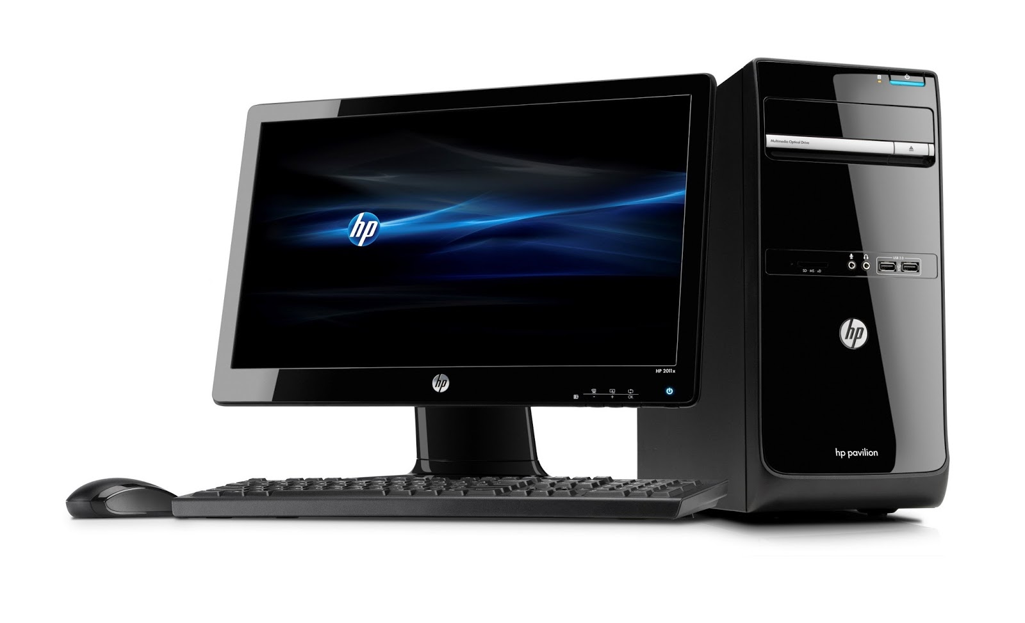
A computer is a machine that process data and supplies answer. Any machine which processes data and supplies answer is a computer for example washing machines, dishwashers, video recorders and personal computer.
Computers are not intelligent- they require a set of instruction called a program to perform a task.

Slide 3

A program is a series of steps a computer must perform on a set of data to supply answer. A program, or suit of programs, is sometimes a software. Hardware is a term used to describe the physical pieces used to make up a computer system. Computer are useful to us because they can perform task reliable and efficiently. To repeat the task just to re-run the program on a new set of data.

Slide 4

They are very efficient a computer can perform a set of repeated steps at breakneck speed- far more quickly than human could. Computers are reliable- running a program on the same set of data any numbers of times will always produce the same answer. They also allow us to have access to large amount of information at the touch of a button.

Slide 5
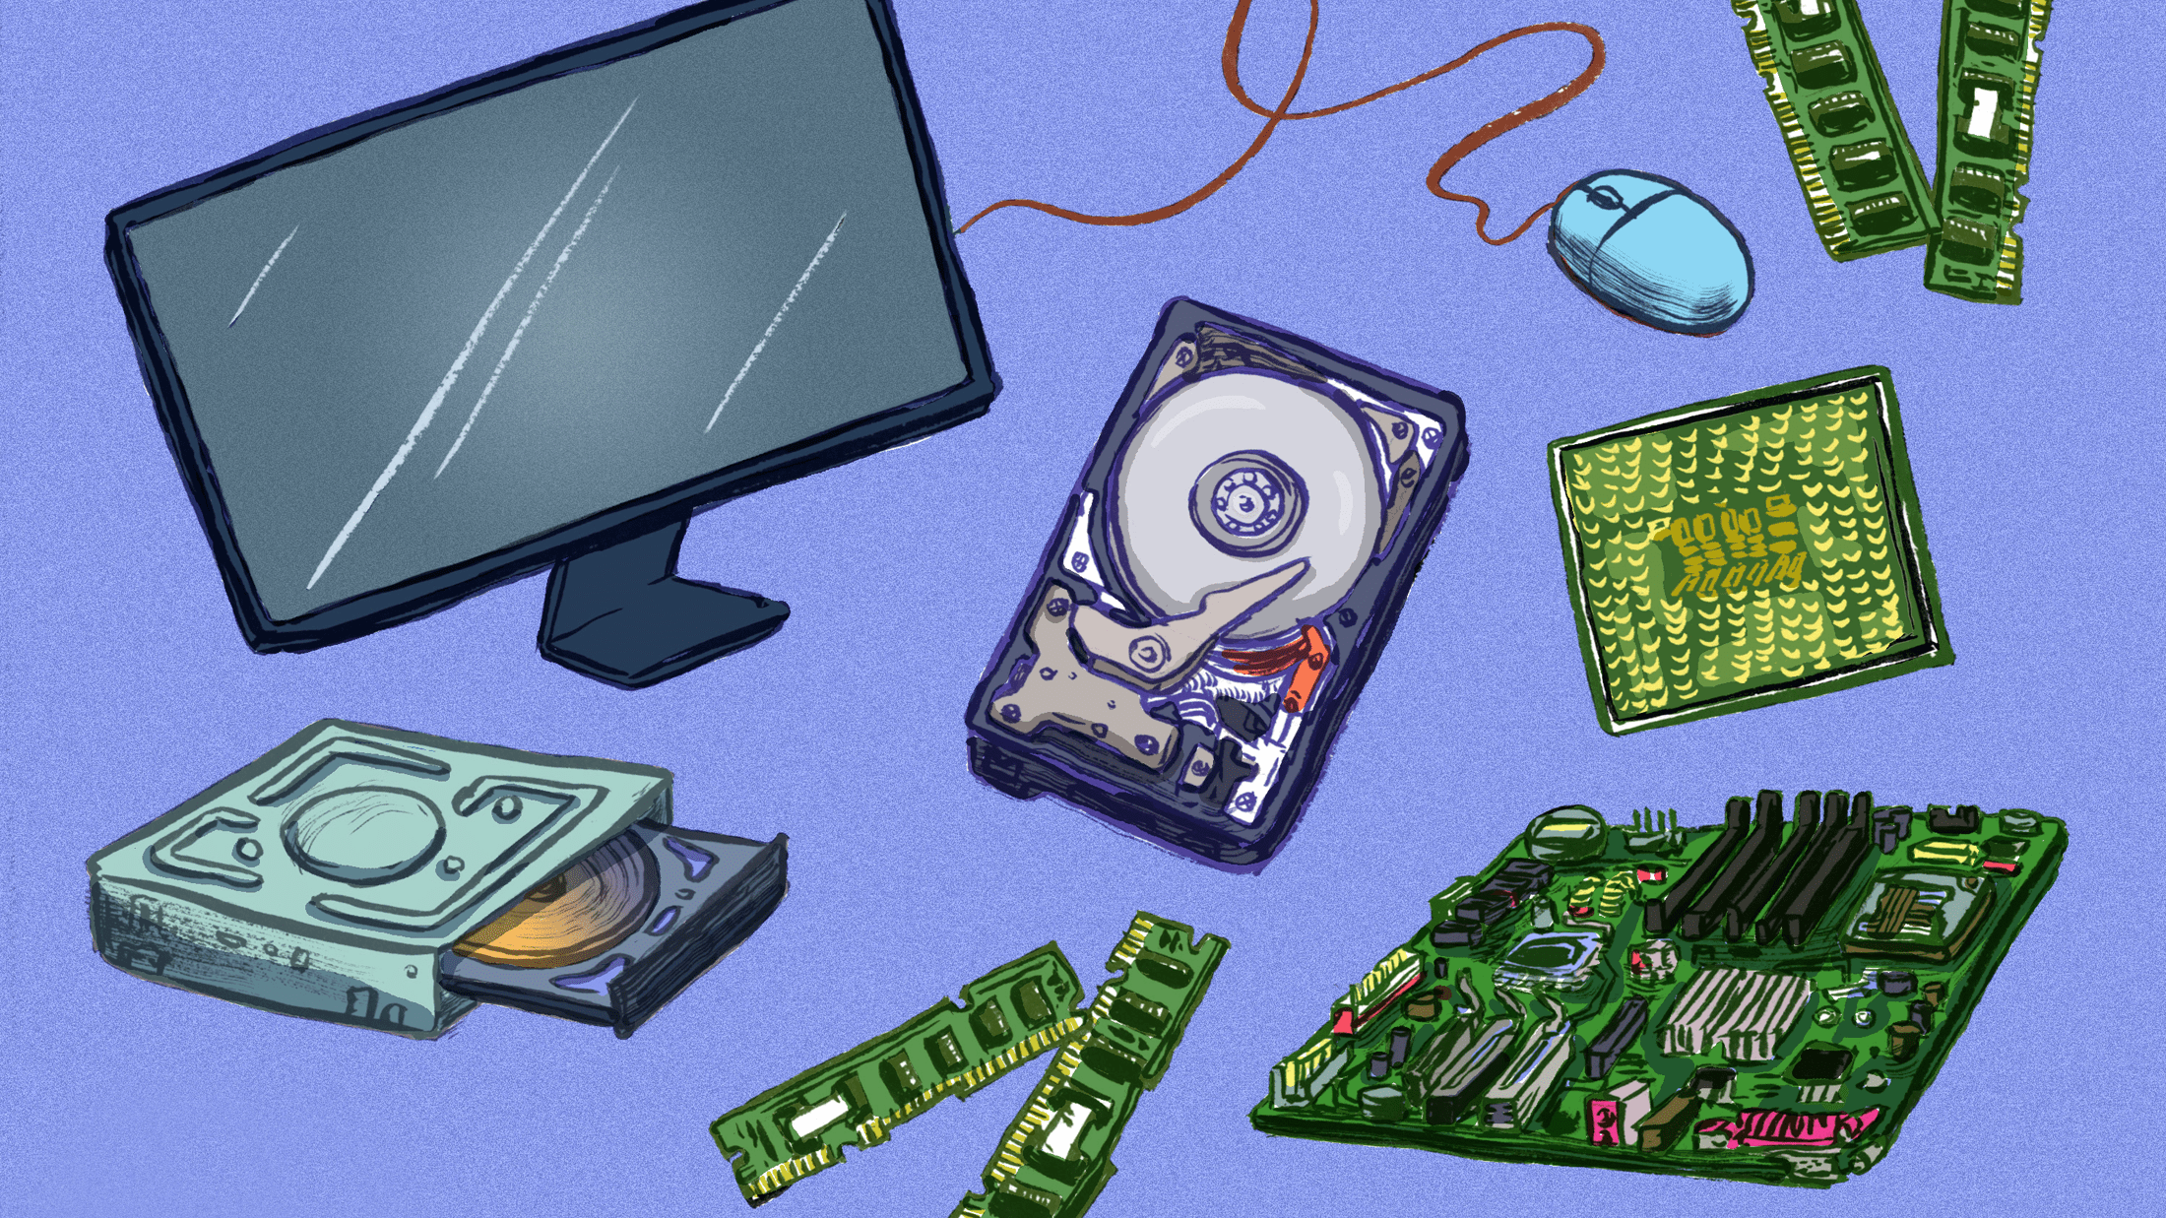
Hardware is a term used to describe the physical pieces used to make up a computer system. To repeat the task just to re-run the program on a new set of data.

Slide 6
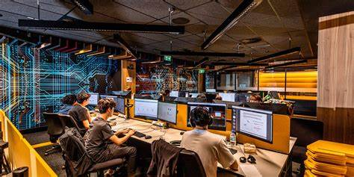
Computer system (as opposed to computers) often have use information storage capability which allow us to have huge stores of sorted and categorized information at our fingertips.

Slide 7


