Slide 1
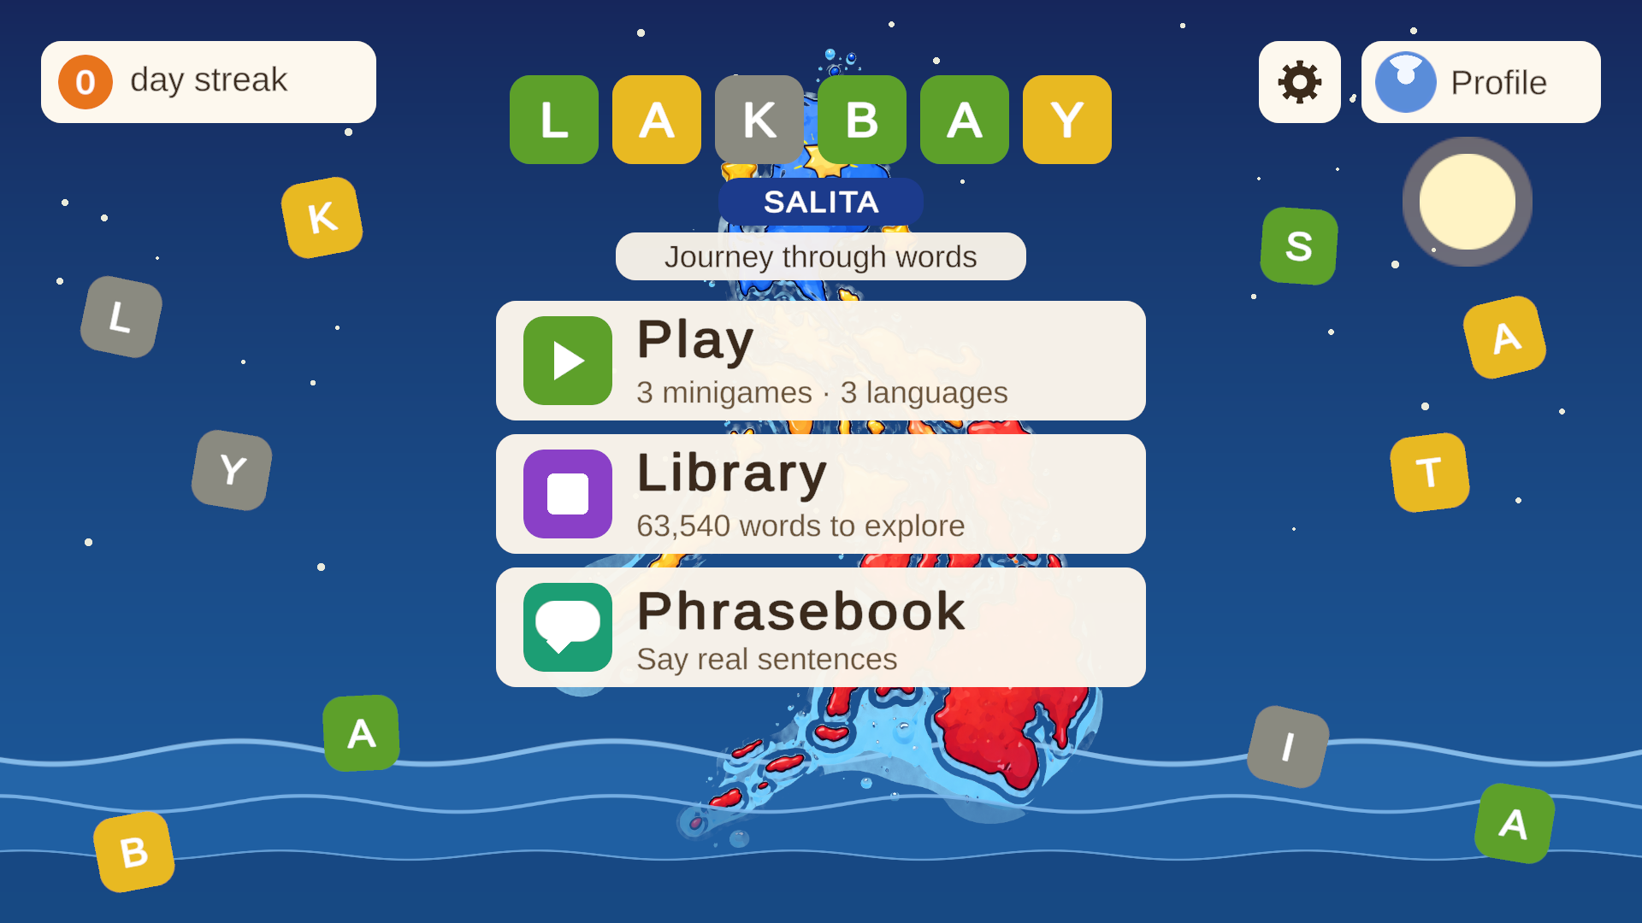
L
A
K
B
A
Y
Lakbay Salita
Journey through words: a 2D game for learning Cebuano, Ilonggo and Tagalog through puzzles, cards and real phrases
Project presentation · October 2026
Notes:
Welcome. This deck walks through the whole Lakbay Salita project: what the game is, every screen and feature, how it is built, and what is next.

Slide 2
What Lakbay Salita is
A word-learning game for Philippine languages. Players learn words on cards, practise them in three puzzle games, use them in real phrases, and look anything up in a built-in dictionary.
3
4
63,540
133
languages
activities
dictionary words
words per language
Cebuano, Ilonggo, Tagalog
Wordle, Crossword, Word Search, Phrasebook
searchable Library
shared by all three games
Built in Unity 2021.3 for Windows · 15 scenes · 97 C# scripts · 13 commits
Notes:
Quick numbers. Three languages, four activities, a 63,540-word dictionary, and one shared list of 133 words per language that every game draws from, so a word learned in one place appears in the others.

Slide 3




How a player learns: see it, play it, use it
1. Learn
2. Play
3. Use
4. Look up
Word cards show each word with its English meaning before the puzzle starts.
Wordle, Crossword and Word Search make the player recall and spell the words.
The Phrasebook and Sentence builder put the words into real sentences.
The Library dictionary answers any word, with favorites to revisit.
Teach the words first, then test them, then use them in a sentence
Notes:
This is the design idea behind every feature. A player who does not know the language needs to see a word, then be tested on it, then see it used in a sentence. Each step maps to a part of the game.

Slide 4
How the screens connect
Wordle topics
Learn cards
Play: language hub
Crossword topics
Result and next level
Puzzle
Word Search topics
Main menu
Library
Words you learned (saved favorites)
Phrasebook
Topics → Cards → Sentence builder
Profile · Settings
Every screen has a back button. Progress is saved after each puzzle, phrase and favorite.
Notes:
The main menu is the hub: Play opens the language hub with the three games, Library opens the dictionary, Phrasebook opens the phrase topics, Profile and the gear settings sit in the corner. Each game goes topic picker, optional learn cards, the puzzle, then a result screen.

Slide 5
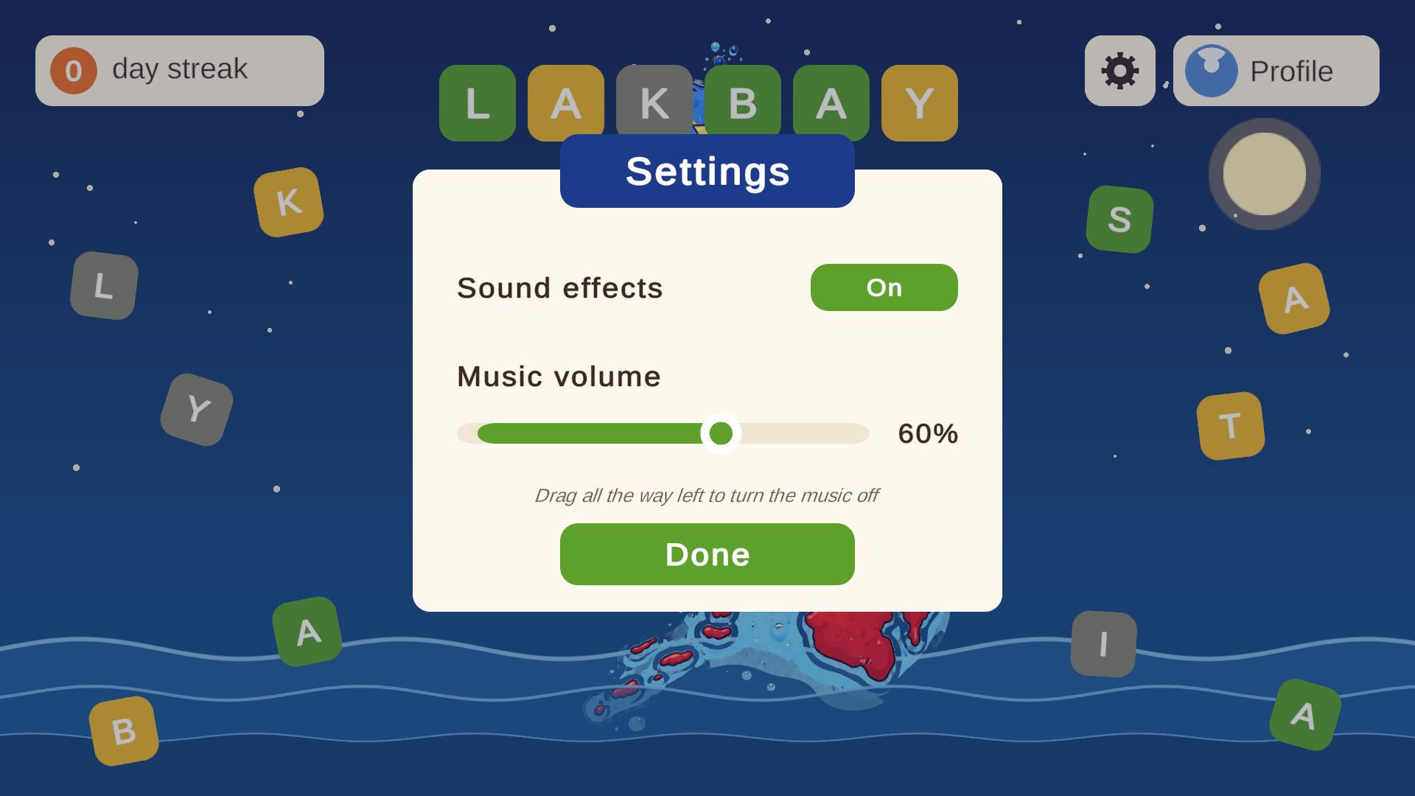
Main menu and settings
Main menu: Play, Library, Phrasebook
Gear settings window
Three big buttons: Play (3 minigames, 3 languages), Library (63,540 words) and Phrasebook (real sentences)
Profile shows the avatar and day streak; the gear opens settings
Settings: sound effects on or off, and a music volume slider
Notes:
The main menu animates letter tiles and a day streak counter. The gear opens a small settings window: sound effects on or off, and music volume. Dragging the slider to zero turns the music off.

Slide 6
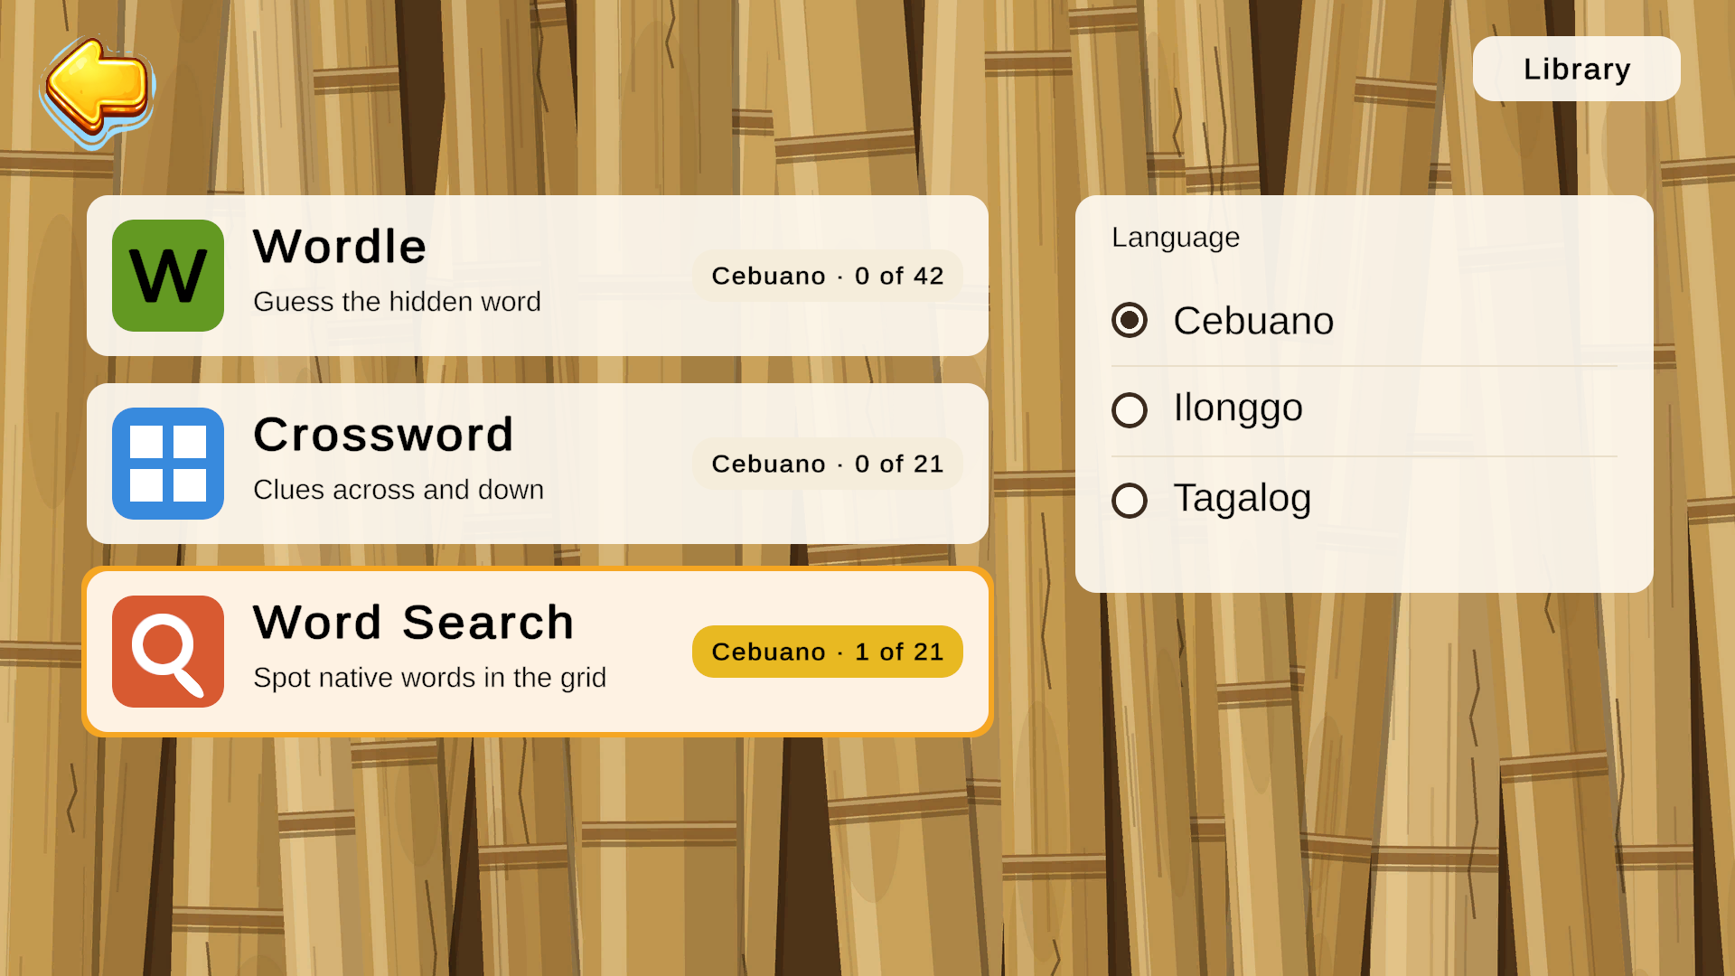
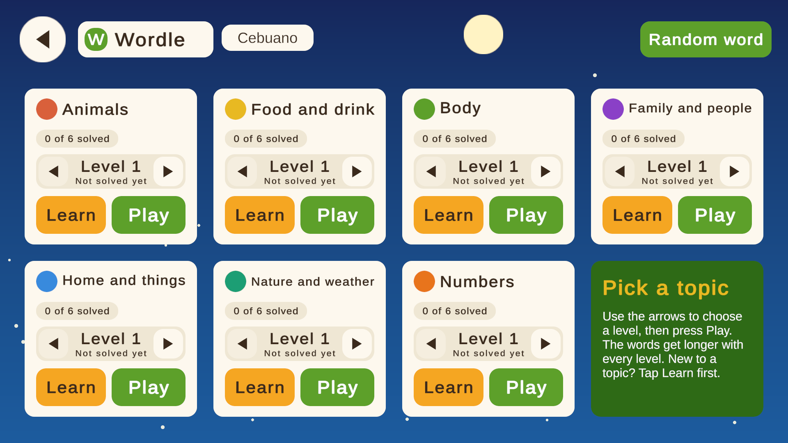
Language hub and topic pickers
Pick a game and a language
Seven topics, six levels each
The hub shows all three games with how many puzzles are solved in the chosen language
Seven topics: Animals, Food and drink, Body, Family and people, Home and things, Nature and weather, Numbers
Each topic has Learn (word cards) and Play, with a level picker that gets harder
Notes:
Choose the language once, then a game. Each topic has a Learn button for the word cards and a Play button. Levels inside a topic get longer words as the player advances. A Random button picks a puzzle for you.

Slide 7

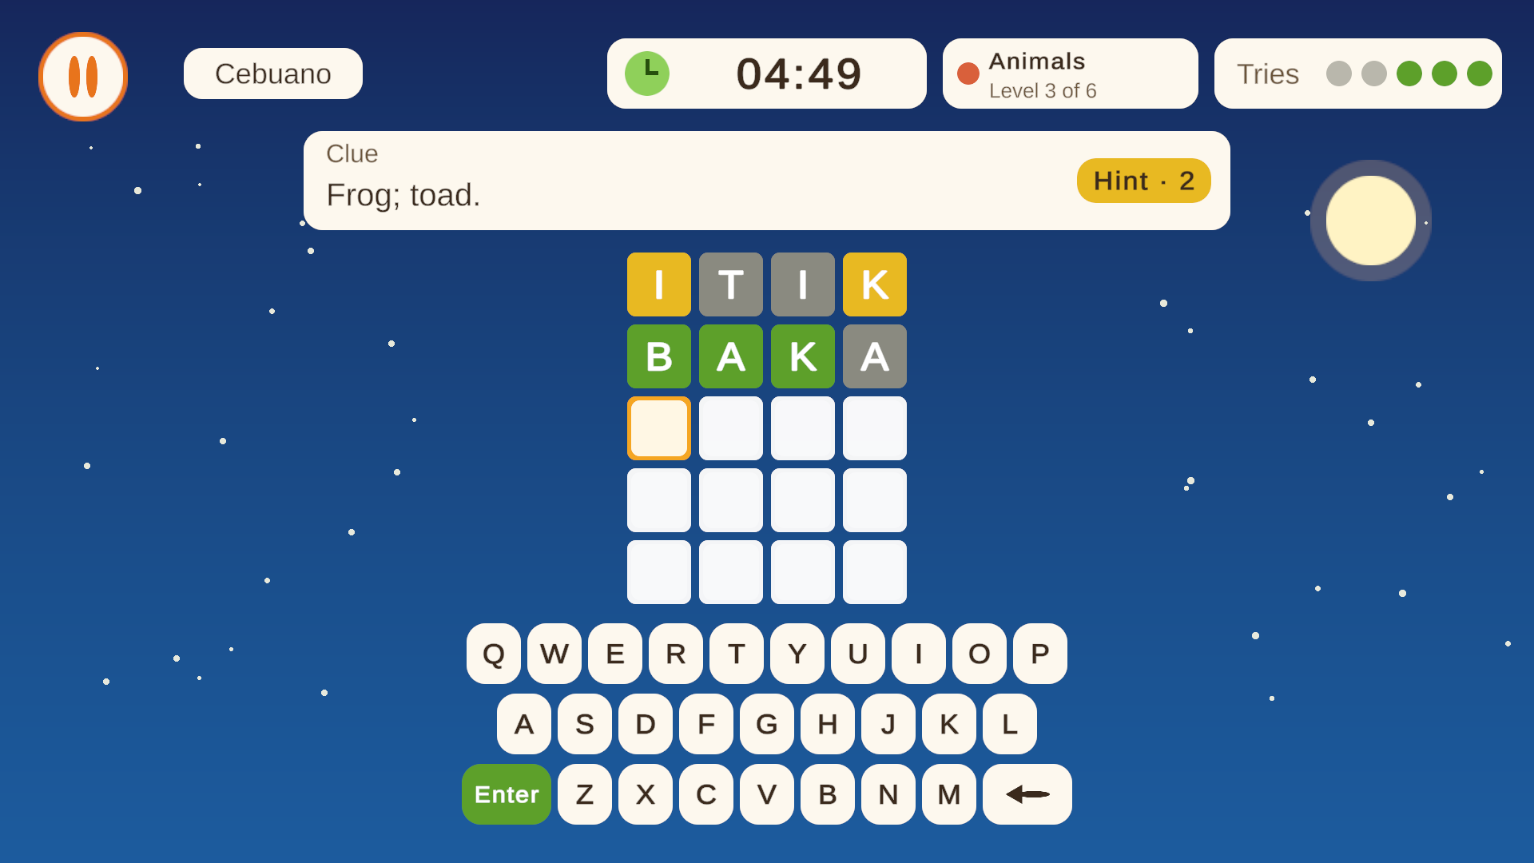
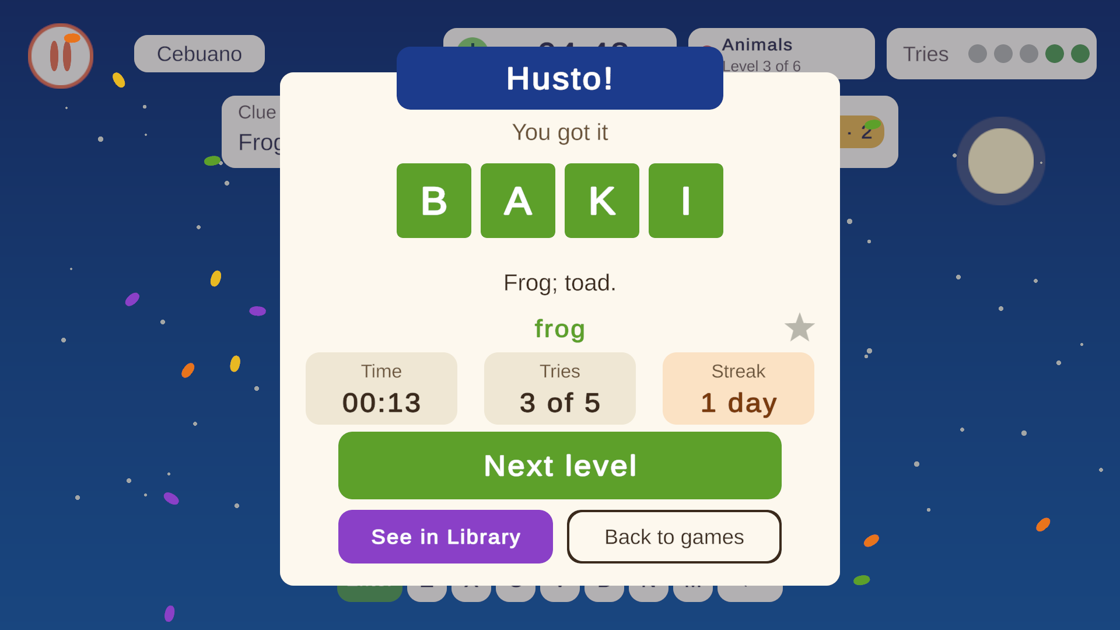
Wordle: guess the hidden word
Letter-by-letter feedback
English clue on top; limited tries and a timer
Green and yellow tiles show right letters
Hint button tells which column a letter is in
On-screen keypad, or the physical keyboard
42 levels per language (7 topics x 6 levels)
A solved level is saved; Next level moves straight on
Playing
Result: time, tries, streak
After every win: the word, its meaning and a star to save it to the Library
Notes:
Wordle: the clue is English, the answer is in the chosen language. Hints say which column holds a letter. The keypad no longer colours letters, so players must think. After a win the result card shows the word, the English meaning and a star to save it.

Slide 8

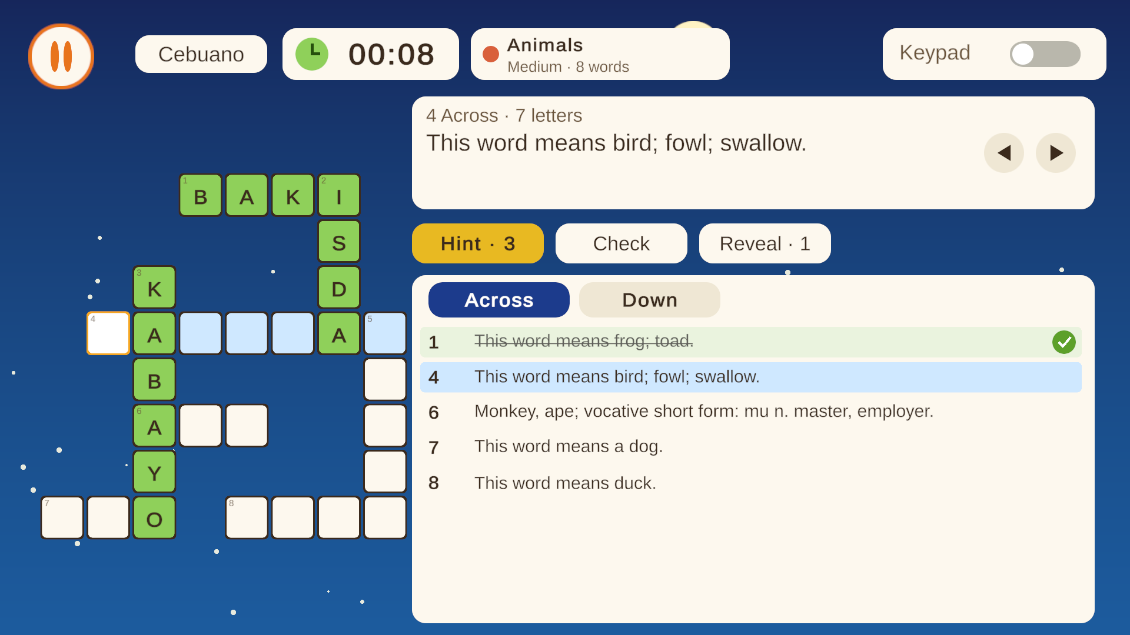
Crossword: clues across and down
Fill the grid from clues
Across and Down clue lists; tap a clue or a cell
Check marks wrong letters; Reveal shows a word
Hint tells the next letter
Clue text is the shared English meaning
21 puzzles per language in three sizes
Crossword puzzle in play
Notes:
Crosswords use the same word list as Wordle. The clue list is on the right; the active word is highlighted. Check, Hint and Reveal help a stuck player.

Slide 9
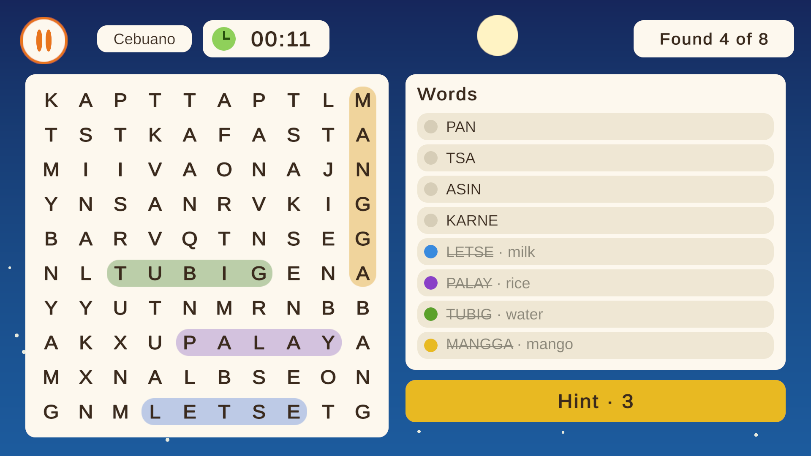
Word Search: spot native words
Drag across the letters
Drag to select a word in any direction
Found words are crossed out and show the English meaning
Hint highlights the first letter of a word
Counter shows 'Found 4 of 8'
21 puzzles per language, 8 words each
Word Search with four words found
Notes:
In Word Search the player sees native words in a list and finds them in the grid. When a word is found it turns coloured and the English meaning appears next to it, so finding it also teaches it.

Slide 10
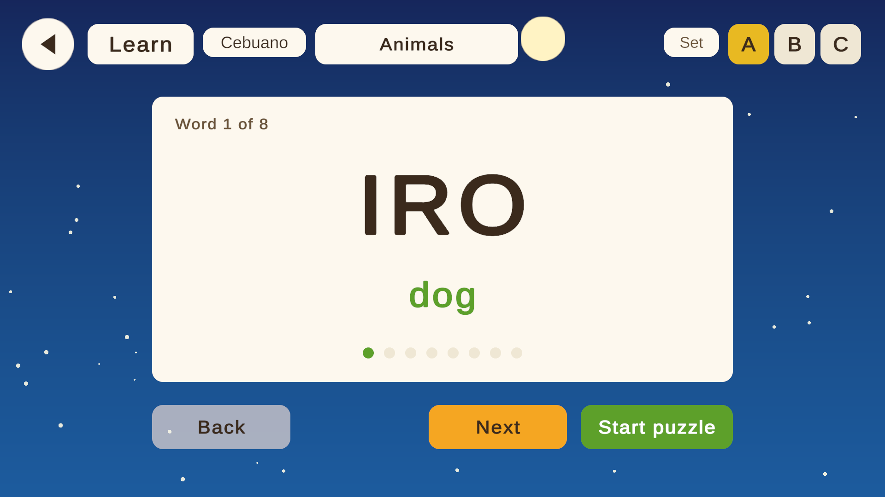
Learn cards: see the word first
Teach before testing
One card per word: the word big, the English below
Next / Back, and a progress dot for each word
Start puzzle goes straight into the game
Every topic has Learn and Play, so cards are optional
Cards cover the same words the puzzle uses
Learn card for a Cebuano word
Notes:
Learn cards fix the problem of testing words a player has never seen. Each topic's words are shown first with their meaning. The cards are optional so experienced players can skip them, but a brand new player can learn first and then play.

Slide 11
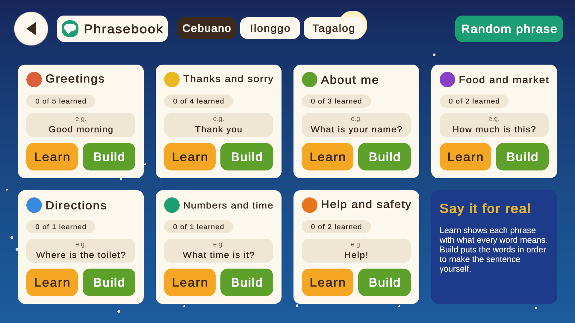
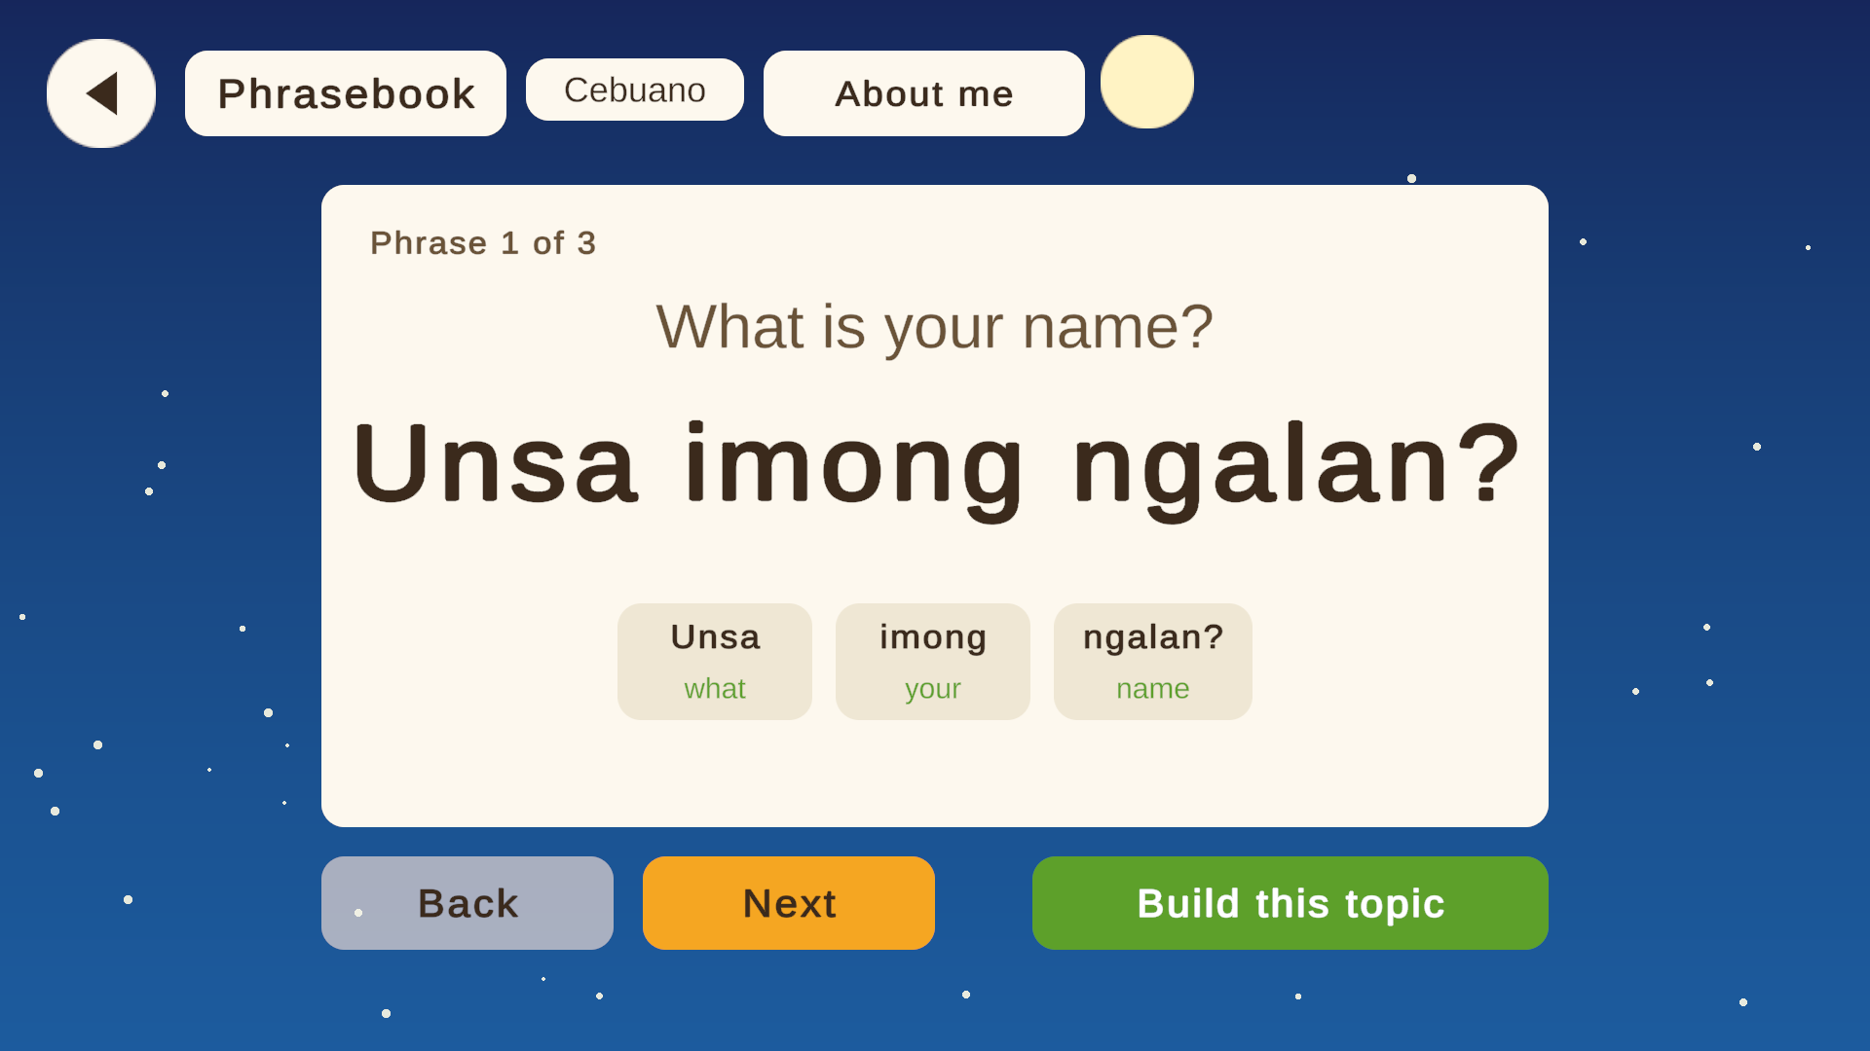
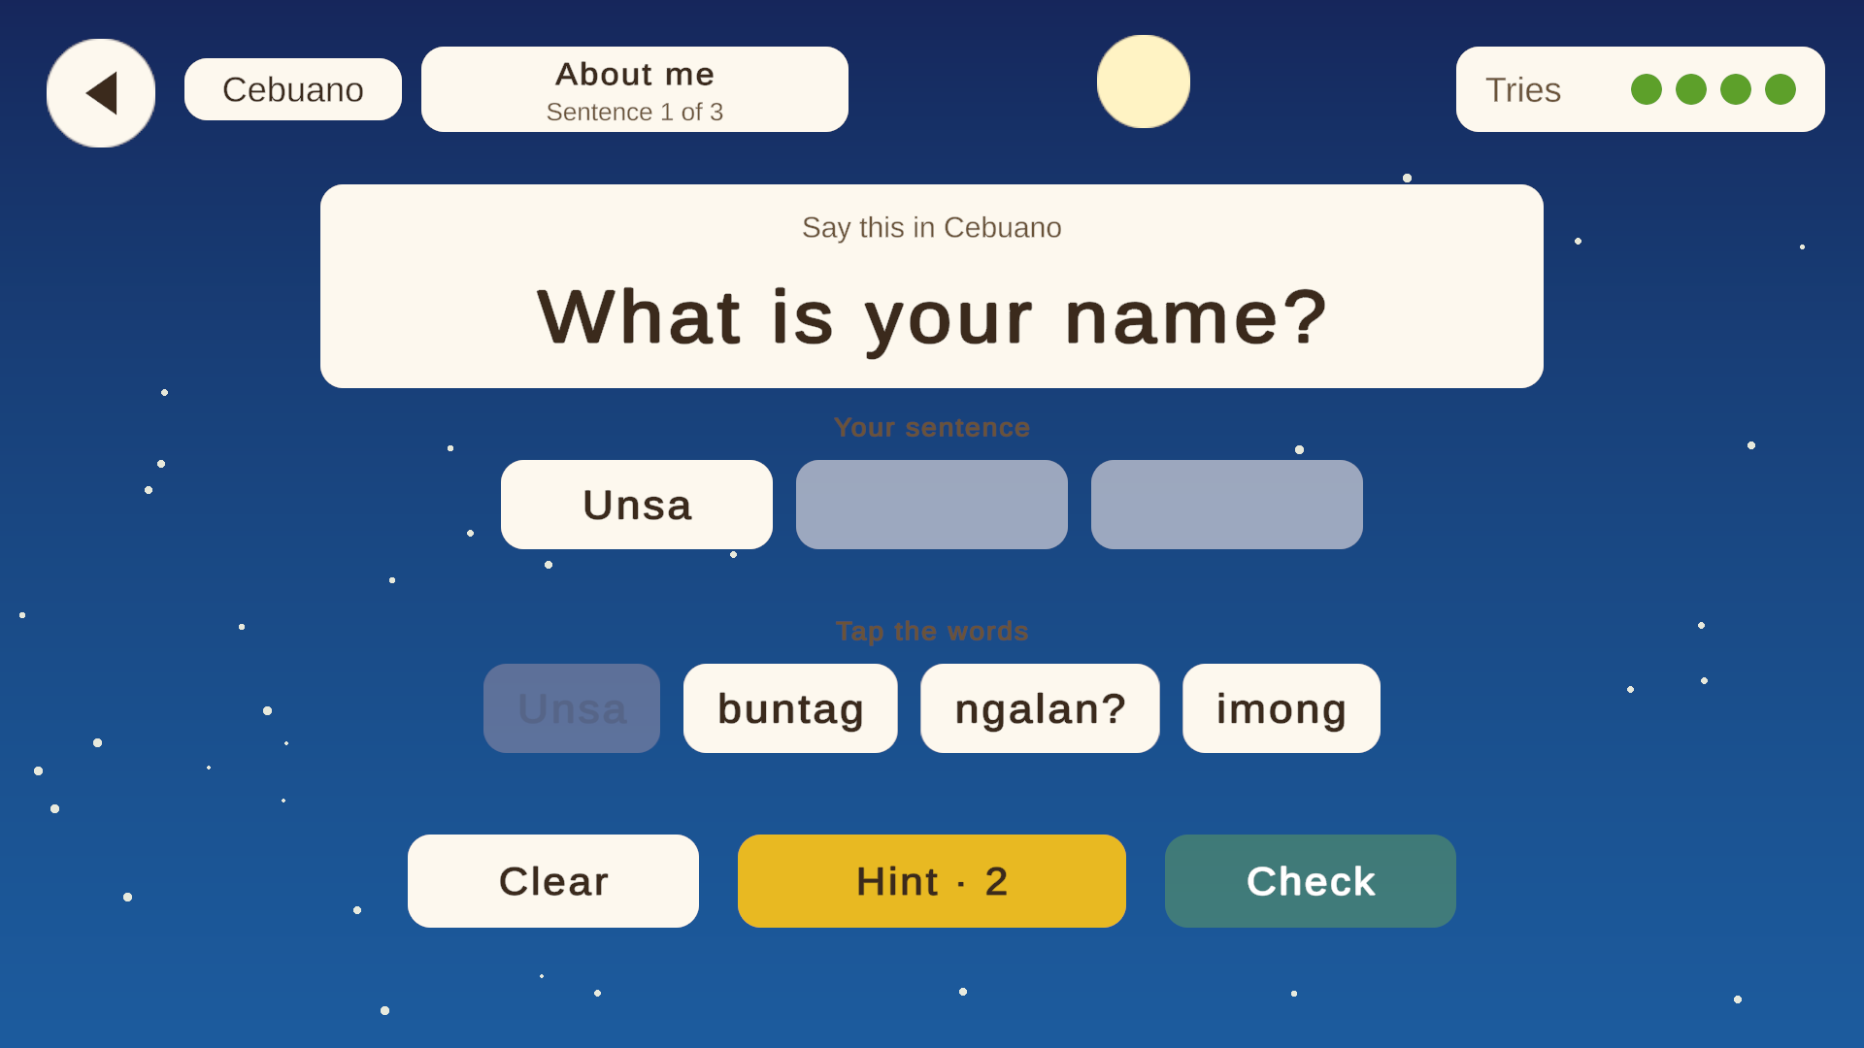
Phrasebook and Sentence builder
Topics, with its own language chips
Phrase card
Sentence builder
Seven topics: Greetings, Thanks and sorry, About me, Food and market, Directions, Numbers and time, Help and safety
53 phrases in total: 18 Cebuano, 17 Ilonggo, 18 Tagalog
Learn shows a phrase word by word; Build puts the words in order from a tile bank
Phrases the player builds correctly count as learned and show on the Profile
Notes:
The Phrasebook teaches words in use. Open it from the main menu, choose the language with the chips, and pick a topic. Learn shows the English sentence, the native phrase and a gloss of each word. Build asks the player to assemble the sentence from word tiles, with a Hint and Check.

Slide 12

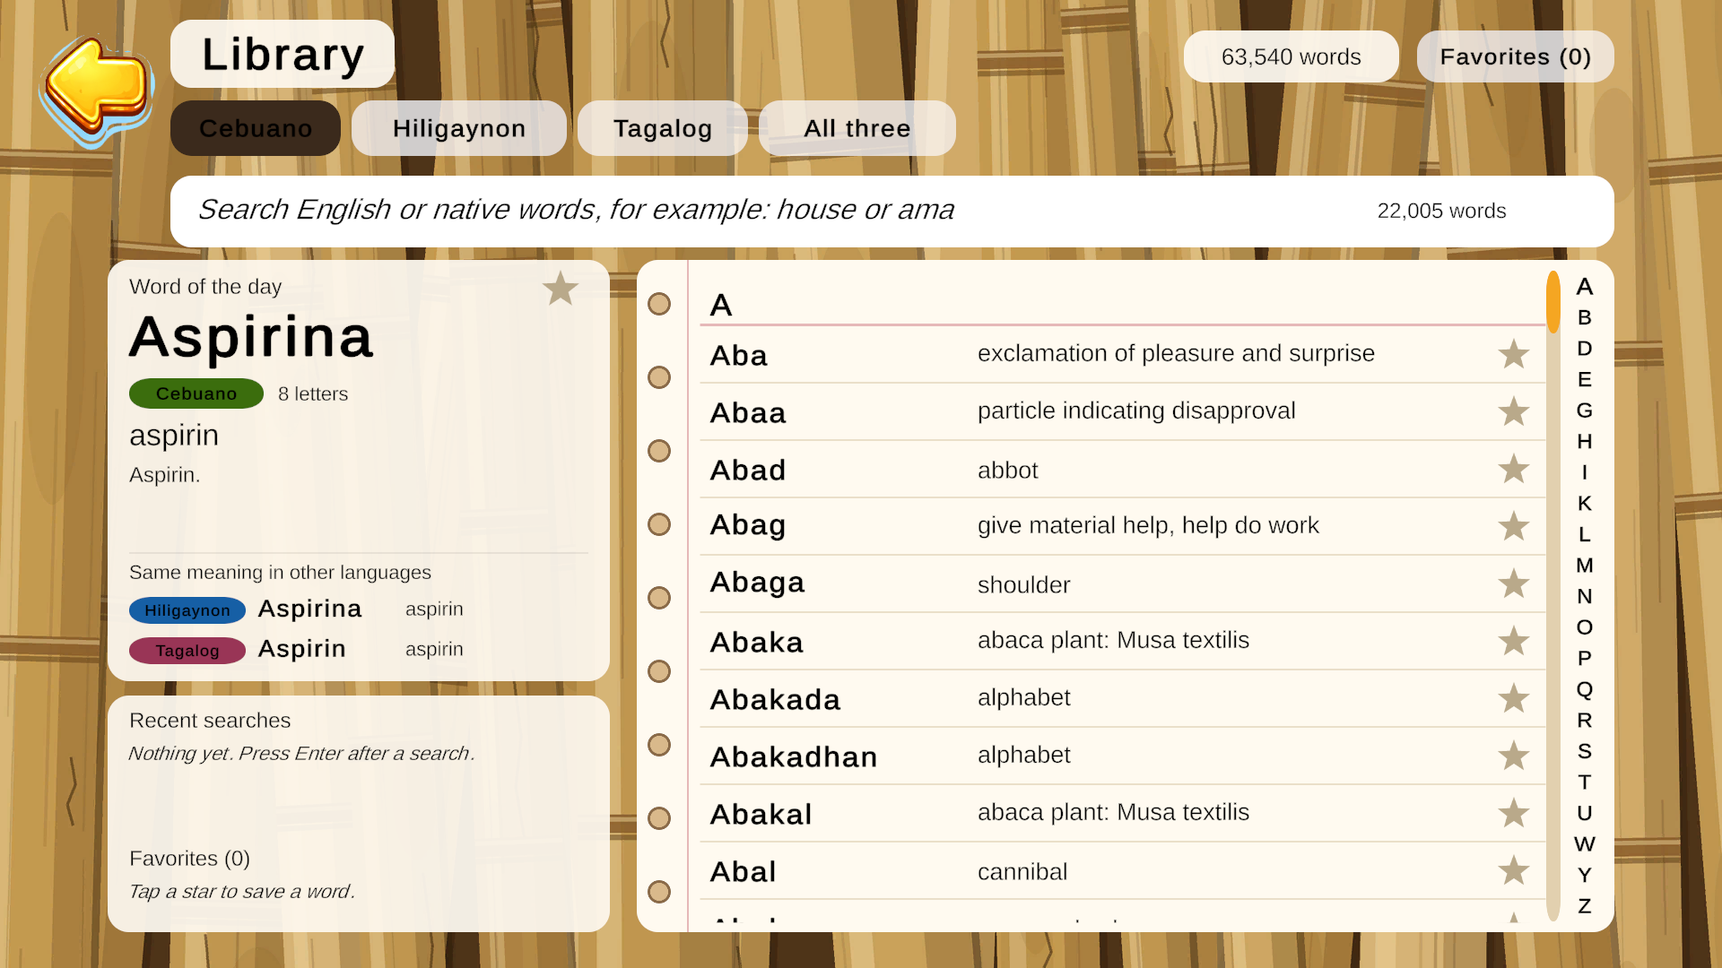
Library: a 63,540-word dictionary
Look up any word
Search English or native words (for example: house or ama)
Filter by Cebuano, Hiligaynon, Tagalog or all three
A to Z index and a word of the day
Same meaning in other languages shown side by side
Star words to keep favorites; recent searches are remembered
Library with the word of the day
Notes:
The Library is the reference part of the game. It holds the full dictionary data, lets the player compare the same word across languages, and keeps favorites from the Learn cards and puzzle results.

Slide 13

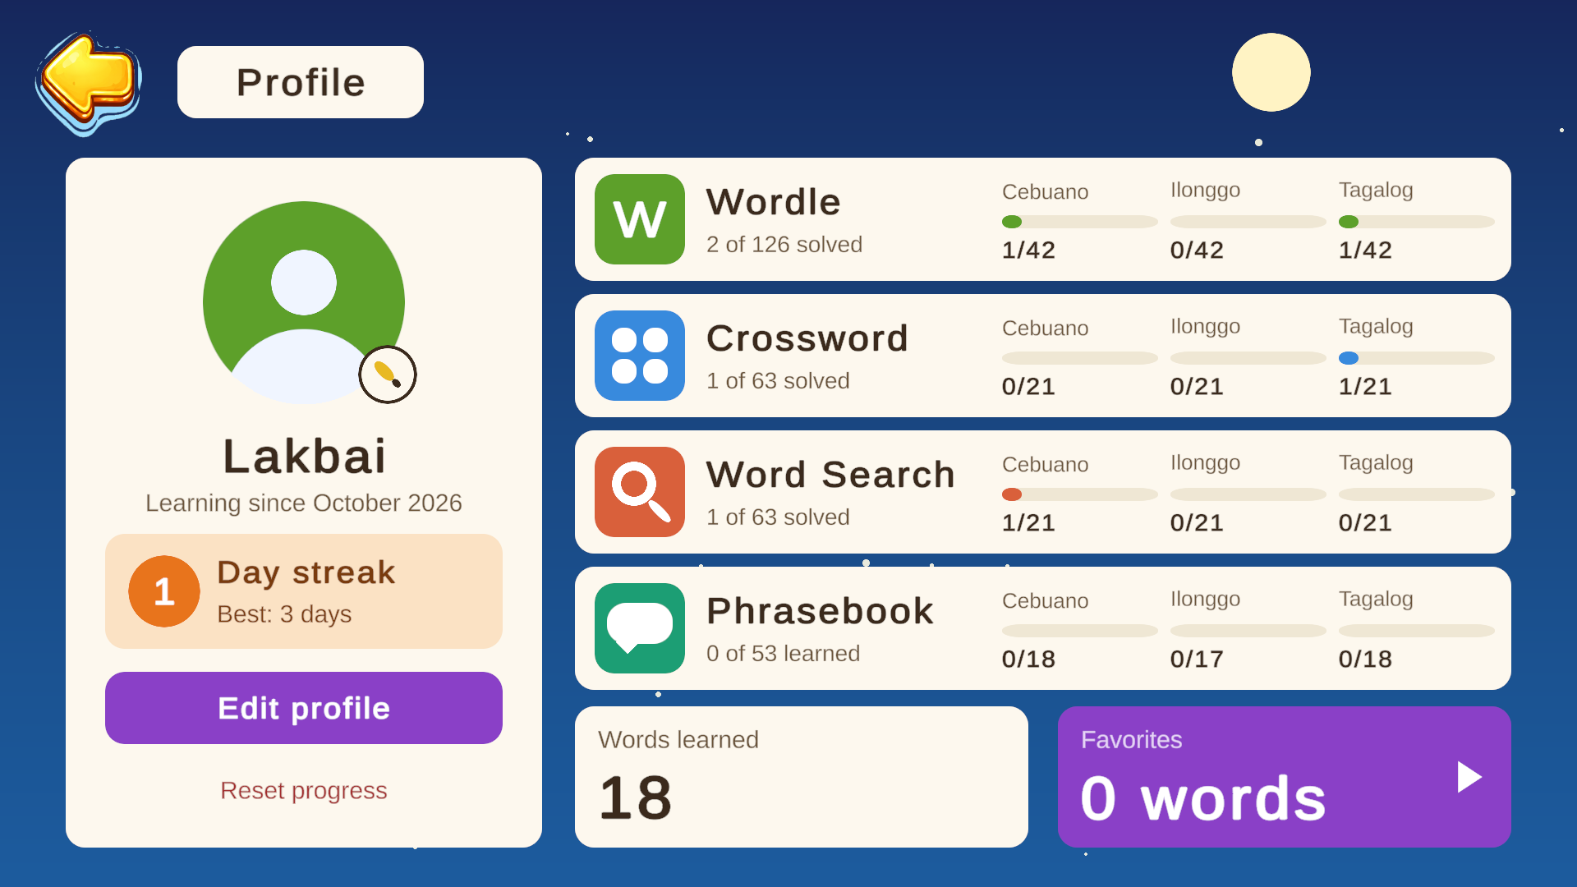
Profile: progress at a glance
Track what you have done
Name, avatar and learning-since date
Day streak counts days played in a row
One row per game with a bar for each language
Words learned and Favorites cards
Edit profile, or Reset progress
Profile with sample progress
Notes:
The profile reads the saved progress of every game. Each row shows solved puzzles out of the total for each language, and the Phrasebook row counts phrases learned. The numbers shown here are sample data from a test run.

Slide 14




Sound and settings
7
25
2
Off
music tracks
sound effects
switches
Tap to hear
background music with a volume slider
plus a click on every button
sound effects on/off and music volume
built, waiting for voice recordings
Button sounds are added by one self-creating script, so every button in every scene gets one
Tap to hear plays a word's recording when the player taps it. It needs 551 recordings, so it is switched off until they exist
Notes:
Audio: seven music tracks and 25 sound effects. A single SoundEffects script gives every button a click, so no scene needs wiring. Tap to hear is fully built but disabled because there are no recordings yet; the list of 551 words to record is in the Mockups folder.

Slide 15


Content and data
Data-driven
Needs a native speaker
Every puzzle and phrase lives in a JSON file, not in code
One registry lists which files each game loads
Wordle, Crossword and Word Search share one 133-word list per language
Adding a level or a language means adding data, not rebuilding scenes
Word lists and Phrasebook phrases are drafts and have not been checked by a native speaker
Some clues come straight from the dictionary and read roughly
Answer lists are saved in the Mockups folder for review
Quality of the language is the most important thing to check before release
Notes:
Be honest about content. The structure is solid, but the words and phrases were prepared without a native speaker. Getting reviewers for Cebuano, Ilonggo and Tagalog is the most valuable next step.

Slide 16
Under the hood
Scenes
15 scenes: menu, hub, three games (topic pickers and play), Library, Profile, Learn, Phrasebook x3
Tech
Unity 2021.3.45f2
uGUI and TextMeshPro
Windows build: Lakbay-Salita.exe
GitHub: main and sub branches
Scripts
97 C# scripts, grouped by feature: Core, Menu, Wordle, Crossword, Word Search, Learn, Phrasebook, Audio
Data
JSON puzzle files, LevelDataRegistry, the 63,540-word dictionary, saved progress in PlayerPrefs and player_data.json
Editor tools
Builder scripts rebuild screens from code, so a design change is one menu click
Progress stays on the player's computer; the game needs no internet connection.
Notes:
Technically the project is a Unity uGUI game. Screens are built by editor tools from code, which keeps the design consistent. All puzzle content is JSON. Progress is saved locally, so no server is needed.

Slide 17
Screen sizes: windowed and maximized
Maximize
1920 x 1080 full screen window
Default and largest window
1024 x 768
Smallest window
800 x 600
In a window the game can be 800 x 600 up to 1024 x 768; if dragged outside, it snaps back
Pressing Maximize switches to a 1920 x 1080 full screen window; Alt+Enter returns to the 1024 x 768 window
Every screen is designed in 16:9, so in a 4:3 window it is letterboxed with dark bars and nothing overlaps
Notes:
The window rules: minimum 800 by 600, default and maximum 1024 by 768 in windowed mode. Maximize goes to full screen 1920 by 1080. Because the art is 16:9, a 4:3 window shows black bars top and bottom rather than stretching. The maximize behaviour has been checked in the editor but still needs a test in a real Windows build.

Slide 18

Where the project stands
Working today
Still open
Main menu, language hub, gear settings and Profile
Wordle, Crossword and Word Search in 3 languages
Learn cards, Phrasebook and Sentence builder
Library dictionary with search and favorites
Music, sound effects and button sounds
Window limits and 1920 x 1080 maximize
Native-speaker review of words and phrases
Voice recordings for Tap to hear (551 words)
Test the maximize behaviour in a built .exe
Sound effects for game events (win, wrong letter)
More levels and difficulty per language
Notes:
The game is playable end to end. Open items are mostly content: language review and recordings. Technical items are small: a build test for maximize and optional event sounds.

Slide 19
Roadmap: next steps
1
Now
2
Next
3
Then
4
Later
Review and fix
Make it speak
Make it grow
Share it
Native speakers check the 133 words and 53 phrases per language; test a Windows build
Record or generate audio for the word list and switch Tap to hear on
More levels and topics, review of missed words, event sound effects
Playtest with real learners, polish, and publish the build
Notes:
Suggested order. First make sure the language is correct, then add voice, then grow the content, then put it in front of learners. Dates are not fixed.

Slide 20
S
A
L
A
M
A
T
Thank you
Questions and feedback welcome
github.com/cabaldanjehoshaphat/LAKBAY-SALITA---PHILIPPINE-LANGUAGE-2D-LEARNING-GAME-
Notes:
Close by inviting questions. 'Salamat' means thank you in Tagalog.

