Slide 1
Crab: A library for building abstract interpretation-based analyses
Jorge A. Navas (Certora)
Dagstuhl Seminar, July 10 2023

Slide 2




Acknowledgments
Arie Gurfinkel
Peter Stuckey
Harald Sondergaard
Graeme Gange
And many collaborators: Elazar Gershuni, Teme Kahsai, Peter Schachte, Yusen Su, Enea Zaffanella, Maria Christakis, Valentin Wustholz, etc

Slide 3
What is Crab?
A library that contains a set of software components to build static analyses based on Abstract Interpretation
It is open-source and available at https://github.com/seahorn/crab
It is written in C++
It is actively maintained
It is language-agnostic with front-ends for LLVM and eBPF
It integrates Apron, Elina, and PPLite

Slide 4

Goals
Open-source infrastructure for quick prototyping abstract domains, fixpoint solvers, etc
Build analysis and verification tools on top of Crab
Combine AbsInt with Model Checking and Symbolic Execution
http://seahorn.github.io/

Slide 5
A Bit of History
In 2013-14, I co-developed IKOS together with Arnaud Venet (team leader) and Maxime Arnaud at NASA Ames
IKOS is a LLVM-based static analyzer focusing on runtime errors in avionics code
First version of SeaHorn in 2015 integrated IKOS
In 2015-16, we started developing Crab
Clean separation between the language-agnostic components (AbsInt algorithms and domains) from LLVM specifics
Over time, Crab diverged from IKOS by having a different IR, domains and analyses

Slide 6
Tutorial Outline
Describe design of the library and main components [15-20min]
Demo: how to use Crab to quickly prototyping ideas [20min]
Describe the LLVM front-end for Crab called Clam [10-15min]
Demo: how to use Clam via command-line interface [15min]
Demo: how to use Clam programmatic API to build a new static [10min] static analysis that infers upper-bounds for dynamic memory allocation
You can run all examples from this tutorial using docker: docker pull seahorn/crab_dagstuhl_23

Slide 7
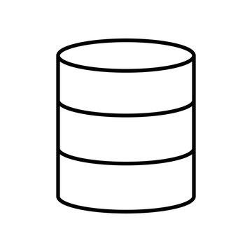
Classical Modular Design of an Abstract Interpreter
…
Interprocedural Analyses
Intraprocedural
Forward/Backward Analyses
Assertion
Checker
Fixpoint Solvers
Invariants
Summaries
Preconditions
Partitioning
Forward/Backward Transformers
Abstract Domains

Slide 8
Program Representation: CrabIR
CrabIR is a language-agnostic representation
But it has been designed to easily translate from languages such as LLVM bitcode
Three-code address representation
Flow modeled via assume and goto
Standard boolean and arithmetic operations:
only integer operations
all integers have a bit-width
Pure functions (i.e., no side effects)
Memory operations are associated to (a finite number of) memory partitions called regions

Slide 9
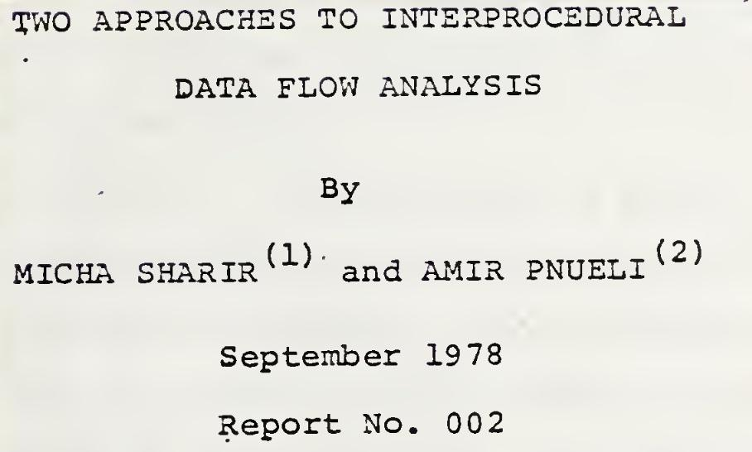
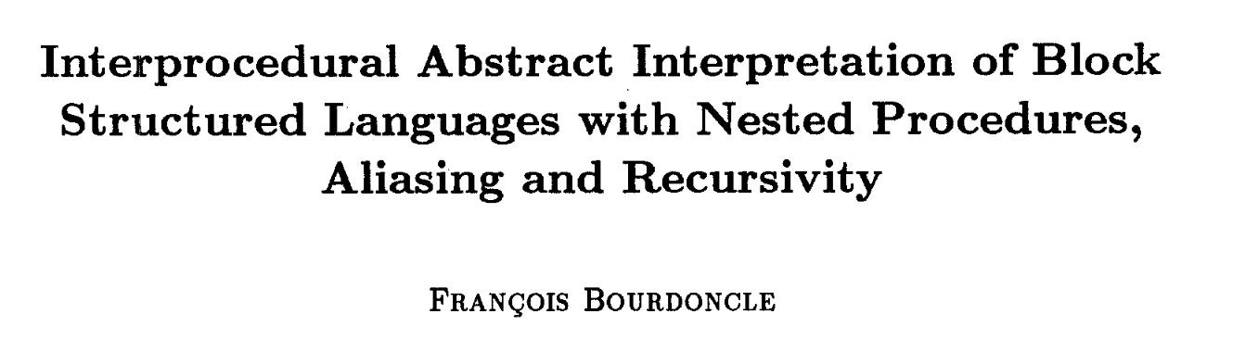
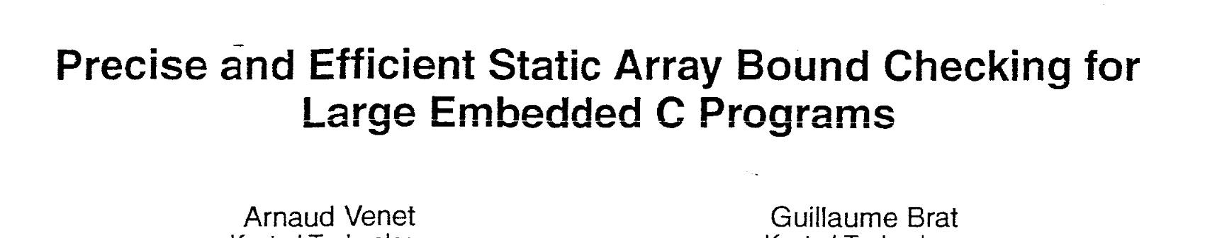
Interprocedural Analyses
Bottom-up (BU) followed by top-down (TD) pass
The BU pass computes context-insensitive summaries
The TD pass propagates abstract states from entry while using summaries
Functions are analyzed only once but summaries require relational/disjunctive domains
Top-down with memoization with support for recursive functions
Context-sensitive, summary-based
A function can be re-analyzed multiple times

Slide 10
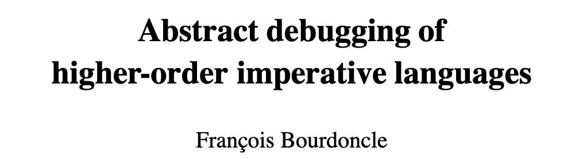
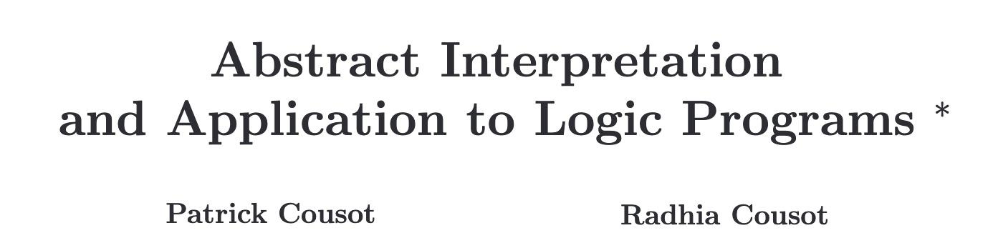
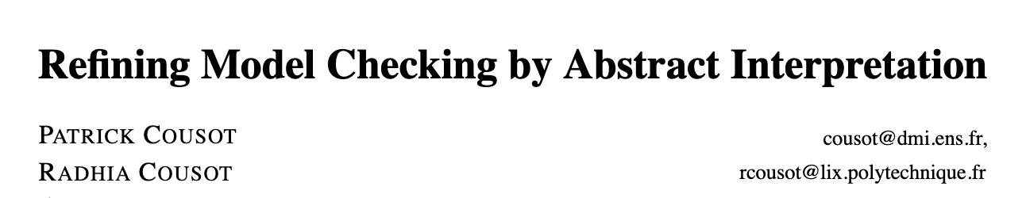
Forward/Backward Analyses
Necessary preconditions (NP) analysis:
Abstract transformers only for numerical operations
Only intra-procedural
Useful for debugging and computing function preconditions
Iterative forward+backward analysis for safety verification
Compute reachable states from init states (invariance analysis)
Compute co-reachable states from error states (NP analysis)
Prune reachable states from the entry that cannot reach error states

Slide 11
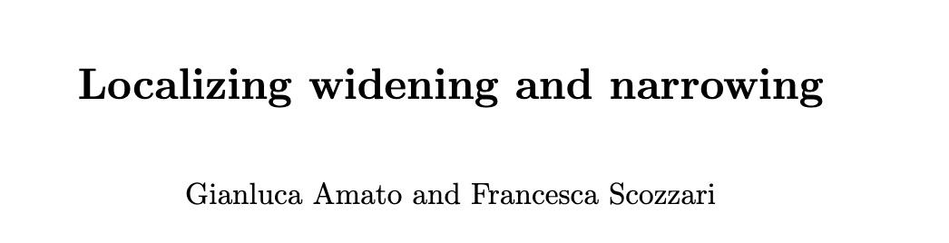
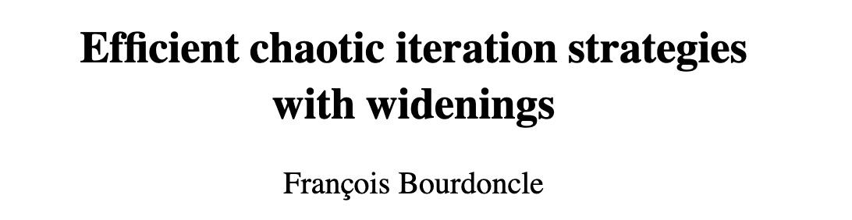
Fixpoint Solvers
Interleaving widening+narrowing
Weak topological ordering

Slide 12
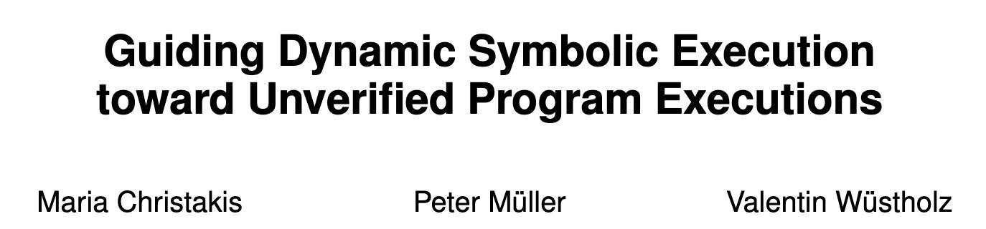
Dataflow Analyses
Generic dataflow engine for inter-procedural forward/backward
Assumption analysis
Interprocedural backward analysis to infer analysis assumptions that might affect an assertion
Example of analysis assumptions:
Arithmetic operations do not overflow
Memory operations cannot access out-of-bounds, etc
Assertion Crawler Analysis (aka cone of influence)
Interprocedural backward analysis that for each block b it computes facts <id,V> meaning that there exists a path emanating from b that will reach assertion id and its evaluation depends on the set of variables V.
Pretty useful for debugging warnings

Slide 13
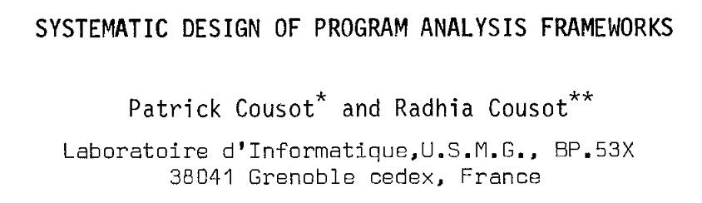
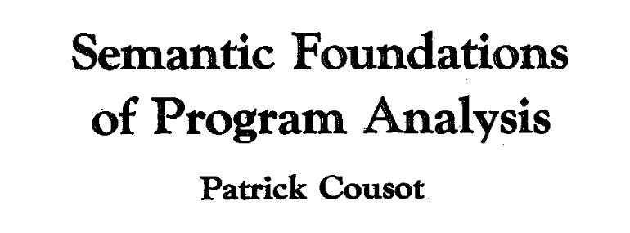
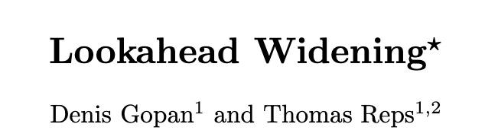
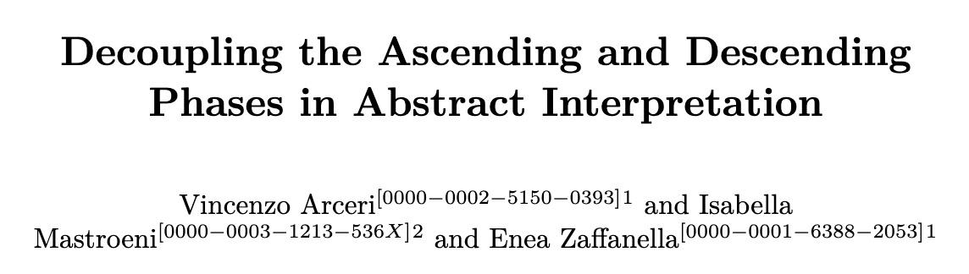
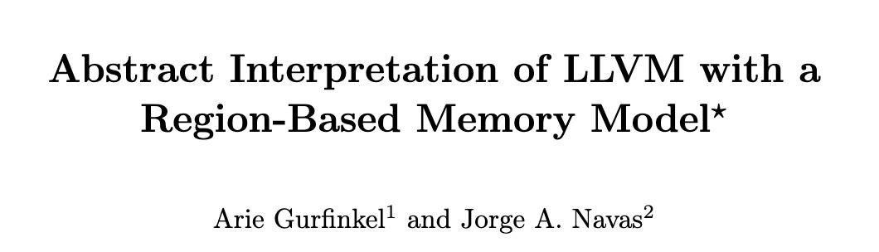
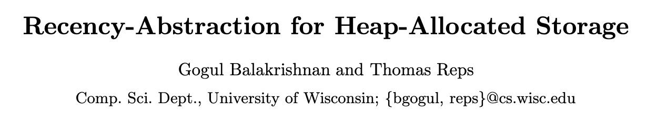
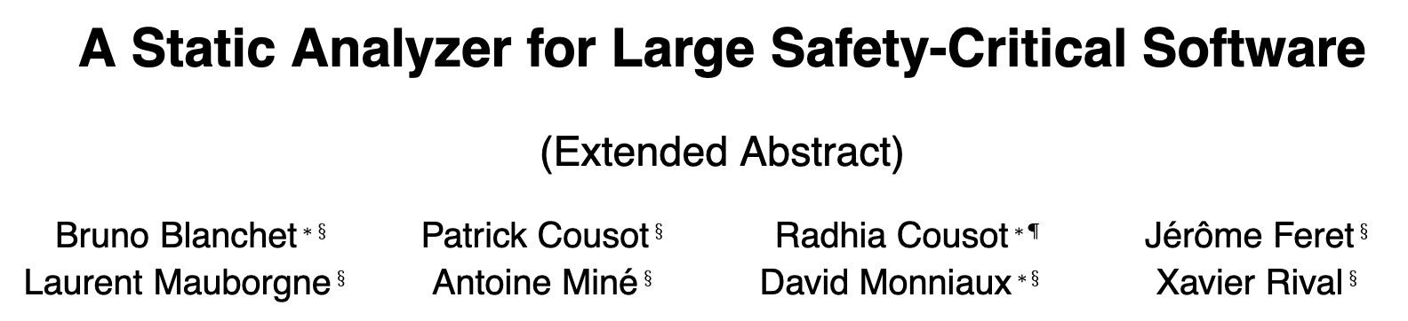
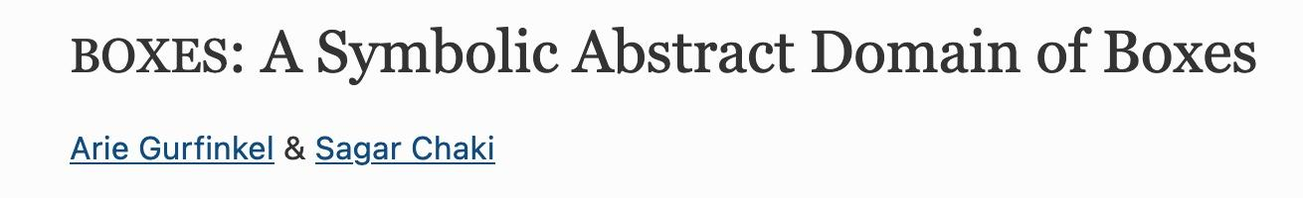
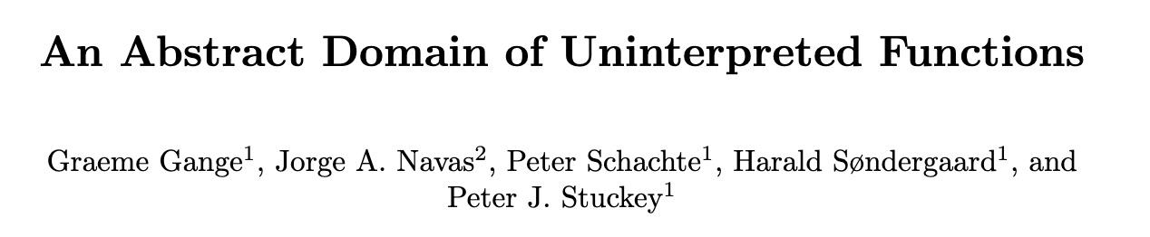
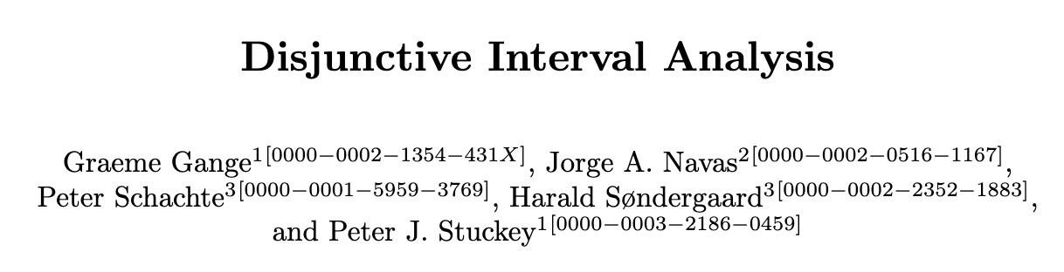
Crab Abstract Domains Hierarchy
Partitioning domains
(Powerset, Value Partitioning)
Widening domains
(Lookahead, Decoupling)
Memory domains
Pointer
domain
Object
domain
Init
domain
Array domains
Symbolic Term domain
TriBool domain
x
Numerical domains
x
Boxes domain
Notes:
Going downwards any domain is optional. Going horizontally different reduce product are possible.

Slide 14
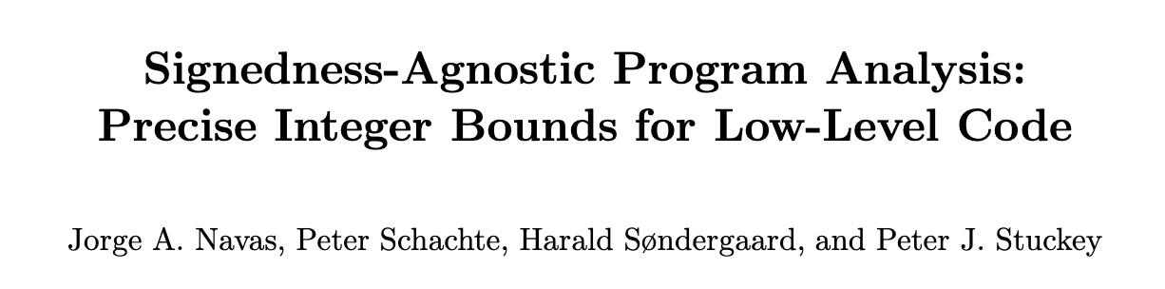
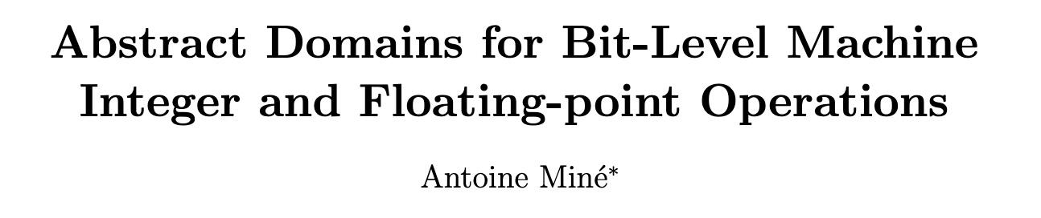
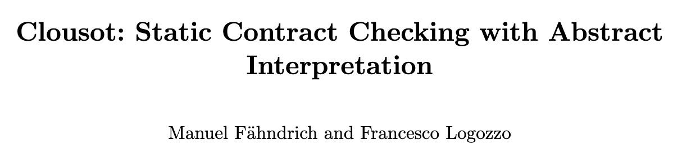
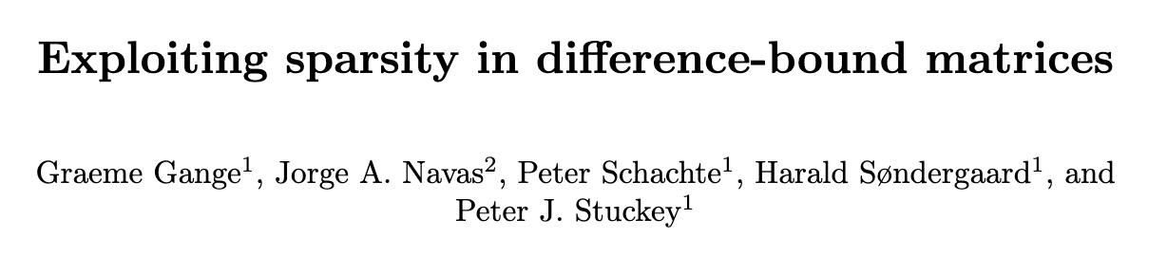
Numerical domains
Wrapped Intervals
ℤ Intervals
Dynamic Variable Packing
Bitfield
Congruences
Fixed TVPI
ℤ dis-intervals
SNF Zones
SNF Octagons
Apron
PPLite
Elina

Slide 15
Crab Domains Rely on Efficient Datastructures
Persistent mergeable maps
Non-relational domains: intervals, congruences, etc
Persistent sets
Finite domains
Sparse graphs with incremental algorithms
DBM-based domains such as Zones and Octagons
Persistent union-find
Dynamic variable packing

Slide 16
Problem: suppose that you have some program P (possibly written in some new language) that can be expressed as a CFG and numerical operations with some property 𝚷, and you would like to investigate which abstractions can capture the relevant aspects of (P, 𝚷)
Example: In 2018, we wondered if we could prove memory safety of Linux eBPF programs using AbsInt while being precise and efficient
Precise: do not reject more programs than the existing verifier
Efficient: verifier must run in few seconds

Slide 17
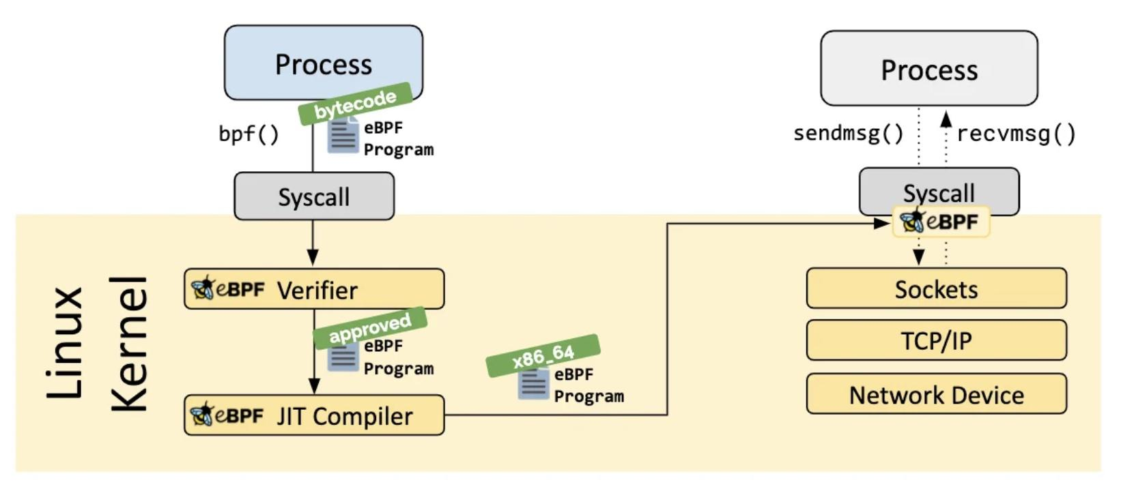
What is eBPF?
Source: https://ebpf.io/what-is-ebpf/
Notes:
eBPF programs are event-driven and are run when the kernel or an application passes a certain hook point. Pre-defined hooks include system calls, function entry/exit, kernel tracepoints, network events, and several others. If a predefined hook does not exist for a particular need, it is possible to create a kernel probe (kprobe) or user probe (uprobe) to attach eBPF programs almost anywhere in kernel or user applications.
The process loading the eBPF program (via bpf() syscall) holds the required capabilities (privileges). Unless unprivileged eBPF is enabled, only privileged processes can load eBPF programs.
The ebpf verifier proves that
the program does not crash or otherwise harm the system.
The program always runs to completion (i.e. the program does not sit in a loop forever, holding up further processing).
After that, The Just-in-Time (JIT) compilation step translates the generic bytecode of the program into the machine specific instruction set to optimize execution speed of the program. This makes eBPF programs run as efficiently as natively compiled kernel code or as code loaded as a kernel module.

Slide 18

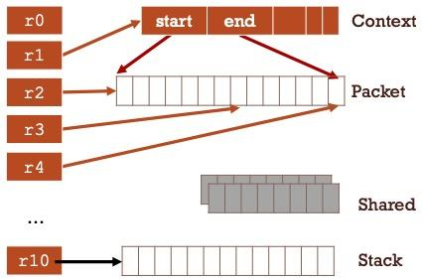
eBPF Virtual Machine
Only 11 registers: r10 is read-only and point to the stack, r1 initially to Context
Context stores fixed-size invocation program arguments
Packet stores variable-size data (e.g., network packet) but not pointers
Stack is a fixed-size scratch memory for register spilling
No dynamic memory allocation, no recursive calls

Slide 19
Demo: write eBPF code in CrabIR
Checkout https://jorgenavas.github.io/slides/crab-dagstuhl.pptx to see the code

Slide 20
eBPF Code Pattern #1
C code
CrabIR
long *start = (void*) ctx->data;
long *end = (void*) ctx->data_end;
if (start+1>end){return;} else {*start=0;}
cfg("example-1")
start:
r4:i64 := 0
r5:i64 := r4 + 76
r6:i64 := r4 + 80
data:i32 := array_load(Context, r5:i64)
data_end:i32 := array_load(Context, r6:i64)
goto bb1
bb1:
r3:i32 := array_load(Context, r6:i64)
r1:i32 := array_load(Context, r5:i64)
r2:i32 := r1 + 8
if (r2 > r3):i32 goto exit else goto bb2
bb2:
EXPECT_EQ(true, assert(r1 >= data):i32)
EXPECT_EQ(true, assert(r1 <= data_end-8):i32)
eBPF bytecode
// Pre: {data = *(u32*)(r1+76)
// Pre: data_end = *(u32*)(r1+80)
1: r3 = *(u32 *) (r1+80)
2: r1 = *(u32 *) (r1+76)
3: r2 = r1 + 8
4: if r2>r3 goto EXIT
assert r1>=data && r1<=data_end-8
5: *(u64 *)(r1) = 0
EXIT: exit
Notes:
Basic example to explain a bit of CrabIR.
The semantics of an array maps integers (64bits) into integers.
The number of bytes being read or written depends on the lhs of the load or the

Slide 21
eBPF Code Pattern #2
Network packet
Network packet
After line 7:
eBPF bytecode
data,r1
data_end, r3
// Pre: {data = *(u32*)(r1+76)
// Pre: data_end = *(u32*)(r1+80)
1: r5 = ...
2: r3 = *(u32 *) (r1+80)
3: r1 = *(u32 *) (r1+76)
4: r2 = r1 + r5
5: if r2<r1 goto EXIT
6: r2 = r2 + 8
7: if r2>r3 goto EXIT
8: r1 = r1 + r5
assert r1>=data && r1<=data_end-8
9: *(u64 *)(r1) = 0
EXIT: exit
+r5
+8
r2
After line 8:
data
data_end, r3
+r5
+8
r1
r2
Notes:
This code pattern shows the need for difference constraints

Slide 22
eBPF Code Pattern #2
CrabIR
eBPF bytecode
start:
havoc(r5:i32)
data:i32 := array_load(Context, 76:i64)
assume(data == 0):i32
data_end:i32 := array_load(Context, 80:i64)
goto bb1
bb1:
r3:i32 := array_load(Context, 80:i64)
r1:i32 := array_load(Context, 76:i64)
r2:i32 := r1 + r5
if (r2 < r1):i32 goto exit else goto bb2
bb2:
r2:i32 := r2 + 8
if (r2 > r3):i32 goto exit else goto bb3
bb3:
r1:i32 := r1 + r5
EXPECT_EQ(true, assert(r1 >= data):i32)
EXPECT_EQ(true, assert(r1 <= data_end-8):i32)
// Pre: {data = *(u32*)(r1+76)
// Pre: data_end = *(u32*)(r1+80)
1: r5 = ...
2: r3 = *(u32 *) (r1+80)
3: r1 = *(u32 *) (r1+76)
4: r2 = r1 + r5
5: if r2<r1 goto EXIT
6: r2 = r2 + 8
7: if r2>r3 goto EXIT
8: r1 = r1 + r5
assert r1>=data && r1<=data_end-8
9: *(u64 *)(r1) = 0
EXIT: exit
Notes:
This code pattern shows the need for difference constraints

Slide 23
eBPF Code Pattern #3
CrabIR
eBPF bytecode
start:
r10:i64 := 4096
data:i32 := array_load(Context, 76:i64)
assume(data == 0):i32
data_end:i32 := array_load(Context, 80:i64)
goto bb1
bb1:
r3:i32 := array_load(Context, 80:i64)
r1:i32 := array_load(Context, 76:i64)
r9:i64 := r10 - 8
array_store(Stack, r9:i64, r3:i32)
havoc(r3:i32)
r4:i32 := array_load(Stack, r9:i64)
r2:i32 := r1 + 8
if (r2 > r4):i32 goto exit else goto bb2
bb2:
EXPECT_EQ(true, assert(r1 >= data):i32)
EXPECT_EQ(true, assert(r1 <= data_end-8):i32)
// Pre: data = *(u32*)(r1+76)
// Pre: data_end = *(u32*)(r1+80)
1: r3 = *(u32 *) (r1+80)
2: r1 = *(u32 *) (r1+76)
3: *(u64 *)(r10-8) = r3
...
4: r4 = *(u64 *)(r10-8)
5: r2 = r1 + 8
6: if r2>r4 goto EXIT
assert r1>=data && r1<=data_end-8
7: *(u64 *)(r1) = 0
EXIT: exit
Notes:
This code pattern shows how the stack is used for register spilling

Slide 24
eBPF Code Pattern #4
CrabIR
r2:i32 := 131328
t2:i32 := -4
value_partition_start(r7:i32)
if (r7 != 0):i32 goto bb1 else goto bb2
bb1:
r2:i32 := 0
t2:i32 := -5
goto bb2
bb2:
r1:i32 := 131328
t1:i32 := -4
if (r7 == 0):i32 goto bb3 else goto bb4
bb3:
r1:i32 := r2
t1:i32 := t2
goto bb4
bb4:
if (r1 != 0):i32 goto bb5 else goto exit
bb5:
EXPECT_EQ(true, assert(t1 == -4):i32)
eBPF bytecode
1: r2 = 131328
2: if (r7 == 0) goto 4
3 r2 = 0
4: r1 := 131328
5: if (r7 != 0) goto 7
6: r1 = r2
7: if (r1 == 0) goto EXIT
8: r2 = r10 - 8
9: r0 = map_lookup_elem(r1, r2)
EXIT
Notes:
This code snippet shows the need for some disjunctive reasoning.
Each register has a shadow variable to represent its type. -6: UNINIT, -5: NUM -4 : MAP FD …
At line 9, we want to prove that r1 has a MAP FD type.
This program can be proven with boxes. We need partitioning on r7

Slide 25
Some Conclusions of the eBPF Experiment
Stack and Ctx can be modeled by two separate arrays
Pkt can be abstracted by a pair (start,end)because no pointers inside
Regs/Stack/Ctx contents (pointers and numbers) can be modeled by int variables
Memory safety of Stack should be easy since offsets are often constant
Memory safety of the Pkt is harder because the start and end are symbolic
Require bin relationships between Regs, Stack contents and (start,end)
A simple array domain (i.e., no summarization) with difference constraints can handle most of the code patterns.

Slide 26
Retrospective
In 2018, Crab already existed as a library but not concrete syntax for CrabIR
The only way to use the tool was writing C++ code
A very smart, dedicate student (Elazar Gershuni) spent 2-3 months writing prototypes in C++
He did a lot trial-and-error to figure out the right abstractions
The whole communication process was slow due to impedance mismatch

Slide 27
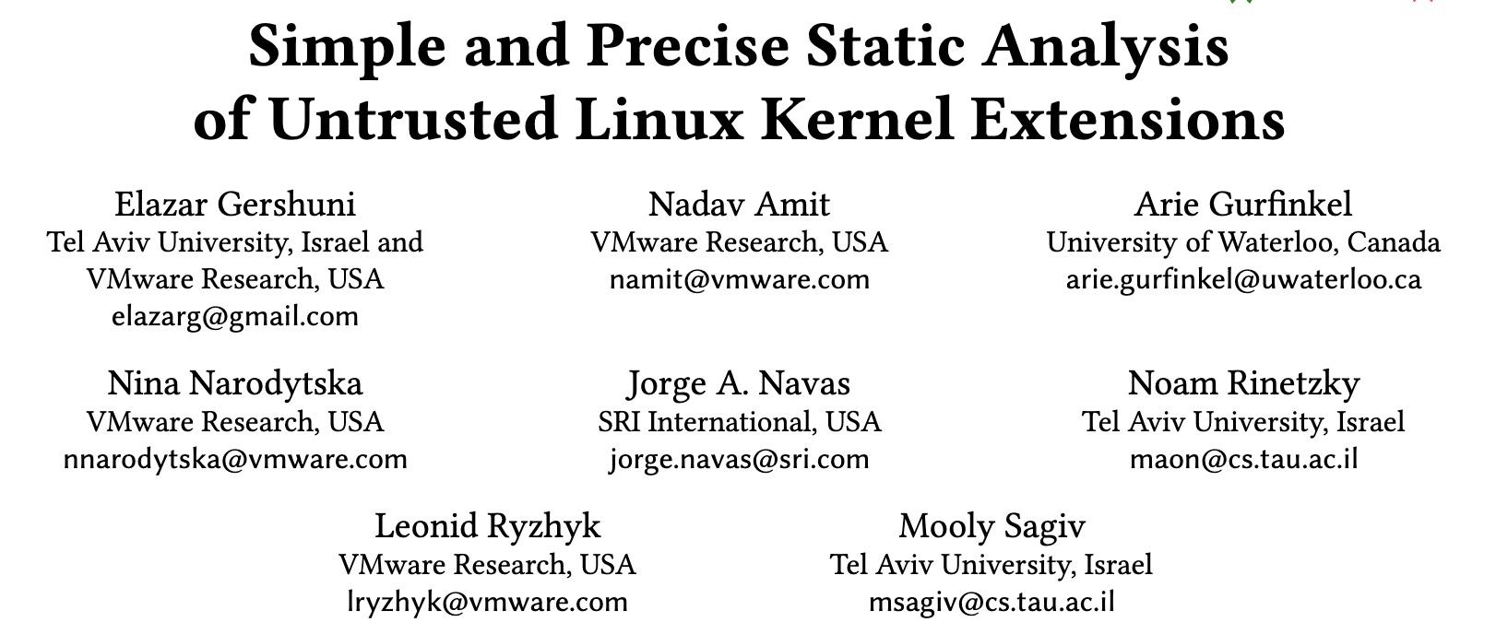
Prevail: a eBPF verifier based on Crab
Notes:
Originally it was implemented as an eBPF front-end for Crab. Prevail reasons about machine arithmetic

Slide 28
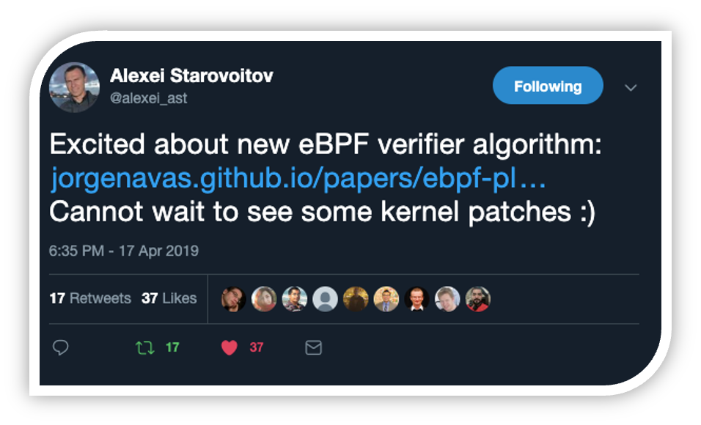
Can Prevail Transition to Industry?
Alexei Starovoitov is the main developer of the Linux eBPF Verifier
After this tweet, I (wrongly) believed that Prevail could transition from research to industry!
Hi Alexei,
My colleagues and I have been working on a new eBPF verifier built on abstract interpretation (I believe you've seen this work and even tweeted about it). We were hoping to pick your brain on what would be the best way to start integrating in into the eBPF ecosystem
Hi Jorge,
It seems there are big gaps between kernel and your user space implementation that is in C++ and relies on some external frameworks and libraries.
How do you see the path into the kernel?
And that was my our conversation with Alexei Starovoitov ;-(

Slide 29
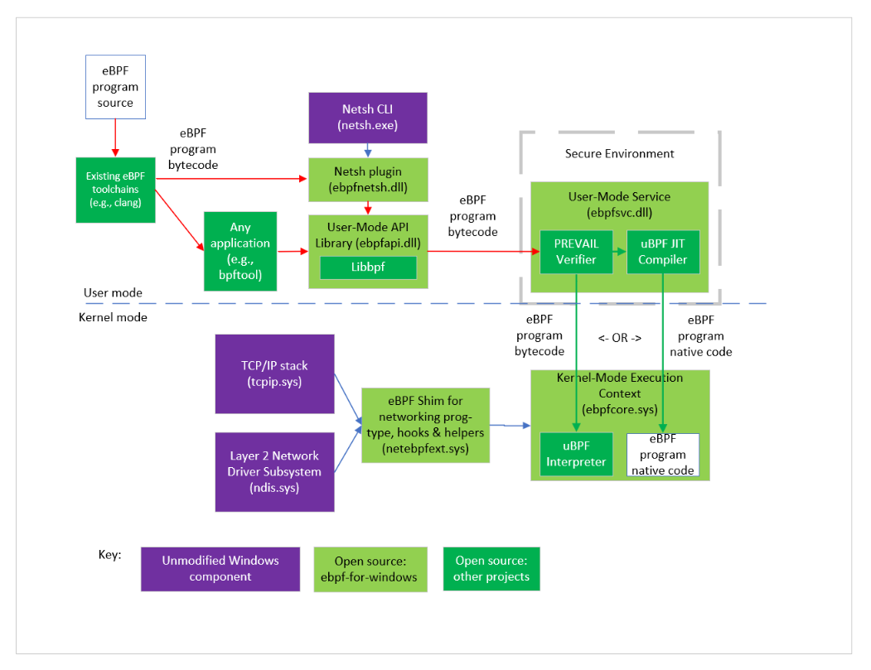
But more than one year later …
https://github.com/microsoft/ebpf-for-windows
Hi Jorge,
My name is Dave Thaler, I am a Software Architect in the Windows Devices and Networking division at Microsoft.
We want to port the eBPF ecosystem to Windows. We cannot port the Linux eBPF verifier for licensing issues and because it’s too tight to Linux specifics.
Would you be interested in integrating Prevail?
After two years of hard engineering work (credits to Dave and Elazar), Prevail is being used in production at Microsoft!
Notes:
The original prevail was using Crab as an external dependency.
As part of the integration of Prevail in windows, we removed all dependencies to Crab (by copying/specializing the needed files) and also re-implemented some files that had NASA licence (e.g., mergeable maps and WTO computation).

Slide 30

Mini Break?

Slide 31
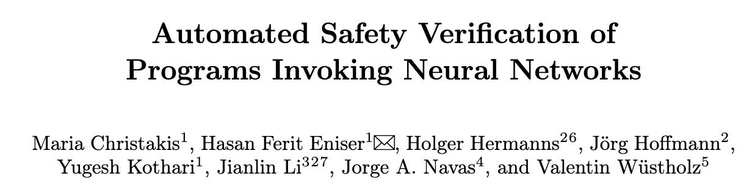
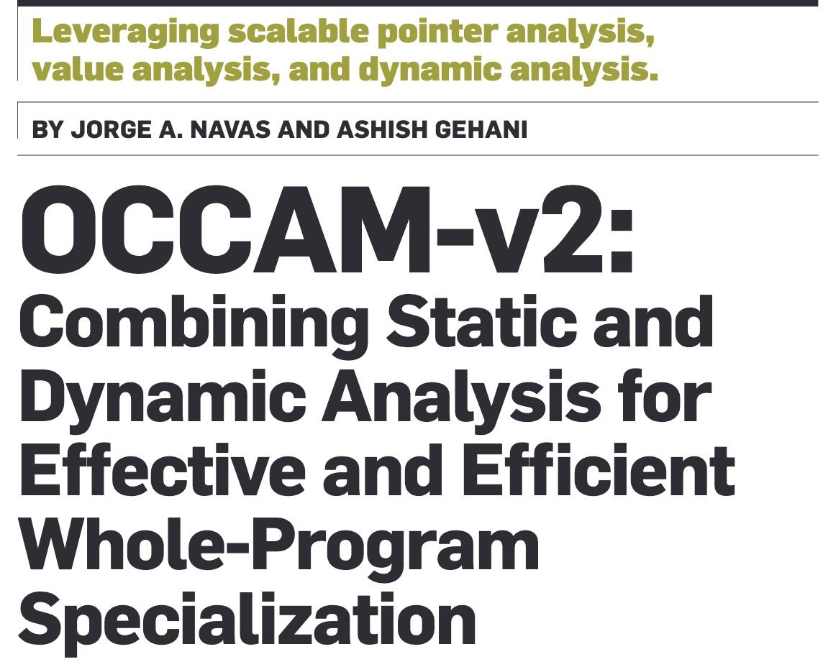
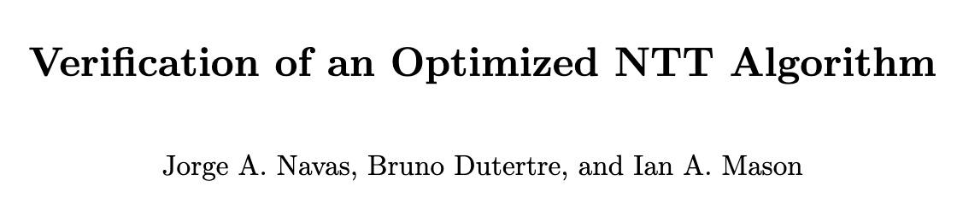
Abstract Interpretation of LLVM bitcode
Implemented as a LLVM front-end for Crab
Translation from LLVM bitcode to CrabIR
The tool is called Clam and it is also open-source
https://github.com/seahorn/clam
Clam can be used both for verification and LLVM code optimizer

Slide 32
Which Programs and Properties Are Considered?
General purpose code written in modern (portable) C
Safety properties
Check of runtime errors: buffer overflows, integer overflows, etc
User-defined assertions

Slide 33
Clam Semantics and Assumptions
Use of C11 semantics:
Strict aliasing rules: the effective type of a lvalue must be compatible with the effective type of the object being accessed
The use of machine semantics depends on which domain the user chooses
Absence of undefined behavior (UB), specially:
Each memory read accesses the same number of bytes last written
No memory access read/write out-of-bounds

Slide 34


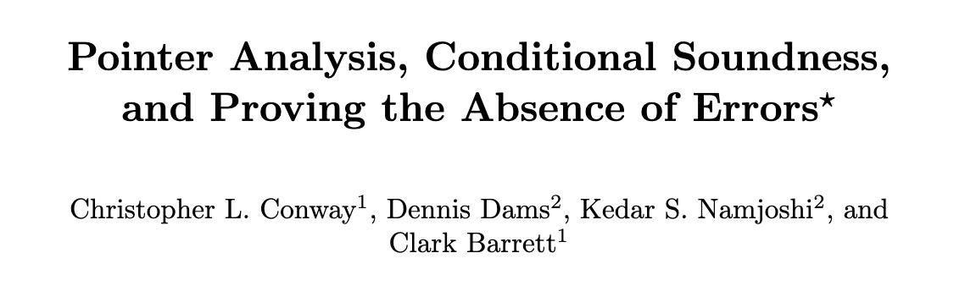
More About Clam Assumptions
Clam follows a trust-and-check approach:
The analysis is done assuming lack of UB
Optionally, the analysis can check for UB

Slide 35
Current Clam Memory Analysis
Four different abstractions are usually needed to reason about memory:
Pointer abstraction: infer non-aliasing facts between pointers
Object abstraction: discrimination between objects from same allocation site
Initialization abstraction: which cells have been written
Shape abstraction: how memory objects are connected
Clam memory analysis is highly simplified due to its assumptions:
Pointer abstraction: flow-insensitive but context-, type-, field-sensitive pointer analysis
Object abstraction: use of allocation site abstraction (i.e., no discrimination between objects from the same allocation site) but the first write can be still modeled as a strong update
Initialization abstraction: it does NOT keep track of which cells have been written
But of course, other abstractions such as cell-based and recency could be used to enforce more faithfully C11 semantics

Slide 36
Demo: using Clam via CLI
Checkout https://jorgenavas.github.io/slides/crab-dagstuhl23.pptx to see the code

Slide 37
Some C code
#include "clam/clam.h"
// malloc that cannot fail
void* xmalloc(size_t sz) {
void* p = malloc(sz);
__CRAB_assume(p > 0);
return p;
}
// Return different sizes based on
// a non-deterministic input
int nondet_size(int lb, int ub) {
int sz = nd_int();
__CRAB_assume(sz >= lb);
__CRAB_assume(sz <= ub);
return sz;
}
int N = nondet_size(10, 1000);
int* array = (int*)xmalloc(sizeof(int) * N);
int i;
for (i=0; i<N;i++) {
int val = nd_int();
__CRAB_assume(val >= 0 && val < 100);
array[i] = val;
}
int j;
for (j=0; j<N;++j) {
__CRAB_assert(array[j] < 100);
}
Notes:
This code dynamically allocates an array of integers whose size is between 10 and 1000.
Then, it initializes each array element between 0 and 100.
Finally, it checks that all array elements are less 100.
Note that the program has calls to special functions __CRAB_assume, __CRAB_assert, and nd_int(). This is how users can write pre-conditions and post-conditions.

Slide 38
Clam Command-Line Usage
Write the specification
clam/clam.h includes a set of special functions:
__CRAB_assume and __CRAB_assert
A family of functions nd_X where X = {int8_t, …, int64_t,...}
Write a yaml configuration file to select the analyzer options
clam_options:
crab-inter: true
crab-track: mem
crab-heap-analysis: cs-sea-dsa-types
crab-widening-delay: 2
crab-narrowing-iterations: 1
crab-check: assert
crab-dom: zones
…
3. Run Clam: clam-yaml -y test.yaml test.c
Notes:
Clam should prove the assertion using the zones domain.

Slide 39
Same C code with an Injected Bug
int N = nondet_size(10, 1000);
int* array=(int*)xmalloc(sizeof(int) * N);
int i;
for (i=0; i<N;i++) {
int val = nd_int();
assume(val >= 0 && val < 100);
array[i] = val;
}
int j;
for (j=0; j<=N;++j) {
sassert(array[j] < 100);
}
The second loop is accessing the array out-of–bounds (UB)
Thus, the assertion does not always hold for array[N]
However, Clam still claims the assertion holds!
Clam soundness guarantees: the analysis is sound under the condition that the program does not exhibit undefined behavior

Slide 40
Same C code with an Injected Bug
int N = nondet_size(10, 1000);
int* array=(int*)xmalloc(sizeof(int) * N);
int i;
for (i=0; i<N;i++) {
int val = nd_int();
assume(val >= 0 && val < 100);
array[i] = val;
}
int j;
for (j=0; j<=N;++j) {
sassert(is_dereferenceable(array+j,
sizeof(int)));
sassert(array[j] < 100);
}
We can ask Clam to check for out-of-bounds accesses
Clam cannot prove the is_dereferenceable assertion
Thus, the validity of the original assertion should not be trusted!
Notes:
Note that clam cannot prove the is_dereferenceable assertion even with the correct program using zones.
The reason is that we need the invariant 4*j <= 4*N. We can use either polyhedra or non-unit-zones.
The latter does some semantic rewrites to replace 4*j into a special variable j’ such that the invariant can be replaced with j’ <= N.

Slide 41
Clam Programmatic API Usage
Problem: suppose that you want to implement an analyzer based on Clam that takes LLVM bitcode and infers upper-bounds of the sizes of dynamic allocated objects.
Example: SeaHorn Bounded-Model Checker requires to know statically the maximum size of each allocated object. Otherwise, the sizes must be provided by the user

Slide 42
Demo: write a new static analysis to infer upper-bounds for dynamic memory allocation
Checkout https://jorgenavas.github.io/slides/crab-dagstuhl23.pptx to see the code

Slide 43
New Static Analysis to estimate sizes of allocated objects
LLVM API
// 1. Parse the LLVM bitcode
std::unique_ptr<Module> M = parseIRFile(argv[1],...);
// 2. Run a pointer analysis
auto mem = std::make_unique<SeaDsaHeapAbstraction>(*M,...);
// 3. Translate each LLVM function to a CrabIR CFG
CrabBuilderManager man(std::move(mem),...);
// 4. Create inter-procedural analysis object
InterGlobalClam analysis(*M, man);
// Set the analysis parameters
AnalysisParams params;
params.dom = CrabDomain::INTERVALS;
params.inter = true;
// Run the inter-procedural analysis
analysis.analyze(params);
// 5. Our new static analysis
AllocSizeVis ASV(ga);
ASV.visit(*M);
class AllocSizeVis: public
InstVisitor<AllocSizeVis> {
InterGlobalClam& m_analyzer;
public:
AllocSizeVis(InterGlobalClam&ana)
: m_analyzer(analyzer) {}
void visitCallBase(CallBase&CB) {
if (auto F=CB.getCalledFunction()) {
if (F->getName() == "malloc") {
auto interval = m_analyzer.range(CB, 1);
llvm::outs() <<
"The size of the allocated object at "
<< CB << " is " << interval << "\n";
}
}
}
};
NEW CODE
CLAM API

Slide 44
New Static Analysis to estimate sizes of allocated objects
#include "clam/clam.h"
// malloc that cannot fail
void* xmalloc(size_t sz) {
void* p = malloc(sz);
__CRAB_assume(p > 0);
return p;
}
int main(...) {
int N = nondet_size(10, 1000);
int* array = (int*)xmalloc(sizeof(int) * N);
...
./AllocSizeAnalyzer example.ll
The size of the allocated object at %call = call i8* @malloc(i32 %sz) #3 is [40,4001)

Slide 45
Conclusions
Crab is a versatile library to build static analysis based on the theory of AbsInt
Clam is a LLVM front-end for Crab
Invariants can be used to transform LLVM bitcode or communicate with other tools
Current efforts focusing on:
Implementing more abstract domains, specially, for memory
Building more static analyses on the top of Crab
Using Crab beyond safety verification
Prevail: termination
OCCAMv2: program debloating
https://github.com/seahorn/crab
Always looking for real use cases that can drive the design of new domains, analyses, and front-ends

Slide 46
