Slide 1
Python
Session 8
Databases

Slide 2
Databases supported
Python supports built-in sqlite3 (https://www.sqlite.org/)
The following libraries are available:
ODBC and ADO generic connectivity
DB2
Firebird and Interbase
Informix
Ingres
MySQL
Oracle
PostgreSQL
SAP DB (MaxDB)
Microsoft SQL Server
Microsoft Access
Sybase
Teradata
IBM Netezza
ThinkSQL
Asql
Metakit
ZODB
BerkeleyDB
KirbyBase
Dorus
Buzhug
SnakeSQL
More information: https://wiki.python.org/moin/DatabaseInterfaces

Slide 3
SQLite3
import sqlite3 conn = sqlite3.connect("dbfile.sqlite3") cursor = conn.cursor() sqlstmt = "Some SQL Statement" cursor.execute(sqlstmt)
conn.commit() conn.close()
Import the sqlite3 module
Open a connection to a database file.
Create a cursor to handle the execution of statements.
Execute required SQL code
Commit changes to the database
Close the connection

Slide 4
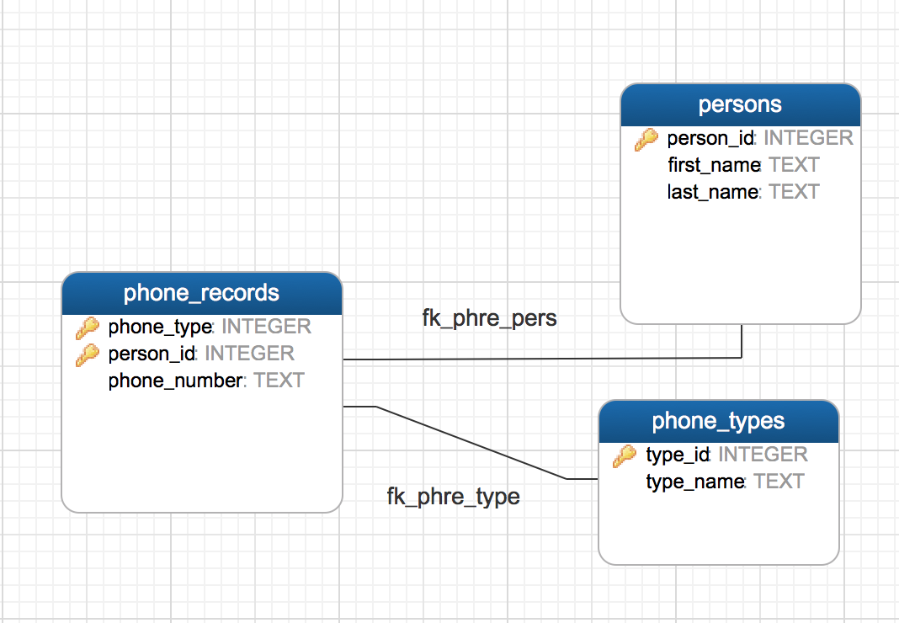
SQLite object creation
Problem
Solution
Create a python script to implement the following ER model
import sqlite3 conn = sqlite3.connect("phonebook.sqlite3") cursor = conn.cursor() cursor.execute("DROP TABLE IF EXISTS persons") cursor.execute("DROP TABLE IF EXISTS phone_records") cursor.execute("DROP TABLE IF EXISTS phone_types") cursor.execute("CREATE TABLE IF NOT EXISTS persons ( " + " person_id INT NOT NULL, " + " first_name TEXT NOT NULL, " + " last_name TEXT NOT NULL, " + " PRIMARY KEY (person_id) )") cursor.execute("CREATE TABLE IF NOT EXISTS phone_types ( " + " type_id INT NOT NULL, " + " type_name TEXT NOT NULL, "+ " PRIMARY KEY (type_id) )") cursor.execute("CREATE TABLE IF NOT EXISTS phone_records ( " + " person_id INT NOT NULL, " + " type_id INT NOT NULL, " + " phone_number TEXT NOT NULL, " + " PRIMARY KEY (person_id, type_id), " + " FOREIGN KEY (person_id) REFERENCES persons (person_id), " + " FOREIGN KEY (type_id) REFERENCES phone_types (type_id) )") cursor.execute("CREATE INDEX IF NOT EXISTS fk_phre_pers_idx ON phone_records (person_id)") cursor.execute("CREATE INDEX IF NOT EXISTS fk_phre_type_idx ON phone_records (type_id)") conn.close()

