Slide 1
Python
Session 8
Object Oriented Python

Slide 2
A python package
Packages are a way of structuring Python’s module namespace using dotted module names
Python treats folders as packages
Packages are a collection of .py files which can be modules or classes
Package folders require a __init__.py file

Slide 3
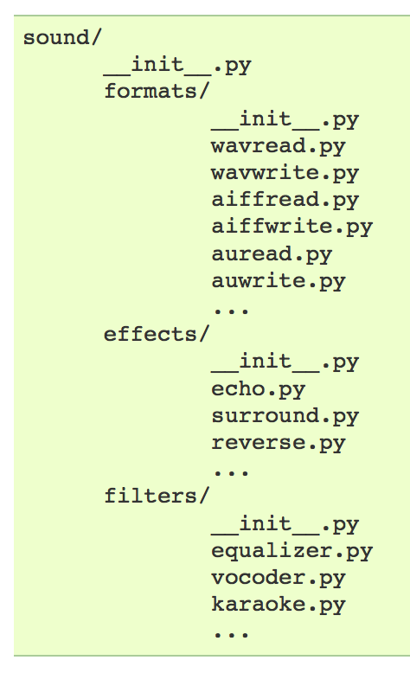
Importing a module from a package
Problem:
You want to use the function echoFilter from the echo module
import sound.effects.echo
The fully qualified name must be used: sound.effects.echo.echoFilter()
from sound.effects import echo
The submodule and function must be used: echo.echoFilter()
from sound.effects.echo import echoFilter
The function is readily available: echoFilter()

Slide 4
Importing * from package
Problem:
You want to import all modules from the effects package
import * from sound.effects
Could take a long time
Importing submodules can have unwanted side-effects
Use __all__ = [sub mod1, submod2,…] in __init__.py file to select what you want to make available

Slide 5
Importing a module from a module
Problem:
You need to use the functions in effects.echo in the vocoder module
from sound.effects import echo
It’s possible to use the absolute import within the package
from ..effects import echo
It’s also possible to use relative imports

Slide 6
OOO terminology
Class: A prototype for an object that defines a set off attributes and behaviors that characterize any object of the class.
Class variable: A variable that’s available to all instances of the class.
Instance: A particular object of an specific class.
Instance variable: A variable defined inside a method and that belongs only to the particular instance of the class.
Inheritance: The transfer of characteristics from one class to other classes that derive from it.
Overloading: Assigning a particular behavior to a common function shared by sub-classes of a class

Slide 7
Class syntax
class Employee: """Base class for all employees""" empCount = 0 def __init__(self, name, salary): self.name = name self.salary = salary Employee.count += 1 def displayNumEmployees(self): print 'Total Employees:', Employee.empCount def displayEmployeeName(self): print 'Name:', self.name
Class definition
Class documentation available through Employee.__doc__
Class variable
Initiation method
Method to access class variable
Method to access instance variable

Slide 8
Instance a class
class Employee: """Base class for all employees""" empCount = 0 def __init__(self, name, salary): self.name = name self.salary = salary Employee.count += 1 def displayNumEmployees(self): print 'Total Employees:', Employee.empCount def displayEmployeeName(self): print 'Name:', self.name employee1 = Employee("Zara", 2000) employee2 = Employee("David", 2500) employee1.displayNumEmployees() employee1.displayEmployeeName() employee2.displayEmployeeName() employee2.displayNumEmployees()

Slide 9
Built-in class attributes
__dict__ : Dictionary containing the class namespace
__doc__: Class documentation string
__module__: Module name in which the class is defined
__bases__: Tuple containing the base classes if any

Slide 10
Instance attributes
Can be defined by using the self reference to the class followed by the attribute name: (i.e. self.firstName )
Can be calculated attributes which are defined using the @property decorator
Can be set either by:
Accessing the attribute directly
Using an attribute setter with the decorator @attname.setter where attname is the actual attribute name (beware of classic classes in python 2.x – see code sample cs_8_3_classic.py)
Can be obfuscated by using trailing double underscore

Slide 11
Exercises
Create a class named Car that holds the following attributes for a car (use a class initiator and variable obfuscation):
Brand
Colour
Total number of gears
Define and implement the following methods for the Car class:
A method to shift-up a gear
A method to shift-down a gear
A method to print the current gear
A method to return the brand of the car
A method to return the colour of the car
A method that states how many cars there are defined
The class must control all corner cases

