Slide 1
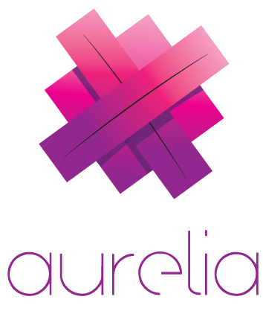
meet
(Your new favorite front-end JavaScript framework)

Slide 2
hi. i‘m adam.

Slide 3
history
Rob Eisenberg is awesome
Caliburn.Micro (XAML) is the best
Convention-based MVVM framework
DurandalJS
Caliburn.Micro on the web (sort of)
Relies on require, knockout and jQuery
AngularJS 2.0
Caliburn.Micro / Durandal awesomeness in Angular?!? Sold.
Goodbye Angular, hello Aurelia!
The best parts of Angular with the best parts of Caliburn.Micro and Durandal

Slide 4
aurelia is different. better.
Cutting edge – written in ES6 and ES7
Powerful databinding
Convention-based MV* architecture means less code
Flexible – use your choice of language, customize or replace conventions
Modern, modular architecture
Easy to create custom elements and attributes
Uses JSPM

Slide 5
code

Slide 6
get started
aurelia.io

