Slide 1
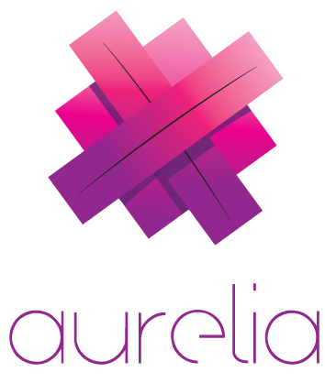
meet
(Your new favorite front-end JavaScript framework)

Slide 2
hi. i’m adam.
Adam Barney
Barney Consulting, Inc. – Lincoln, NE
Lincoln .NET Users Group
Nebraska.Code() / Nebraska Code Camp
@cabarney
adambarney.com
adam@adambarney.com

Slide 3
history
Rob Eisenberg is awesome
Caliburn.Micro (XAML) is the best
Convention-based MVVM framework
DurandalJS
Caliburn.Micro on the web (sort of)
Relies on require, knockout and jQuery
AngularJS 2.0
Caliburn.Micro / Durandal awesomeness in Angular?!? Sold.
Goodbye Angular, hello Aurelia!
The best parts of Angular with the best parts of Caliburn.Micro and Durandal

Slide 4
aurelia is different. better.
Cutting edge – written in ES6 and ES7
Powerful databinding
Convention-based MV* architecture means less code
Modern, modular architecture
Easy to create custom elements and attributes
Uses JSPM
Strongly opinionated – but very happy to accept your differing opinions.
Vs. Angular 2.0? Listen to Rob on the Herding Code Podcast

Slide 5
code

Slide 6
get started
aurelia.io
Read the docs
Subscribe to the blog
Podcasts with Rob Eisenberg
Build something!
Thank You!
adam@adambarney.com

