Slide 1
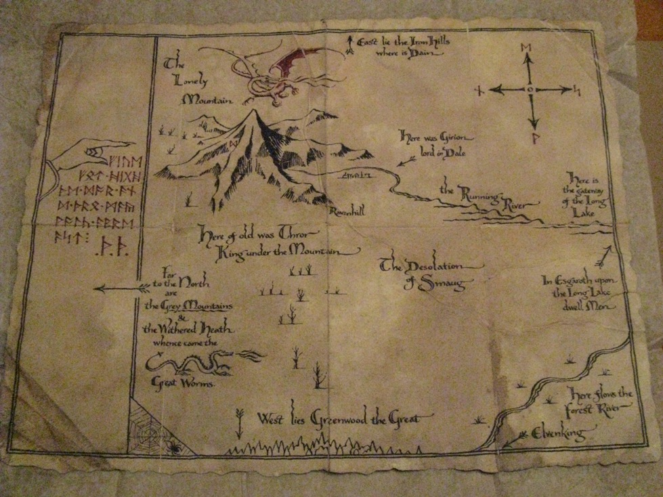
There and Back Again
(Not my best effort at a clever title)
A Microsoft Developer’s Journey to the Web Front-End

Slide 2
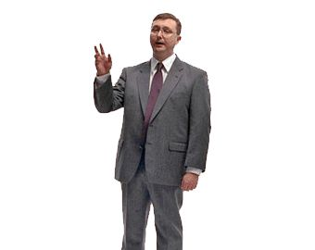
Hi. I’m Adam
Microsoft MVP (C#)
Barney Consulting, Inc. (barneyconsulting.net)
Nebraska Code Camp (nebraskacodecamp.com)
Lincoln .NET Users Group (do you really care?)
adam@adambarney.com
adambarney.com
@cabarney
LinkedIn
Facebook
Blah, blah, blah… I’m everywhere.
I’m a PC

Slide 3
I’m a Microsoft Fan Boy (recovering)
Microsoft tunnel-vision
SQL Server for data
ADO, ADO.NET, LINQ-to-SQL, Entity Framework
ASP, ASP.NET, ASP.NET MVC
ASP.NET Web Services, WCF

Slide 4
Microsoft Hasn’t Been Kind to Clients
Guidance over the years:
Pre-ASP: “What’s the internet?”
ASP: “We don’t care.”
ASP.NET: “Don’t worry – we’ll take it from here”
ASP.NET MVC: “Developer, meet the client – his name is jQuery”
The Microsoft Stack was concerned about passing content down to the client, then it was done.
And then…. Something amazing happened…

Slide 5
Microsoft Embraced Open-Source!
MS finally got out of our way
NuGet makes it easy to use JS libraries
Azure has support for frameworks other than ASP.NET
MS is contributing to Open Source projects
TypeScript!
OWIN / Katana
WebEssentials
Visual Studio loves the Front-End Developer now!

Slide 6
Open Source JavaScript Libraries
Underscore.js
AngularJS
jQuery Mobile
CommonJS
DurandalJS
Require.js
Breeze.js
Modernizr
TypeScript
jQuery
Prototype
Ember.js
Node.js
jQueryUI
YUI
Lightbox
KnockoutJS
Q
d3

Slide 7
Libraries
Underscore.js
Like LINQ for JavaScript.
Or Underscore is to JavaScript objects as jQuery is to the DOM
KnockoutJS
Brings the MVVM pattern to the client side
Data binding statements
Properties and events

Slide 8
Libraries (cont)
Breeze.js
Easy data access from the client
Like a database context on the client – it manages entities
DurandalJS
From the maker of Caliburn.Micro – and very similar
Leverages Knockout and require.js
Composition, Eventing, Convention-based, easy navigation, app and screen life-cycles, etc…

Slide 9
Psst. Your Ignorance is Showing…
I’m NOT a rockstar front-end developer, but I WANT to be…
I’m learning too. I learned a lot just preparing this session.
I just want to share with you what I’ve learned…
I won’t have all the answers, but we can talk though them together after the session, or at the end, if time.

Slide 10
DEMOS
Underscore, Knockout, Breeze and Durandal.

Slide 11
More Tools for Your Front End Toolbox
JavaScript
AngularJS
Backbone
Marionette
Design
HTML5 Boilerplate
Bootstrap
Tools
LESS, SASS, CoffeeScript, TypeScript, Dash, WebStorm, ReSharper, Hot Towel, SideWaffle, so many more…
28 more JavaScript libraries were created during this talk.
What are your favorites?

Slide 12
Thanks!
Questions?
adam@adambarney.com
adambarney.com
@cabarney

