Slide 1

There and Back Again
A Microsoft Developer’s Journey to the Web Front-End

Slide 2
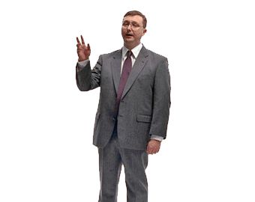
Hi. I’m Adam
Microsoft MVP (C#)
Barney Consulting, Inc. (barneyconsulting.net)
Nebraska Code Camp (nebraskacodecamp.com)
Lincoln .NET Users Group (do you really care?)
adam@adambarney.com
adambarney.com
@cabarney
LinkedIn
Facebook
Blah, blah, blah… I’m everywhere.
I’m a PC

Slide 3

I’m a Microsoft Fan Boy (recovering)
Microsoft tunnel-vision
SQL Server for data
ADO, ADO.NET, LINQ-to-SQL, Entity Framework
ASP, ASP.NET, ASP.NET MVC, Silverlight
ASP.NET Web Services, WCF, ASP.NET Web API
Looks like you drank too much
Microsoft Kool-Aid…
Repeat after me… MS Paint is NOT better
than Photoshop…

Slide 4
My Journey…
Mid-90s: I’m a Web Developer – HTML & JS. GeoCities FTW!
Started using CGI / perl. Blech. The web sucks.
I’m now a Windows Developer. Borland C++ & Delphi FTW!
2000-2003: The dark years. UNIX, C, TclTk
2003: This .NET thing is cool. Win Forms! (searches for job….)
2004-2006: The darker years. Java. Struts. Web Still Sucks
2006: Hey, ASP.NET is WinForms for the Web! I’m a Web Dev!
Back and forth. WPF – I’m a Win Dev. Silverlight – I’m Web again! Silverlight out of browser – Windows AND Mac, baby! MVC – All Web again!, etc…

Slide 5
Where I Am Now
I am a Developer.
The line between Windows and The Web is blurring
Time to face facts: Silverlight is gone.
View Separation patterns tend to make life easier
MVVM in Silverlight and WPF.
MVC for web applications
I know Microsoft stack VERY well
WPF, ASP.NET MVC, Silverlight (yes, still), WCF, Web API, etc…

Slide 6
Where I’m Going Next…
I’m going to the Cloud! (another talk)
Availability an pricing of cloud-hosted solutions makes it very appealing
I’m going in you pocket – mobile development (another talk)
I’m going to the CLIENT! (this talk)
Single Page Applications are hot.
I suck at HTML, CSS, JavaScript
But it’s SO important
Responsive design, for instance – (go see Josh Broton’s talk later!)
Where to start?
With a look back…

Slide 7
Microsoft Hasn’t Been Kind to Clients
Front-end Guidance over the years:
Pre-ASP: “What’s the internet?”
ASP: “We don’t care.”
ASP.NET: “Don’t worry – we’ll take it from here”
ASP.NET MVC: “Developer, meet the client – his name is jQuery”
The Microsoft Stack was concerned about passing content down to the client, then it was done.
And then….

Slide 8
Microsoft Embraced Open-Source!
MS finally got out of our way
NuGet makes it easy to use JS libraries
Azure has support for frameworks other than ASP.NET
MS is contributing to Open Source projects
TypeScript!
OWIN / Katana
WebEssentials
Visual Studio loves the Front-End Developer now!
Cool. So which JS / CSS stack should I use?

Slide 9
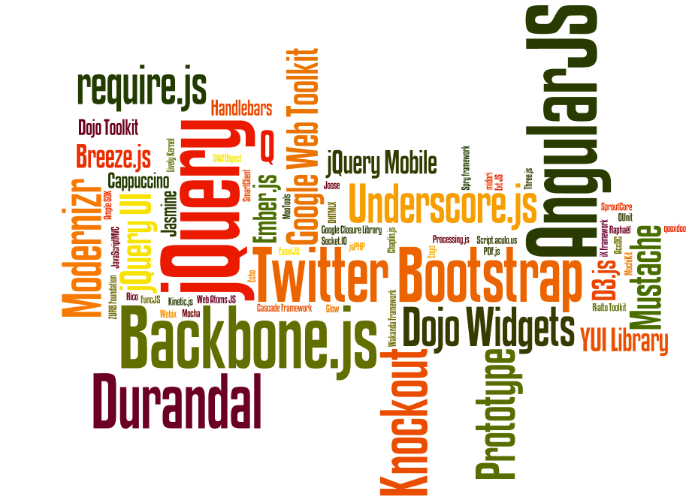

JavaScript Libraries
Only a small sampling ->
Which ones are best?
It depends, of course.
These are the ones that I like for SPAs

Slide 10
Single Page Applications (SPA)
The new hotness – it’s how you write rich clients (almost like the thick-clients) on the web
A page and its assets are loaded once up front
All future communication is done via asynchronous REST calls
At least, this is how we probably should be doing it
NOT EVERY SITE NEEDS TO BE A SPA!!!!
AngularJS, Backbone.js, Ember.js and Durandal

Slide 11

DurandalJS
From the creator of Caliburn.Micro
Clean MV* Architecture
Built on top of jQuery, Knockout & RequireJS
JS & HTML Modularity
Custom Templatable and Bindable Widgets
Simple App Lifecycle
Eventing, Modals, Message Boxes, etc.
Consistent Async Programming w/ Promises
Use any Backend Technology
Integrates with popular CSS libraries such as Bootstrap

Slide 12
The 3 Pillars
jQuery
RequireJS
Knockout

Slide 13
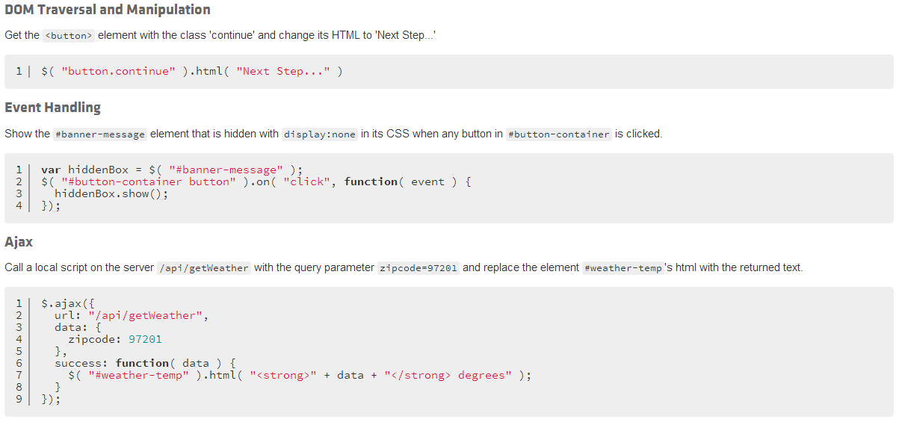
jQuery

Slide 14
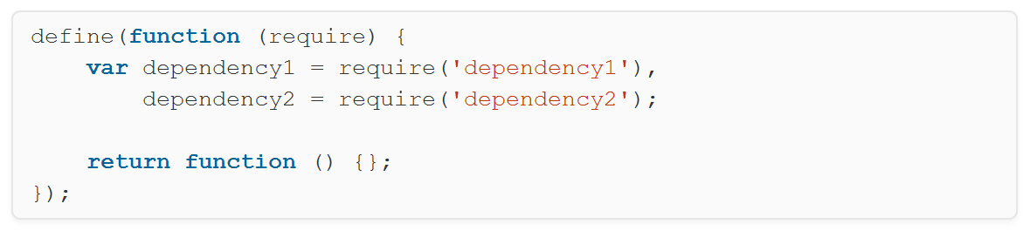
RequireJS
AMD
Wrap
Module Code

Slide 15
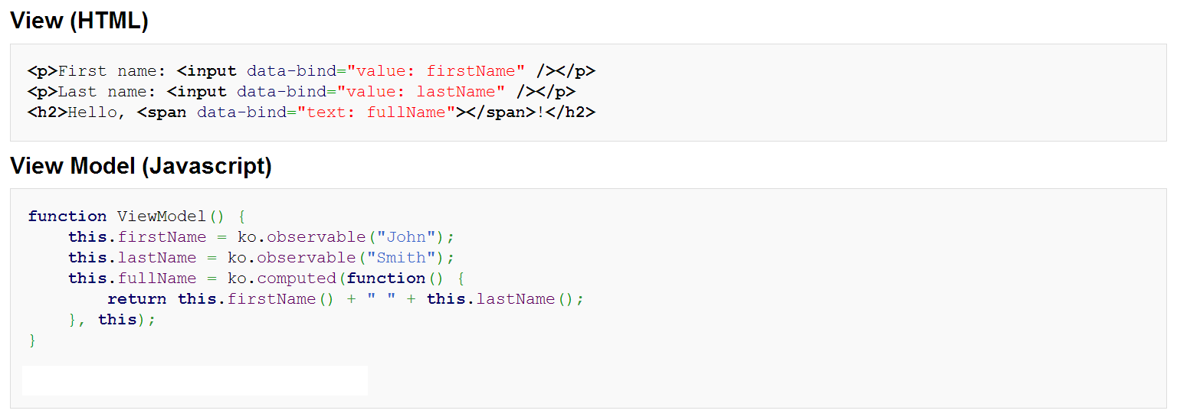
Knockout
Declarative Binding

Slide 16
DEMOS ???
Simple SPA with Durandal

Slide 17
Other helpful libraries
Underscore
LINQ-like operations on JavaScript objects
Toastr
Popup notifications
Breeze.js
Easy data access from the client
Like a database context on the client – it manages entities
SignalR
Real-time client-server communication (pub-sub)

Slide 18
More usefulness…
The web is scary. These help:
Bootstrap
HTML5 Boilerplate
LESS / SASS
CoffeeScript
TypeScript
Templates
SideWaffle
HotTowel
Tools:
Visual Studio 2013!
ReSharper
WebStorm
WebEssentials
What else?

Slide 19
Thanks!
Questions?
adam@adambarney.com
adambarney.com
@cabarney

