Slide 1


Let’s Build a Nebraska.Code() AI Assistant
Adam Barney
Staff Software Engineer, Travefy
adam@adambarney.com
NOT an AI Expert
We have plenty of time!
(We’re hiring! – careers.travefy.com)

Slide 2

Agenda
State of AI
Thinking about LLMs
Figuring out how we’re going to build this
Let’s build it!

Slide 3
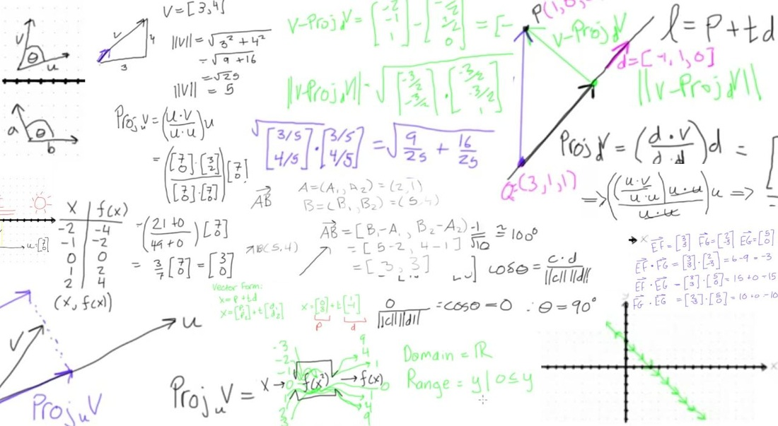
AI is “easy” now
OpenAI
LangChain
Ollama
And more…
HuggingFace

Slide 4
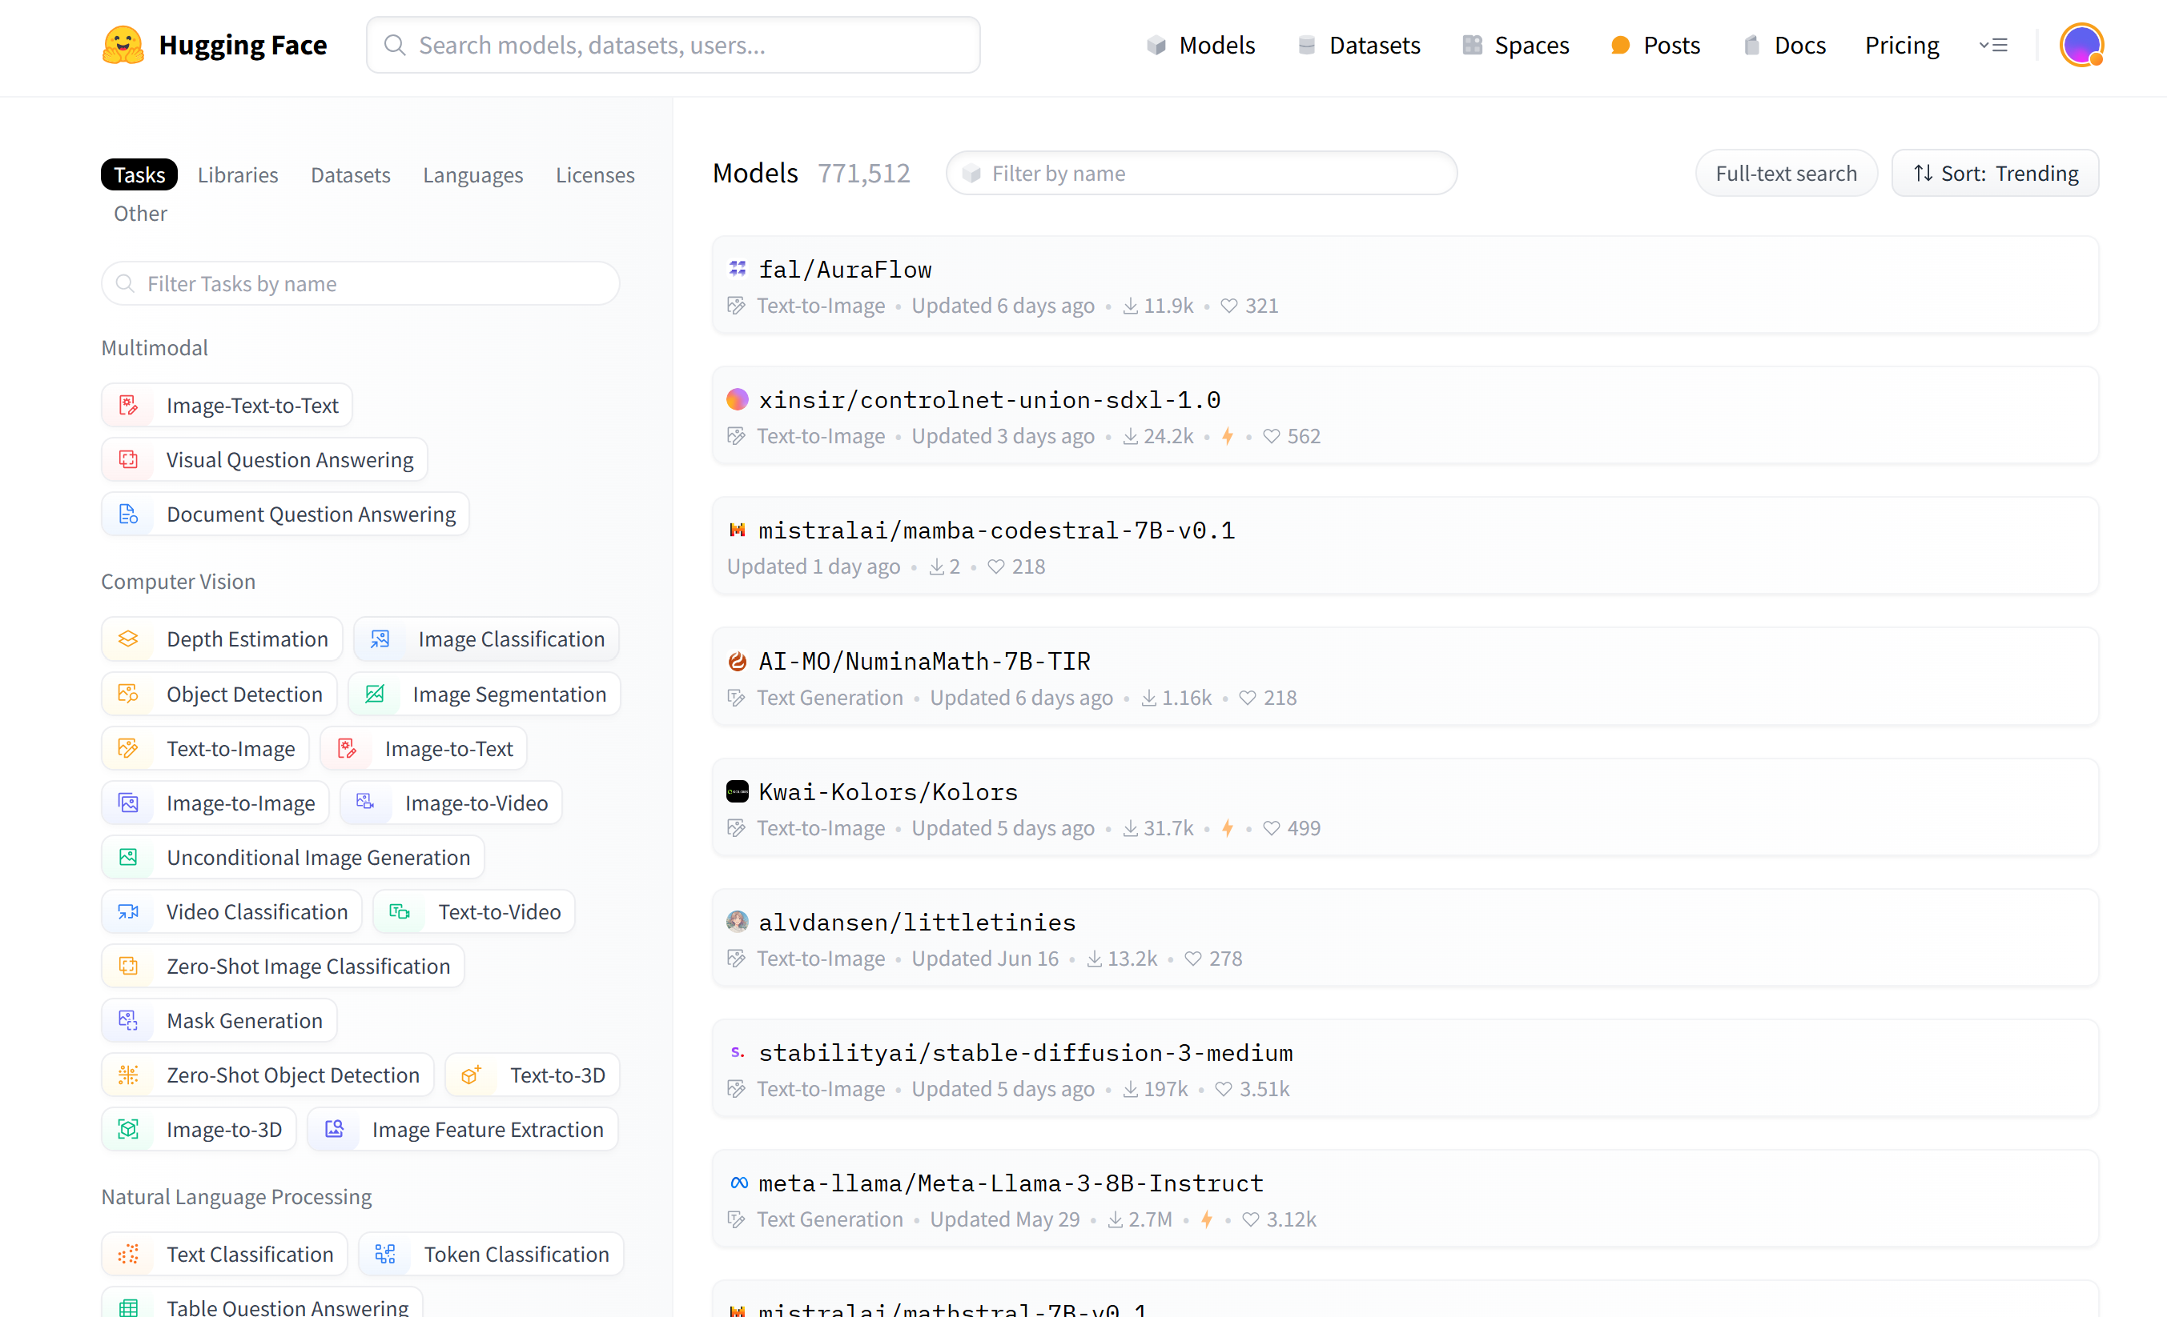

Slide 5

How do AI Assistants (LLMs) Work?

Slide 6

Cable box model: TR-9000
TR-9000 has a history of loose cable connections - when disconnected, shows only a black screen
Last service date: 2/12/2024
Summary: Cable was out because his cat pulled the cable out. Plugging it back in restored service.
The damned thing is broken again. Power’s on, but just black. It’s starting in 10 minutes. What did we do last time?
Respond:
Uh, what? Have you tried turning it off and on again?

Slide 7

Predictive Text Keyboards
Small context
Last couple of words
Any currently typed letters
Small dataset to draw from
Common English words
Word history
Given text context and my knowledge of common words and this user’s history, what 3 words are statistically most likely to come next?

Slide 8
Cable box model: TR-9000
TR-9000 has a history of loose cable connections - when disconnected, shows only a black screen
Last service date: 2/12/2024
Summary: Cable was out because his cat pulled the cable out. Plugging it back in restored service.
You are a helpful assistant for a cable company, helping users with problems related to their cable service and equipment.
You have a query from Customer 1234 at 2:20pm
Query:
The damned thing is broken again. Power’s on, but just black. It’s starting in 10 minutes. What did we do last time?
Respond:
I’ll try to help, but I need more information. The power to what is on? The TV? Your cable box? Seriously, have you tried turning them off and on again? What’s happening in 10 minutes?

Slide 9
Cable box model: TR-9000
TR-9000 has a history of loose cable connections - when disconnected, shows only a black screen
Last service date: 2/12/2024
Summary: Cable was out because his cat pulled the cable out. Plugging it back in restored service.
You are a helpful assistant for a cable company, helping users with problems related to their cable service and equipment.
You have a query from Customer 1234 at 2:20pm:
Name: Ron McRonson
Customer for: 10 years
Cable box model: TR-9000
TR-9000 has a history of loose cable connections - when disconnected, shows only a black screen
Query:
The damned thing is broken again. Power’s on, but just black. It’s starting in 10 minutes. What did we do last time?
Respond:
Alright, Ron, let’s see. Chances are the cable to your box came loose. They do that. Check the connection. I hope this fixes your problem – we appreciate you being a customer for so long! I wouldn’t want you to miss whatever it is in 10 minutes.

Slide 10
Cable box model: TR-9000
TR-9000 has a history of loose cable connections - when disconnected, shows only a black screen
Last service date: 2/12/2024
Summary: Cable was out because his cat pulled the cable out. Plugging it back in restored service.
You are a helpful assistant for a cable company, helping users with problems related to their cable service and equipment.
You have a query from Customer 1234 at 2:20pm:
Name: Ron McRonson
Customer for: 10 years
Service area: Lincoln, NE
Service: Platinum w/ Sports+ Package
Cable box model: TR-9000
TR-9000 has a history of loose cable connections - when disconnected, shows only a black screen
Last service date: 2/12/2024
Summary: Cable was out because his cat pulled the cable out. Plugging it back in restored service.
Upcoming Programming:
2:30: NCAA Football - Husker vs Iowa
Query:
The damned thing is broken again. Power’s on, but just black. It’s starting in 10 minutes. What did we do last time?
Respond:
I’m sorry to hear that, Mr. McRonson. As a valued Platinum subscriber for over 10 years, I’m happy to assist you so you can watch the Husker game! It looks like you have a TR-9000. Those things are prone to the cable cord being knocked out. Perhaps your cat brushed against it like last time. Check the connection and plug it back in if it’s loose.

Slide 11

How do we build an AI Assistant?
Use an existing LLM as-is
Fine-tune an existing LLM with our data
Train a LLM from scratch with our data
Use an Agent to retrieve data on demand
Use Retrieval Augmented Generation to enhance prompts to an existing LLM

Slide 12

Retrieval Augmented Generation (RAG)
Documents are stored in a Vector Database w/ embeddings
User submits query
Embeddings are created for the query
Relevant documents are retrieved from the Vector Store using a similarity search of the embeddings
Documents are used to augment the prompt that’s sent to the LLM
Augmented prompt is sent to the LLM for completion

Slide 13
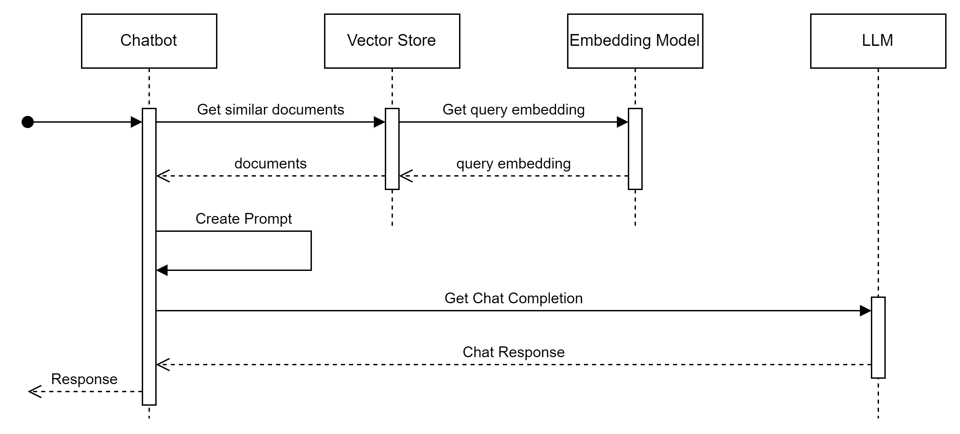
Typical RAG Flow

Slide 14
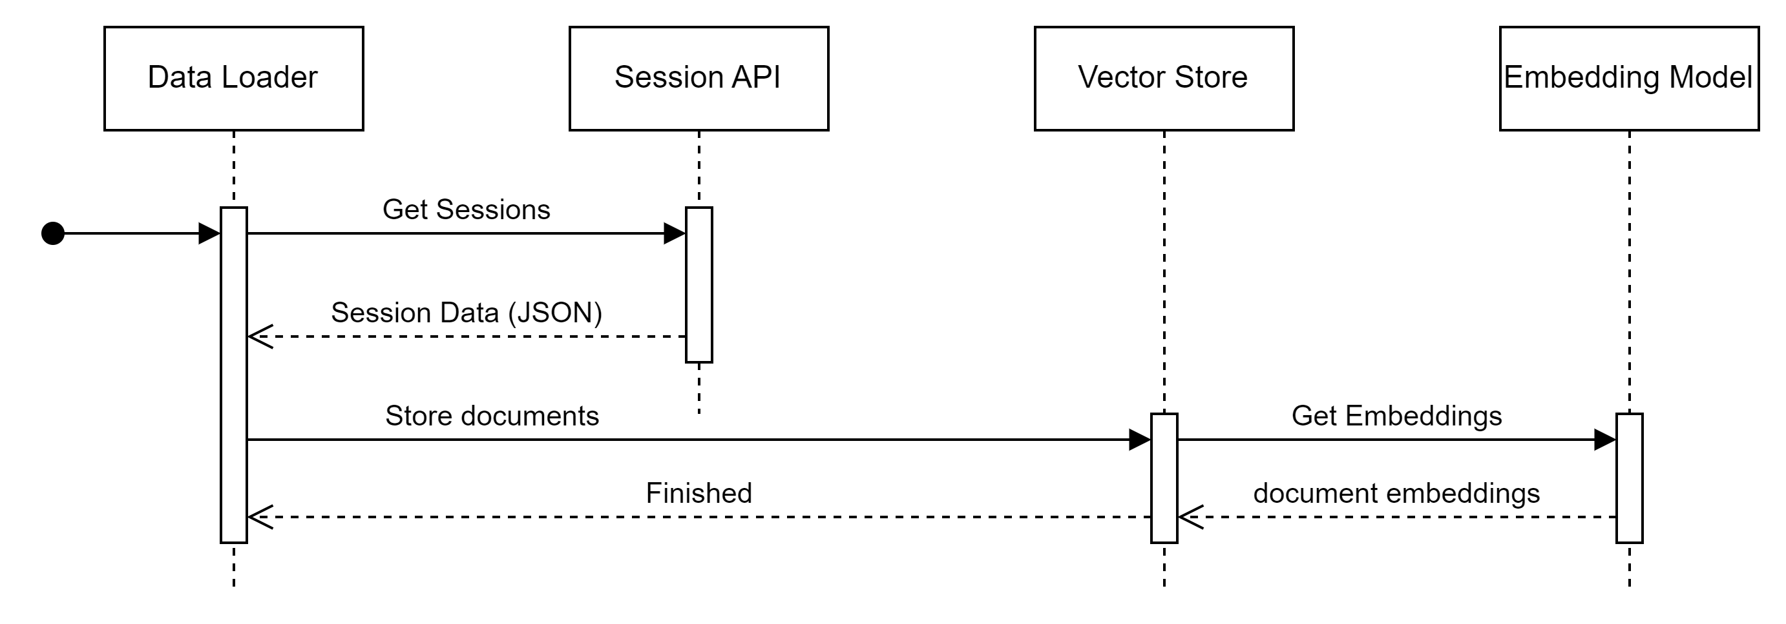
Loading the Data

Slide 15
Embeddings
Paris
France
High dimensional numeric representation of text
Helps group related subjects within the embedding space
Can provide contextual understanding through dynamic embeddings
Dog
Cat

Slide 16
[0.029301034286618233, 0.00038311356911435723, 0.0008067640010267496, -0.008412601426243782, -0.0060058217495679855, 0.019139781594276428, -0.02284056320786476, -0.00793569628149271, -0.008101023733615875, -0.039678484201431274, -0.020093590021133423, -0.0043843453750014305, -0.0046768467873334885, -0.012761973775923252, 0.013251596130430698, 0.004587824456393719, 0.032175179570913315, -0.013938338495790958, 0.006702102720737457, 0.0005714909639209509, 0.012933659367263317, 0.019177934154868126, -0.007318899501115084, 0.0020204868633300066, -0.006129817105829716, -0.0031682378612458706, 0.009938696399331093, -0.01793162152171135, -0.007325258571654558, -0.012959093786776066, 0.031819090247154236, 0.001056344248354435, -0.01964847929775715, -0.018325863406062126, 0.0016739360289648175, -0.024875355884432793, -0.0015237110201269388, -0.028283637017011642, 0.0007137676002457738, 0.006470009218901396, 0.010968810878694057, 0.010282068513333797, -0.0022907329257577658, 0.005614759866148233, -0.009029398672282696, 0.026147102937102318, 0.0028789155185222626, 0.005681526381522417, 0.009913261979818344, 0.014790408313274384, 0.017842600122094154, 0.00712813762947917, -0.02422676607966423, -0.02797841653227806, -0.013277030549943447, 0.0022557599004358053, -0.0027596892323344946, -0.012494906783103943, -0.003360589500516653, -0.01073989737778902, -0.005859570577740669, 0.010383808054029942, -0.013658554293215275, 0.01791890524327755, -0.0032445425167679787, -0.011623760685324669, -0.006511340849101543, 0.014065513387322426, 0.002932964824140072, 0.006040794774889946, 0.021772295236587524, 0.01809694990515709, -0.007598683703690767, -0.016672592610120773, 0.0024004210717976093, -0.0046927435323596, 0.011095985770225525, 0.006543134339153767, -0.015337259508669376, -0.0005396972992457449, 0.029657121747732162, -0.015947697684168816, -0.014459754340350628, 0.01964847929775715, 0.011477509513497353, -0.005859570577740669, -0.015311825089156628, 0.021098271012306213, -0.017206726595759392, -0.023654479533433914, 0.006810201331973076, -0.0029679378494620323, 0.02235729806125164, 0.012513983063399792, 0.008488906547427177, -0.01466323435306549, 0.013442358002066612, 0.03550715371966362, -0.012488547712564468, -0.011324900202453136, -0.014625081792473793, 0.005360410548746586, -0.008412601426243782, -0.003808879991993308, -0.04145892709493637, 0.001936233602464199, 0.011242236942052841, 0.0024353940971195698, 0.020169895142316818, -0.011280389502644539, -0.014714104123413563, 0.02114913985133171, 0.01218968816101551, -0.04969984292984009, -0.006625798065215349, -0.017372053116559982, 0.008304502815008163, -0.005271388217806816, -0.021912187337875366, -0.018313145264983177, 0.028283637017011642, 0.03469323739409447, -0.008310861885547638, -0.01725759729743004, 0.023794371634721756, -0.0230694767087698, -0.021606968715786934, -0.004699102137237787, -0.014714104123413563, 0.0007793419645167887, 0.020704029127955437, 0.026147102937102318, 0.006867429707199335, -0.014421602711081505, -0.009213801473379135, 0.000658923527225852, -0.039017174392938614, 0.012259634211659431, -0.008177327923476696, 0.019762936979532242, -0.004521057941019535, 0.02406143955886364, -0.01943228207528591, -0.00017158639093395323, -0.00024878536351025105, 0.021467076614499092, 0.010517341084778309, -0.008031077682971954, 0.00836173165589571, -0.02764776349067688, 0.04374806955456734, -0.032454963773489, 0.026503192260861397, 0.027088195085525513, 0.0054017421789467335, 0.012145176529884338, -0.013340618461370468, 0.001651680446229875, -0.020894790068268776, -0.0006831662030890584, 0.008043794892728329, 0.010708102956414223, 0.020945660769939423, 0.0106699513271451, -0.010358372703194618, 0.027546023949980736, 0.03087799809873104, -0.016265634447336197, 0.020042721182107925, 0.009124779142439365, -0.011776369996368885, -0.002592772711068392, -0.033014532178640366, 0.030318429693579674, 0.022153818979859352, 0.025994492694735527, -0.006422318518161774, -0.004575107246637344, -0.029122989624738693, -0.01964847929775715, -0.013175291009247303, -0.014218122698366642, 0.0038629292976111174, 0.0009848085464909673, -0.022039363160729408, -0.030242126435041428, 0.0007328437641263008, 0.014739538542926311, 0.009690706618130207, 0.006104381754994392, 0.015070192515850067, 0.03548172116279602, -0.004457470495253801, 0.016812484711408615, -0.6767724752426147, -0.000272034463705495, -0.013467792421579361, 0.010822560638189316, 0.013111704029142857, -0.02336197905242443, 0.004769048187881708, 0.044078726321458817, -0.01636737398803234, 0.003983744885772467, 0.02422676607966423, 0.0005917593953199685, -0.012564852833747864, -0.012011643499135971, -0.01101332250982523, -0.015578891150653362, -0.011776369996368885, -0.0008592235390096903, -0.02287871576845646, 0.017957057803869247, -0.00997049082070589, 0.03156474232673645, -0.00012131266703363508, -0.004629156086593866, 0.01561704371124506, -0.009550814516842365, 4.2201110773021355e-05, -0.046189822256565094, -0.01844032108783722, 0.03479497879743576, -0.04896223172545433, 0.009391846135258675, 0.017715424299240112, -0.005131496116518974, 0.04690200090408325, -0.012348655611276627, -0.009175648912787437, 0.028232766315340996, 0.018669234588742256, 0.036270201206207275, -0.009538096375763416, 0.00456874817609787, 0.017715424299240112, 0.008584287017583847, 0.005560710560530424, 0.00682291854172945, 0.01262208167463541, 0.018046079203486443, 0.03395562618970871, -0.0009697065106593072, 0.017969774082303047, 0.022764258086681366, -0.0008047769078984857, 0.027418848127126694, -0.0001046210018103011, -0.00392333697527647, 0.019928263500332832, 0.0034909434616565704, 0.0013393077533692122, 0.014904865995049477, -0.01655813679099083, 0.02596905827522278, -0.011998925358057022, -0.018707387149333954, -0.0063650901429355145, 0.006301502697169781, -0.027927547693252563, 0.01879640854895115, 6.771054904675111e-05, -0.005919978953897953, 0.01390018593519926, 0.011089627631008625, 0.0037929832469671965, 0.015146497637033463, 0.023133063688874245, 0.0037198576610535383, 0.04056870564818382, -0.006905582267791033, -0.0026881536468863487, 0.012997246347367764, 1.1550038834684528e-05, -0.019216084852814674, -0.03197170048952103, -0.011274030432105064, 0.012990888208150864, -0.024659158661961555, 0.011375769972801208, 0.011731859296560287, 0.0010022950591519475, -0.005506661254912615, 0.00592633755877614, 0.04522329568862915, -0.013175291009247303, -0.004088663961738348, -0.00930918287485838, 0.01739748939871788, -0.006943734362721443, 0.017448358237743378, 0.008158252574503422, 0.0002694512368179858, 0.013416922651231289, 0.00213017500936985, 0.012005284428596497, 0.02238273434340954, -0.00401235930621624, 0.012202405370771885, -0.03599041700363159, 0.0187709741294384, 0.006260171066969633, -0.01280648447573185, 0.0007833162089809775, -0.007248953450471163, -0.025651121512055397, 0.0025069296825677156, -0.004330296069383621, -0.023514587432146072, 0.03342149034142494, 0.003983744885772467, 0.025206010788679123, -0.010784408077597618, 0.016837920993566513, -0.005239594727754593, 0.013722142204642296, -0.017321184277534485, -0.00623155664652586, 0.03161561116576195, 0.00886407122015953, -0.007172648794949055, -0.008686026558279991, -0.020449679344892502, 0.019839242100715637, 0.010415601544082165, 0.011992567218840122, -0.0012590287951752543, 0.02813102677464485, 0.005331796128302813, 0.018732821568846703, 0.00045345703256316483, 0.019750218838453293, 0.001150135532952845, -0.007554172538220882, -0.0048739672638475895, -0.010828918777406216, -0.0032842846121639013, -0.005687884986400604, -0.01246947143226862, -0.007535096257925034, -0.011649195104837418, -0.026147102937102318, 0.00041053557652048767, -0.010606363415718079, -0.029835166409611702, -0.01892358437180519, 0.006136175710707903, -0.013378770090639591, 0.005751472432166338, 0.016672592610120773, -0.02219197154045105, -0.02627427689731121, -0.03227692097425461, -0.004164969082921743, 0.011274030432105064, -0.01840216852724552, -0.014612364582717419, -0.014790408313274384, -0.01296545285731554, -0.001721626496873796, 0.030114950612187386, 0.012603005394339561, -0.02830907143652439, 0.006091664545238018, -0.004893043544143438, -0.012755614705383778, 0.019317826256155968, 0.0025895931757986546, -0.0049057612195611, -0.009557172656059265, -0.0064445738680660725, -0.0018090590601786971, -0.015426281839609146, 0.0036403737030923367, -0.008088306523859501, -0.018020644783973694, -0.0018996709259226918, 0.0007026398088783026, -0.01585867628455162, 0.03487128019332886, 0.0375928170979023, -0.03161561116576195, 0.028537984937429428, 0.013505944982171059, -0.013747576624155045, -0.0013234108919277787, 0.011032398790121078, 0.009061192162334919, -0.01006587129086256, -0.008259992115199566, 0.02526959776878357, 0.01117229089140892, 0.006158431060612202, 0.026147102937102318, 0.016418244689702988, 0.010116741061210632, -0.016850637272000313, 0.0030744464602321386, -0.020920226350426674, 0.014853996224701405, -0.007465150207281113, 0.0044797263108193874, 0.018465755507349968, 0.031641047447919846, -0.04115370661020279, -0.036778900772333145, -0.00013045335072092712, -0.013709424063563347, 0.009608042426407337, -0.005706961266696453, 0.004308040253818035, -0.012844637036323547, -0.009169290773570538, 0.0011572890216484666, 0.02080576866865158, 0.01500660553574562, -0.02065315842628479, -0.018007926642894745, 0.008984887041151524, -0.006797483656555414, 0.014116383157670498, 0.00017456704517826438, -0.02099652960896492, -0.0012033898383378983, -0.014586929231882095, 0.002503750380128622, -0.006228377111256123, 0.010275709442794323, 0.005646553356200457, -0.016329221427440643, -0.029301034286618233, 0.010472830384969711, 0.014332580380141735, 0.010288426652550697, 0.014993888325989246, 0.010072230361402035, -0.04557938501238823, 0.02577829547226429, -0.0070391152985394, 0.022789692506194115, 0.0029917829670011997, -0.009862392209470272, 0.0037929832469671965, -0.006088485009968281, -0.023349260911345482, -0.007280747406184673, 0.00862879864871502, 0.0017057296354323626, -0.02902125008404255, -0.004212659318000078, -0.02698645554482937, 0.005516199395060539, 0.016151176765561104, 0.005233235657215118, 0.014930300414562225, 0.009099344722926617, -0.0033701276406645775, 0.017524663358926773, -0.012571211904287338, -0.012348655611276627, -0.020436961203813553, 0.005125137511640787, 0.006511340849101543, -0.0038756467401981354, 0.00024878536351025105, 0.0014211764791980386, -0.010625439696013927, -0.00040417685522697866, -0.007363410666584969, 0.022637082263827324, -0.015299106948077679, -0.009404563345015049, 0.011668271385133266, 0.008037435822188854, -0.02030978724360466, 0.00904211588203907, 0.015540738590061665, -0.021810447797179222, -0.039653047919273376, -0.016494547948241234, -0.007528737653046846, -0.017613684758543968, 0.021098271012306213, -0.007598683703690767, -0.008482547476887703, -0.02525687962770462, -0.009099344722926617, 0.021721426397562027, 0.014396167360246181, 0.026732105761766434, -0.0064668296836316586, -0.005093343555927277, -0.01151566207408905, -0.0008989656344056129, -0.008101023733615875, 0.012787408195436, -0.02713906392455101, 0.02579101361334324, 0.01042196061462164, -0.015782371163368225, -0.013124421238899231, 0.00021858137915842235, 0.004336654674261808, -0.004196762572973967, -0.017104987055063248, -0.006193404085934162, -0.0037611895240843296, -0.011814522556960583, 0.017613684758543968, 0.012596646323800087, -0.018834561109542847, 0.0136458370834589, 0.002340013161301613, -0.012692027725279331, 0.0002956810058094561, -0.04245088994503021, -0.011617401614785194, 0.0903448536992073, -0.002756509929895401, -0.002842352958396077, 0.020424244925379753, 0.016291068866848946, -0.0005309540429152548, -0.013683989644050598, -0.039856527000665665, 0.020945660769939423, 0.0007213185890577734, 0.013798446394503117, 0.0035227371845394373, 0.005859570577740669, -0.006765690166503191, 0.008164610713720322, 0.011833598837256432, -0.010949735529720783, -0.02318393439054489, 0.013683989644050598, -0.0026500013191252947, 0.006056691519916058, 0.0073379757814109325, 0.022064797580242157, 0.04117914289236069, 0.0179443396627903, 0.030420169234275818, -0.02352730557322502, -0.007007321808487177, 0.013098985888063908, -0.010148534551262856, -0.0005444663693197072, -0.0011978260008618236, -0.004749972373247147, -0.008393525145947933, -0.004546492826193571, 0.02746971882879734, -0.005948592908680439, 0.011922621168196201, 0.01187175139784813, -0.019750218838453293, 0.007713140919804573, 0.02356545813381672, 0.00827270932495594, -0.02579101361334324, 0.010135817341506481, -0.007732217200100422, 0.00022792076924815774, 0.022789692506194115, -0.0034400736913084984, 0.004231735598295927, 0.00657492782920599, 0.00913749635219574, -0.010301144793629646, -0.02593090571463108, -0.01604943722486496, 0.01602400280535221, 0.004457470495253801, 0.0031475720461457968, -0.00038033162127248943, -0.03291279450058937, -0.01772814244031906, -0.013442358002066612, -0.003158699721097946, 0.006524058058857918, -0.004110919777303934, -0.03822869062423706, -0.0005031346227042377, 0.0012216712348163128, -0.00023567047901451588, -0.0213399026542902, -0.0017693169647827744, -0.020525984466075897, -0.02147979475557804, 0.015502586960792542, 0.011363052763044834, -0.00020745360234286636, -0.012812843546271324, -0.023133063688874245, 0.0011119830887764692, -0.008081947453320026, 0.006727537605911493, 0.0058118803426623344, 0.03822869062423706, 0.004244453273713589, -0.019038042053580284, 0.0034845846239477396, 0.006899223197251558, 0.005398562643676996, 0.02493894286453724, 0.02268795296549797, -0.009595325216650963, -0.006317399442195892, 0.022586213424801826, -0.020233482122421265, 0.001670756610110402, 0.010231198742985725, -0.003684884635731578, 0.021963058039546013, -0.020729463547468185, -0.022128384560346603, 0.031183218583464622, -0.018987171351909637, 0.00750330276787281, 0.013340618461370468, -0.004759510513395071, 0.018872713670134544, 0.0007153572514653206, 0.0009005552856251597, -0.006727537605911493, -0.014739538542926311, 0.02455741912126541, -0.0230186078697443, 0.022471755743026733, -0.0005349282873794436, 0.001453764969483018, 0.011375769972801208, 0.01809694990515709, 0.02271338738501072, -0.009023039601743221, 0.016151176765561104, -0.001230414491146803, -0.04468916356563568, 0.020055437460541725, 0.03260757401585579, 0.01218968816101551, -0.03685520589351654, 0.020436961203813553, -0.027902113273739815, -0.03260757401585579, -0.01571878418326378, 0.01169370673596859, -0.005821418482810259, -0.00027600867906585336, -0.014268992468714714, -0.009150214493274689, -0.03774542734026909, -0.015375412069261074, 0.01774086058139801, -0.0341082327067852, 0.01603672094643116, -0.032454963773489, -0.003808879991993308, -0.005433535668998957, -0.023451000452041626, -1.9386678104638122e-05, -0.027215369045734406, -0.02506611868739128, -0.00426352908834815, -0.01706683449447155, 0.028894074261188507, -0.019915545359253883, 0.0007793419645167887, -0.009480868466198444, 0.0008647874346934259, -0.00022891433036420494, -0.01332790032029152, 0.004546492826193571, 0.006470009218901396, 0.004025076981633902, 0.0032175180967897177, 0.028716029599308968, -0.0013250006595626473, 0.02744428440928459, 0.0009212211589328945, -0.024455679580569267, -0.015591609291732311, 0.007764010690152645, -0.01126131322234869, -0.017702708020806313, 0.007401563227176666, 0.00886407122015953, -0.0040536909364163876, -0.008825918659567833, 0.003052190877497196, -0.0009601684287190437, 0.017817165702581406, -0.005939054768532515, -0.014396167360246181, -0.01760096848011017, -0.03443888947367668, 0.006511340849101543, 0.011846316047012806, -0.015807805582880974, 0.030979737639427185, 0.017130421474575996, -0.0016095538157969713, 0.005179186351597309, -0.00853977631777525, 0.008724179118871689, -0.0374910794198513, 0.01271110400557518, 0.009658913128077984, 0.027164500206708908, -0.003961489535868168, 0.0061266375705599785, 0.0001666186290094629, -0.0140782305970788, -0.011134138330817223, -0.015159214846789837, 0.016176613047719002, 0.012825560756027699, 0.008488906547427177, -0.010288426652550697, 0.020424244925379753, -0.006196583621203899, 0.004209480248391628, -0.023311108350753784, -0.0015777602093294263, 0.03497302159667015, 0.0018011105712503195, -0.002932964824140072, -0.0020141280256211758, -0.01807151362299919, -0.04145892709493637, 0.014739538542926311, -0.004066408611834049, -0.021467076614499092, 0.030064081773161888, -0.014358014799654484, -0.011229519732296467, -0.0055988626554608345, 0.012653875164687634, 0.005611580330878496, 0.009169290773570538, 0.03128495812416077, 0.025040684267878532, -0.001772496267221868, -0.019076192751526833, 0.0012574391439557076, -0.010911582969129086, -0.009805163368582726, 0.024328505620360374, -0.005827777087688446, 0.017779013141989708, -0.00913113821297884, 0.015210084617137909, 0.011490227654576302, 0.014536059461534023, -0.009194725193083286, 0.026426887139678, 0.014510625042021275, -0.002818507608026266, -0.008425318636000156, -0.0042603500187397, -0.008552493527531624, 0.004749972373247147, -0.002925016451627016, -0.00400918023660779, -0.013086268678307533, -0.02986060082912445, 0.006848353426903486, 0.026350582018494606, -0.025460360571742058, 0.027952982112765312, 0.017346618697047234, 0.028639724478125572, 0.0005635425332002342, -0.020182613283395767, 0.004037794191390276, -9.965323988581076e-05, 0.012666592374444008, 0.006752972491085529, -0.022637082263827324, 0.016939660534262657, -0.0031618790235370398, -0.0035354546271264553, -0.014675951562821865, 0.0032509013544768095, 0.005328616593033075, 0.026223408058285713, -0.02629971131682396, -0.005748292896896601, -0.00434937234967947, -0.004482905380427837, -0.00931554101407528, 0.034718673676252365, -0.01500660553574562, 0.00605351198464632, 0.02955538220703602, -0.014675951562821865, 0.013429639860987663, -0.008565210737287998, -0.01042196061462164, -0.004559210501611233, -0.02443024516105652, -0.003204800421372056, -0.015553456731140614, 0.004988424479961395, -0.012316862121224403, -0.005236415192484856, -0.0020268454682081938, 0.0013599736848846078, -0.01568063162267208, 0.008660592138767242, 0.019864676520228386, -0.0011994156520813704, 0.006829277146607637, 0.013416922651231289, -0.035761505365371704, 0.011458433233201504, 0.023425566032528877, 0.024341223761439323, -0.009010322391986847, 0.01842760294675827, -0.0003872864763252437, -0.03334518522024155, 0.010053154081106186, 0.01620204746723175, -0.011776369996368885, -0.024837203323841095, 0.025295032188296318, 0.011750935576856136, -0.0080946646630764, -0.022929584607481956, 0.01805879734456539, 0.016469113528728485, -0.01896173693239689, -0.00124949065502733, -0.017295747995376587, 0.023768937215209007, -0.009010322391986847, -0.00827270932495594, 0.024646442383527756, -0.010053154081106186, -0.001519736717455089, 0.01484127901494503, -0.002271656645461917, 0.005458970554172993, -0.02866516076028347, -0.005611580330878496, -0.0014521752018481493, 0.016926942393183708, 0.002958399709314108, -0.004473367240279913, -0.0012701565865427256, -0.002010948723182082, -0.018211405724287033, 0.023857958614826202, -0.00294568226672709, -0.010046795010566711, 0.010720821097493172, 0.047690484672784805, -0.01584595814347267, 0.004110919777303934, -0.0032143385615199804, -0.023005889728665352, -0.014701386913657188, 0.0033097194973379374, -0.028436245396733284, -0.016100307926535606, -0.006765690166503191, 0.036626290529966354, 0.018198689445853233, -0.002584824338555336, -0.040873922407627106, 0.01655813679099083, -0.015426281839609146, 0.012940018437802792, -0.0014354835730046034, -0.004889864474534988, 0.0031300855334848166, -0.009480868466198444, 4.438692485564388e-05, 0.032505832612514496, 0.021912187337875366, 0.003853391157463193, -0.027876676991581917, 0.004174507223069668, 7.257895777001977e-05, -0.026070797815918922, 0.009525379166007042, -2.8738484616042115e-05, -0.02744428440928459, -0.020208047702908516, 0.005996283609420061, -0.04817374795675278, -0.00734433438628912, 0.011159573681652546, 0.0034655085764825344, -0.002643642481416464, -0.021352618932724, 0.006190225016325712, 0.013798446394503117, 0.02645232155919075, 0.003274746472015977, -0.016278352588415146, -0.02609623223543167, 0.009029398672282696, -0.0008894275524653494, -0.0018408526666462421, 0.014307145029306412, 0.02357817441225052, -0.0011620580917224288, -0.002850301330909133, -0.00032826949609443545, -0.02167055569589138, -0.007732217200100422, -0.00988782662898302, 0.008921300061047077, 0.0004252401413396001, 4.5604025217471644e-05, 0.02576557919383049, -0.005013859365135431, -0.03334518522024155, -0.013200726360082626, -0.006619438994675875, -0.017651837319135666, 0.018325863406062126, 0.009849674999713898, -0.005919978953897953, -0.021403489634394646, -0.0008719410398043692, 0.005834135692566633, -0.010771690867841244, -0.028894074261188507, 0.014574212022125721, -0.013353335671126842, 0.0008218659786507487, 0.016011284664273262, 0.017295747995376587, -0.003424176713451743, -0.00785939209163189, -0.006225198041647673, -0.01620204746723175, 0.005958131048828363, -0.007198083680123091, 0.02917385846376419, -0.02287871576845646, -0.004562389571219683, 0.02955538220703602, -0.012056154198944569, -0.007833956740796566, 0.01844032108783722, 0.017333900555968285, -0.02285327948629856, 0.015286389738321304, 0.23766393959522247, 0.002414728282019496, -0.01314985565841198, 0.020411526784300804, 0.02678297646343708, 0.014065513387322426, 0.022637082263827324, -0.008692385628819466, 0.0024369836319237947, 0.0040282560512423515, -0.011286747641861439, 0.002238273387774825, -0.013785729184746742, 0.01135033555328846, -0.0017200368456542492, -0.0256002526730299, -0.008259992115199566, -0.014052796177566051, -0.0011119830887764692, -0.0047531514428555965, 0.013963773846626282, -0.015655195340514183, 0.011477509513497353, -0.021428924053907394, 0.028792334720492363, 0.024811768904328346, -0.004772227723151445, -0.02421404793858528, 0.03845760598778725, 0.003079215530306101, 0.00801836047321558, -0.00635555200278759, -0.010415601544082165, 0.010701744817197323, -0.014637799002230167, -0.019394129514694214, 0.005290464498102665, -0.007980207912623882, 0.009697064757347107, 0.017702708020806313, -0.003134854370728135, 0.001796341617591679, 0.003373306943103671, -0.011401205323636532, 0.006190225016325712, 0.007649553474038839, -0.012577570043504238, -0.0187582578510046, -0.005732396151870489, 0.017639121040701866, 1.826893276302144e-05, -0.019699349999427795, 0.001557889161631465, 0.03484584763646126, -0.01653270050883293, -0.0023113987408578396, 0.030954303219914436, -0.011776369996368885, 0.0027422027196735144, -0.02627427689731121, 0.007566890213638544, 0.04751243814826012, -0.030674519017338753, 0.025676555931568146, -0.0002430227614240721, 0.004368448164314032, -0.03667716309428215, 0.017206726595759392, 0.002473546424880624, 0.0213399026542902, -0.01117229089140892, -0.02066587656736374, -0.004641873762011528, -0.013773011974990368, 0.006225198041647673, -0.004784945398569107, 0.014790408313274384, 0.02782580815255642, 0.027088195085525513, -0.003897902322933078, -0.022611647844314575, -0.0027453822549432516, -0.01314985565841198, 0.00023010658333078027, -0.005821418482810259, -0.035100195556879044, 0.017791729420423508, -0.011973490938544273, -0.0179443396627903, -0.011522021144628525, -0.0051378547213971615, 0.011928979307413101, 9.08478887140518e-06, 0.004619618412107229, 0.020704029127955437, 0.021467076614499092, -0.003916978370398283, 0.02629971131682396, -0.020017284899950027, -0.0023749861866235733, -0.015642479062080383, -0.03052191063761711, 0.01219604630023241, 0.01058092899620533, 0.006905582267791033, 0.012507623992860317, 0.00712813762947917, 0.009957772679626942, 0.008895864710211754, -0.014116383157670498, 0.007897543720901012, -0.03281105309724808, 0.0162274818867445, -0.0025514408480376005, -0.005630656611174345, 0.007045474369078875, 0.021746860817074776, -0.01911434531211853, -0.0052554914727807045, -0.002818507608026266, 0.009188366122543812, -0.009957772679626942, -0.033370621502399445, 0.017155855894088745, -0.006969169247895479, -0.0256129689514637, -0.0018408526666462421, 0.025727426633238792, -0.005071088206022978, -0.025689274072647095, 0.02609623223543167, -0.013658554293215275, 0.001324205775745213, -0.0054017421789467335, -0.014154535718262196, -0.0034782260190695524, 0.016176613047719002, -0.027367979288101196, -0.027520589530467987, -0.003190493443980813, 0.0034973020665347576, -0.0307253897190094, -0.002573696430772543, -0.02422676607966423, 0.020742181688547134, -0.02406143955886364, 0.018033361062407494, -0.014943018555641174, -0.019203368574380875, 0.006263350136578083, -0.03611759468913078, -0.01841488480567932, -0.016634440049529076, -0.019063476473093033, 0.02731710858643055, 0.00018440320855006576, -0.010409243404865265, -0.01827499270439148, 0.0012025950709357858, 0.0264777559787035, -0.006772048771381378, 0.002975886221975088, 0.02337469533085823, -0.008851354010403156, -0.002754920395091176, 0.0036244767252355814, -0.16146090626716614, 0.01210702396929264, 0.018020644783973694, -0.027927547693252563, -0.0003040268493350595, 0.023171216249465942, 0.013022681698203087, 0.010733538307249546, -0.028944944962859154, 0.007662271149456501, -0.00010243518772767857, -0.0004618028469849378, -0.02762232907116413, 0.020894790068268776, 0.0019950519781559706, -0.002233504317700863, 0.003436894156038761, 0.008259992115199566, 0.02886863984167576, 0.0032175180967897177, 0.024977095425128937, -0.008565210737287998, 0.009569890797138214, -0.004772227723151445, 0.019534021615982056, -0.004301681648939848, 0.000720523705240339, 0.027927547693252563, 0.01534997671842575, -0.025040684267878532, 0.006260171066969633, -0.0056656296364963055, 0.011369411833584309, -0.004152251407504082, 0.03451519459486008, -0.007764010690152645, 0.00571014080196619, -0.010377448983490467, -0.016303787007927895, 0.01947043463587761, 0.03090343438088894, -0.004365269094705582, 0.00990690290927887, 0.022967737168073654, -0.01805879734456539, 0.015197367407381535, -0.009983208030462265, 0.018567495048046112, -0.001421971246600151, -0.015337259508669376, 0.029962342232465744, -0.03214974328875542, -0.004517878405749798, -0.004619618412107229, 0.03652455285191536, 0.02356545813381672, -0.0034209974110126495, 0.012316862121224403, -0.00032926304265856743, -0.020945660769939423, -0.02187403477728367, -0.021797729656100273, -0.017372053116559982, -0.009487226605415344, 0.030928868800401688, 0.0015014554373919964, -0.0008536596433259547, 0.019177934154868126, -0.008813201449811459, 0.013493227772414684, 0.024366658180952072, -0.009182007983326912, 0.015934979543089867, 0.008177327923476696, 0.0034400736913084984, 0.002710409229621291, -0.046164389699697495, -0.0170795526355505, 0.012145176529884338, 0.00043199630454182625, -0.019877392798662186, 0.04486720636487007, -0.023425566032528877, 0.013874751515686512, -0.011712783016264439, 0.004934375640004873, 0.011579249054193497, 0.009499944746494293, -0.017015963792800903, -0.0012320041423663497, 0.0014179970603436232, 0.014968452975153923, 0.008978528901934624, -0.01738477125763893, 0.0089530935510993, 0.006905582267791033, 0.022497190162539482, 0.00635555200278759, -0.005993104074150324, -0.02050055004656315, 0.00623473571613431, 0.010485547594726086, -0.036270201206207275, 0.0011930569307878613, -0.012825560756027699, 0.02443024516105652, 0.018503908067941666, 0.007280747406184673, 0.02220468968153, -0.006702102720737457, -0.014548776671290398, -0.0041204579174518585, 0.007255312521010637, 0.01459964644163847, -0.015210084617137909, 0.04008544236421585, 0.016799768432974815, -0.006988245528191328, 0.013569531962275505, -0.029148424044251442, 0.016952376812696457, -0.010561852715909481, -0.012259634211659431, -0.0059835659340023994, 0.007528737653046846, 0.007611401379108429, -0.09080268442630768, -0.00802471861243248, 0.0029822448268532753, 0.004861250054091215, 0.009092985652387142, 0.019673913717269897, -0.001166827161796391, 0.030852563679218292, -0.0017613685922697186, 6.771054904675111e-05, -0.011185008101165295, -0.019864676520228386, 0.0015801447443664074, -0.010854354128241539, 0.019165216013789177, -0.02526959776878357, 0.0013591788010671735, -0.02698645554482937, -0.002618207596242428, 0.0196357611566782, 0.0046069007366895676, -0.007382486946880817, -0.01287643052637577, -0.029962342232465744, -0.01117229089140892, 0.0048739672638475895, -0.02234458178281784, 0.007751293480396271, 0.021403489634394646, 0.00537312775850296, -0.005493943579494953, -0.026248842477798462, -0.026223408058285713, -0.02609623223543167, -0.016850637272000313, -0.017524663358926773, -0.015896828845143318, 0.011738217435777187, 0.0011119830887764692, -0.0512513741850853, 0.010517341084778309, -0.010574569925665855, 0.025854600593447685, -0.04451111704111099, 0.003634014865383506, -0.01841488480567932, -0.01861836574971676, 0.021060118451714516, 0.004203121177852154, 0.0006458086427301168, -0.013124421238899231, -0.019750218838453293, -0.005166469141840935, -0.010892506688833237, -0.007293464615941048, -0.009856033138930798, 0.006625798065215349, 0.02151794545352459, -0.00413635466247797, 0.007732217200100422, -0.010040436871349812, 0.007439715322107077, -0.011992567218840122, 0.049928758293390274, 0.024710029363632202, 0.019572174176573753, -0.029122989624738693, 0.014866713434457779, 0.01466323435306549, -0.007700423710048199, -0.0256129689514637, 0.016163894906640053, -0.021072834730148315, 0.01841488480567932, -0.012901865877211094, -0.02524416334927082, -0.03395562618970871, 0.0059835659340023994, 0.013404205441474915, -0.004896223079413176, 0.0011429819278419018, -0.013696706853806973, -0.012971811927855015, -0.018681952729821205, 0.006937375757843256, 0.025727426633238792, -0.005360410548746586, -0.03019125573337078, -0.00499478355050087, 0.001956899417564273, 0.011903544887900352, 0.03207344189286232, 0.02237001620233059, -0.009112061932682991, -0.00012578365567605942, -0.008870430290699005, -0.013366052880883217, -0.015756936743855476, 0.011274030432105064, 0.005993104074150324, -0.005350872408598661, -0.010943376459181309, -0.052294205874204636, 0.0009760652319528162, 0.006454112008213997, -0.019063476473093033, 0.0037039609160274267, 0.0016341939335688949, -0.005999462679028511, -0.01212610024958849, 0.013442358002066612, 0.0067847659811377525, -0.015133780427277088, -0.007242594845592976, -0.005776907317340374, -0.008323579095304012, 0.0018678773194551468, 0.009639836847782135, 0.0014402526430785656, 0.005067908670753241, 0.005176007281988859, 0.0008186866180039942, -0.012844637036323547, -0.010727179236710072, -0.006218838971108198, 0.015375412069261074, -0.015477151609957218, 0.02253534272313118, -0.03492215275764465, 0.025345902889966965, -0.02151794545352459, -0.0015634529991075397, 0.019381413236260414, -0.028766900300979614, 0.0021778654772788286, 0.037287600338459015, -0.019508587196469307, -0.003697602078318596, -0.010301144793629646, 0.0281564611941576, 0.01569334790110588, 0.010975169949233532, -0.021568816155195236, -0.02830907143652439, 0.02780037187039852, 0.005300002638250589, -0.022141102701425552, -0.025053400546312332, -0.01348051056265831, 0.014790408313274384, 0.032454963773489, -0.007541455328464508, 0.02033522166311741, 0.025040684267878532, -0.013264313340187073, -0.016939660534262657, 0.0011262902989983559, -0.013887468725442886, -0.006352372467517853, -0.011159573681652546, 0.008679668419063091, -0.007617759983986616, 0.027902113273739815, 0.02645232155919075, 0.02437937632203102, -0.00734433438628912, 0.03039473481476307, 0.010256633162498474, -0.02065315842628479, 0.02544764243066311, -0.011407563462853432, -0.015210084617137909, 0.0007225108565762639, -0.014421602711081505, 0.01108326856046915, 0.01995369791984558, 0.00920108426362276, -0.001507019274868071, 0.013836598955094814, -0.0037198576610535383, -0.006476367823779583, 0.030292995274066925, 0.014408884570002556, 0.017015963792800903, -0.026376016438007355, 0.01144571602344513, 0.0196357611566782, 0.014625081792473793, -0.026325147598981857, -0.0067593310959637165, -0.021352618932724, 0.013200726360082626, -0.02030978724360466, -0.010943376459181309, -0.0046069007366895676, 0.0013456664746627212, 0.015744218602776527, 0.009805163368582726, -0.005764189641922712, -0.017321184277534485, 0.027927547693252563, 0.019826523959636688, 0.003564068814739585, -0.001670756610110402, -0.02919929288327694, -0.016087589785456657, -0.044638294726610184, 0.001349640660919249, 0.0021460717543959618, -0.04420590028166771, 0.005398562643676996, 0.0051632896065711975, 0.002093612216413021, -0.01443431992083788, 0.009690706618130207, -0.0028868638910353184, 0.01459964644163847, -0.004721357952803373, -0.03998370096087456, -0.005430356599390507, -0.01844032108783722, -0.0033224369399249554, -0.018567495048046112, -0.0027835345827043056, -0.011719141155481339, 0.010116741061210632, -0.0038184181321412325, 0.01534997671842575, 0.0027422027196735144, 0.0002309014234924689, -0.004749972373247147, 0.016341939568519592, 0.013188008219003677, 0.0021492510568350554, -7.506283145630732e-05, -0.016278352588415146, -0.019584892317652702, -0.00626652967184782, 0.007884826511144638, 0.010294785723090172, -0.00869874469935894, 0.04072131589055061, 0.015426281839609146, -0.00431439932435751, 0.02782580815255642, 0.008686026558279991, 0.028944944962859154, -0.001462508225813508, 0.0004645847948268056, -0.0031809553038328886, -0.023946981877088547, 0.017283031716942787, 0.013200726360082626, 0.019165216013789177, -0.02952994778752327, -0.032531268894672394, -0.025345902889966965, 0.0018885431345552206, 0.008965810760855675, -0.015044758096337318, -0.009391846135258675, 0.021263597533106804, 0.0034273560158908367, 0.01997913420200348, 0.012679309584200382, -0.015833240002393723, -0.029301034286618233, 0.02441752701997757, 0.002851890865713358, -0.025536663830280304, -0.013353335671126842, -0.005096523091197014, -0.005856391508132219, -0.01688878983259201, -0.002037973375990987, 0.007299823220819235, 0.00036125542828813195, 0.0016437319573014975, -0.019330542534589767, 0.0017979312688112259, 0.019038042053580284, 0.009264671243727207, 0.009449074976146221, -0.0016675773076713085, -0.027851242572069168, 0.005296823102980852, -0.0053063612431287766, -0.002403600374236703, -0.008902223780751228, -0.004972527734935284]

Slide 17

Enough talk
Let’s build it already

Slide 18

Future Improvements
Chat memory
Add user info to context
Agent capabilities

Slide 19
Questions?
Adam Barney
Staff Software Engineer, Travefy
adam@adambarney.com

