Slide 1
Building the Internet of Things…
With JavaScript???

Slide 2
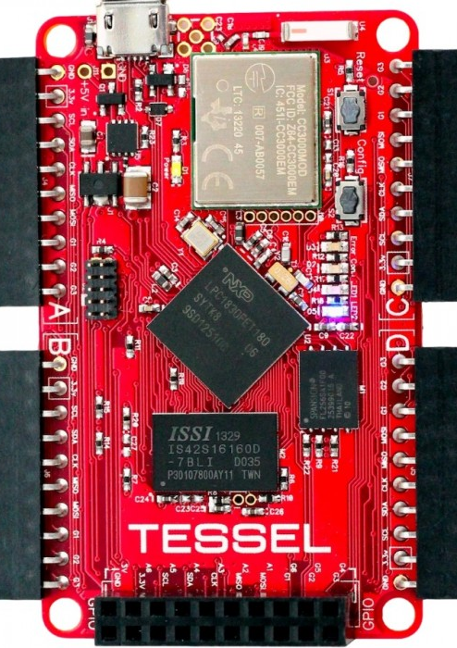


Slide 3
The Internet
CC3000 WiFi Chip
The Brain
ARM Cortex M3 Microprocessor
Enough Memory
…that you likely won’t have to worry about it
32MB each of Flash and RAM

Slide 4
Installing
Updating
Getting online
npm install tessel -g
tessel update
tessel wifi –n <ssid> -p <pw>

Slide 5
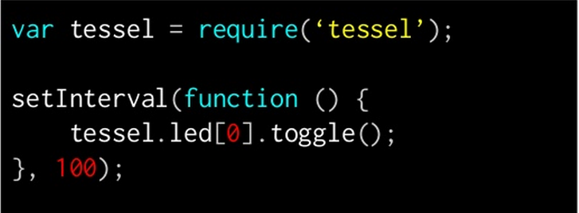
Blinking Lights
tessel run blink.js

Slide 6
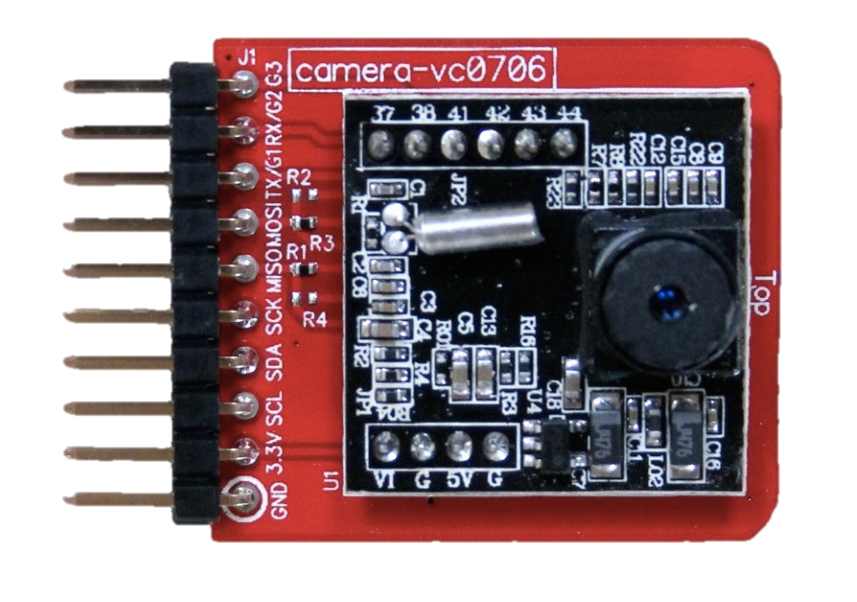

Slide 7
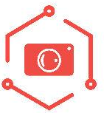
npm install camera-vc0706
camera.takePicture(function(){});

