Slide 1

Clustering with an N-Dimensional Extension of Gielis Superformula
AIKED 2008
Cambridge, U.K.
Angel Kuri
akuri@itam.mx
Instituto Tecnológico Autónomo de México
http://www.itam.mx/es/index.php
February 22, 2008

Slide 2
Clustering
Clustering can be considered the most important unsupervised learning problem; so, as every other problem of this kind, it deals with finding a structure in a collection of unlabeled data.
A loose definition of clustering could be “the process of organizing objects into groups whose members are similar in some way”.
A cluster is therefore a collection of objects which are “similar” between them and are “dissimilar” to the objects belonging to other clusters

Slide 3
Clustering
The clustering problem has been addressed in many contexts and by researchers in many disciplines; this reflects its broad appeal and usefulness as one of the steps of exploratory data analysis.

Slide 4
Clustering: Associated Issues
Regardless of the approach selected to tackle this problem, there are 4 basic associated issues:
How many clusters are there?
Which is the best way to determine similarities? What distance to use?
Which is the best algorithm?
How representative are the clusters?

Slide 5
How Many Clusters are There?
This problem has no unique solution. It depends on the type of data, the distance used, etc.
“Elbow criterion”.
Extended penalized competitive learning
GAP statistic
Bayesian information criterion
Evolutionary algorithms (entropy based fitness)
Parsimony and homogeneity

Slide 6
How representative are the clusters?
There are several measures of “quality”
  Dunn and Dunn-like validity indices
  Davies-Bouldin validity index
  SD validity index
  S_Dbw validity index
  DBSCAN algorithm (density based)
  DENCLUE algorithm (density based)
  Variance of the nearest neighbor (VNN)

Slide 7
A measure of goodness?
If the validity indices are a good measure of success it would seem natural to try to directly find the clusters from such indices.
That is the approach of DBSCAN, for instance.
But even then, some clusters are poorly evaluated if they present irregular shapes.
Purportedly, the VNN index is superior to others. Their use as an explicit optimization distance is, however, difficult to implement (but wait a bit).

Slide 8
What distance to use?
Which is the best algorithm?
This matters are central to our study.
We discuss them in what follows

Slide 9
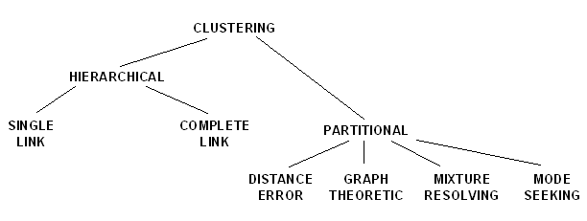
Taxonomy
A taxonomy of clustering approaches is the following.

Slide 10
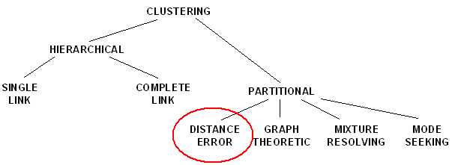
Taxonomy
We shall focus in clustering with the aim of minimizing some kind of error measure.

Slide 11
Clustering
The problem is to find an appropriate set of clusters assuming their number is given and the data has be chosen such that it is representative of the population and, therefore, the clustering derived from the sample applies with generality to the population from which the sample has been collected.

Slide 12
The Goals of Clustering
For instance, we could be interested in finding representatives for homogeneous groups (data reduction), in finding “natural clusters” and describe their unknown properties (“natural” data types), in finding useful and suitable groupings (“useful” data classes) or in finding unusual data objects (outlier detection).

Slide 13
The Goals of Clustering
So, the goal of clustering is to determine the intrinsic grouping in a set of unlabeled data. But how to decide what constitutes a good clustering? It can be shown that there is no absolute “best” criterion which would be independent of the final aim of the clustering. Consequently, it is the user which must supply this criterion, in such a way that the result of the clustering will suit their needs.

Slide 14
Distance Measure
An important component of a clustering algorithm is the distance measure between data points.
If the components of the data instance vectors are all in the same physical units then it is possible that the simple Euclidean distance metric is sufficient to successfully group similar data instances.
However, even in this case the Euclidean distance can sometimes be misleading.

Slide 15
Distance Measure
The next figure illustrates this with an example of the width and height measurements of an object.
Despite both measurements being taken in the same physical units, an informed decision has to be made as to the relative scaling. As the figure shows, different scalings can lead to different clusterings

Slide 16
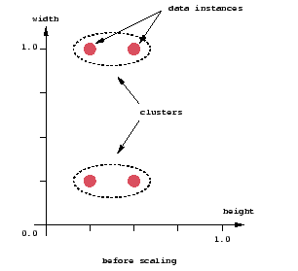
Distance Measure

Slide 17
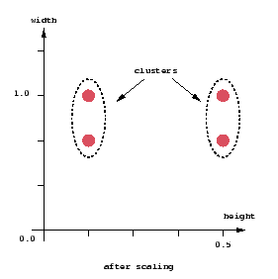
Distance Measure

Slide 18
Distance Measure
Notice however that this is not only a graphic issue: the problem arises from the mathematical formula used to combine the distances between the single components of the data feature vectors into a unique distance measure that can be used for clustering purposes: different formulas lead to different clusterings.

Slide 19
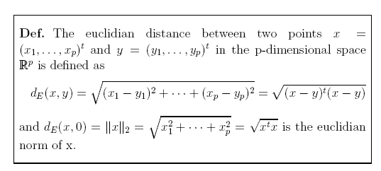
Euclidean Distance

Slide 20
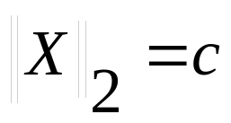
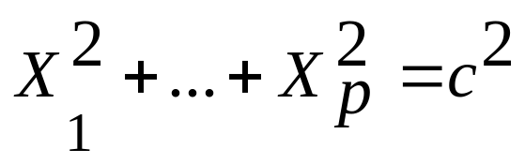
Euclidean Distance
It follows, immediately, that all points with the same
distance of the origin satisfy
which is the equation of a spheroid.
This issue is central to the considerations leading to the approach we have taken in our study.

Slide 21
Mahalanobis Distance
We would, alternatively, like to have a distance that for each of the components (the variables) takes the variability of that component into account when determining its distance from the center. Components with high variability should receive less weight than components with low variability. This can be obtained by rescaling the components.

Slide 22
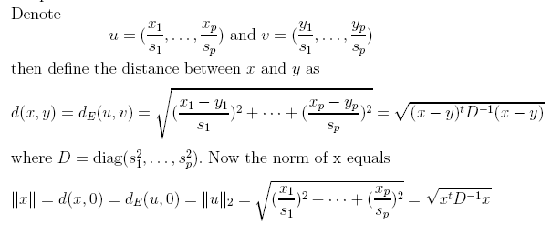
Mahalanobis Distance

Slide 23
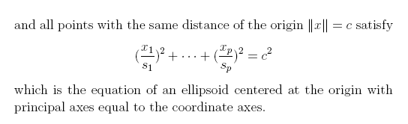
Mahalanobis Distance

Slide 24
Mahalanobis Distance
Finally, we also want to take the correlation between variables into account when computing statistical distances. Correlation means that there are associations between the variables. Therefore, we want the axes of the ellipsoid to reflect this correlation. We allow the axes of the ellipsoid at constant distance to rotate. This yields the following general form for the distance of two points.

Slide 25
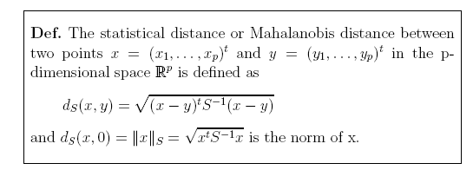
Mahalanobis Distance

Slide 26
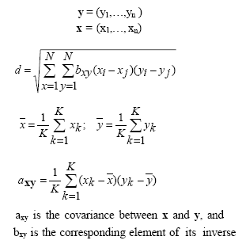
Mahalanobis Distance

Slide 27
Mahalanobis Distance
a=new double[V][V];
cov(a,dato); //Calculate covariance
b=new double[V][V];
if (!Inverse(a,b,V)){
System.out.println("Non-invertible");
return false;
}//endIf

Slide 28
Mahalanobis Distance
CALCULATE THE COVARIANCE MATRIX
for (int i=0;i<V;i++){
for (int j=0;j<V;j++){
cov[i][j]=0;
for (int k=0;k<U;k++){
cov[i][j]=cov[i][j]+(X[k][i]-
mu[i])*(X[k][j]-mu[j]);
}cov[i][j]=cov[i][j]/U;
}//endFor
}//endFor

Slide 29
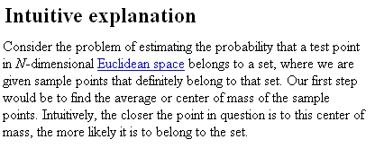
Mahalanobis Distance

Slide 30
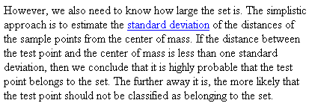
Mahalanobis Distance

Slide 31
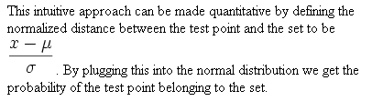
Mahalanobis Distance

Slide 32
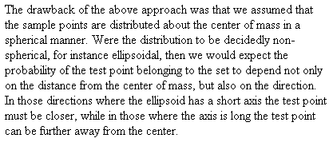
Mahalanobis Distance

Slide 33
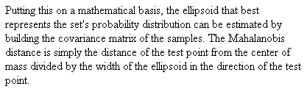
Mahalanobis Distance

Slide 34
Mahalanobis Distance
This measure (and many others) have been invented to try to circumvent the inherent hyper-spheroidicity of the spaces resulting from classical distance measures

Slide 35
Some Clustering Methods
There are many approaches to minimum distance clustering. Some of them:
K-means
Fuzzy C-means
Hierarchical dynamic clustering
Self-Organizing Maps
Genetic algorithmic clustering

Slide 36
Some Clustering Methods
We now briefly describe a few of the attempts at practically solving the problem of clustering a set of arbitrary data.
In the statistically based methods the distance is usually taken to be Euclidean. But this need not be the case, as already discussed.

Slide 37
K-Means
K-means (MacQueen, 1967) is one of the simplest unsupervised learning algorithms that solve the well known clustering problem. The procedure follows a simple and easy way to classify a given data set through a certain number of clusters (assume k clusters) fixed a priori. The main idea is to define k centroids, one for each cluster. These centroids should be placed in a cunning way because of different location causes different result. So, the better choice is to place them as much as possible far away from each other.

Slide 38
K-Means
The next step is to take each point belonging to a given data set and associate it to the nearest centroid. When no point is pending, the first step is completed and an early groupage is done. At this point we need to re-calculate k new centroids as barycenters of the clusters resulting from the previous step. After we have these k new centroids, a new binding has to be done between the same data set points and the nearest new centroid.
A loop has been generated. As a result of this loop we may notice that the k centroids change their location step by step until no more changes are done. In other words centroids do not move any more.

Slide 39


K-Means
This algorithm aims at minimizing an objective function, in this case a squared error function: the objective function
where is a chosen distance measure between a data point x_{i}^{(j)} and the cluster center c_{j}, is an indicator of the distance of the n data points from their respective cluster centres.

Slide 40

Fuzzy C-Means
Fuzzy c-means (FCM) is a method of clustering which allows one piece of data to belong to two or more clusters. This method is frequently used in pattern recognition. It is based on minimization of the following objective function:

Slide 41
Fuzzy C-Means
where m is any real number greater than 1, u_{ij} is the degree of membership of x_{i} in the cluster j, x_{i} is the ith of d-dimensional measured data, c_{j} is the d-dimension center of the cluster, and ||*|| is any norm expressing the similarity between any measured data and the center

Slide 42
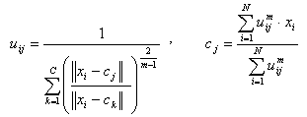
Fuzzy C-Means
Fuzzy partitioning is carried out through an iterative optimization of the objective function shown above, with the update of membership uij and the cluster centers c_{j} by:

Slide 43
Fuzzy C-Means
The iteration will stop when where ε is a termination criterion between 0 and 1, whereas k are the iteration steps. This procedure converges to a local minimum or a saddle point of J_{m}.

Slide 44
Fuzzy C-Means
Consider the simple case of a one dimensional application of the FCM. Twenty data and three clusters are used to initialize the algorithm and to compute the U matrix. The figures below show the membership value for each datum and for each cluster. The color of the data is that of the nearest cluster according to the membership function.

Slide 45
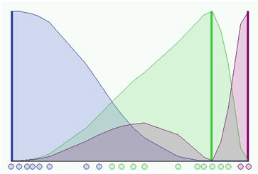
Fuzzy C-Means
The picture shows the
initial condition where
the fuzzy distribution
depends on the parti-
cular position of the clusters. No step is performed yet so that clusters are not identified very well. Now we can run the algorithm until the stop condition is verified.

Slide 46
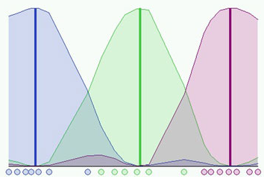
Fuzzy C-Means
The next figure
shows the final
condition reached
at the 8th step
with m = 2 and
ε = 0.3:

Slide 47
Hierarchical Clustering
Given a set of N items to be clustered, and an N*N distance (or similarity) matrix, the basic process of hierarchical clustering is this:
Start by assigning each item to a cluster, so that if you have N items, you now have N clusters, each containing just one item. Let the distances (similarities) between the clusters the same as the distances (similarities) between the items they contain.
Find the closest (most similar) pair of clusters and merge them into a single cluster, so that now you have one cluster less.

Slide 48
Hierarchical Clustering
3. Compute distances (similarities) between the new cluster and each of the old clusters.
4. Repeat steps 2 and 3 until all items are clustered into a single cluster of size N.
Of course there is no point in having all the N items grouped in a single cluster but, once you have got the complete hierarchical tree, if you want k clusters you just have to cut the k-1 longest links.

Slide 49
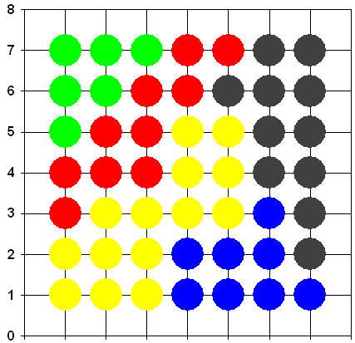
Self Organizing Maps
Competitive neural networks are often used to cluster input data.
SOMs have the desirable characteristic that neighboring neurons define regions of similarity
In the map every color represents
a cluster (5 in this example).
Notice that neurons with similar
colors (belonging to the same
cluster) appear in neighboring
regions of the map

Slide 50
Evolutionary Computation
Candidate solutions (an individual) to the clustering problem are initially randomly generated.
Three (typical) operators are used (selection, recombination and mutation).
These transform a set of individuals into a different set.
A fitness function evaluated for every individual determines its probability of survival for the next iteration.
Typically, a distance is minimized as fitness function.

Slide 51
Limitations
All of the methods described so far have one thing in common: they depend on the distance as defined. In general any measure of distance ultimately results in structures which resemble an N-dimensional spheroid. Therefore, clusters with irregular forms are very difficult (at best) to detect.

Slide 52
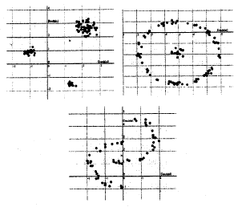
Irregular Clusters
Clusters such as the ones shown are very difficult to detect

Slide 53
Further Motivation
The interest in finding irregular patterns in a set of data is manyfold.
For instance, in bioinformatics, one of the most urgent needs is to find similarities between known and unknown proteins.
Large genomic databases are now available.
But, in many cases, researchers are unable to find significant relationships between known and “new” proteins because the patterns are highly irregular.

Slide 54
Further Motivation
In data mining the relationships between relevant independent variables are difficult to uncover when the structure of the clusters is simplified.
In data compression, the state of the art methods rely on finding the patterns imbedded in the messages.

Slide 55
Further Motivation
In robotics the identification of patterns is closely associated to the problem of adaptive behavior.
In algorithmic information theory, the amount of information may be approximated by identifying the embedded patters.
…many others

Slide 56
Efficient optimization
A central issue behind all attempts to clusterize efficiently is the capability of finding the subset of the nearest vectors.
Such subset may be searched for in a variety of ways. A few of these have already been mentioned.
However, a general optimization tool must take into consideration that, in general, there is a non-linear relation between the elements of the set which minimize the nearness.

Slide 57
Efficient optimization
During the last 15 years the possibility of applying computing tools with virtually zero cost has made usual the application of computer intensive methodologies.
One such methodology is called “Evolutionary Computation” and relies on the basic idea of refining a plausible solution iteratively by simulating the processes of natural evolution.

Slide 58
Evolutionary Computation
In truth, EC should be more properly seen as an optimization method which constitutes a directed stochastic search.
In particular Genetic Algorithms have enjoyed favor in the AI community because they are rugged and easy to implement.
In fact, their ruggedness has induced the application of some sort of Gas which may be shown not to be the most efficient.

Slide 59
Genetic Algorithms
These algorithms have been proven to:
a) Be independent of the initial population
b) Fully explore the search space when mutation is applied
c) Reach a global optimum when the best individual is retained (elitism)
d) Rapidly converge to near optimal solutions
However, their convergence is not bounded in time. Therefore we would like to make this convergence as efficient as possible.

Slide 60
The Simple Genetic Algorithm
In this regard the so-called “Simple” GA is hampered by:
a) Deceptive functions
b) Hitchhiking
To overcome the limitations of a Simple Genetic Algorithm we worked with Vasconcelos GA.
It displays:
a) Deterministic (i -> n-i+1) coupling
b) Annular crossover
c) Uniform mutation
d) Full elitism

Slide 61
Vasconcelos’ GA
A particular GA (called Vasconcelos GA, in honor of the Latin American philosopher José Vasconcelos who postulated the admixture of all races leading to the best possible race, the “Cosmic Race”) has been proven to be relatively better than other genetic variations over a wide range of functions.

Slide 62
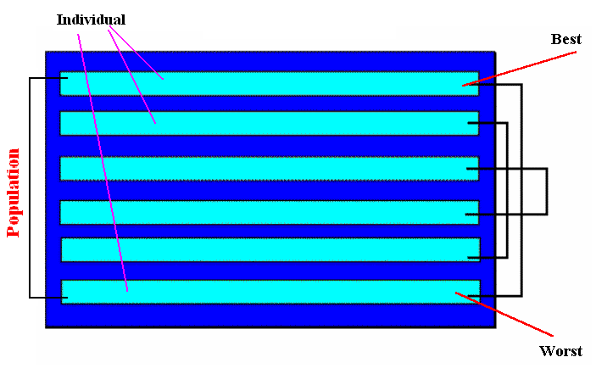
Vasconcelos Genetic Algorithm
(Deterministic Coupling)

Slide 63
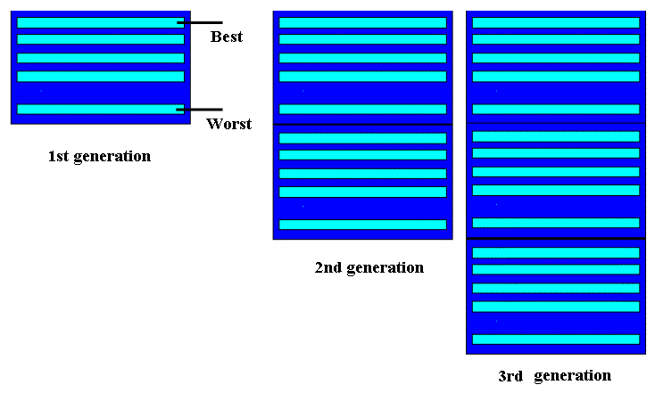
Vasconcelos Genetic Algorithm
(Full Elitism)

Slide 64
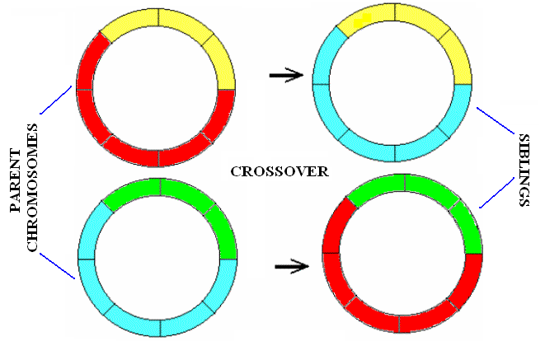
Vasconcelos Genetic Algorithm
(Annular Crossover)

Slide 65
Testing traditional metrics using Vasconcelos GA
Since we know that VGA outperforms most other sorts of Gas we decided to use it as an optimization tool while retaining traditional distance measures.
We decided to try its clustring capabilities versus a set of data gotten from a very simple figure.

Slide 66
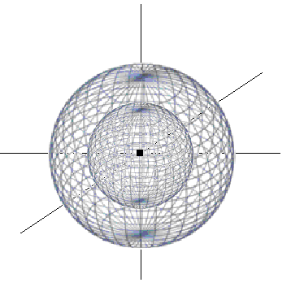
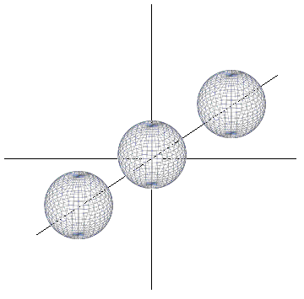
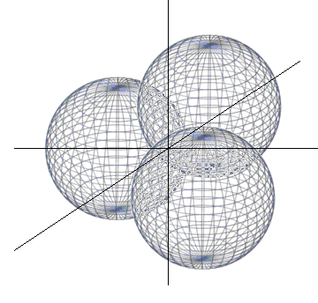
Spheres
Concentric
Disjoint
Overlapping
Three combinations of 3D Spheres

Slide 67
Testing for Spheres
In a set of experiments we tried out genetic clustering algorithms using different types of distances in an effort to see if the limitations mentioned could be overcome.
We tried L₁, L₂, L∞ and Mahalanobis distances. They where used as the basic fitness fucntion for a Genetic Algorithm.

Slide 68
Clustering Spheres
 | Metrics/Efficiency Percentage
 | L₁ | L₂ | L∞ | Mh
Concentric | 35.11 | 35.11 | 30.13 | 32.33
Overlapping | 53.28 | 41.71 | 31.44 | 29.71
Disjoint | 89.91 | 89.23 | 82.15 | 28.47

Slide 69
Unsatisfactory Results
Clearly, the results are unsatisfactory.
Since GAs allow us to try to optimize some of the validity indices mentioned in the opening slides we used them as fitness functions.
Hence,we tested for the Dunn and VNN validity indices as a fitness functions.
Results were not satisfactory either.

Slide 70
Geometric determination of elements in a cluster
A novel alternative is to explore the forms of the cluster and find whether a set of data lies within such objects.
The idea is to express N-dimensional bodies in such a way that their geometric characteristics are mathematically expressed and then find the parameters which best fit into the arbitrary bodies.

Slide 71


Gielis Superformula
One possible alternative is to use:
In 3D we have:

Slide 72
Gielis Superformula (SF)
Originally developed by Johan Gielis^{(*)} this SF was originally intended as a tool to analyze forms of bodies arising spontaneously in the natural world.
This formula gives rise to a surprising variety of 3D bodies of which we offer some interesting examples.
(*)Gielis, J.: “A generic geometric transformation that unifies a wide range of natural and
abstract shapes”, American Journal of Botany, 90(3): pp. 333–338, 2003.

Slide 73
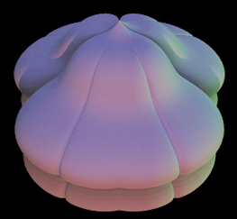

Slide 74
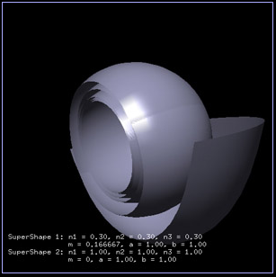

Slide 75
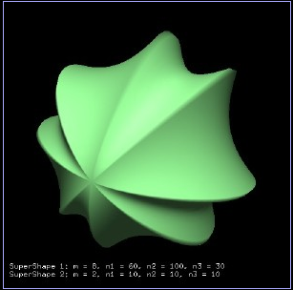

Slide 76
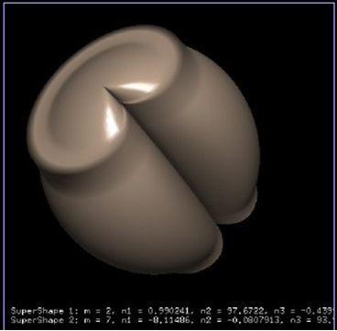

Slide 77
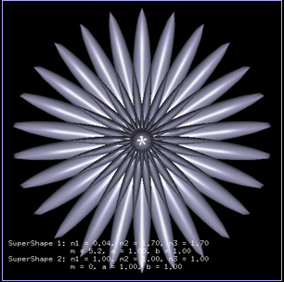

Slide 78
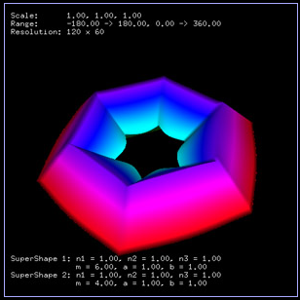

Slide 79
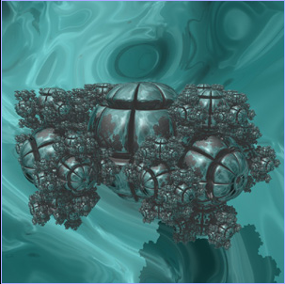

Slide 80
Clustering with Gielis SF
We decided to try and use Gielis SF “in reverse”.
Instead of plugging in some values for its parameters in order to investigate the properties arising from the Gielis bodies we intend to find the parameters which define the hypothetical bodies which encompass the largest possible data vectors.

Slide 81
How do we find the parameters?
The idea is simple:
a) Determine the number of clusters
b) Encode this in a binary string
c) Evolve the best solution using a Genetic Algorithm

Slide 82
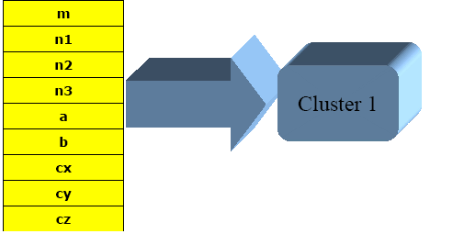
Encoding
The variables
to optimize
are m, n1, n2,
n3, a, b for
each of the
clusters. Cx,
Cy and Cz are the coordinates of the centers.

Slide 83
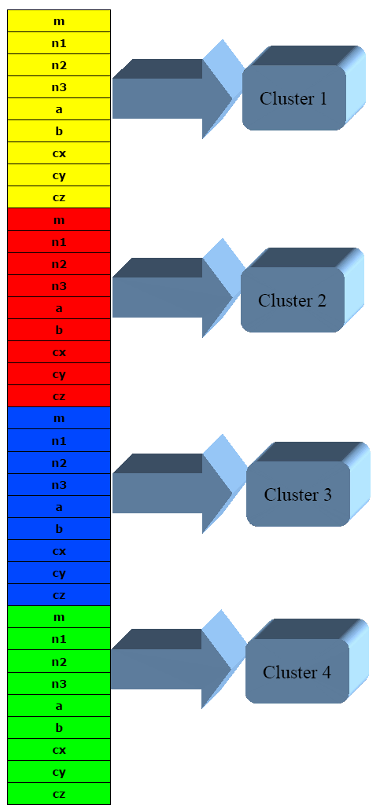
Encoding
The full chromosome (assuming 4 clusters) is shown in the figure.

Slide 84
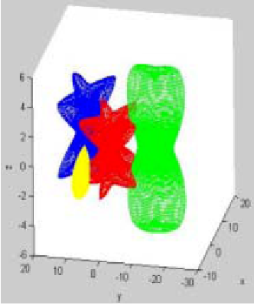
Geometric Clustering
To test our method
we “generated” 4
bodies and obtained
2,500 elements in
every cluster.

Slide 85
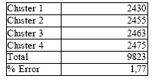
Geometric Clustering
The number of correctly assigned elements per cluster is as follows.

Slide 86

Relative Performance
We tackled the same data set with other algorithms. In the perceptrons the network was trained with known memberships.

Slide 87
Results
Notice that using our strategy we obtained better results than even those gotten from supervised learning algorithms (i.e. multi-layered perceptron networks).
This fact is, of course, encouraging since the form of the clusters was totally irregular.

Slide 88
Conclusions
Geometric clusters are not hampered by the hyper-spherical-cluster-form limitation.
The complexity of the chromosome, however, grows with the number of clusters and dimensions.
The task of generalizing Gielis SF to higher dimensions is not a trivial task.

Slide 89
Conclusions
Furthermore, as the GA’s chromosome grows in length so does the expected computational time.
On the other hand, the matter of determining whether a data vector lies within the “Gielis body” becomes computationally challenging.
We expect to report on a much wider set of experiments shortly.

Slide 90
Thank you!

