Slide 1
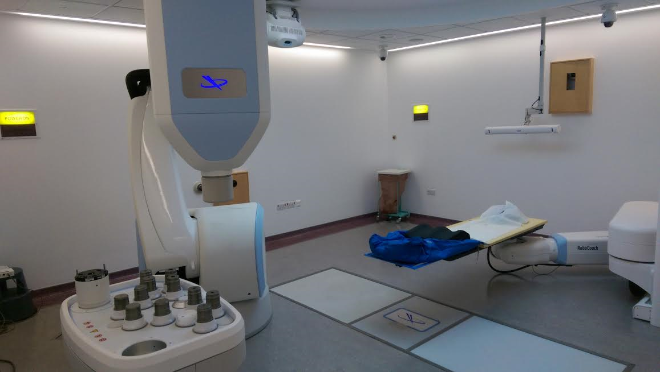
6MV FFF-Linac
Synchrony camera
kV source
(1 of 2)
Robotic gantry
kV panels
Robotic couch
Iris collimator
Fixed collimators

