Slide 1
Let’s Recapitulate

Slide 2
Regular Languages
DFAs
Regular
Grammars
NFAs
Regular
Expressions

Slide 3




A standard representation
of a regular language :
A DFA that accepts
A NFA that accepts
A regular expression
that generates
A regular grammar
that generates

Slide 4
When we say:
“We are given a Regular Language “
We mean:
Language in a standard representation

Slide 5
Elementary Questions about
Regular Languages

Slide 6
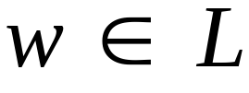
Question:
Given regular language
how can we check
if a string ?

Slide 7

Question:
Given regular language
how can we check
if a string ?
Answer:
Take the DFA that accepts
and check if is accepted

Slide 8
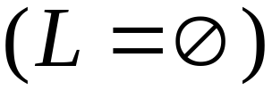
Question:
Given regular language
how can we check
if is empty,
finite,
infinite ?
Answer:
Take the DFA that accepts
Then check the DFA

Slide 9
If there is a walk from the start state
to a final state then:
is not empty
Otherwise empty
If the walk contains a cycle then:
is infinite
Otherwise finite

Slide 10


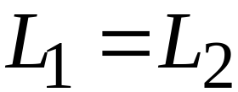
Question:
Given regular languages and
how can we check if ?

Slide 11
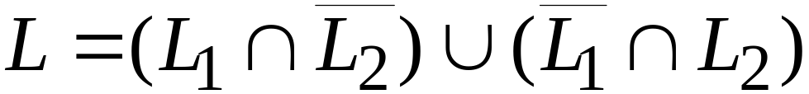

Question:
Given regular languages and
how can we check if ?
Answer:
take
And find if

Slide 12
Question:
Given language
how can we check
if is not a regular language ?

Slide 13
Question:
Given language
how can we check
if is not a regular language ?
Answer:
The answer is not obvious
We need the Pumping Lemma

Slide 14

The Pigeonhole Principle

Slide 15
4 pigeons
3 pigeonholes

Slide 16
A pigeonhole must
have two pigeons

Slide 17



pigeons
...........
pigeonholes
...........

Slide 18
The Pigeonhole Principle
pigeons
pigeonholes
There is a pigeonhole
with at least 2 pigeons
...........

Slide 19
The Pigeonhole Principle and
DFAs

Slide 20






DFA with states

Slide 21
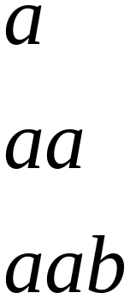
In walks of strings:
no state
is repeated

Slide 22
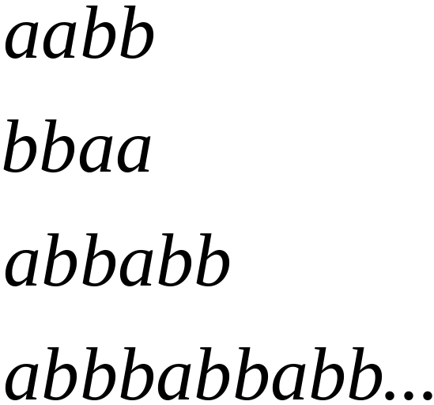
In walks of strings:
a state
is repeated

Slide 23
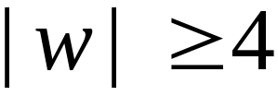
If the walk of string has length
Then a state is repeated

Slide 24

The pigeonhole principle:
If in a walk: transitions states
Then: A state is repeated

Slide 25

In other words:
transitions are pigeons
states are pigeonholes

Slide 26
In general:
A string has length number of states
A state must be repeated in the walk
......
......

Slide 27
The Pumping Lemma

Slide 28
Take an infinite regular language
DFA that accepts
states

Slide 29

Take string
with
There is a walk with label :
.........

Slide 30
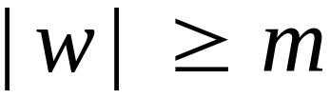
If string has length
number
of states
Then, from the pigeonhole principle:
A state is repeated in the walk
......
......

Slide 31




Write
......
......

Slide 32
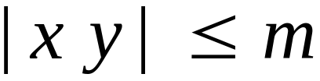
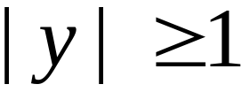
Observations :
number
of states
length
length
......
......

Slide 33

Observation:
The string is accepted
......
......

Slide 34

Observation:
The string
is accepted
......
......

Slide 35

Observation:
The string
is accepted
......
......

Slide 36
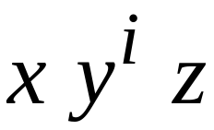
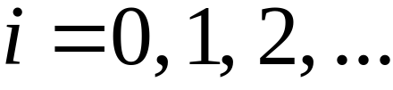
In General:
The string
is accepted
......
......

Slide 37
In other words, we described:
The Pumping Lemma

Slide 38
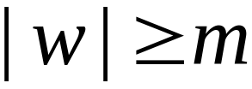
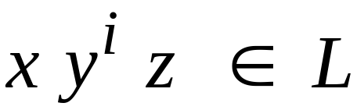
The Pumping Lemma:
1. Given a infinite regular language
2. There exists an integer
3. For any string with length
4. We can write
5. With and
6. Such that: string

Slide 39
Applications of the Pumping Lemma

Slide 40
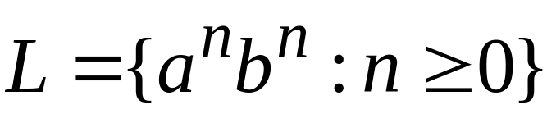
Claim:
The language
is not regular
Proof:
Use the Pumping Lemma

Slide 41
Proof:
Assume for contradiction
that is a regular language
Since is infinite
we can apply the Pumping Lemma

Slide 42
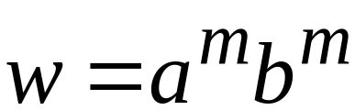
Let be the integer
in the Pumping Lemma
Pick a string such that:
length
Example:
pick

Slide 43
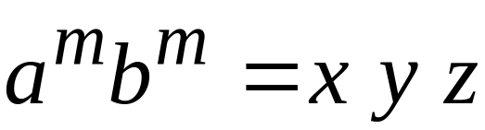
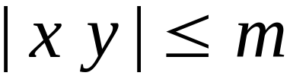

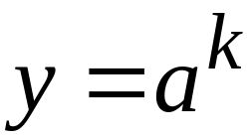
Write
From the Pumping Lemma
it must be that length
Therefore:

Slide 44
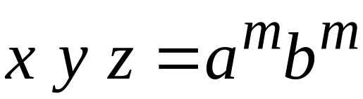
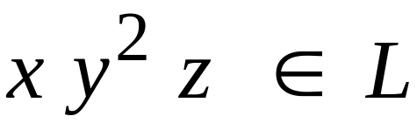
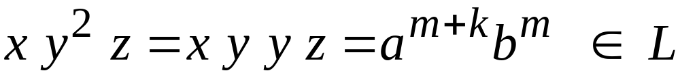
From the Pumping Lemma:
Thus:

Slide 45
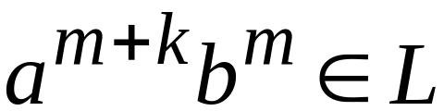
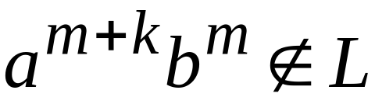
Therefore,
BUT:
and
CONTRADICTION!!!

Slide 46
Therefore:
Our assumption that
is a regular language
cannot be true
CONCLUSION:
is not a regular language

Slide 47
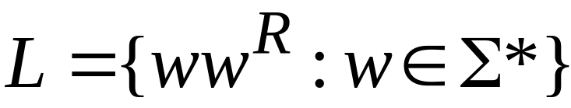
Claim:
The language
is not regular
Proof:
Use the Pumping Lemma

Slide 48
Proof:
Assume for contradiction
that is a regular language
Since is infinite
we can apply the Pumping Lemma

Slide 49
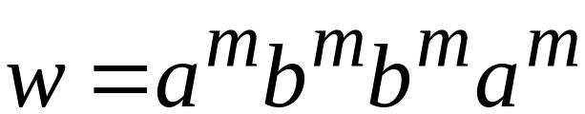
Let be the integer
in the Pumping Lemma
Pick a string such that:
length
Example:
pick

Slide 50
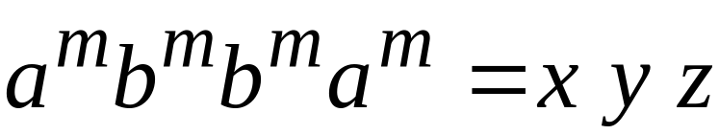
Write
From the Pumping Lemma
it must be that length
Therefore:

Slide 51
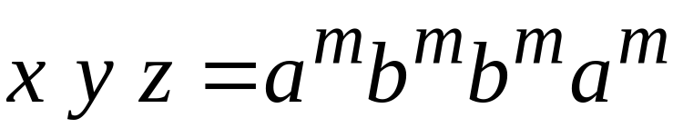
From the Pumping Lemma:
Thus:

Slide 52
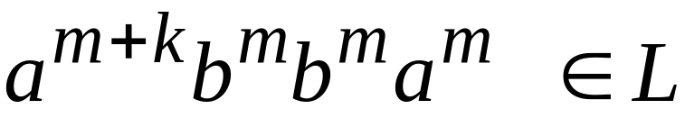
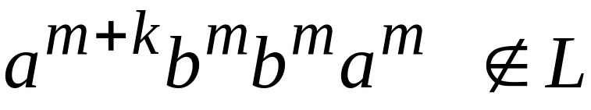
Therefore,
BUT:
and
CONTRADICTION!!!

Slide 53
Therefore:
Our assumption that
is a regular language
cannot be true
CONCLUSION:
is not a regular language

