Slide 1
Decidable Problems
of
Regular Languages
Prof. Busch - RPI

Slide 2



Membership Question
Question:
Given regular language
and string
how can we check if ?
Answer:
Take the DFA that accepts
and check if is accepted
Prof. Busch - RPI

Slide 3


DFA
DFA
Prof. Busch - RPI

Slide 4
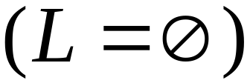
Question:
Given regular language
how can we check
if is empty: ?
Answer:
Take the DFA that accepts
Check if there is any path from
the initial state to an accepting state
Prof. Busch - RPI

Slide 5


DFA
DFA
Prof. Busch - RPI

Slide 6
Question:
Given regular language
how can we check
if is finite?
Answer:
Take the DFA that accepts
Check if there is a walk with cycle
from the initial state to a final state
Prof. Busch - RPI

Slide 7
DFA
is infinite
DFA
is finite
Prof. Busch - RPI

Slide 8


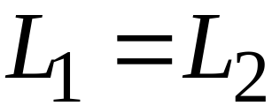
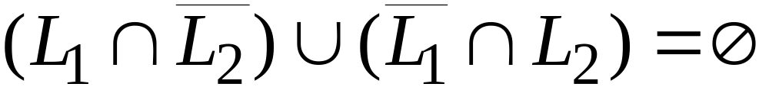
Question:
Given regular languages and
how can we check if ?
Answer:
Find if
Prof. Busch - RPI

Slide 9
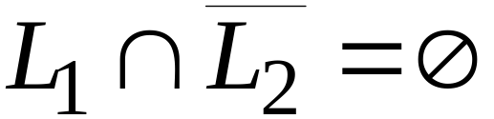
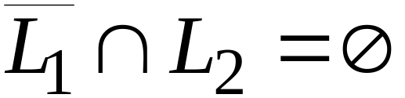

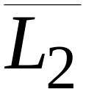
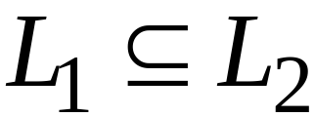
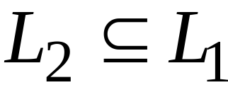
and
Prof. Busch - RPI

Slide 10
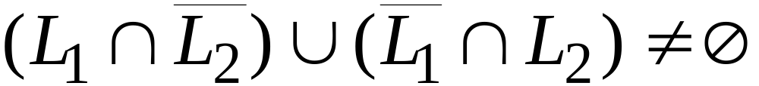
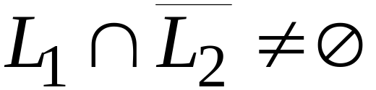
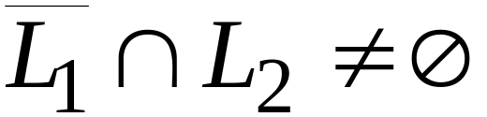
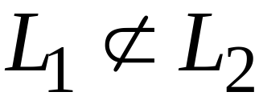
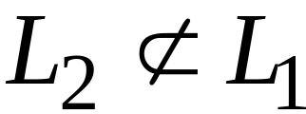
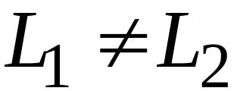
or
Prof. Busch - RPI

Slide 11
Decidable Problems
of
Context-Free Languages
Prof. Busch - RPI

Slide 12


Membership Question:
for context-free grammar
find if string
Membership Algorithms:
Parsers
Exhaustive search parser
CYK parsing algorithm
Prof. Busch - RPI

Slide 13
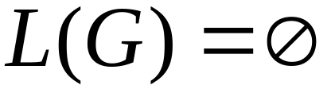

Empty Language Question:
for context-free grammar
find if
Algorithm:
Remove useless variables
Check if start variable is useless
Prof. Busch - RPI

Slide 14
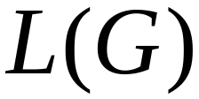

Infinite Language Question:
for context-free grammar
find if is infinite
Algorithm:
1. Remove useless variables
2. Remove unit and productions
3. Create dependency graph for variables
4. If there is a loop in the dependency graph
then the language is infinite
Prof. Busch - RPI

Slide 15
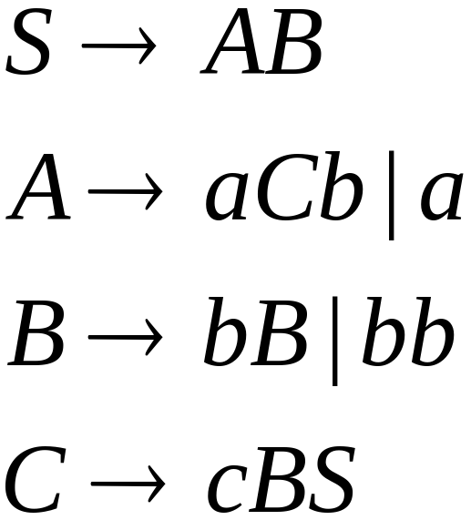




Example:
Infinite language
Dependency graph
Prof. Busch - RPI

Slide 16
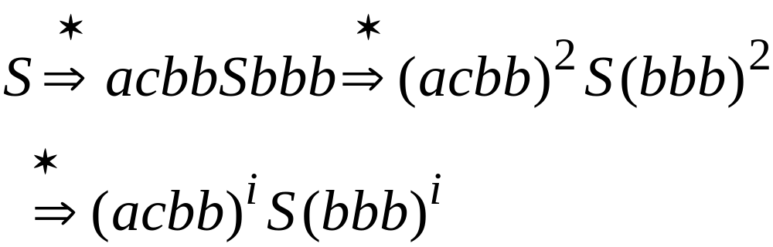
Prof. Busch - RPI

