Slide 1


Accredited Conformity Assessment
Bodies Council
ACAB’c update
Clemens Wanko Matthias Wiedenhorst
65th CA/B Forum F2F Meeting
June 10th to 12th 2025 – Toronto

Slide 2
Updates from the Council
Report update: Audit Attestation Letter Templates
EU-Legislation: news-update for CA
Questions?

Slide 3
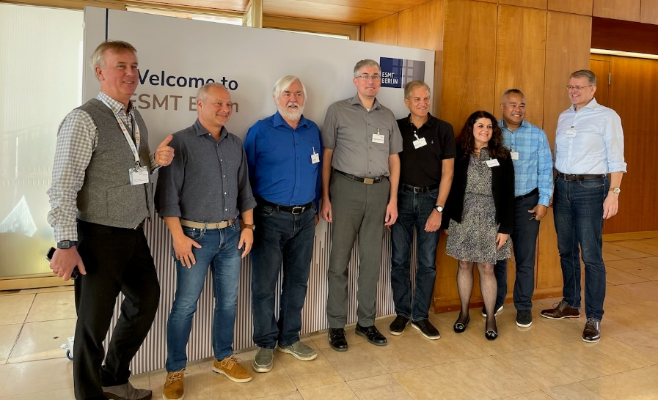

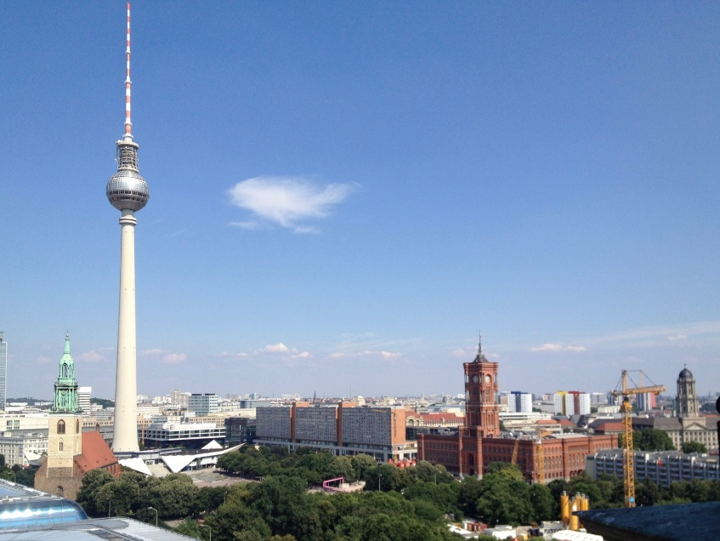
WebTSI
WebTrust & ETSI
BERLIN
TORONTO

Slide 4
WebTSI
WebTrust & ETSI
BERLIN
TORONTO
WebTrust @ ACAB’c >>> General Assembly Meeting Thessaloniki, Greece - July 1st 2025

Slide 5
Updates from the Council
Report update: Audit Attestation Letter Templates
EU-Legislation: news-update for CA
Questions?

Slide 6
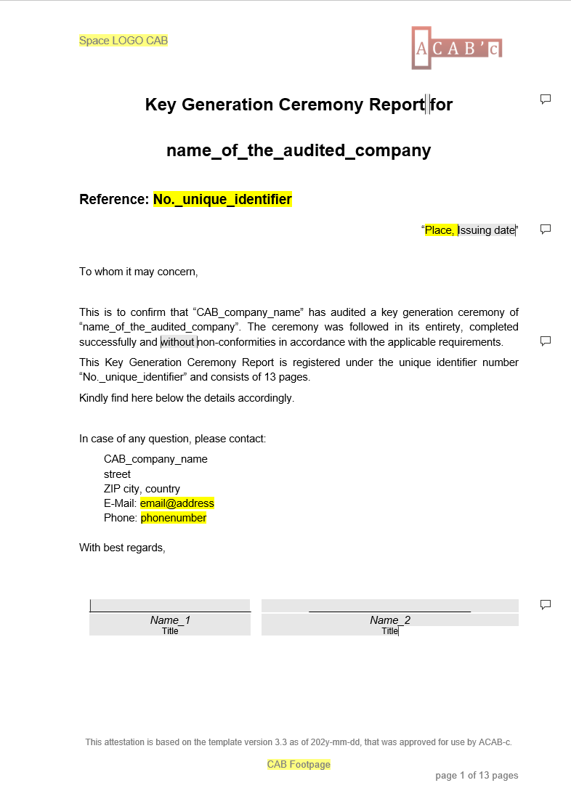
I. Key Ceremony Report:
Stable version!
Please download from:
https:\\acab-c.com\downloads

Slide 7
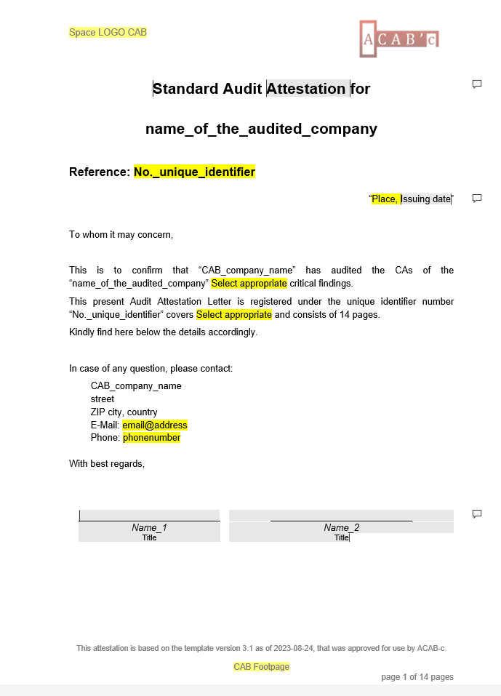
II. Standard Reports:
incl. TLS-BR, TLS-EV, Code Signing, SMIME-BR
Stable version with updates pending!
Please download from:
https:\\acab-c.com\downloads

Slide 8
Updates from the Council
Report update: Audit Attestation Letter Templates
EU-Legislation: news-update for CA
Questions?

Slide 9
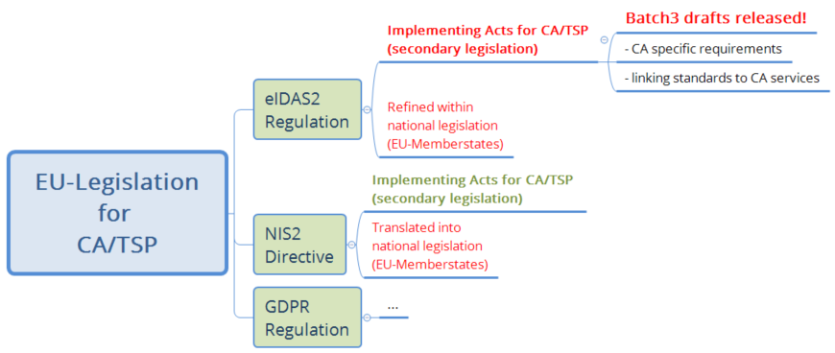
EU-Legislation: news-update for CA
(European eIDAS2/NIS2/GDPR/…)
Batch 3 drafts…
concern EU based CA/TSP
link-in ETSI standards
adapt/change/amend ETSI standards
Note: Current drafts require use of Common Criteria (CC/EU-CC) certified devices (HSM) for CA/TSP-keys – fading out NIST FIPS-140 certified ones!

Slide 10
EU-Legislation: news-update for CA
(European eIDAS2/NIS2/GDPR/…)
Batch 3 drafts…
concern EU based CA/TSP
link-in ETSI standards
adapt/change/amend ETSI standards
Note: Current drafts require use of Common Criteria (CC/EU-CC) certified devices (HSM) for CA/TSP-keys – fading out NIST FIPS-140 certified ones!
CA/TSP may want to comment on drafts!

Slide 11

Questions

Slide 12
For further information or in order to register, please contact us at:
www.acab-c.com
The Accredited Conformity Assessment Bodies’ council
72 Bd Edgar quinet
75014 Paris – France
Secretariat Jurger Uka
jurger.uka@tuv-austria.com - +49 171 9178436
secretary@acab-c.org

