Slide 1
CA/Browser Forum – Toronto TRS Update
Compliance / Gatekeepers / Praetorians
Chad Dandar, Cisco, Cryptographic Services
June 10, 2025
Notes:
We gave our last update in Oct last year and we mentioned that we wanted to move towards automation in the Trusted Root Store space. We’ve made some progress on this…

Slide 2
Out with the old…
In with the new…(soon)
Initial Pull
TRS bundle is pulled once during client s/w build and release process
Validity
Remains effective until a new client s/w version is released
Subsequent Pull
Pulled again when the new client s/w version comes out
Dynamic/Agile Client
Need for a client that adapts dynamically
No dependency on the release of new s/w version
Revocation Support
Provides Versioning, Rollback, Manifests, Deltas
Notes:
For the longest time… Root bundles were loaded during initial software building and release process. Then only updated in new software versions. So then everyone is locked into a static trust store until a new software update is released and loaded in their environment.
So we have been working on a solution for our products and services to be more dynamic in this regard.

Slide 3
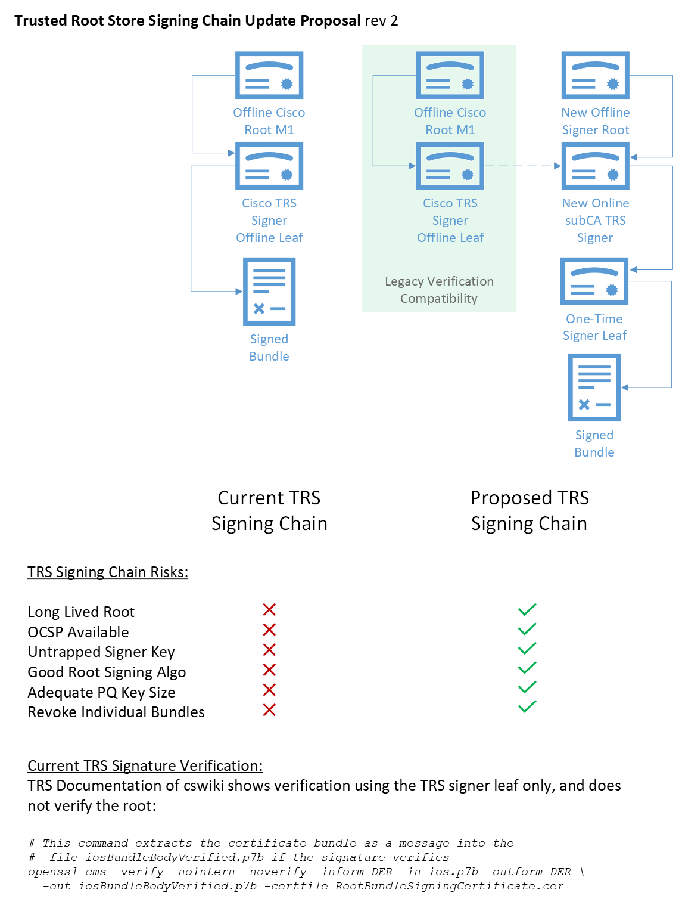
New Features
New signing chain with bundle-specific signing cert auto-generated at time of creation
Daily job to produce bundles based on:
CCADB changes
GitHub changes
Implemented enhanced distribution features
JSON endpoints for deltas
Manifests – inventory + rejected w/ reason
Rollback / versioning
JKS format
More digest options – SHA256 + SHA512
Detached signatures
/archive directory for older versions
Directory listing on https://www.cisco.com/security/pki/trs
Notes:
We're introducing a new certificate signing chain for TRS bundles. The goal of this update is to get away from the old manual processes and to a fully automated build, signing, and publishing process.
It monitors for expiring root certificates or CAs changes within the CCADB and automatically triggers a new bundle creation. Each bundle is accompanied by a versioned JSON manifest file to easily rollback to previous versions.
We’ve been beta testing with the early adopters for a little while now. We plan on rolling this out in the next 5-6 months and giving consumers with at least a 3-month testing window.

Slide 4
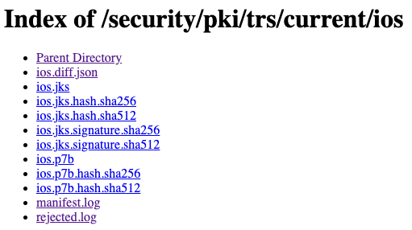
Directory Listing + Examples
ios.diff.json
{
"currentVersion": "20250417",
"prevVersion": "20250404",
"additions": [],
"deletions": [
{
"certSha256": "A040929A02CE53B4ACF4F2FFC6981CE4496F755E6D45FE0B2A692BCD52523F36",
"certSubjectDn": "CN=Hellenic Academic and Research Institutions RootCA 2015,O=Hellenic Academic and Research Institutions Cert. Authority,L=Athens,C=GR"
},
{
"certSha256": "44B545AA8A25E65A73CA15DC27FC36D24C1CB9953A066539B11582DC487B4833",
"certSubjectDn": "CN=Hellenic Academic and Research Institutions ECC RootCA 2015,O=Hellenic Academic and Research Institutions Cert. Authority,L=Athens,C=GR"
},
{
"certSha256": "CECDDC905099D8DADFC5B1D209B737CBE2C18CFB2C10C0FF0BCF0D3286FC1AA2",
"certSubjectDn": "CN=XRamp Global Certification Authority,O=XRamp Security Services Inc,OU=www.xrampsecurity.com,C=US"
},
{
"certSha256": "1465FA205397B876FAA6F0A9958E5590E40FCC7FAA4FB7C2C8677521FB5FB658",
"certSubjectDn": "OU=Starfield Class 2 Certification Authority,O=Starfield Technologies\\, Inc.,C=US"
},
{
"certSha256": "D7A7A0FB5D7E2731D771E9484EBCDEF71D5F0C3E0A2948782BC83EE0EA699EF4",
"certSubjectDn": "CN=AAA Certificate Services,O=Comodo CA Limited,L=Salford,ST=Greater Manchester,C=GB"
},
{
"certSha256": "EBD41040E4BB3EC742C9E381D31EF2A41A48B6685C96E7CEF3C1DF6CD4331C99",
"certSubjectDn": "CN=GlobalSign Root CA,OU=Root CA,O=GlobalSign nv-sa,C=BE"
},
{
"certSha256": "BFD88FE1101C41AE3E801BF8BE56350EE9BAD1A6B9BD515EDC5C6D5B8711AC44",
"certSubjectDn": "CN=TWCA Root Certification Authority,OU=Root CA,O=TAIWAN-CA,C=TW"
},
{
"certSha256": "C3846BF24B9E93CA64274C0EC67C1ECC5E024FFCACD2D74019350E81FE546AE4",
"certSubjectDn": "OU=Go Daddy Class 2 Certification Authority,O=The Go Daddy Group\\, Inc.,C=US"
},
{
"certSha256": "30D0895A9A448A262091635522D1F52010B5867ACAE12C78EF958FD4F4389F2F",
"certSubjectDn": "CN=IdenTrust Public Sector Root CA 1,O=IdenTrust,C=US"
},
{
"certSha256": "8A866FD1B276B57E578E921C65828A2BED58E9F2F288054134B7F1F4BFC9CC74",
"certSubjectDn": "CN=QuoVadis Root CA 1 G3,O=QuoVadis Limited,C=BM"
},
{
"certSha256": "18F1FC7F205DF8ADDDEB7FE007DD57E3AF375A9C4D8D73546BF4F1FED1E18D35",
"certSubjectDn": "CN=QuoVadis Root CA 3,O=QuoVadis Limited,C=BM"
}
]
}
rejected.log
SHA256:02ED0EB28C14DA45165C566791700D6451D7FB56F0B2AB1D3B8EB070E56EDFF5 Entrust Root Certification Authority - EC1 - TLS DISTRUST
SHA256:604D32D036895AED3BFEFAEB727C009EC0F2B3CDFA42A1C71730E6A72C3BE9D4 MULTICERT Root Certification Authority 01 - NOT UNANIMOUS
SHA256:E75E72ED9F560EEC6EB4800073A43FC3AD19195A392282017895974A99026B6C Security Communication RootCA1 - EXPIRED
SHA256:E6BE68CE06FE0DA0C140F1AEB00B67B636C5EEA9422088929362375CE086DB39 Visa Public ECC Root CA - NOT UNANIMOUS
SHA256:FB47D92A9909FD4FA9BEC02737543E1F3514CED747407A8D9CFA397B0915067C Autoridade Certificadora Raiz Brasileira v2 - EXPIRED
SHA256:A040929A02CE53B4ACF4F2FFC6981CE4496F755E6D45FE0B2A692BCD52523F36 Hellenic Academic and Research Institutions RootCA 2015 - NOT UNANIMOUS
SHA256:44B545AA8A25E65A73CA15DC27FC36D24C1CB9953A066539B11582DC487B4833 Hellenic Academic and Research Institutions ECC RootCA 2015 - NOT UNANIMOUS
SHA256:A7C8681042F3675AA8505D3BA313D80F8AC3250FDF874AD29B834689C087FB11 NAVER Cloud Trust Services ECC Root G1 - NOT UNANIMOUS
SHA256:1A0D20445DE5BA1862D19EF880858CBCE50102B36E8F0A040C3C69E74522FE6E COMODO Certification Authority - NOT UNANIMOUS
SHA256:554153B13D2CF9DDB753BFBE1A4E0AE08D0AA4187058FE60A2B862B2E4B87BCB AC RAIZ FNMT-RCM SERVIDORES SEGUROS - NOT UNANIMOUS
Notes:
Main points:
Here's a quick preview of what the new system looks like.
As mentioned before, we have a JSON endpoint now which lists the current latest version of this bundle. You can see it on the right here. It also lists the previous version and every addition or deletion in this latest release. If you’re looking through the deletion list in the JSON and you want to see why a certain cert was removed, you can look up the cert sha in the rejected.log file. That one is shown here at the bottom and it's also human-readable.
SHOW- https://www.cisco.com/security/pki/archive.
We added the most requested feature, a passwordless jks version of the TRS bundles. We now have that as you can see in the index list.
Now, with a passwordless JKS you don't get the benefit of MAC for integrity checking. So we publish detached signatures here that can be used to verify the integrity of the jks bundle.

Slide 5
Roadmap
Trusted Root Store bundle documentation being published publicly
Testing – minimum 3 months for clients
Production cutover to new bundles (symlink /trs/current bundle to existing)
TRS Client as a package maintained by Cisco’s Cryptographic Services team
Performs revocation checking
Ensures proper verification of bundle signatures
Supports rollback to previous versions
Maintains cached copy of bundles (in case it can’t reach cisco.com)
Each new bundle is signed with a unique release key-pair
All bundles are versioned
Ability to revoke if signing key is compromised
Provide config option for installing root cert directory
Users only manage the TRS Client version
Users will have the functionality to fetch bundles dynamically
Notes:
Here’s a little summary of things we’re planning to make available soon.
Suchas, making our Trusted Root Store program documentation available publicly soon, in the coming months
We're also adding a configurable option for installing a custom root certificate directory, giving users more flexibility in their env's.
We aim to achieve End-to-End Automation starting from how we create the bundles and how our users are going to consume these bundles.
In FY26, we will be building TRS client as a managed package. This client will be responsible for several key functions:
Revocation checking to ensure that compromised certificates are not trusted.
Verification of bundle signatures to maintain integrity and authenticity.
Rollback support, so TRS consumers can revert to a previous version if needed.
Caching of bundles, which is especially useful if the consumer can't reach cisco.com
Each bundle will be signed with a unique release key-pair and will be versioned, giving us traceability and control.
Importantly, users will only need to manage the TRS client version – everything else will be handled dynamically by the client.

Slide 6
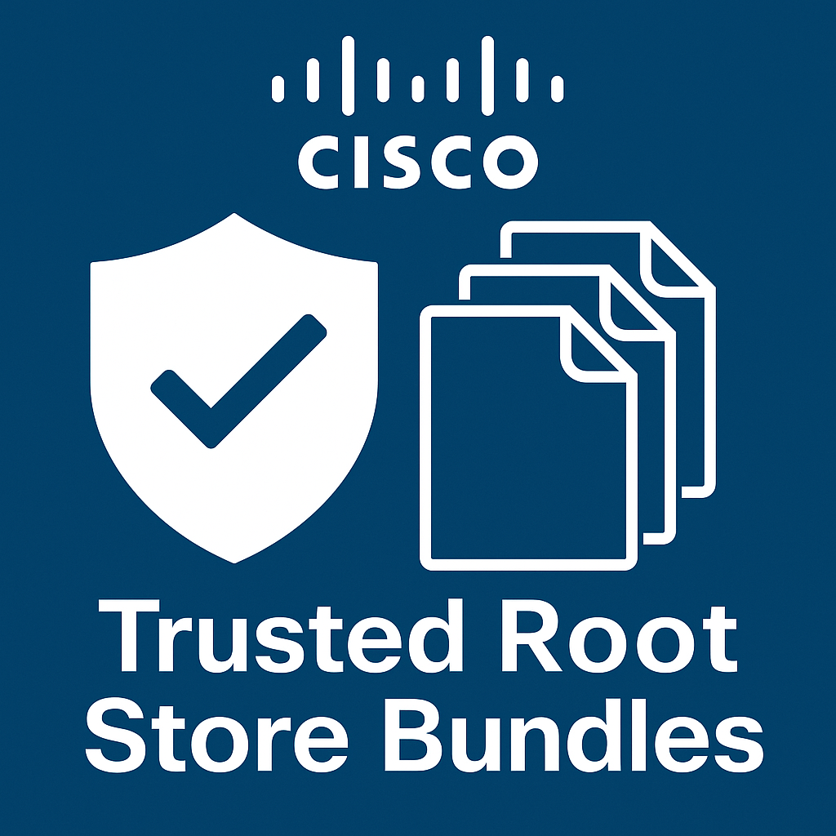
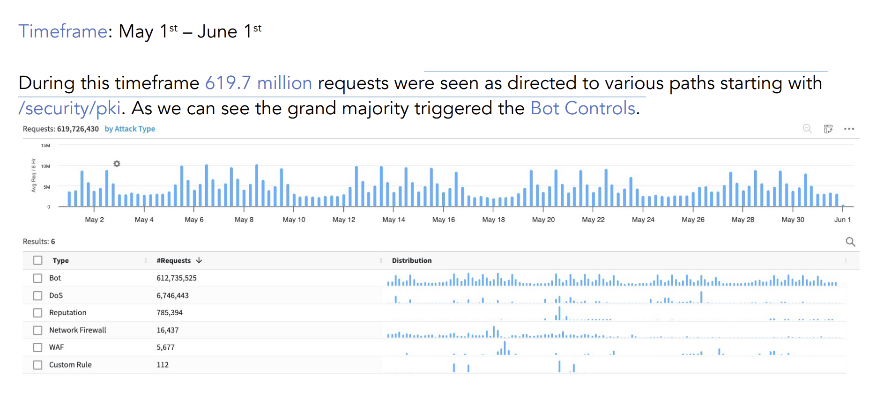
Metrics
Notes:
Here are some metrics for the traffic hitting our repository for certificates and bundles. Almost 620 million GET requests per month.

