Slide 1
DERIVATIVES OVERLAY PROGRAM
Designing a Hedging & Yield Overlay for a Concentrated
Indian Equity PMS Mandate
Applied CFA Level III Project — v2, built on live QuantsApp Pro+ market data
Ashoka Capital Advisors (Simulated PMS Mandate) • Rs 78 Cr AUM • 14 HNI Clients
Prepared by CA Bhavya Dhingra

Slide 2
ROADMAP
What This Deck Covers
01
The Problem
02
Stock Selection
Concentrated, promoter-heavy book; two clients ask for protection without selling
A documented 4-point screen — and a real finding that changed the answer
03
The Two Sleeves
04
Timing the Hedge
Protective collars (protection) + covered calls (income), priced from first principles
Why IV percentile, not raw IV, decides *when* to trade
05
Rates & Currency
06
Does It Work?
Swap-based duration overlay; currency risk reversal
Stress-test results, net program economics, and the honest limits
2

Slide 3
CLIENT & MANDATE
A Concentrated Book, and a Direct Client Ask
Ashoka Capital Advisors runs a Rs 78 Cr, 14-client PMS with a concentrated, promoter-heavy 16–18 stock book — single names up to 11% of AUM, several clients are the promoter families themselves.
Rs 78 Cr
Total AUM
The trigger: after the 2024 pre-election volatility spike, two client relationships (~Rs 9.5 Cr AUM) asked for “some way to protect the portfolio without selling out of positions we believe in long-term.”
11%
Largest single-stock weight
40–60 bps
That request is a mandate, not a suggestion.
IC-approved annual cost budget
3

Slide 4
REQUIREMENTS
Four Objectives, One Non-Negotiable Constraint
1
2
3
4
Yield
Protection
Duration
Currency
Modest extra income on the stable half of the book, without capping upside materially
Defined downside on concentrated names ahead of known risk windows — no forced sale
Tactically manage debt-sleeve duration without disturbing the liquidity bond book
A documented, graduated hedge policy for the unhedged USD/LRS allocation
Non-negotiable: the desk will not deploy anything it cannot explain to a first-generation-wealth client in one page. Cost budget capped at 40–60 bps of AUM annually.
4

Slide 5
STOCK SELECTION — PROTECTION SLEEVE
Checking, Not Assuming, What Can Actually Be Hedged
The four criteria applied (in order):
Replaced Archetype | Real F&O Name | Wt
Navin-Fluorine-like | SRF Ltd | 11.0%
Kirloskar-Ferrous-like | Bharat Forge | 9.5%
CSB-Bank-like | Kalyan Jewellers | 9.0%
Apar-Industries-like | Polycab India | 8.5%
1
NSE F&O eligibility (hard gate) — checked directly on QuantsApp Pro+
2
High single-stock concentration weight in the book (8.5%–11%)
3
Promoter-heavy / event-sensitive character
4
Elevated IV relative to the income-sleeve names
All four cleared the F&O check and share the concentrated/promoter-driven character of the original mandate.
THE REAL FINDING
None of the four originally-planned names returned a match on QuantsApp's live F&O symbol search — they are not NSE F&O-eligible at all. Not “illiquid.” Not optionable, period.
5

Slide 6
STOCK SELECTION — INCOME SLEEVE
The Other Half: Fairly-Valued, Liquid, Lower Vol
1
Fairly-valued, lowest-conviction core large-caps — the PM has no strong directional view
Ticker | Spot (Rs) | IV | Wt
HDFC Bank | 819.9 | 24.5% | 6.0%
ICICI Bank | 1,449.1 | 25.5% | 5.5%
Infosys | 1,090.0 | 33.7% | 5.0%
L&T | 3,843.6 | 24.3% | 4.5%
HUL | 2,150.2 | 22.1% | 4.0%
Titan | 4,636.3 | 20.0% | 4.0%
2
Deep, liquid NSE options market (top ~150 names by OI/ADV) — needed to actually execute the roll
3
Lower baseline IV than the concentration sleeve — confirms these are genuinely the “boring, stable” half
All six confirmed F&O-eligible and liquid on QuantsApp; only the position data (spot/IV) was refreshed to live figures.
6

Slide 7
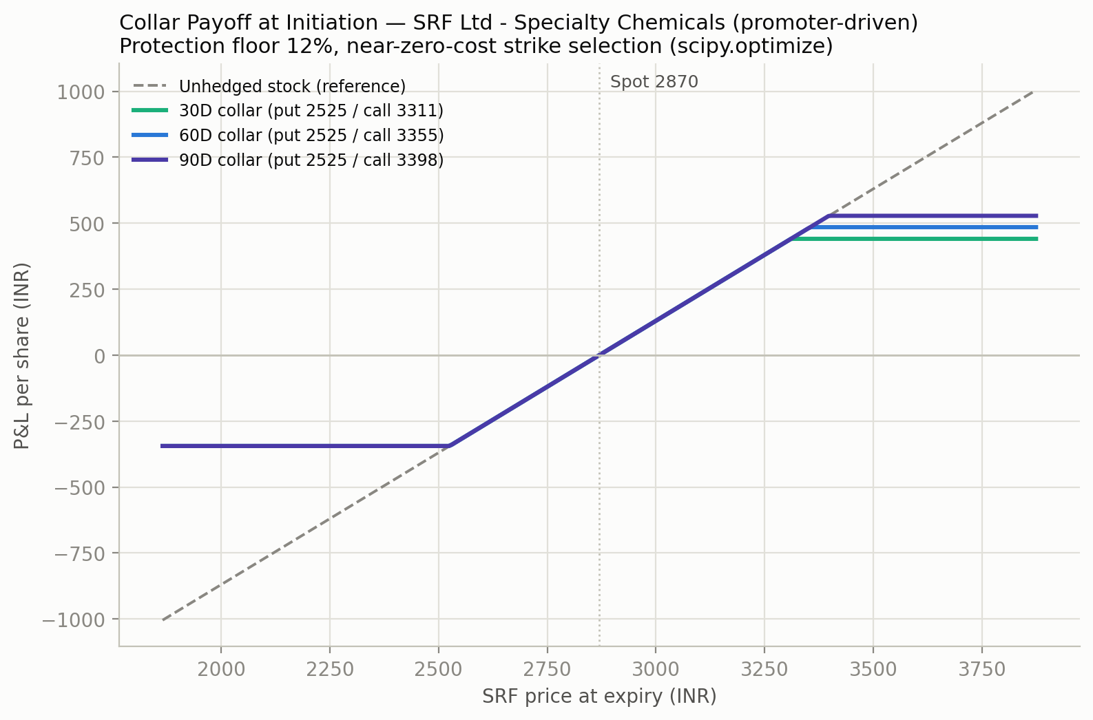
MECHANIC 1 — PROTECTIVE COLLAR
A Self-Funding Floor, Solved Not Guessed
Put strike fixed at a 12% downside floor (a design choice, not a market price).Call strike solved via scipy.optimize.brentq so its premium exactly funds the put — no closed-form solution exists for this.
27.5 bps/yr
Gross cost across all 4 names
≤60 bps
IC ceiling — 46% utilized
7

Slide 8
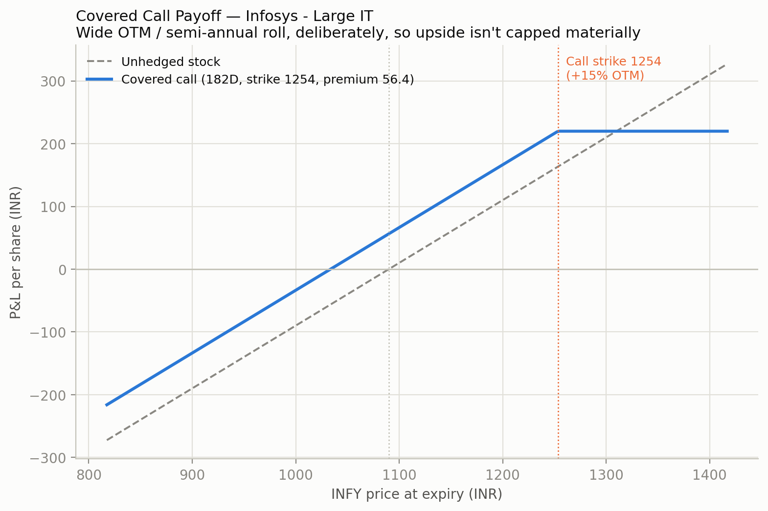
MECHANIC 2 — COVERED CALL
Why 15% OTM / Semi-Annual — and What Got Rejected
Design | Modeled Income | Verdict
Monthly, 6% OTM | ~200 bps/yr | Rejected — caps upside monthly
Quarterly, 9% OTM | ~170 bps/yr | Rejected — caps upside 4x/yr
Semi-annual, 15% OTM | 177.3 bps/yr (real) | Chosen — upside rarely capped
Real IVs price richer than the original placeholder (e.g. Infosys ~34% IV) — which is why this sleeve's income roughly doubled once live data replaced the simulated estimate.
8

Slide 9
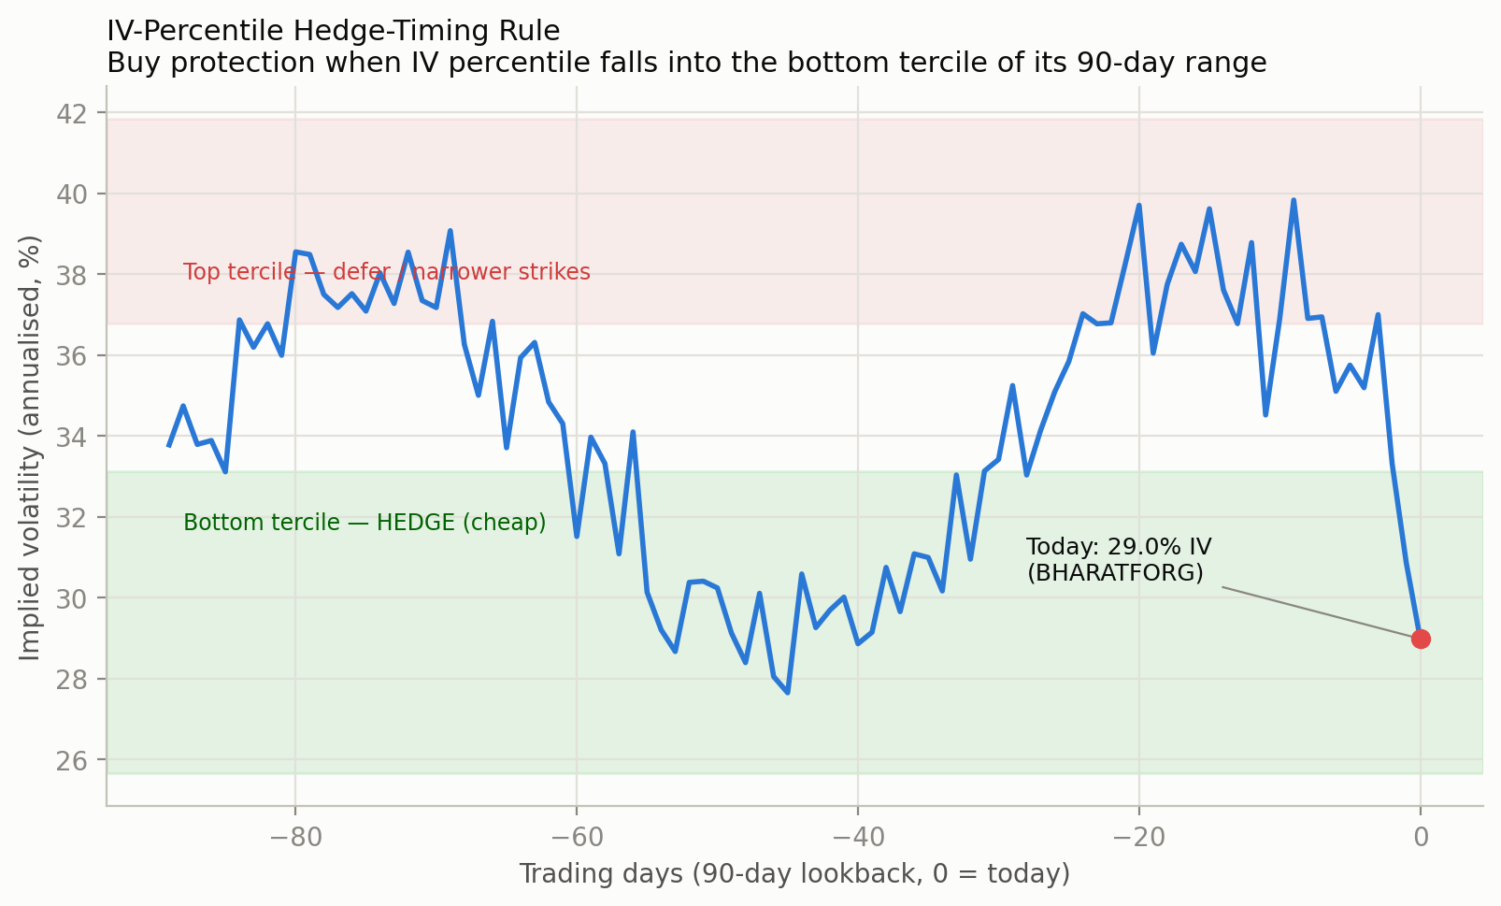
TIMING THE HEDGE
IV Percentile: Why *When* Matters as Much as *Which*
The rule: hedge when a name's IV Percentile sits in the bottom tercile (≤33.3) of its own 90-day range — buy protection when it's statistically cheap, not after a selloff.
THE HONEST READ ON THIS SNAPSHOT
7 of 10 sleeve names sit ABOVE the 66th IV percentile right now (e.g. Kalyan Jewellers at 97.2 — a live vol event, +4.87% the day of capture).
This is NOT a statistically cheap window to initiate new protection. A real desk documents this and either accepts the richer cost (event risk may outweigh it) or waits — and says so to the IC.
9

Slide 10
MECHANIC 3 — RATES
Swap-Based Duration Overlay, In Detail
The problem
Item | Value
Debt sleeve | Rs 7.00 Cr
Current modified duration | 2.1 yrs
Target duration shift | 0.75 yrs
Swap notional required | Rs 2.50 Cr
Cost avoidance vs. physical trade | Rs 4.2 Lakh
Capital gains avoided | Rs 18 Lakh
Counterparty | OTC, CCIL-cleared
The Rs 7 Cr debt sleeve (2.1-yr modified duration) is held for liquidity/rebalancing dry powder. A rates view calls for shortening duration by 0.75 yrs — but selling and re-buying the physical bonds means transaction costs AND may crystallize capital-gains tax.
The instrument
A payer swap (pay fixed / receive floating) SHORTENS duration; a receiver swap LENGTHENS it. Sizing the notional so the swap's own DV01 reproduces the target duration change on the full sleeve — the underlying bonds are never touched.
Direction discipline: payer-vs-receiver must be anchored to a documented, market-implied rate view (e.g. OIS-implied forward path) — never a discretionary desk call. That discipline is what separates a PM's process from a trader's opinion.
A materially different risk category: OTC/CCIL-cleared, NOT NSE Clearing Corporation-guaranteed like the equity F&O legs — must be called out separately in any risk memo.
10

Slide 11
MECHANIC 4 — CURRENCY
A Graduated Policy, Not “Hedge or Don't”
Why a risk reversal, not a forward: a forward locks a single rate both ways and typically needs margin. A collar (long USD put / short USD call) caps INR-appreciation downside while preserving some INR-depreciation upside — a floor, not a fixed rate.
Item | Value
USD/LRS allocation | Rs 3.00 Cr
Target hedge ratio | 50%
Hedge notional | Rs 1.50 Cr
Structure | Long USD put / short USD call
USDINR spot | 86.50
Put strike / Call strike | 84.77 / 91.69
Net premium | 0.60% of notional
Why 50%, not 0% or 100%: 0% leaves clients fully exposed; 100% removes ALL upside from INR depreciation — which NRI clients holding US assets may actually want as a currency diversifier. 50% is the documented middle ground.
11

Slide 12
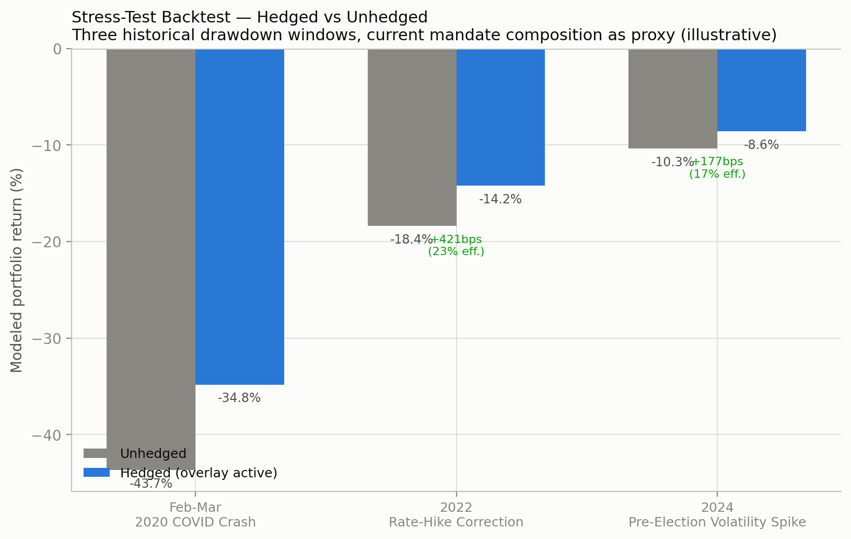
DOES IT WORK?
Stress-Test Backtest — Hedged vs. Unhedged
Read by efficiency, not just bps saved: The 2024-election window (-10.35%) shows the lowest protection efficiency — the move sits inside the -12% floor, so protection barely engages. Efficiency is highest (23–26%) for the larger, slower drawdowns the floor is actually built for.
GAP-RISK LIMIT
A crisis-speed, single-week gap-down (COVID-style) can move through a strike faster than the desk can re-strike intraday — a real, bounded limitation, named explicitly, not smoothed over.
12

Slide 13
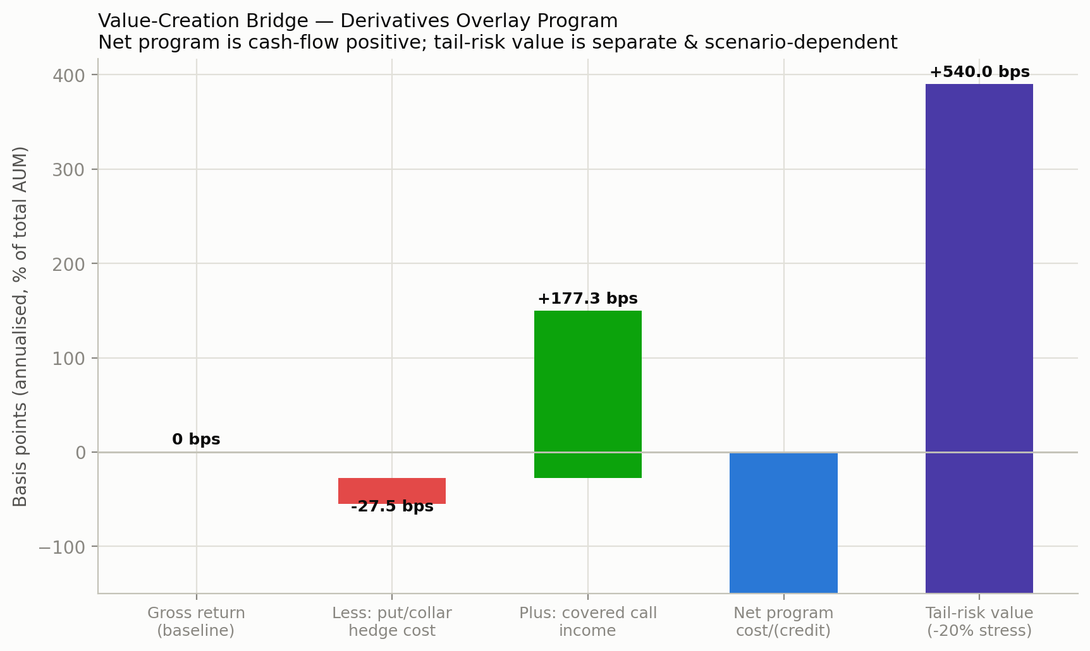
PROGRAM ECONOMICS
Net Cash-Flow Positive, Inside the IC Budget
27.5 bps
Gross collar cost
177.3 bps
Gross covered-call income
149.8 bps NET CREDIT
Program cash-flow
13

Slide 14
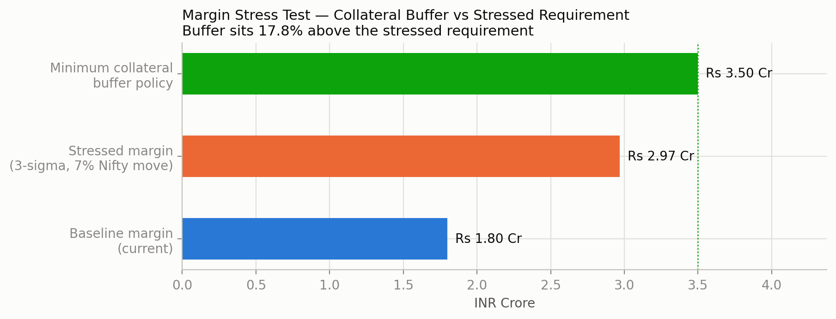
RISK FRAMEWORK
Margin Stress, Liquidity, and Escalation Triggers
Escalation triggers
Hedge cost exceeding 60bps budget by >20% in any quarter -> mandatory IC review
Margin utilization exceeding 70% of posted collateral -> immediate de-risking of options book
Single-name option liquidity score (OI/ADV) below desk threshold -> mandatory switch to index-proxy hedge
Under a 3-sigma single-day Nifty move (~7%), margin rises ~65% — the desk holds a 17.8% buffer over that stressed requirement at all times.
Portfolio tracking error vs Nifty 500 exceeding 8% band (incl. overlay effects) -> review and rebalance
Any planned protection-sleeve name found NOT F&O-eligible on the monthly QuantsApp check -> escalate to IC
14

Slide 15
RECOMMENDATION
Approve the Overlay Program
Protective collars on 4 F&O-verified, promoter-driven names • covered calls on 6 core large-caps • swap-based duration overlay • graduated currency policy — within a 60 bps annual gross ceiling.
Checking beats assuming.
The single biggest finding here isn't a price — it's that the original planned hedge names couldn't be hedged at all.
Timing is a real input.
Real IV percentile shows most of the book is NOT cheap to hedge right now — surfaced honestly, not smoothed over.
The program pays for itself.
Covered-call income funds the protection cost more than fully — a net credit, not an expense line.
Applied CFA Level III Project — educational, not investment advice. Equity sleeve data: QuantsApp Pro+, 17-Jul-2026.

