Slide 1
Moving from Closed to Open Source: Observations from Six Transitioned Projects to GitHub
Pavneet Singh Kochhar, Eirini Kalliamvakou, Nachiappan Nagappan,
Thomas Zimmermann, Christian Bird

Slide 2




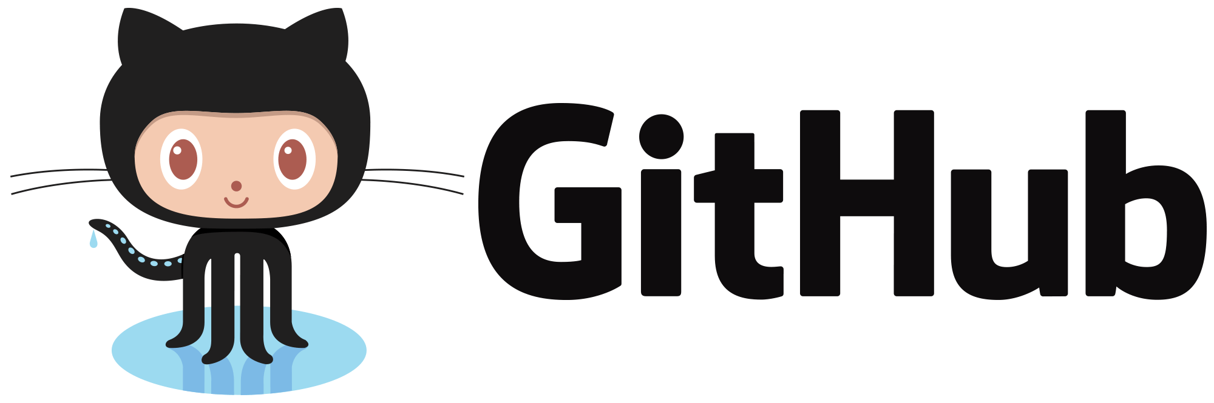






Closed Source -> Open Source

Slide 3
Overall Process
Themes
(Coding & Sorting)
Survey
62 responses
Projects
Interviews
CoreFX
CoreCLR
Roslyn
Entity Framework
MVC
Orleans
11 Microsoft Developers
Transition Reasons
8 statements
The Transition
5 statements
5 Microsoft Managers
Transition Outcomes
24 statements
11 Open-Source Developers
The Community
13 statements

Slide 4
Transition Reasons
Vibrant Community
“To make ourselves one with the community and participate more.”
Prompt Answers
“Some of our best bugs come from the community”
Open Source Culture
“To be a better company, we need to move in that direction.”
Building Trust
“number of agencies won’t pick us unless they trust the code”

Slide 5
Transition Outcomes – Process Changes
Version Control (TFS -> Git)
+ “faster and more decoupled system”
- “Higher learning curve”
Code Reviews (CodeFlow -> GitHub)
+ “For small changes it’s much better”
- “I’m still missing code review tools”
Testing
+ “There are external contributors who do primarily test”
- “….you lose a big portion of testing”

Slide 6
Transition Outcomes – Developers’ Perception
Simple Build
“We just wanted simple self-contained build as vanilla as possible”
Agile Process
“new model is more agile than before”
Number of Bugs
“I think there are more bugs reported”
Code Quality
“our codebase health is improving”

Slide 7
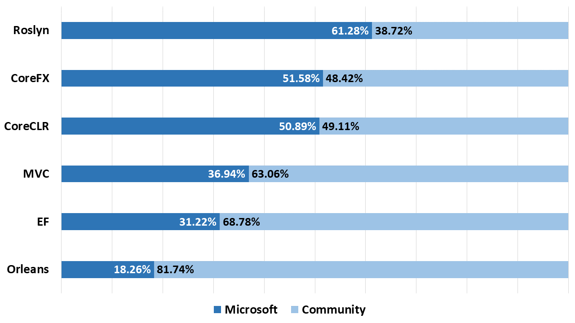
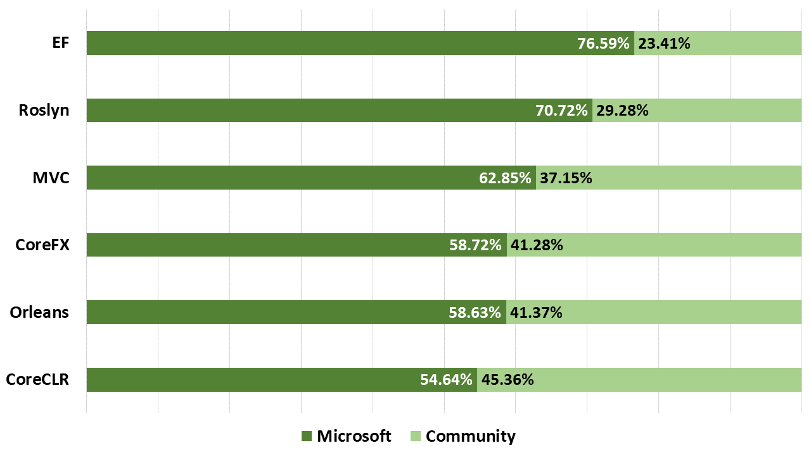
Contributions
Issues
Pull Requests

Slide 8
Key Takeaways
Organizations:
Infrastructure support, clear goals, uniform processes, hosting platform
Developers & Managers:
Developing culture, documenting best practices, harmonious attitude

Slide 9
Appendix

Slide 10
Transition Reasons
Vibrant Community
Prompt Answers
Open Source Culture
Building Trust
Business Opportunities
Limited Resources
Better Code, Better Coders
Potential Employees

Slide 11
Transition Outcomes – Process Changes
Version Control (TFS -> Git)
+ “faster and more decoupled system”
- “Higher learning curve”
Code Reviews (CodeFlow -> GitHub)
+ “For small changes it’s much better”
- “I’m still missing code review tools”
Testing
+ “There are external contributors who do primarily test”
- “….you lose a big portion of testing”

Slide 12
Transition Outcomes – Process Changes
Continuous Integration
+ “We are running continuous integration on Windows, Linux, and Mac”
Code Check In
+ “pull request must be OKed by two senior members”
+ “It was clearer what the issues are and who is working on them, and easier to
submit pull requests”

Slide 13
Transition Outcomes – Developers’ Perception
Simple Build
“We just wanted simple self-contained build as vanilla as possible”
Agile Process
“new model is more agile than before”
Number of Bugs
“I think there are more bugs reported”
Code Quality
“our codebase health is improving”

Slide 14
Transition Outcomes – Developers’ Perception
Developer Awareness
“eye opening experience to alternative tool chains”
Tool Support
“open source workforce is standardized and several tools which are well-known”
Discoverability
“It was all over the news sites I read. Hard to miss really”

Slide 15
The Community
Developer Excitement
“Surprising how quickly the first pull request comes in”
“I looked at the issue tracker and found some bugs that were labelled ‘up for grabs’
Active Engagement
“MS people have been very nice, polite and they focus on the topic”
“there is very good discussion going on and in the community”
Transparency
“we are working in the open, they see all the bugs we file, we publish our design
meeting notes”

Slide 16
The Community
Ownership
“Some of the community members took a leadership role”
“there has been a lot of interaction talking about ideas”
Recognition System
“There are people who hangout in the issues and are passionate about their areas”
Relevant Contributions
“We look at it and say this is nice for your scenario but it is missing all these other
things around it”
“people have an expectation that like you are going to be taking almost anything”

