Slide 1

draft-richardson-secdispatch-idevid-considerations-02
IETF108 – secdispatch - 2020-07-30
Michael Richardson <mcr+ietf@sandelman.ca>
JayYang <jay.yang@huawei.com>
http://www.sandelman.ca/SSW/ietf/meeting/ietf108/secdispatch-ietf108-idevid-considerations-expanded.pdf

Slide 2
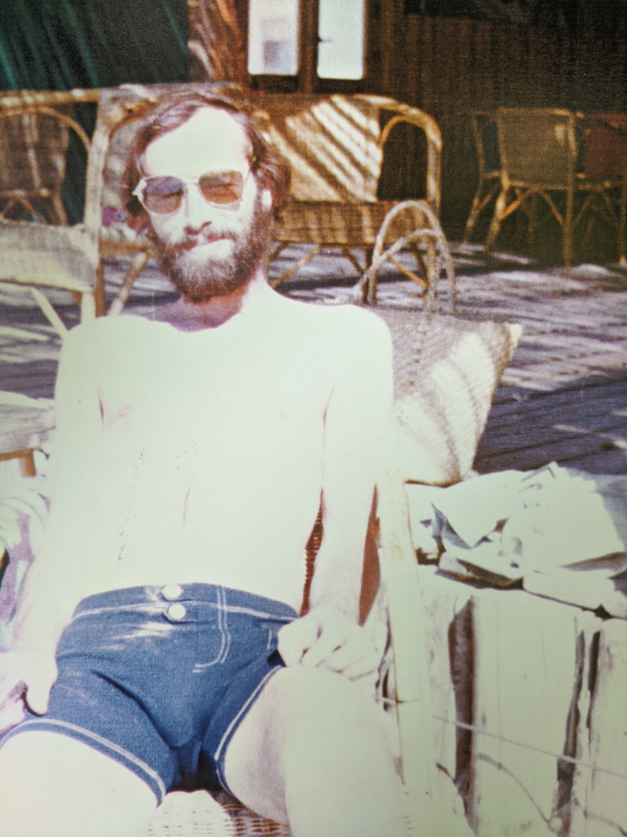
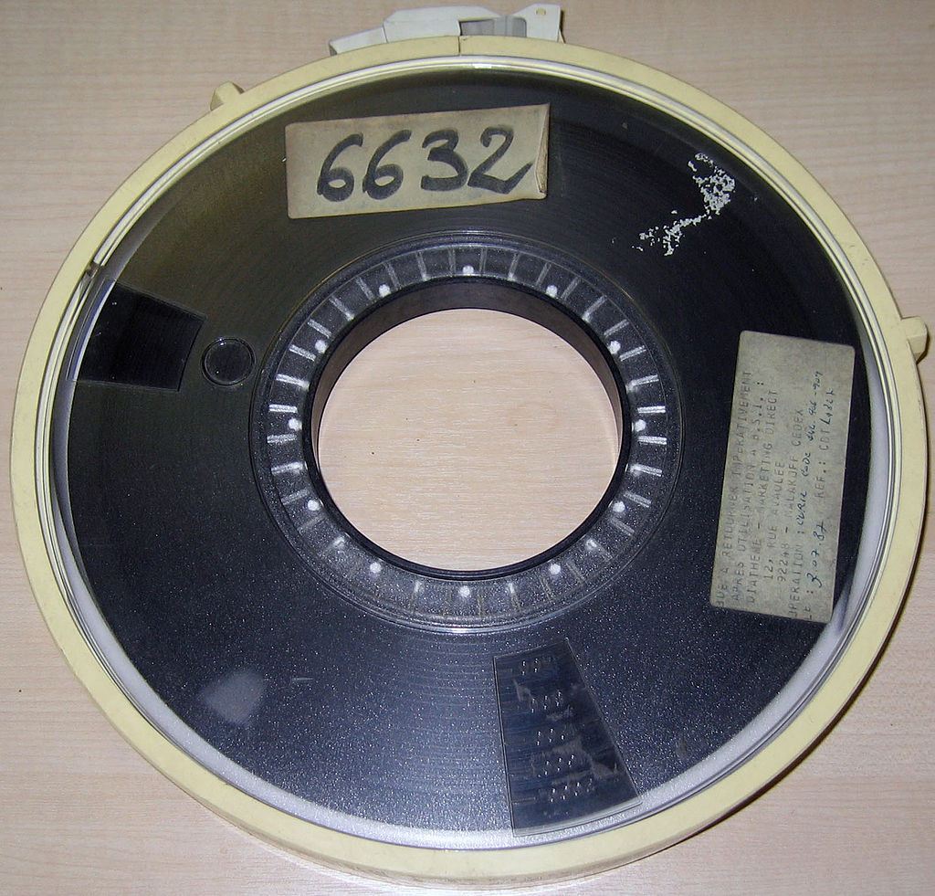
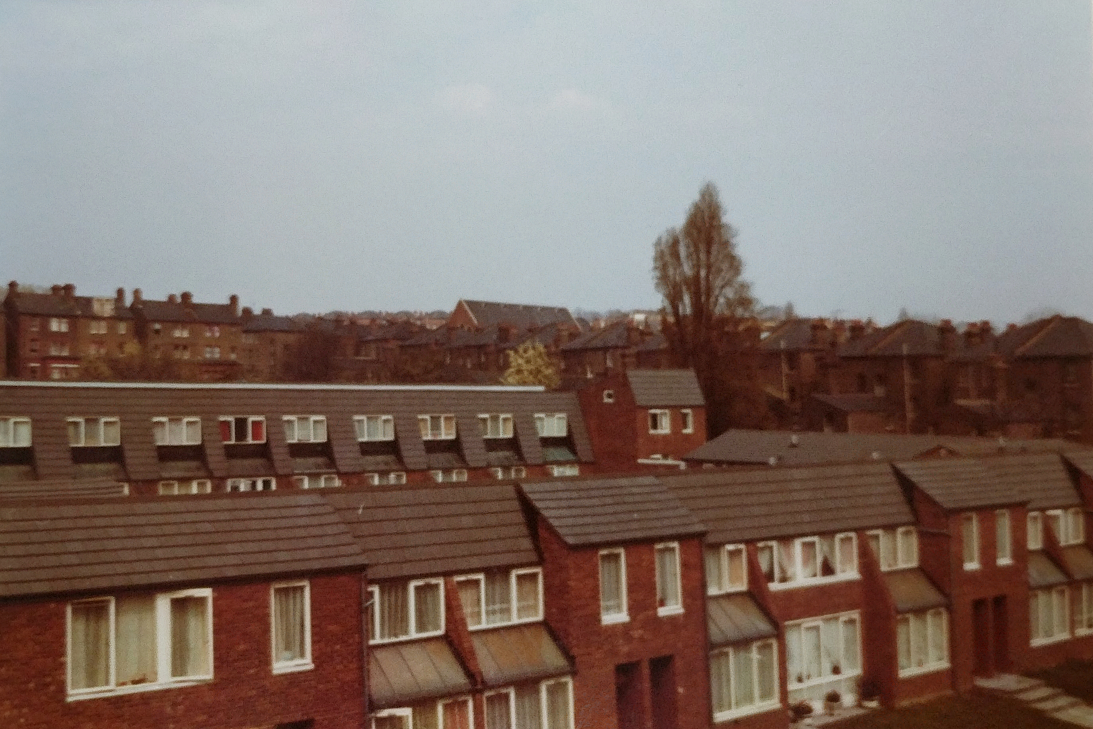
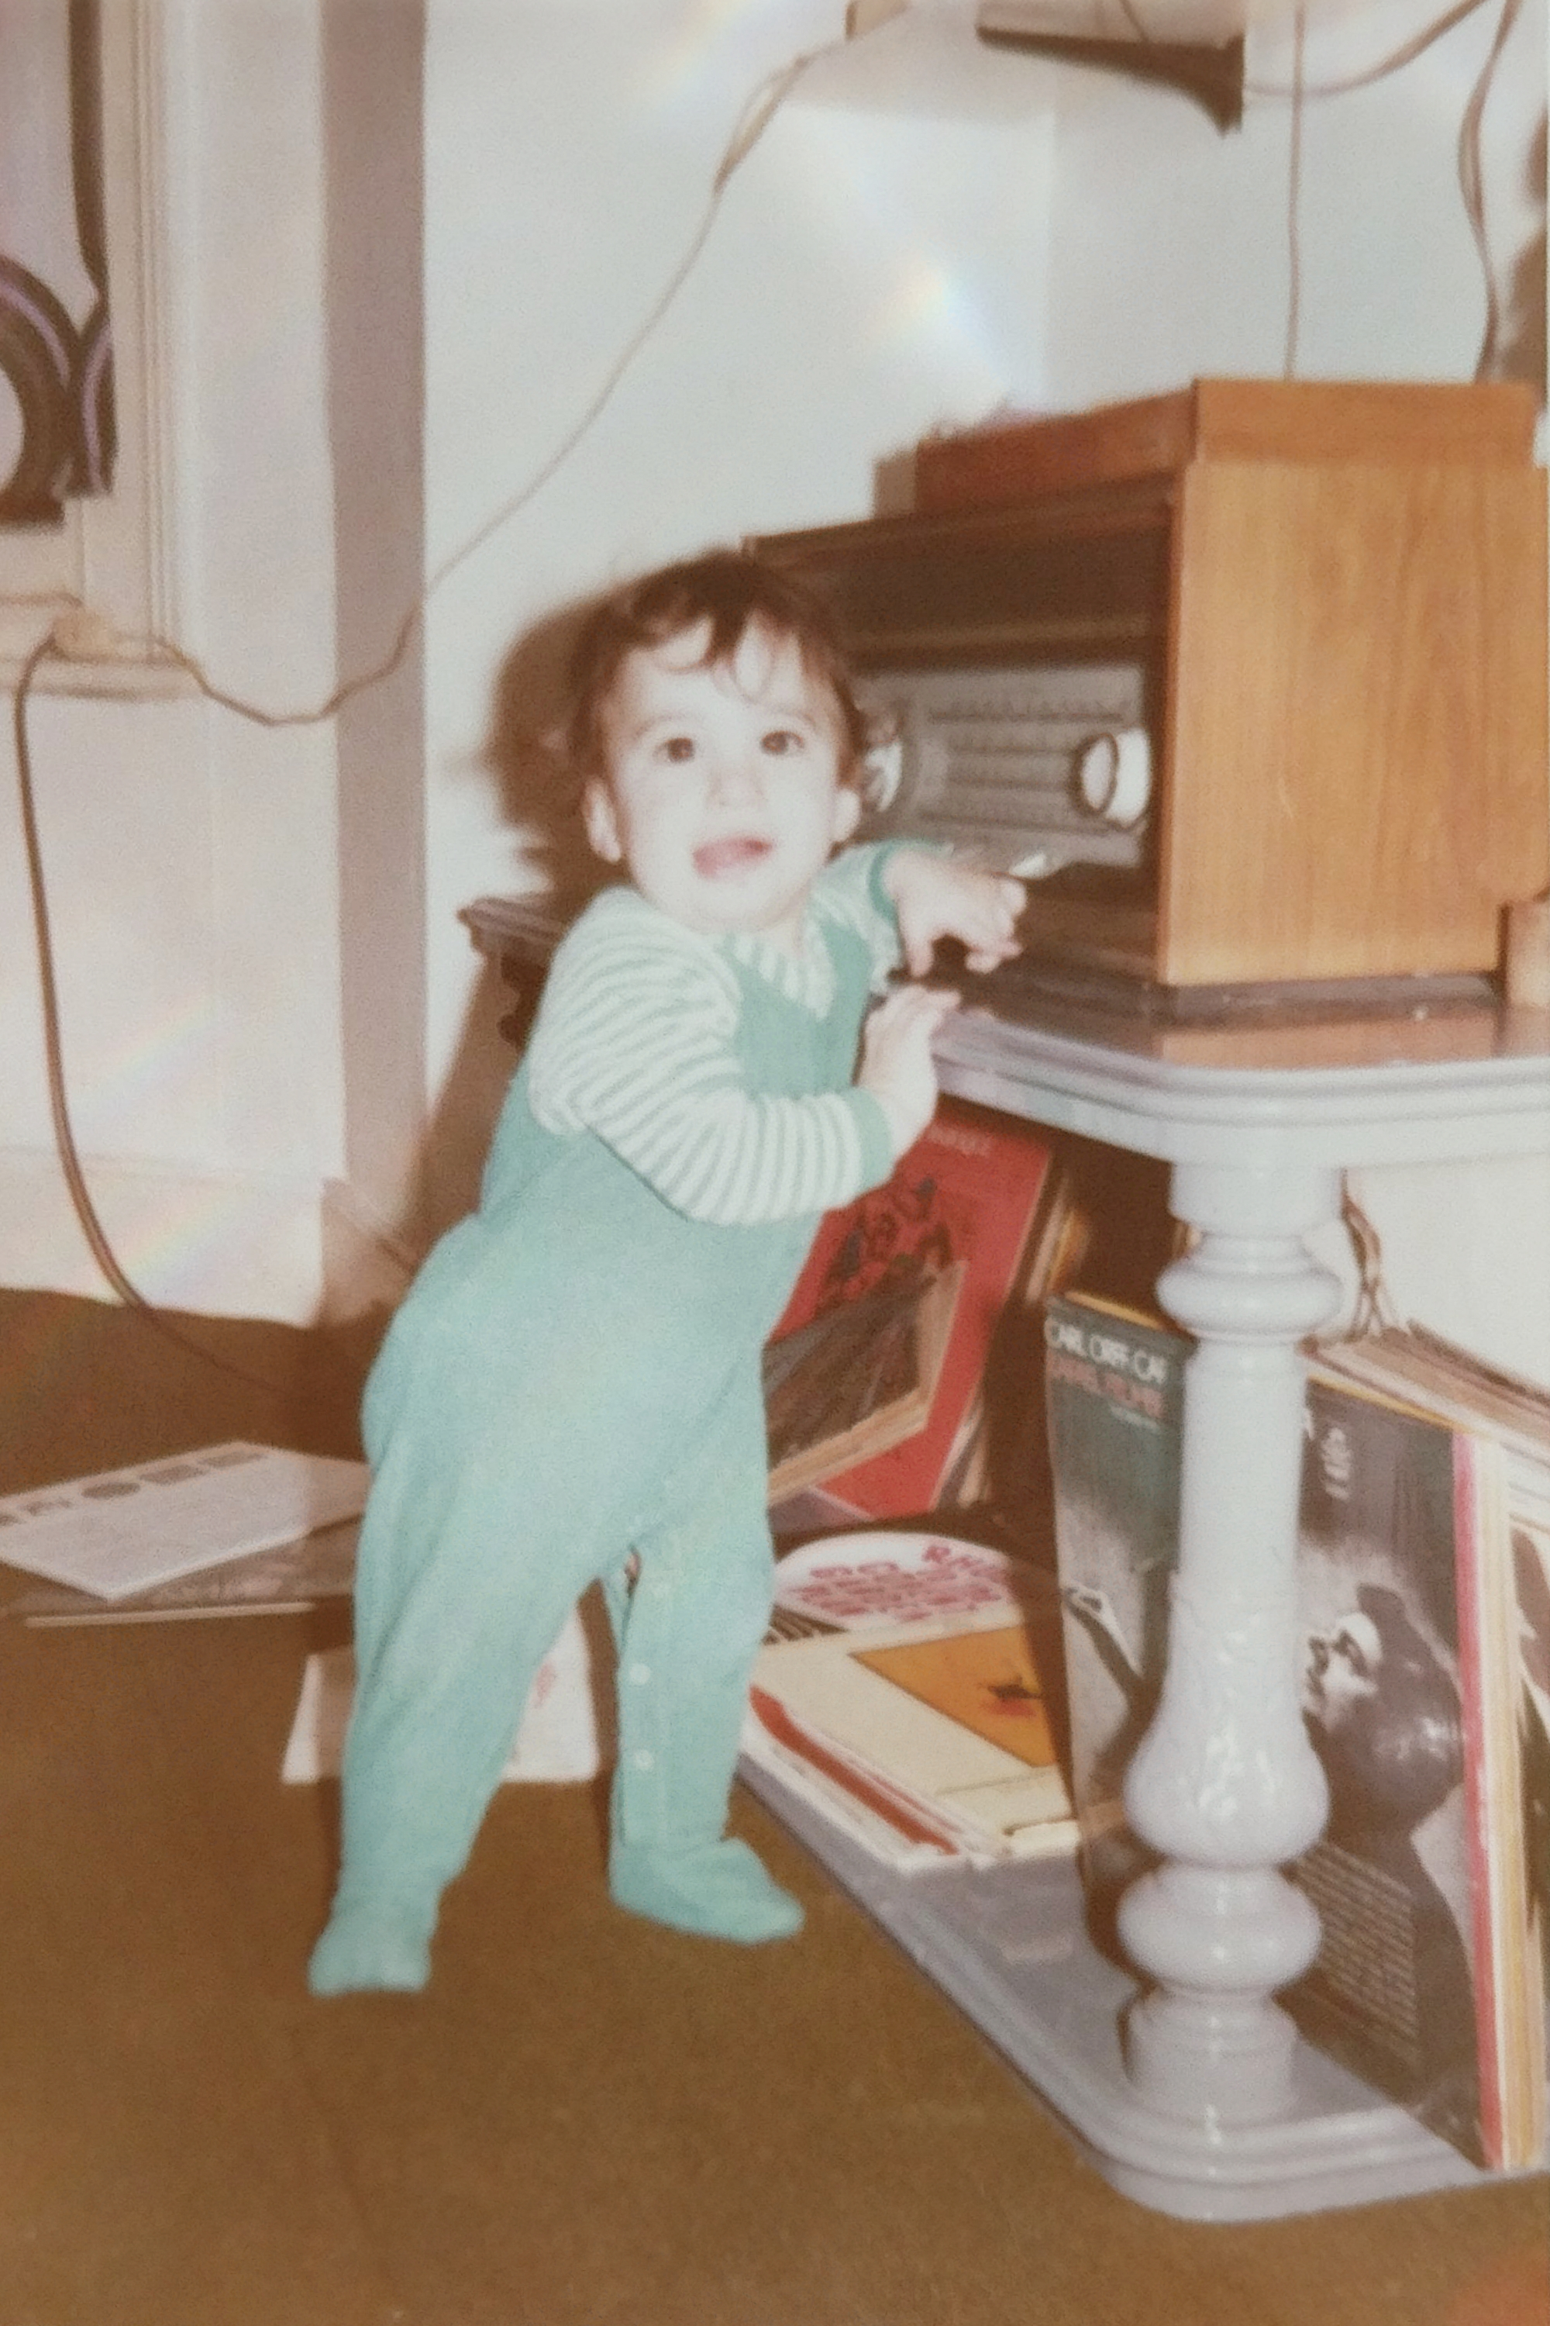
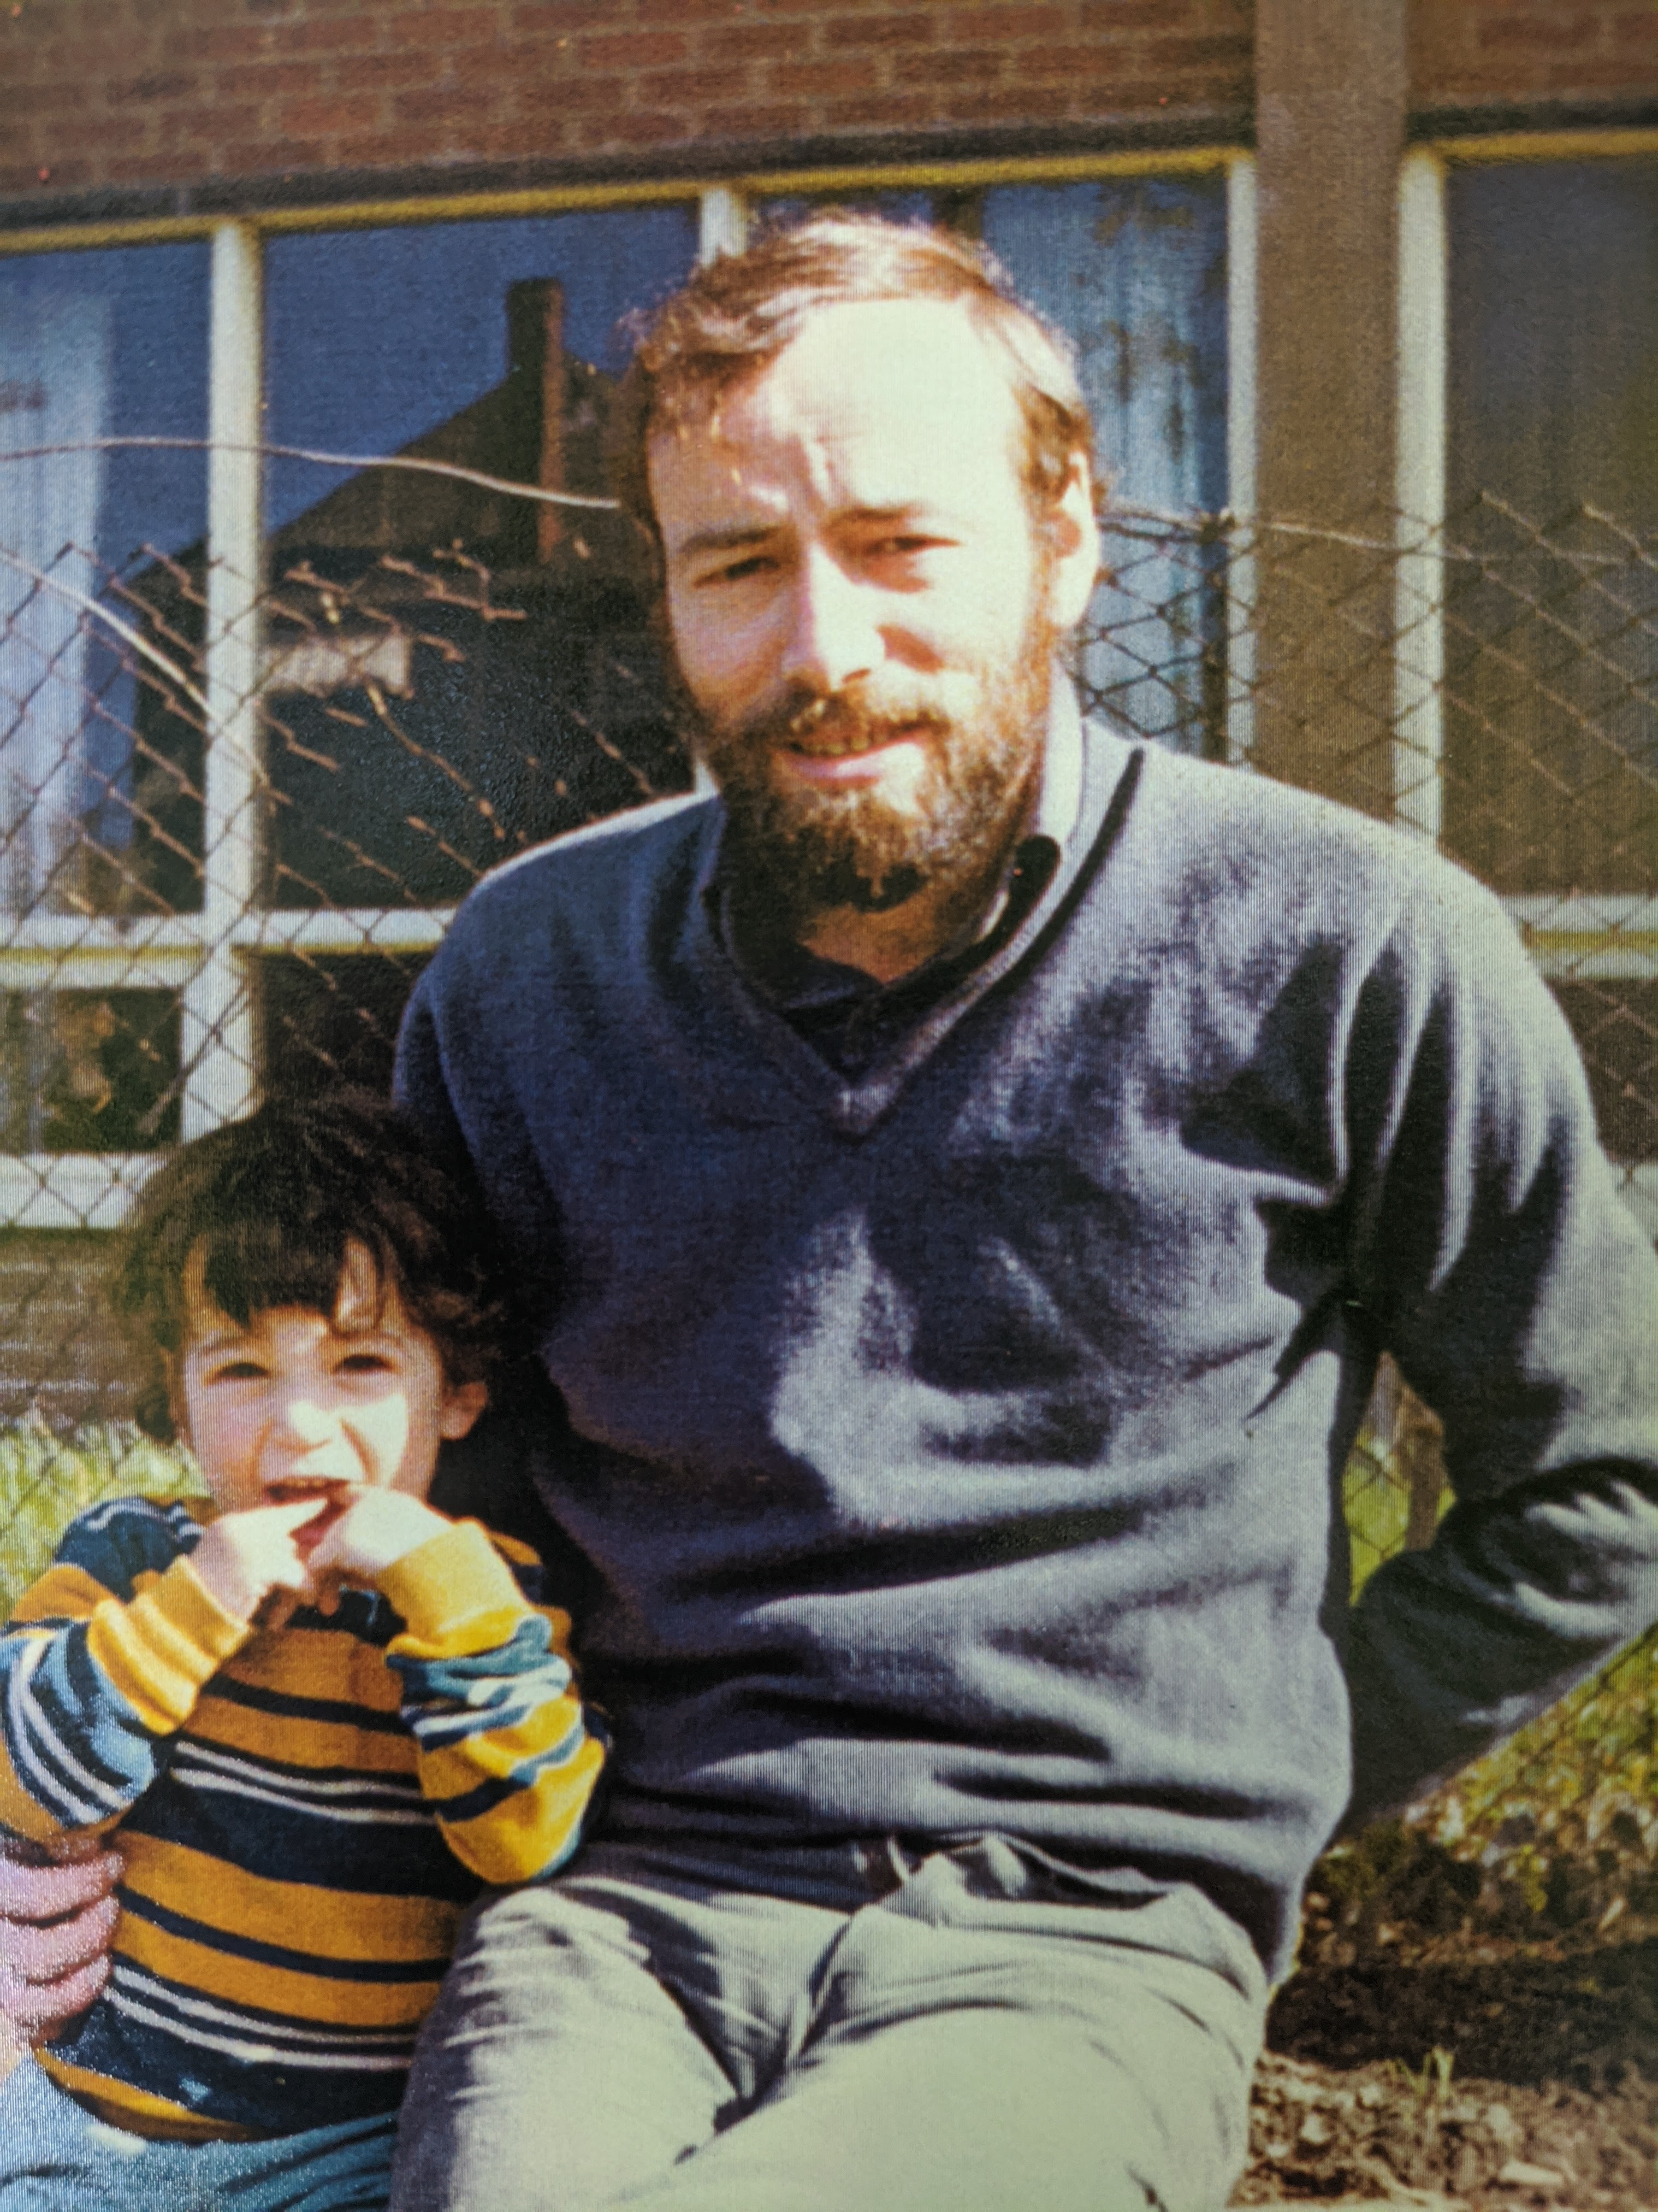
1972
My Dad (cjr) [Sociologist!]
Returned from UK
Alpha version of SPSS: Statistical Package for the Social Sciences
With
Baby Boy (mcr)

Slide 3

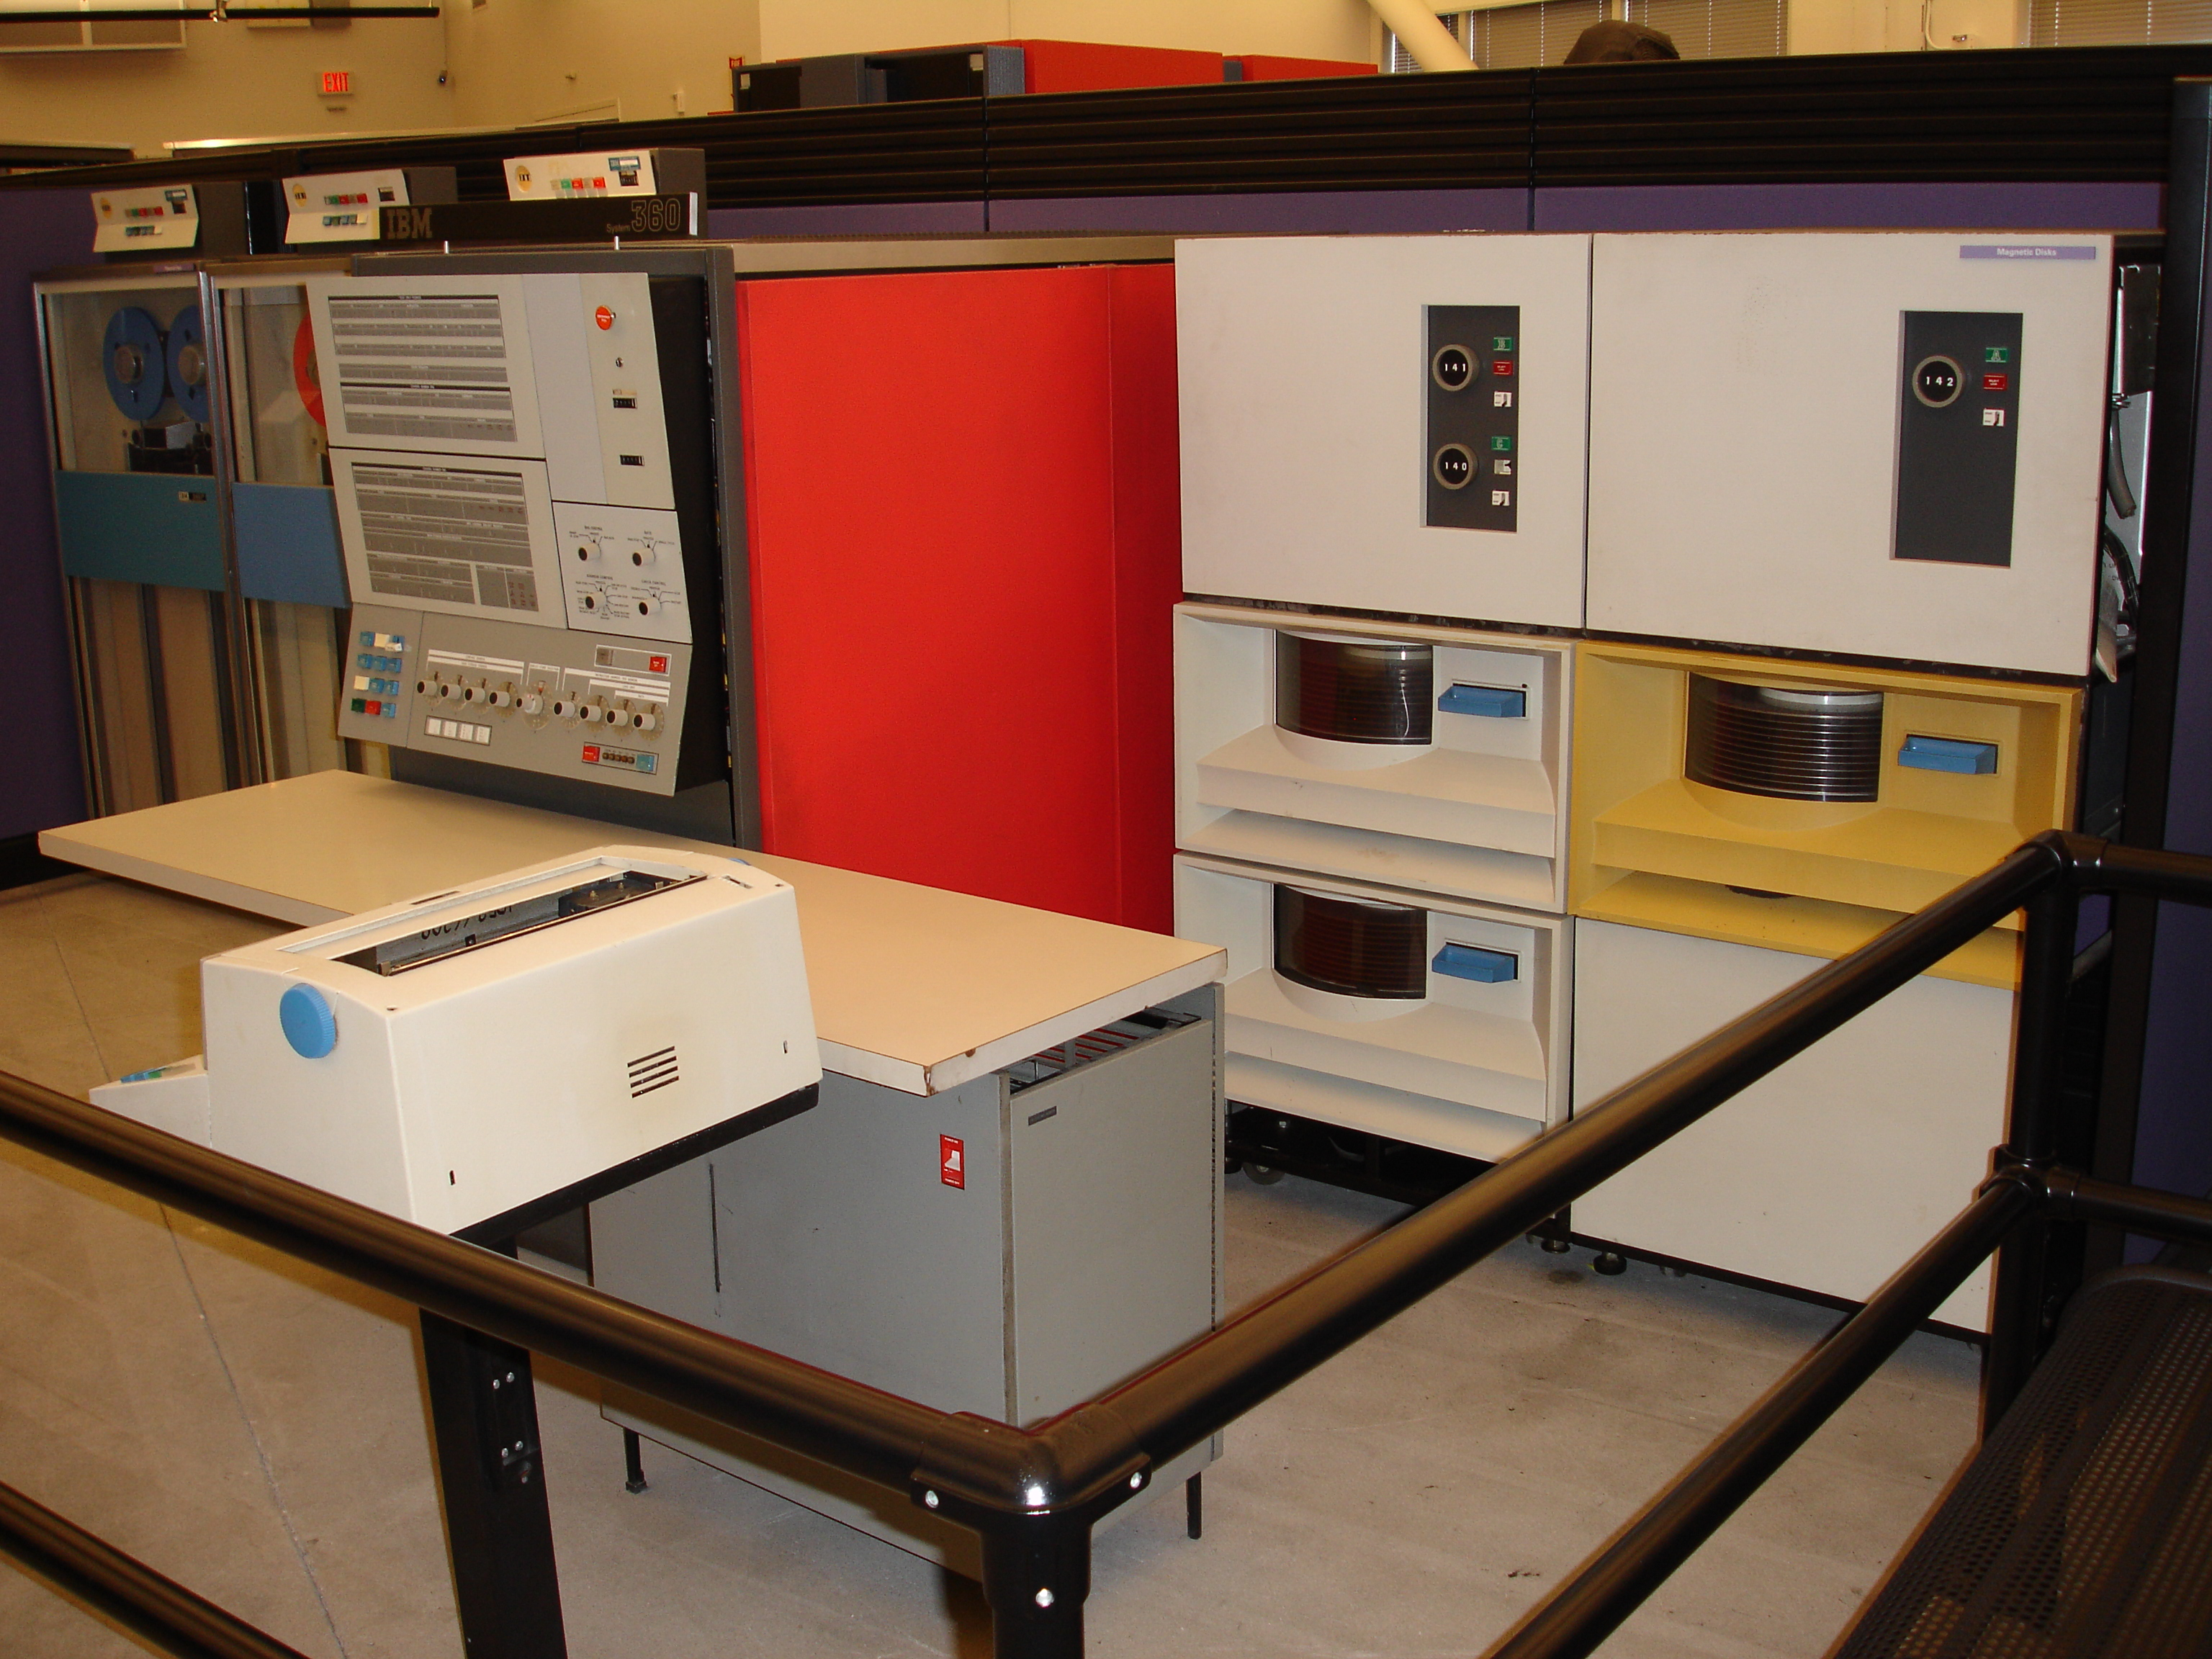
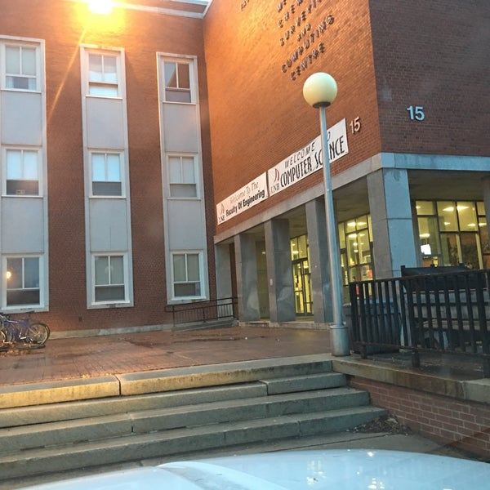
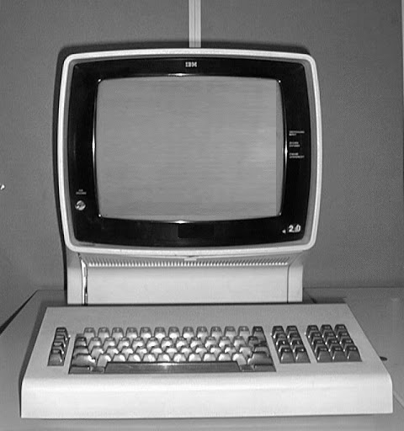
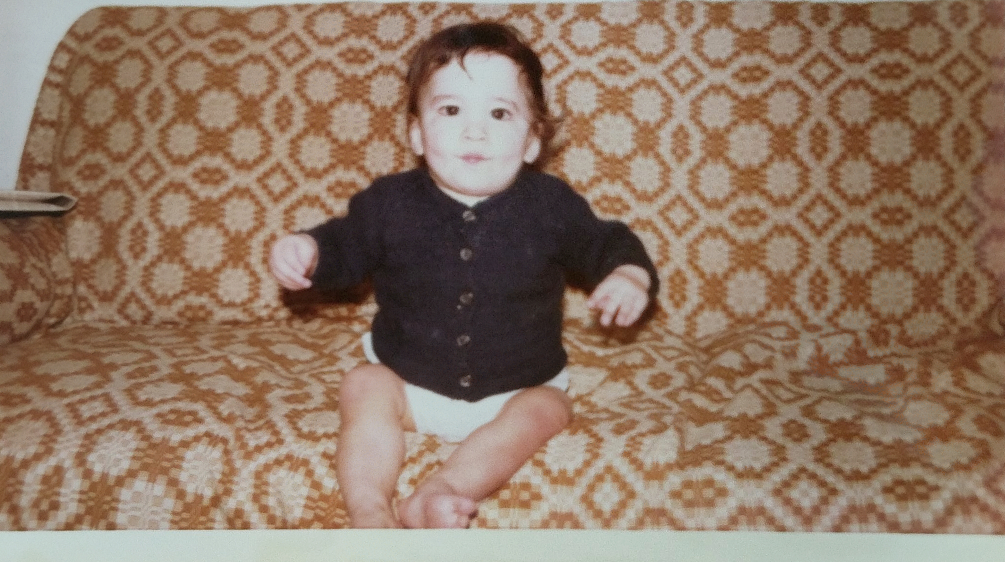

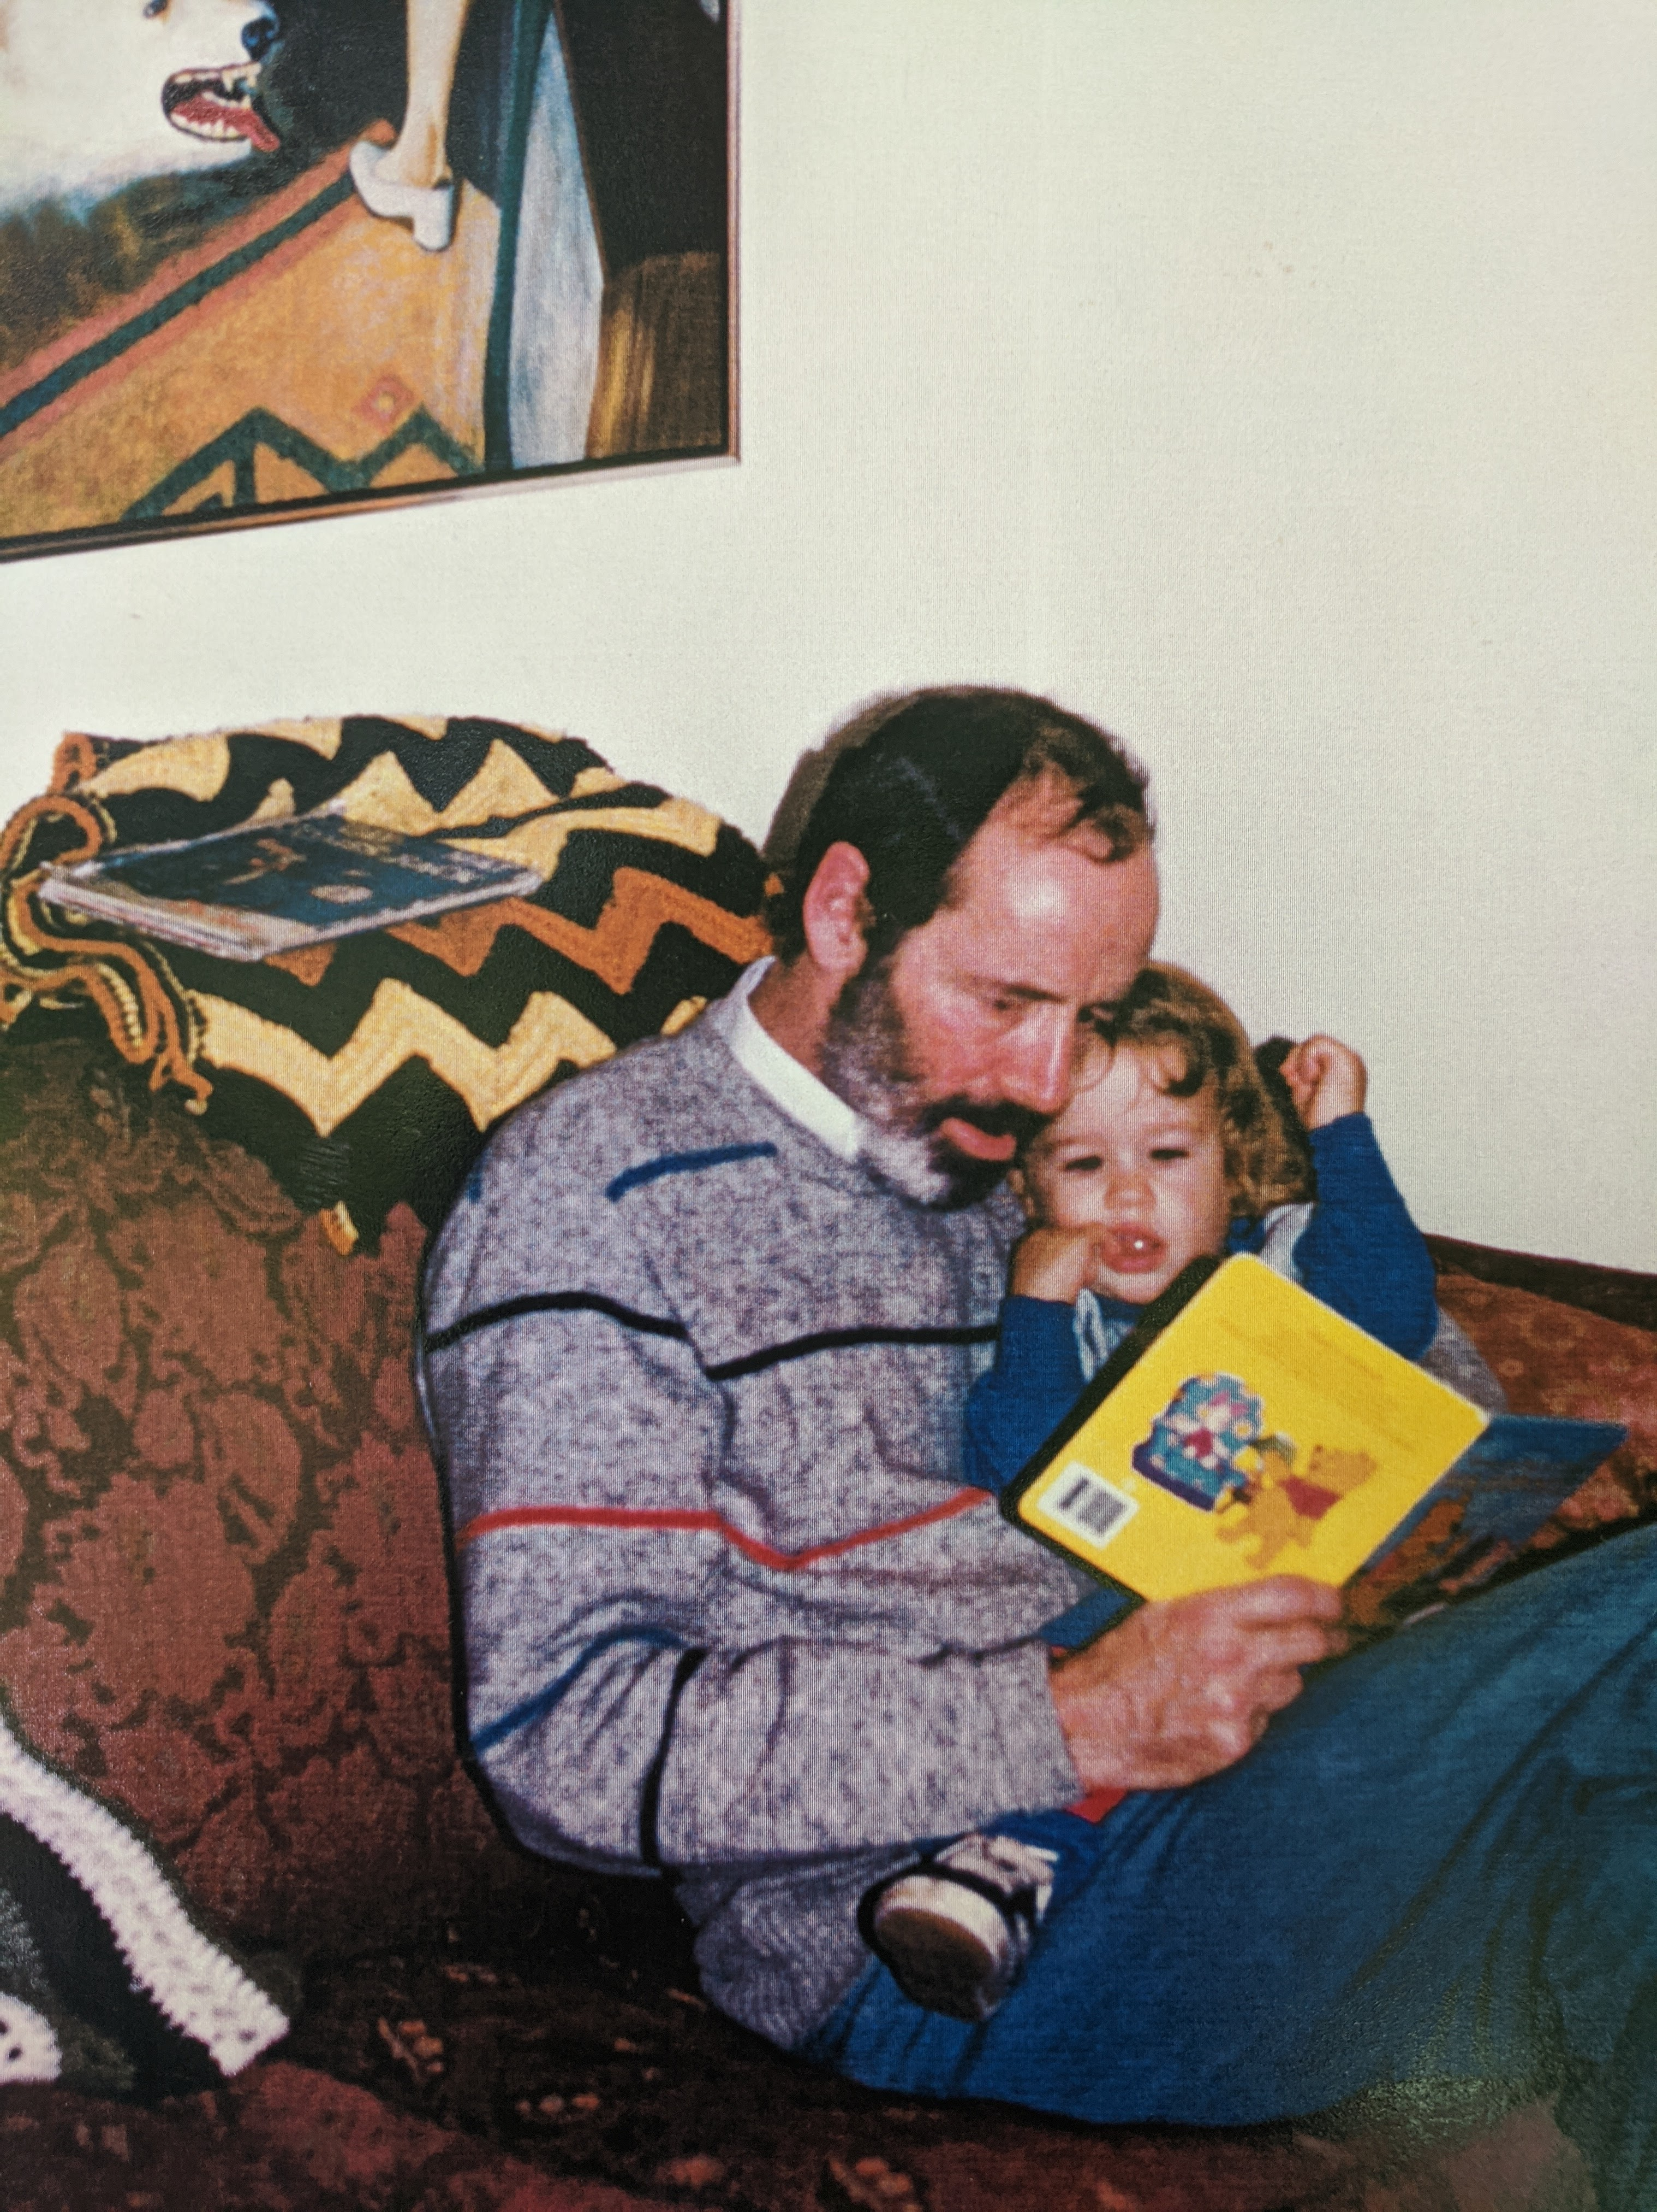
1975
Got a “computer”
Worn
Out
copy
And we read
An awful lot

Slide 4
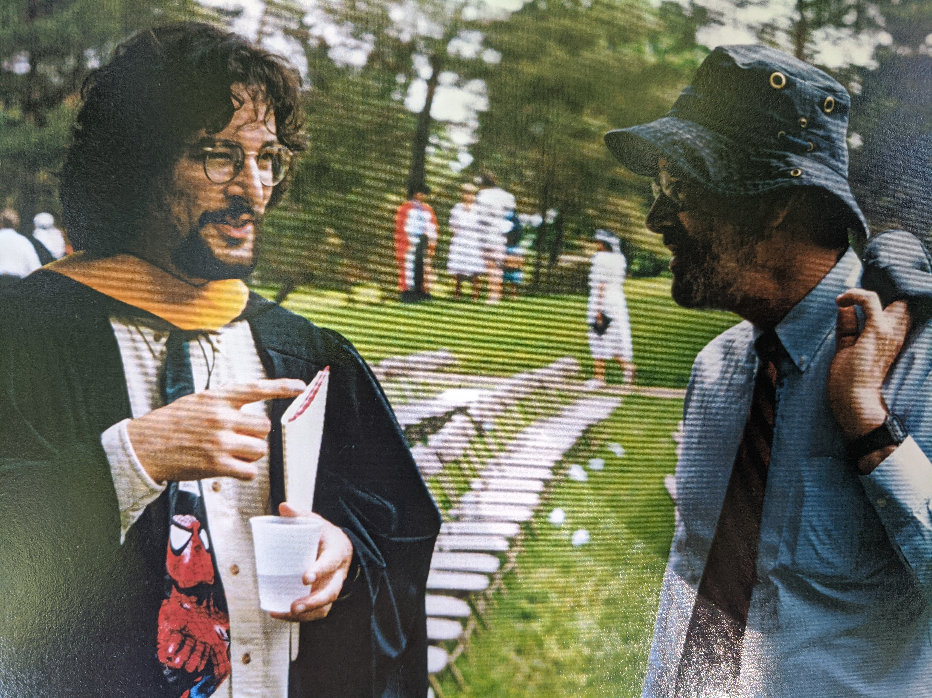
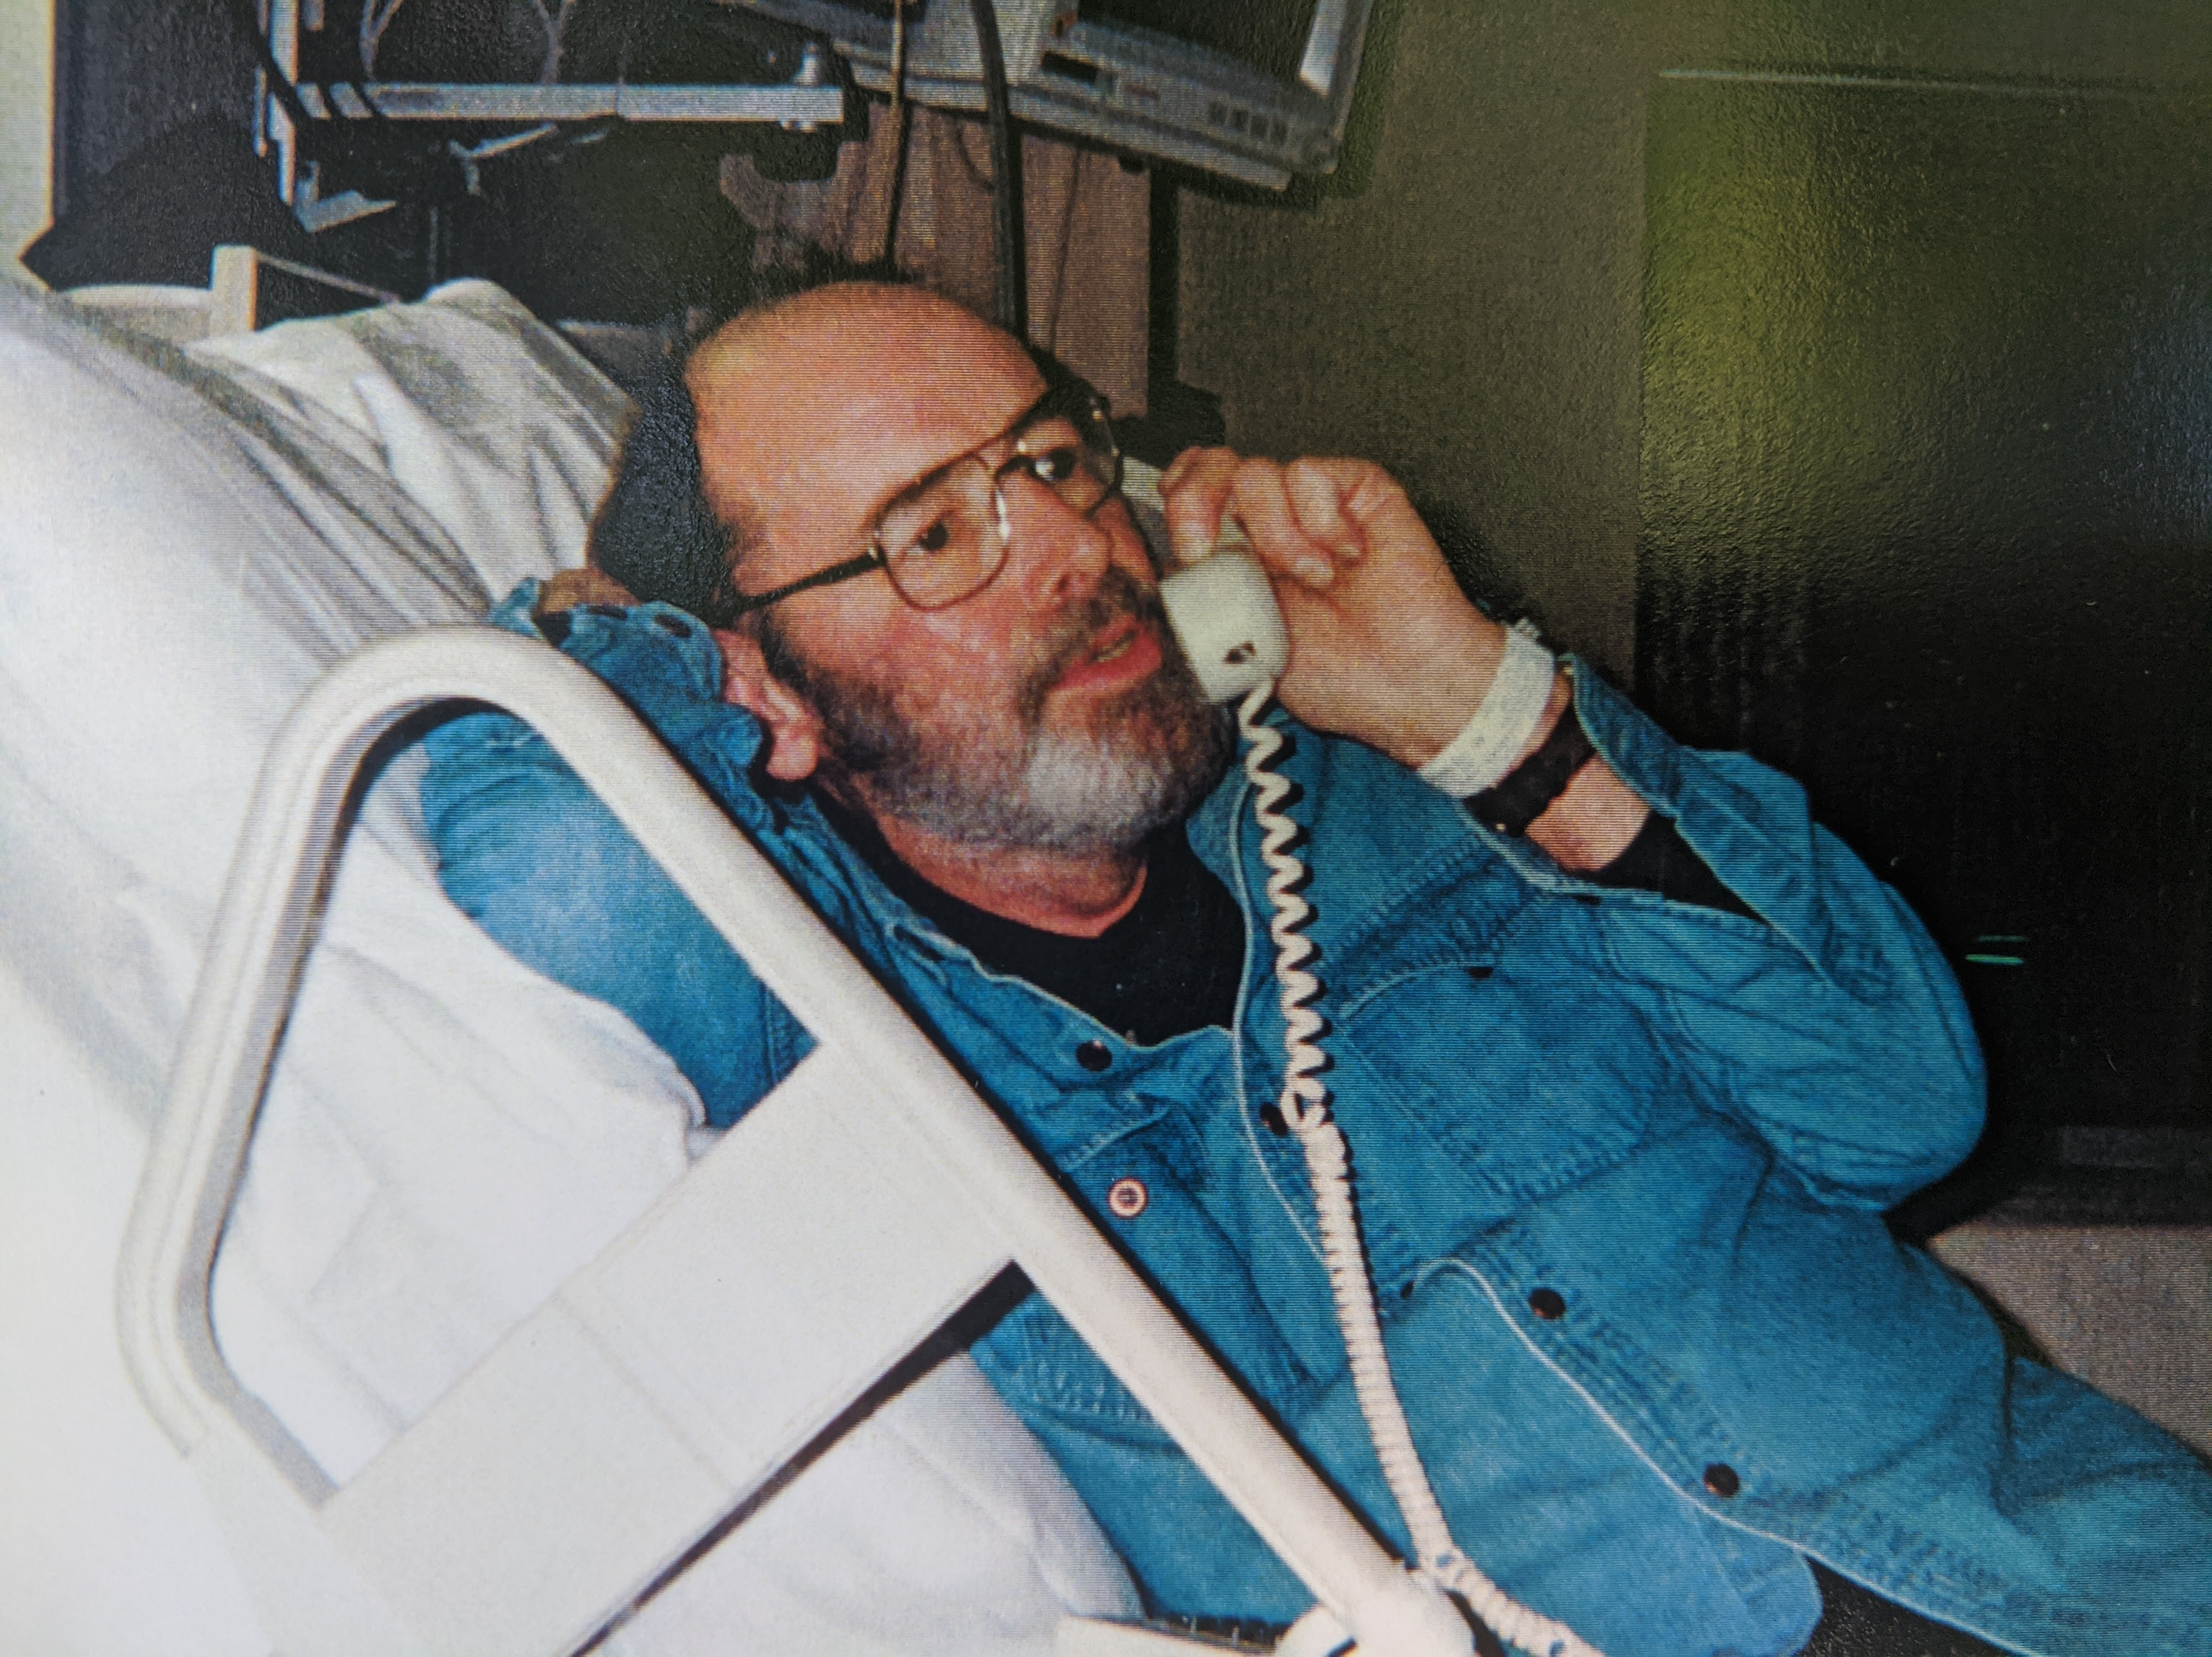
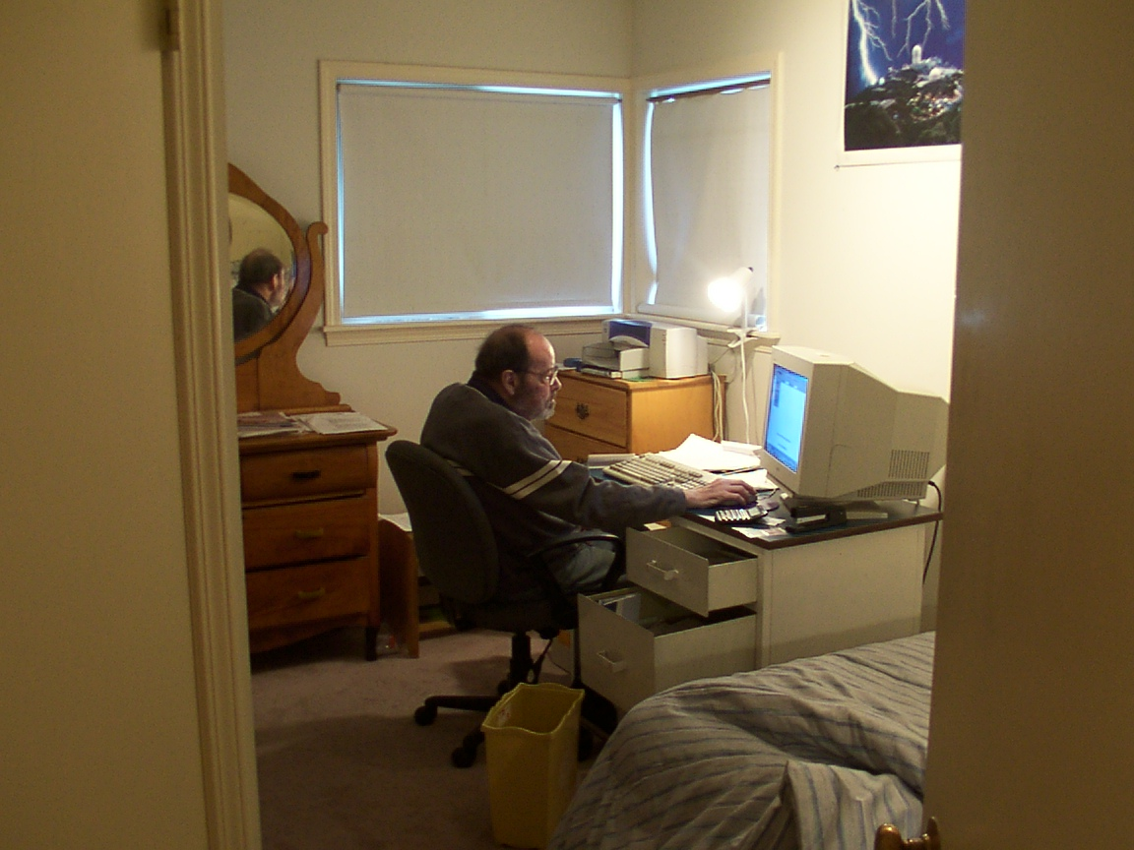
1995: for decades, he had been pestering me:
HOW DOES MY COMPUTER KNOW
WHAT TO DO WHEN I TURN IT ON?
HOW DOES IT KNOW IT WHO IT CAN TRUST?
Me, explaining
What a BIOS is
“So, does every
IoT device have
a secure enclave?”
“No, I don’t want
to securely update
right now!!”

Slide 5
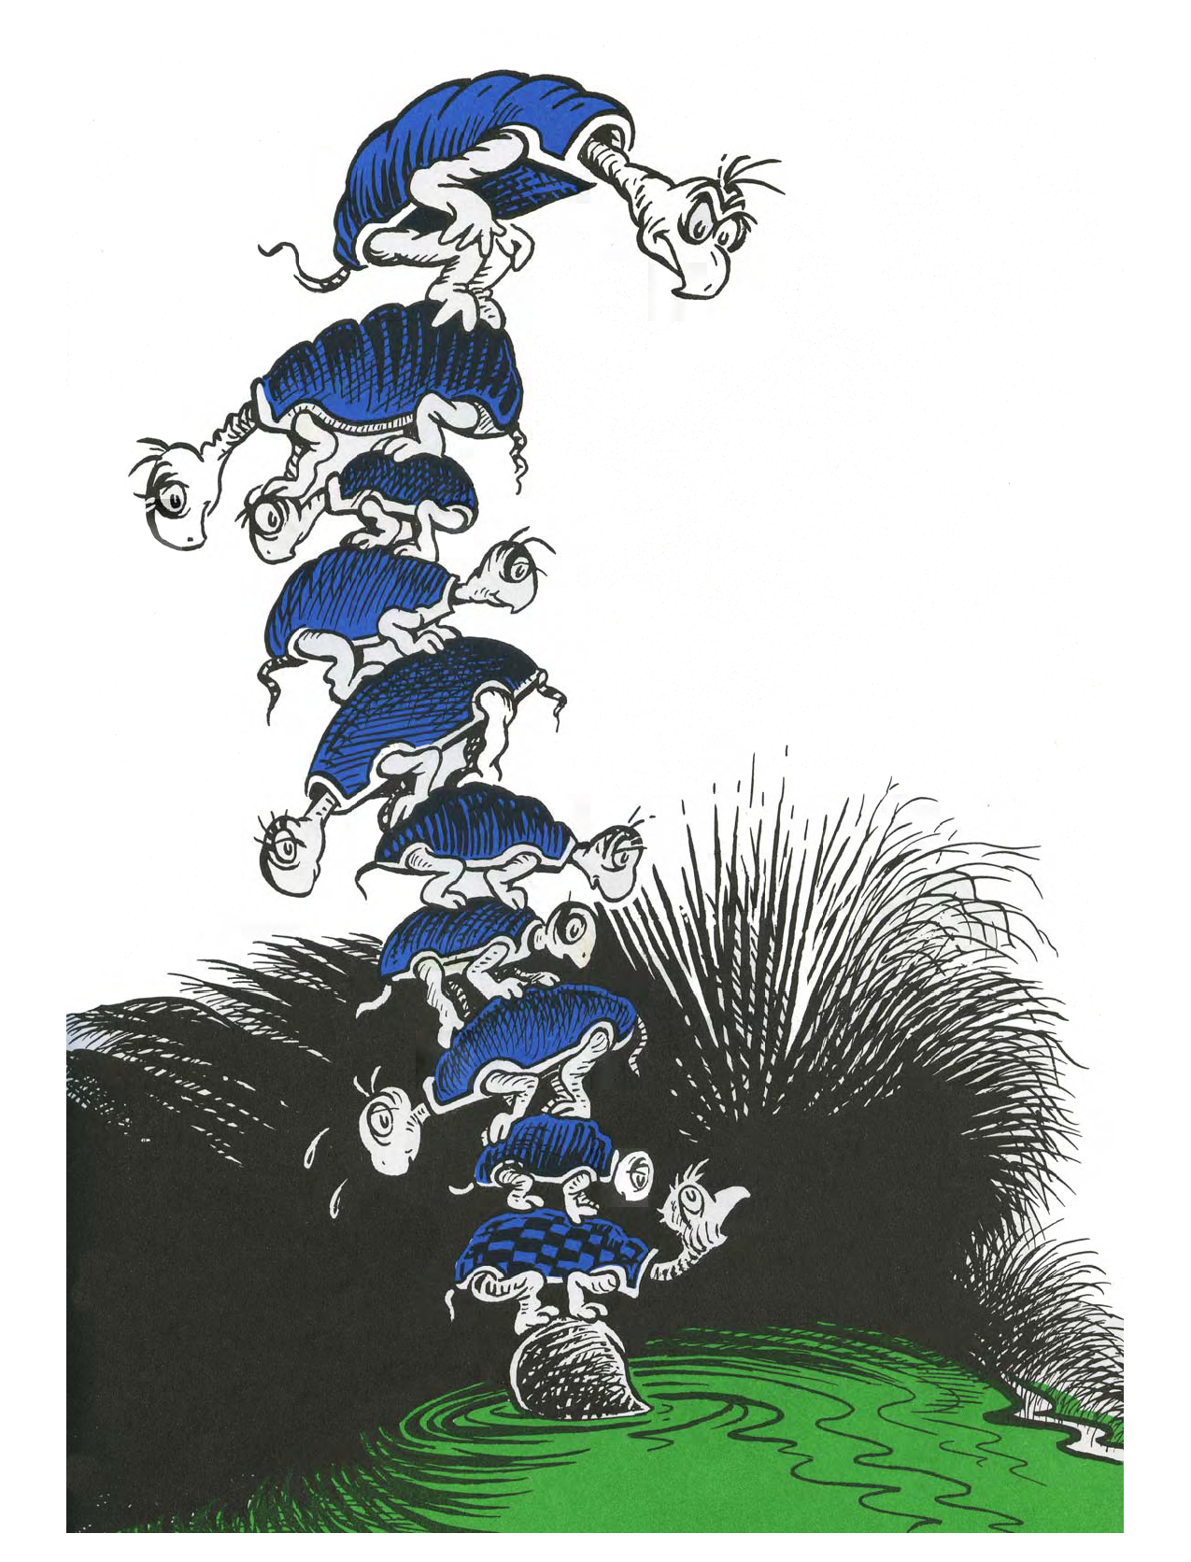
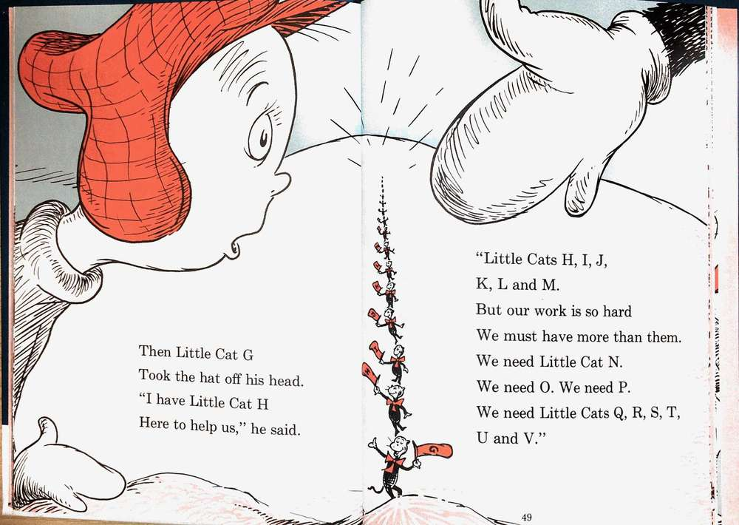
Turtles all the way down
Everytime I thought I’d convinced him, he’d just just complain:
  You’ve just added a turtle.
At some point, it’s gotta stop,
There must something down
there, he would complain.

Slide 6
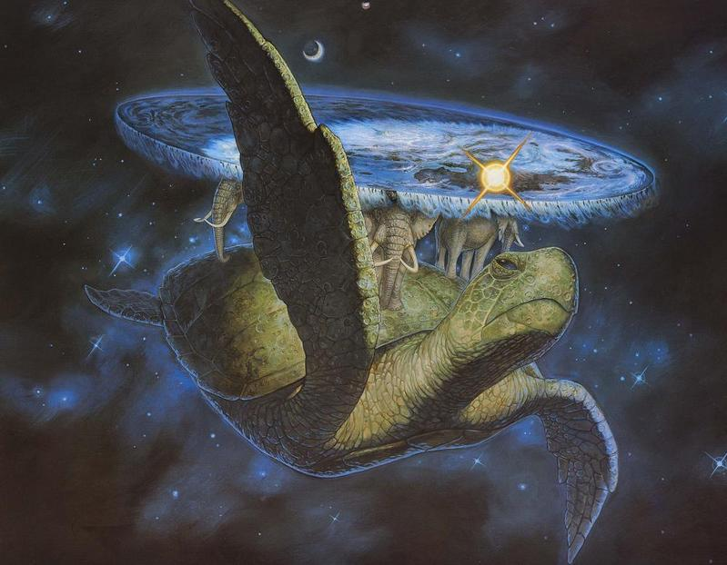
IDevID considerations document
This document is about the quality of the turtles
  How do they get there?
  Can they be trusted?
    How much?
    For what? (Is the risk mitigation appropriate to the user’s threat model?)
Three fundamental ways to provision initial roots of trust.
Ultimately, the software update trust anchor rules everything.
Insert parable about blind people examining different parts of an elephant.
https://en.wikipedia.org/wiki/Blind_men_and_an_elephant

Slide 7

Confidentiality of IDevID private key..
Non-Disclosure
Agreement
Firmware
TPM
Hardware
TPM
Supply Chain
Security Audit
Silicon Root
Of Trust

Slide 8
Adding layer of indirection...
Auditor:
Returns
Normative
Description
Non-Disclosure
Agreement
Firmware
TPM
Hardware
TPM
Supply Chain
Security Audit
Silicon Root
Of Trust

Slide 9
Audit Model
Recognize:
Posessor of Bootloader software update key wins all battles.
However >pubkey< is provisioned determines in-system risk of entire system.
  This is the bottom turtle, “Mack”, and he’d better not burp.
App:
WebPKI
trust
anchors
Stage 2
bootloader
Even more critical: how is the private key that can sign code kept?
Stage 1
Bootloader
>pubkey<
Validates
signature
or access
(f)TPM
IDevID

Slide 10
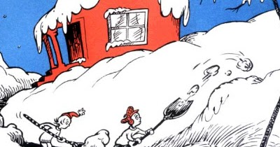

Non-Goals of the document
Not aiming to write an ISO27001-ish evaluation process.
Not going to make any recommendation as to an appropriate solution for a given risk situation.
The PKI part of the document
Is still proscriptive, that’s a bug
left from splitting.

Slide 11

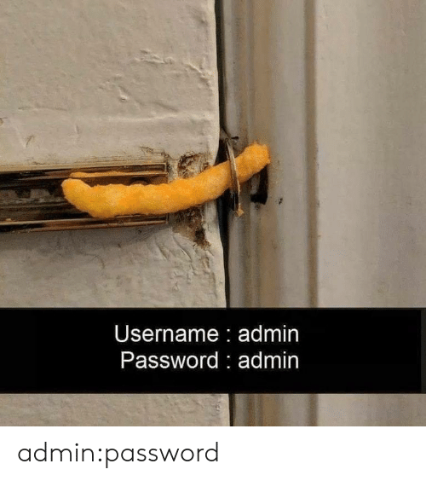
Goals of this document
Enumerate the reasonable, and maybe some less reasonable ways to provision and secure keys, and give them names.
Not just the most secure way, because it is not always worth it.
IETF
CERTIFICATE
Integrity

Slide 12
History of Document
ANIMA!
draft-richardson-anima-
registrar-considerations
(enterprise private CA)
ANIMA?!
draft-ietf-anima
Autonomic-control-plane
(ACP). At IESG.
draft-ietf-anima
Bootstrapping-keyinfra
(BRSKI). In RFC-editor Q
draft-richardson-anima-
masa-considerations
(vendor private CA + voucher)
ANIMA!
Document
Split up
PHB
Threshold
work
draft-richardson-secdispatch-
idevid-considerations
(vendor private CA
+ trust anchors)
ANIMA?!
draft-richardson-anima-
masa-considerations
(voucher)

Slide 13
What to do?
Supports work in:
  SUIT
  TEEP
  RATS
  ANIMA
  LAMPS (CMP)
  IPsecME, COSE, TLS,...
But it is not even close to a protocol.
Also not an applicability draft.
It would be referenced by an applicability draft
  Probably one in an outside SDO

Slide 14
What to do?
Do it in SAAG?
AD sponsor
  Would not get enough review
Needs a lot of
outside review
and contribution
QUESTIONS!!

Slide 15
Useful Links
IDevID discussions
  https://mailarchive.ietf.org/arch/msg/secdispatch/Hqe1lHG2wnW_9NxJLazEYbmGYN0/
  https://mailarchive.ietf.org/arch/msg/anima/-2Niz98BNSopDi4GpgxrDfI_Mdc/
  https://mailarchive.ietf.org/arch/msg/anima/eMOH3NFbEDjZOi5gZgB9EkI6yxw/
  https://mailarchive.ietf.org/arch/msg/anima/-6-eQJgtUWrz5v067u9Xb030qnQ/
MASA operational considerations
  https://mailarchive.ietf.org/arch/msg/anima/PSkpYZs0C_RLzUFD2BSMipEggfQ/

Slide 16
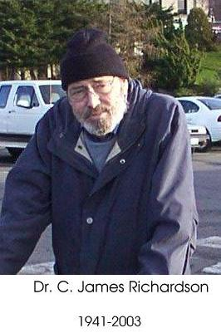
Useless Links and Irrelevant Facts
Return of Cat in the Hat https://www.youtube.com/watch?v=YJf2f_LqnLo
Yertle the Turtle https://www.youtube.com/watch?v=xY5vs2WtlKM
..in which the eponymous Yertle, king of the pond, stands on his subjects in an attempt to reach higher than the moon—until the bottom turtle (Mack) burps and he falls into the mud, ending his rule.
Actually,
My brother jjrh
Actually, Sardinia,
Not London.

