Slide 1
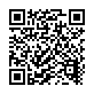
A Taxonomy of operational security considerations for manufacturer installed keys and Trust Anchors
Michael Richardson
<mcr@sandelman.ca> https://www.sandelman.ca/SSW/talk/2023-t2trg-taxonomy-installed-keys/

Slide 2
An even briefer history of this draft
ANIMA documents
  masa-considerations
  registrar-considerations
  common contents,
Went to SECDISPATCH in virtual interim meeting in July 2022, at IETF108
  https://datatracker.ietf.org/meeting/108/session/secdispatch
Adopted by T2TRG Jan. 2023.
?
Profit!

Slide 3
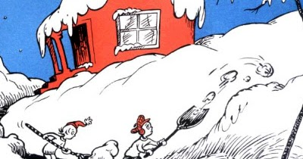

Non-Goals of the document
Not aiming to write an ISO27001-ish evaluation process.
Not going to make any recommendation as to an appropriate solution for a given risk situation.

Slide 4
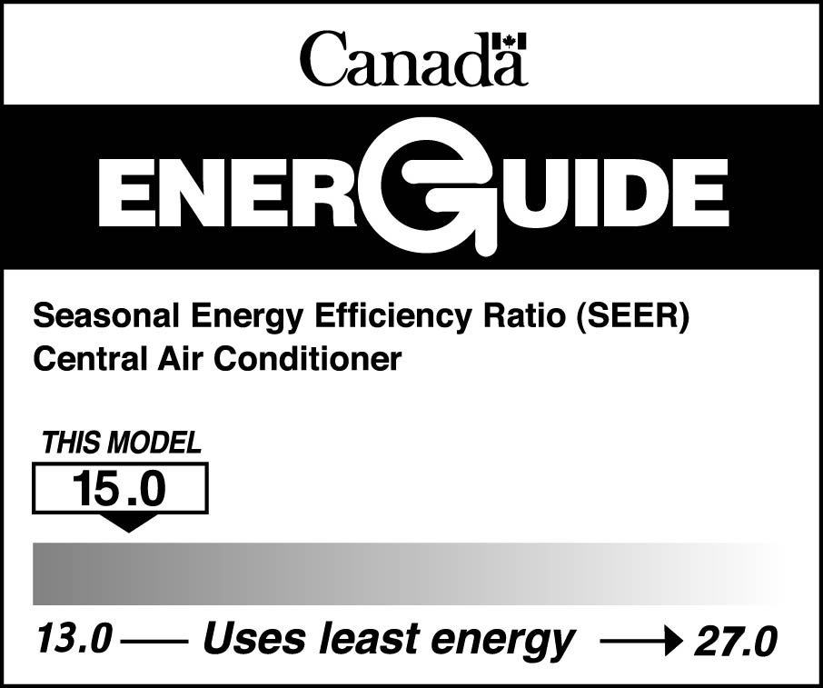
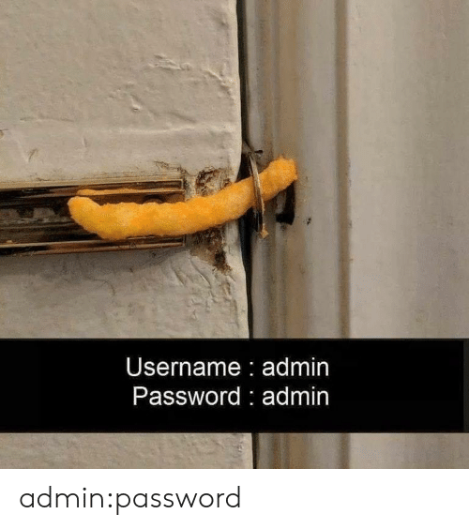
Goals of this document
Enumerate the reasonable, and maybe some less reasonable ways to provision and secure keys, and give them names.
Not just the most secure way, because it is not always worth it.
IETF
CERTIFICATE
Integrity

Slide 5
Recent events at CA/B FORUM and LAMPS
CA/Browser Forum decided that code-signing keys need to be in an HSM
CA that signs code-signing key must have some kind of attestation from HSM about key provence
CSR needs to hold this attestation
LAMPS still debating about what the format of attestation will be

Slide 6
Taxonomy: Key Generation Process
where/how is the device key generated
  internal?
  external/factory?
  CPU provisioned seed?
  threashold methods?
++ Key Attributes
> Source/Creation (enum)
>> Loaded
>> Device Derived (e.g. Derived from a device permanent master secret such as a TPM hierarchy seed)
>> Generated on Device
>> Key Agreement (???) (Derived from a key agreement)
>> Co-Generated (???) (Securely cogenerated on more than one machine)
>> KDF (???) (Derived from a master secret which was in turn derived from a two - or greater - party protocol).
> Protection (enum - ordered from least to most protected)
>> Unknown
>> None/Software
>> Extractable/Migratable (by the user)
>> Extractable for Backup (encrypted under a key migratable to another HSM)
>> Extractable for Storage (encrypted under a PUF, not migratable)
>> Non Extractable
LAMPS notes:
https://mailarchive.ietf.org/arch/msg/spasm/d0xsQZIBgizetVRaZVULmTkEdlk/

Slide 7
Next Steps
Additional bikeshedding over some of the terminology/definitions
Promote the terms more widely
  Within the IETF and IRTF and also outside
  Listen to feedback, look for awkward usages
Publish in late 2023

Slide 8

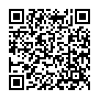
Questions!

