Slide 1


MECA482 Ball On a Plate
Nicolaus Breuer, Cory Davidson, Dominic DeBenedetti, Patrick Orr, Brian Williams

Slide 2


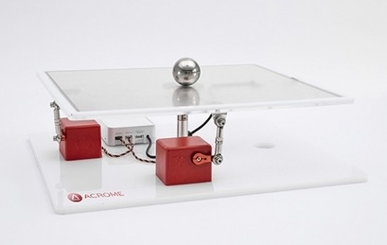
Solution
Justification
There is a use for a machine that can receive a user placed ball off-center on a plate and balance this ball so that it does not roll off the plate
8”x8” plate that is mounted to a central fixed shaft via a spherical ball joint
2 servo motors
Control the movement of the plate to effectively balance the ping pong ball in the center of the plate.
Camera to determine ball’s position

Slide 3
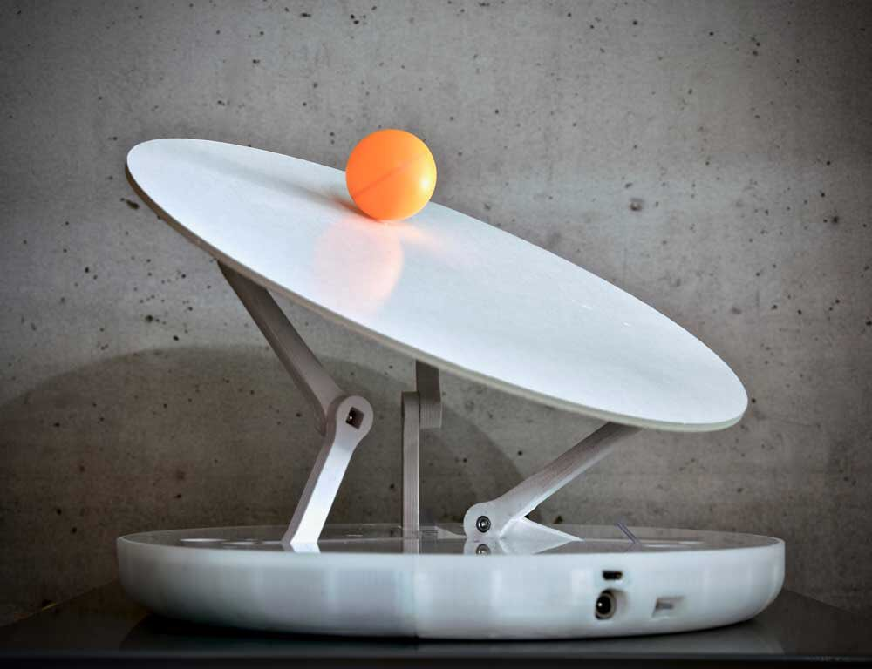
Capabilities Database
Shall work with a ping pong ball
Shall have a square input plate
Shall keep the ball within 1” of the center point
Should be completely autonomous and require no human input besides placing the ball
Should work for any initial placement location

Slide 4
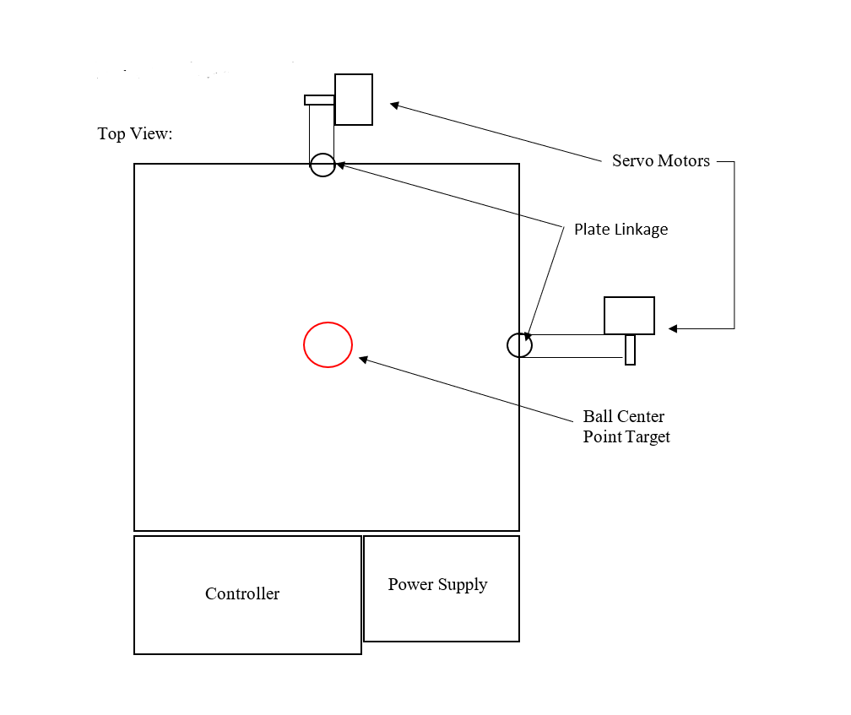
Operational Viewpoint

Slide 5
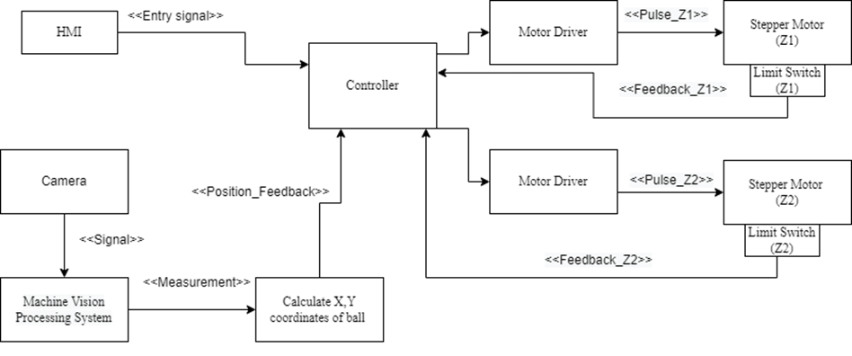
Functional Viewpoint

Slide 6
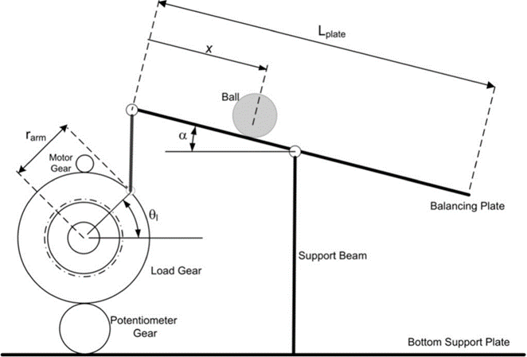
Freebody Diagram

Slide 7
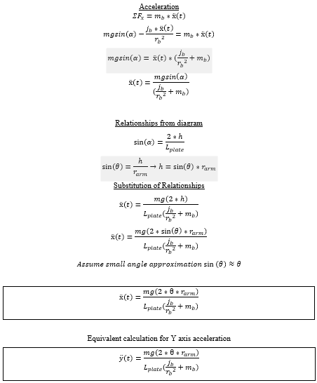
Nomenclature & Equations:

Slide 8
Sensor Calibration
Vision system that constantly monitors the position of the ball.
Use blob analysis to determine the position of the ball on the plate
MATLABS Image Acquisition system will be used to process what is seen by the camera

