Slide 1
(7.) Computing image parameters
ROR
Source
ROI
ROR: smallest cylinder such that all the measurements are captured
ROI: biggest cylinder such that all the voxels result in a measurement

Slide 2
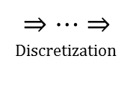
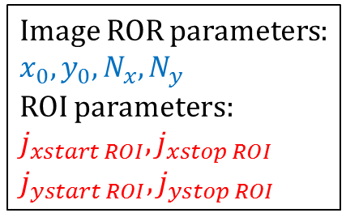
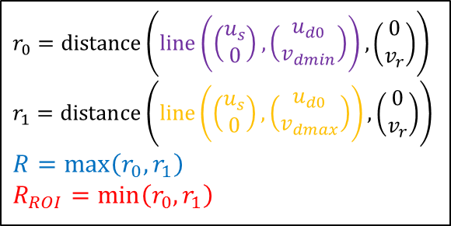
Top view: $xy$-plane ($uv$-plane)
$$v_{dmax}$$
$$|u_{s}|$$
$$|u_{d0}|$$
Source
$$R_{ROI}<R$$
$$v$$
Detector
Rotation
axis
$$u$$
Rotation axis
$r_{0}=\text{distance}\left(\text{line}\left(\left(\begin{matrix}u_{s} \\ 0\end{matrix}\right), \left(\begin{matrix}u_{d0} \\ v_{dmin}\end{matrix}\right)\right), \left(\begin{matrix}0 \\ v_{r}\end{matrix}\right)\right)$
$r_{1}=\text{distance}\left(\text{line}\left(\left(\begin{matrix}u_{s} \\ 0\end{matrix}\right), \left(\begin{matrix}u_{d0} \\ v_{dmax}\end{matrix}\right)\right), \left(\begin{matrix}0 \\ v_{r}\end{matrix}\right)\right)$
$R=\max\left(r_{0},r_{1}\right)$
$R_{ROI}=\min\left(r_{0}, r_{1}\right)$
Image ROR parameters:
$x_{0}, y_{0}, N_{x}, N_{y}$
ROI parameters:
$j_{xstart ROI},j_{xstop ROI}$
$j_{ystart ROI},j_{ystop ROI}$
$$v_{dmin}$$
$$⇒…⇒$$
Discretization

Slide 3
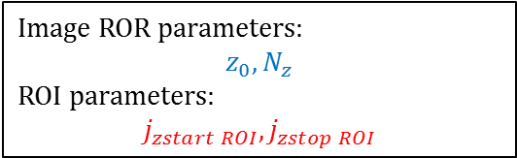
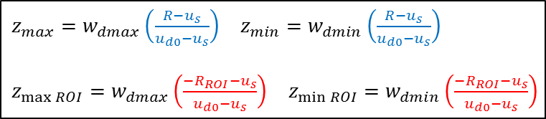
Side view: $xz$-plane ($uw$-plane)
$$w_{dmax}$$
$$|u_{s}|$$
Rotation
axis
$$|u_{d0}|$$
$$z_{max}$$
ROR
$$z_{max⁡ROI}$$
ROI
Source
$$w$$
Detector
$$u$$
$$z_{min⁡ROI}$$
$$z_{min}$$
$$R_{ROI}<R$$
$\begin{matrix}z_{max}=w_{dmax}\left(\frac{R−u_{s}}{u_{d0}−u_{s}}\right) & z_{min}=w_{dmin}\left(\frac{R−u_{s}}{u_{d0}−u_{s}}\right)\end{matrix}$
$\begin{matrix}z_{max⁡ROI}=w_{dmax}\left(\frac{−R_{ROI}−u_{s}}{u_{d0}−u_{s}}\right) & z_{min⁡ROI}=w_{dmin}\left(\frac{−R_{ROI}−u_{s}}{u_{d0}−u_{s}}\right)\end{matrix}$
$$w_{dmin}$$
Image ROR parameters:
$$z_{0}, N_{z}$$
ROI parameters:
$$j_{zstart ROI},j_{zstop ROI}$$
$$⇒…⇒$$
Discretization

