Slide 1

Shiny Application Development
Part I
Charles Bradbury
Phoenix R Users Group
May 23, 2017

Slide 2
Introduction
What is Shiny?
What can you do with it?
Workflow
Examples
Structure of an Application
Building an Application
Customize Reactions
Customize Appearance
Deployment

Slide 3
What is Shiny?
Web Application Framework for R
Simple Syntax
No HTML, JavaScript or CSS knowledge needed
Deployment/Hosting Options
Initial Release: June, 2012
Current Version: 1.0.3

Slide 4
What Can You Do With It?
Interactive Applications
Static Dashboards
Dynamic Dashboards
Maps, Tables, Plots/Charts
Control Widgets (buttons, checkboxes, etc.)

Slide 5
General Workflow
Identify Problem
Obtain Data
Process Data with R
Save Data to File
Read Data into Application
Charts/Plots
Tables
Control Widgets
Display

Slide 6
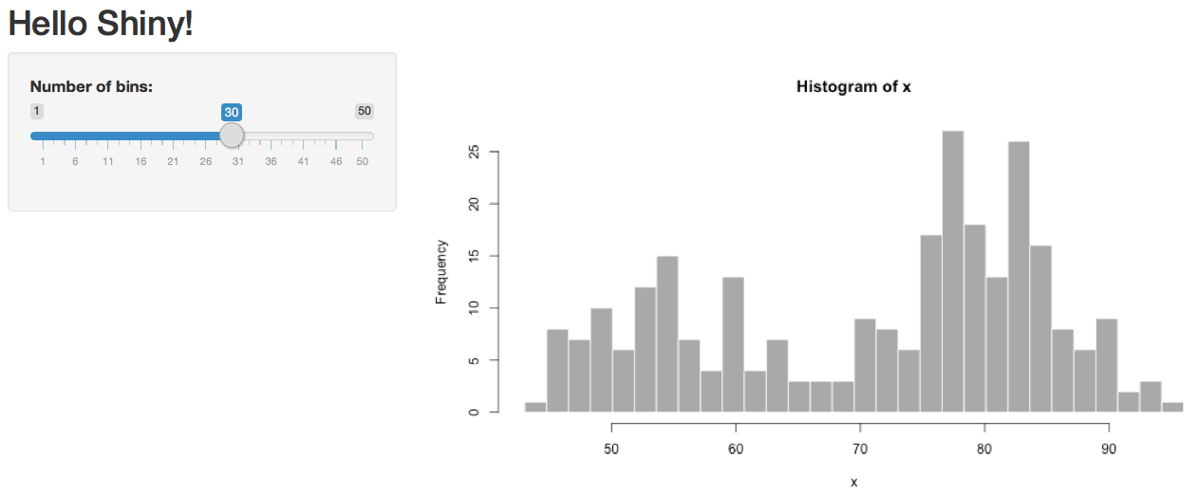
Example
(Basic Static Dashboard)
Shiny Example "01_hello”

Slide 7
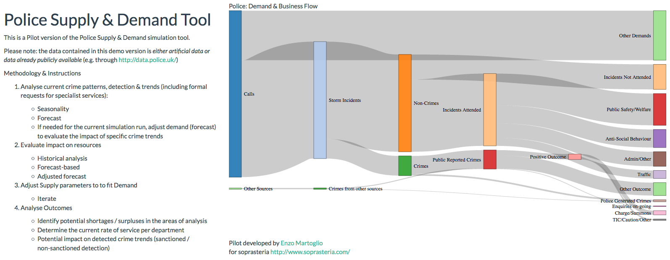
Example
(Something a bit more fancy)
https://gallery.shinyapps.io/TSupplyDemand/

Slide 8
Structure of Application
User Interface
The user interface is defined in the ui.R file.
Server-side
The server side of the application is defined in the server.R file.
Single file Applications
Two-file applications
Environments (global.R)
Notes:
global.R is read upon application execution and provides data read or variables to both the UI and the Server. This can be useful when you want to display something directly from a variable into the UI, or in my case, I use it to allow anyone using the application to see the exact same data no matter who runs the application when there are multiple users.

Slide 9
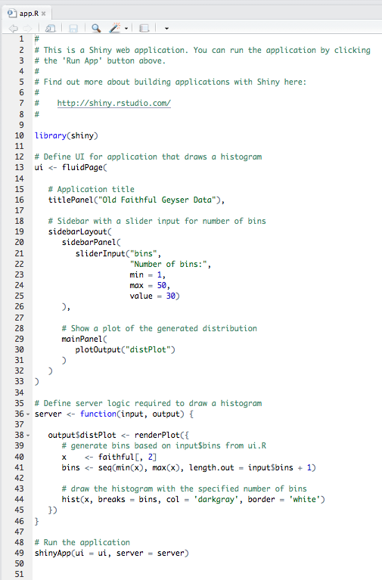
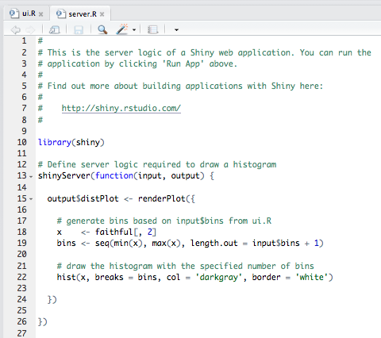
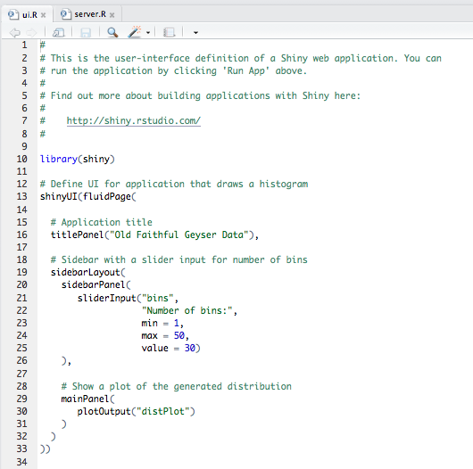
Structure of Application
Single File Application
Two File Application
server.R and ui.R in the same file
Server.R and ui.R have their own files
Notes:
One nice feature about single-file apps is that you can copy and paste the entire app into the R console, which makes it easy to quickly share code for others to experiment with. For example, if you copy and paste the code above into the R command line, it will start a Shiny app.
Otherwise, there is no difference, older versions of the shiny framework used two files, as it looked for those two files. Now, it looks for the functions, so it can but put in one file or two.

Slide 10
Hands On Example
Create Application in RStudio and Execute It

Slide 11
Links / Resources
Shiny Home Page
https://www.rstudio.com/products/shiny/
Tutorials (Web and Video)
https://shiny.rstudio.com/tutorial/
Shiny Showcase (Examples)
https://www.rstudio.com/products/shiny/shiny-user-showcase/
Shinyapps.io (Hosting – Free and Paid)
https://www.shinyapps.io/

