Slide 1

Shiny Application Development
Part I
Charles Bradbury
Phoenix R Users Group
May 23, 2017

Slide 2
Introduction
What is Shiny?
What can you do with it?
Workflow
Structure of an Application
Input & Outputs
Example 1
Placement of Code
Example 2
Reactivity
Deployment
Notes:
Shiny is a web framework/portal to the R language. Everything you do in a Shiny application goes back and executes some sort of R code to filter data, display a new chart, modify a plot, etc..

Slide 3
What is Shiny?
Web Application Framework for R
Simple Syntax
No HTML, JavaScript or CSS knowledge needed
Deployment/Hosting Options (Local / Web)
Initial Release: June, 2012
Current Version: 1.0.3
Notes:
Shiny is a web framework/portal to the R language. Everything you do in a Shiny application goes back and executes some sort of R code to filter data, display a new chart, modify a plot, etc..
This also provides a simple syntax for interacting with HTML and web development so you do not have a be a web developer to create a nice application (though, some HTML experience is nice to have)
When you run a shiny app locally, you desktop or laptop acts as a web server to serve out the application. You can deploy your application to other services on the Web, however for others to use them.

Slide 4
What Can You Do With It?
Interactive Applications
Static Dashboards
Dynamic Dashboards
Maps, Tables, Plots/Charts
Control Widgets (buttons, checkboxes, etc.)

Slide 5
General Workflow
Identify Problem
Obtain Data
Process Data with R
Save Data to File
Read Data into Application
Charts/Plots
Tables
Control Widgets
Display
Backend Processing
Data Cleaning / Preparation
Automation
Presentation Layer
Keep data processing lightweight

Slide 6
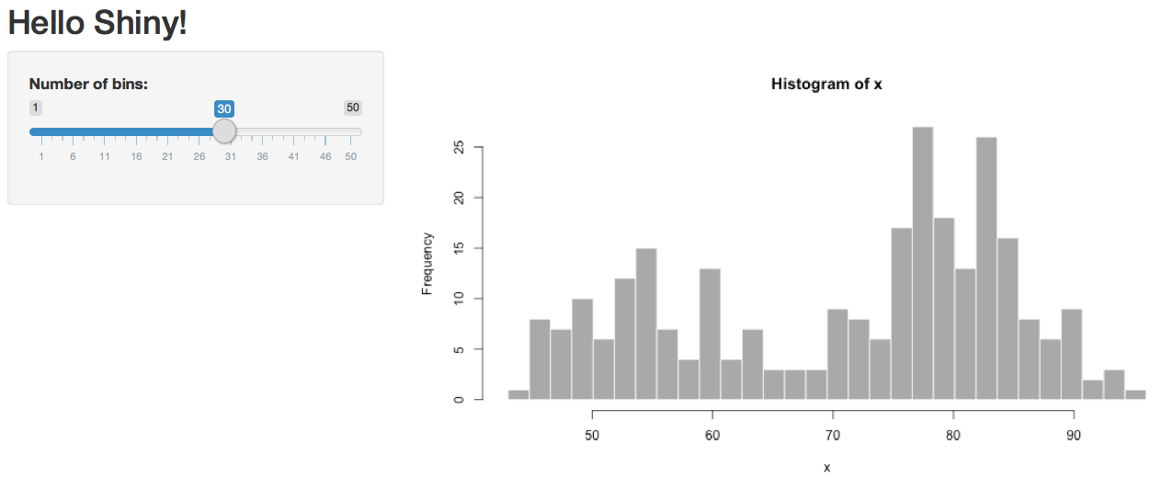
Example
(Basic Static Dashboard)
Shiny Example "01_hello”

Slide 7
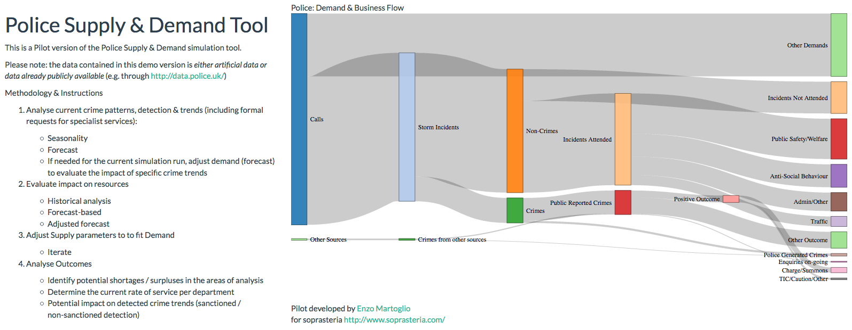
Example
(Something a bit more fancy)
https://gallery.shinyapps.io/TSupplyDemand/

Slide 8
Structure of Application
User Interface
The user interface is defined in the ui.R file.
Server-side
The server side of the application is defined in the server.R file.
Single file Applications
Two-file applications
Environments / Scoping (global.R)
Notes:
Objects defined in global.R are similar to those defined in server.R outside shinyServer(), with one important difference: they are also visible to the code in ui.R. This is because they are loaded into the global environment of the R session; all R code in a Shiny app is run in the global environment or a child of it.
In practice, there aren’t many times where it’s necessary to share variables between server.R and ui.R. The code in ui.R is run once, when the Shiny app is started and it generates an HTML file which is cached and sent to each web browser that connects. This may be useful for setting some shared configuration options.
The reason I have used it in the past is when I need to make sure that all users accessing the application at the same time see the same thing when a reactiveFileReader() updates a data file.

Slide 9
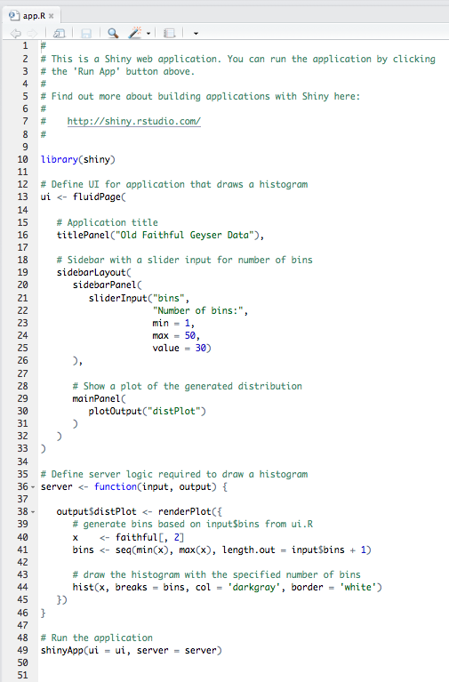
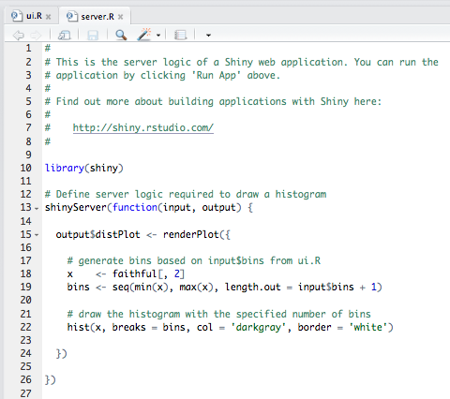
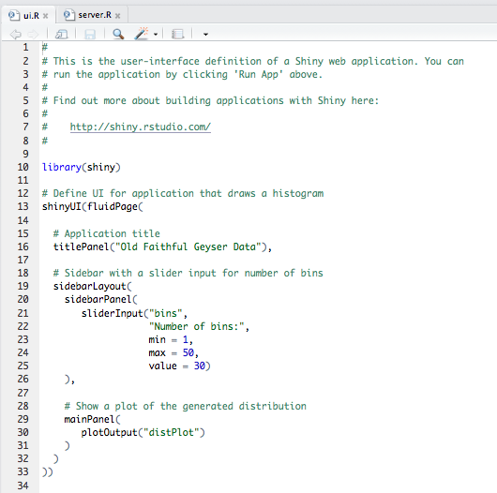
Structure of Application
Single File Application
Two File Application
server.R and ui.R in the same file
Server.R and ui.R have their own files
Notes:
One nice feature about single-file apps is that you can copy and paste the entire app into the R console, which makes it easy to quickly share code for others to experiment with. For example, if you copy and paste the code above into the R command line, it will start a Shiny app.
Otherwise, there is no difference, older versions of the shiny framework used two files, as it looked for those two files. Now, it looks for the functions, so it can but put in one file or two.
Notes about the single file application:
Streamlined
Requires a shinyApp() funciton to define the UI and Server code blocks that are used.
Notes about two file application:
Notice, no shinyApp() function
Both files must reside in the same folder to work

Slide 10
Inputs & Outputs
As you develop your applications think in terms of:
Inputs and Outputs
Inputs: Things your users can toggle.
Outputs: Things your users see.
Notes:
As you build you application, think in terms of inputs and outputs. Inputs are things your users can toggle or provide value to the application. Outputs are things your users see – plots, charts, tables, etc.. They respond when your user changes and input. Therefore, when you develop out your application you use Input() functions for inputs and Output() functions for outputs.

Slide 11
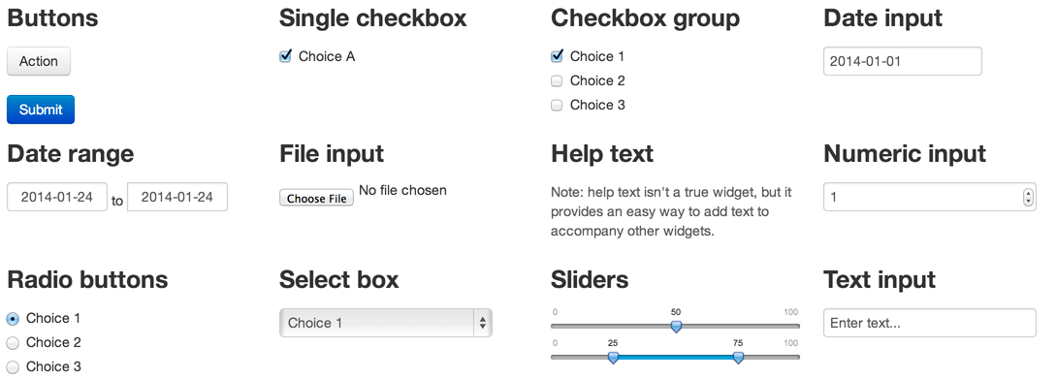
Inputs
Notes:
As you build you application, think in terms of inputs and outputs. Inputs are things your users can toggle or provide value to the application. Outputs are things your users see – plots, charts, tables, etc.. They respond when your user changes and input. Therefore, when you develop out your application you use Input() functions for inputs and Output() functions for outputs.

Slide 12
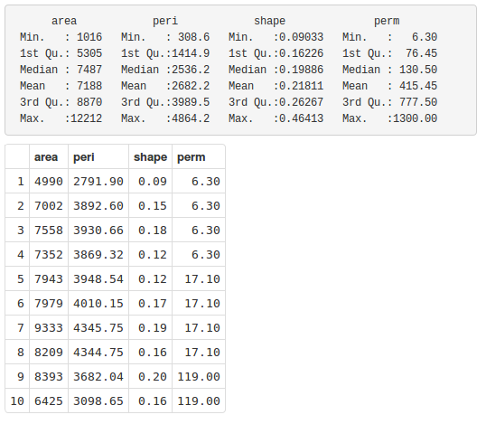
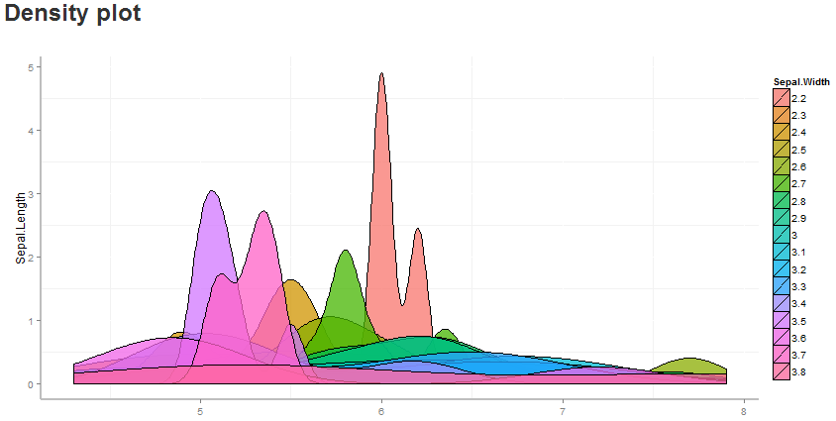

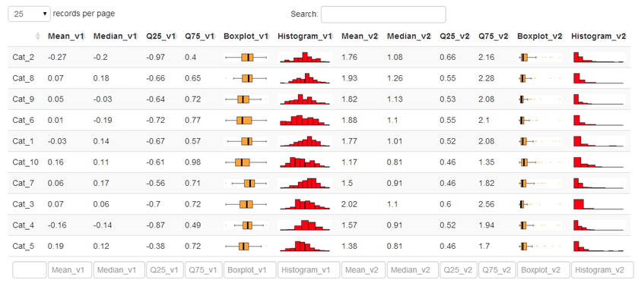
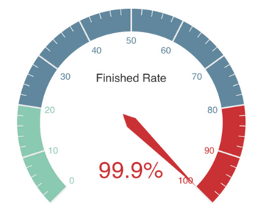
Outputs
Notes:
As you build you application, think in terms of inputs and outputs. Inputs are things your users can toggle or provide value to the application. Outputs are things your users see – plots, charts, tables, etc.. They respond when your user changes and input. Therefore, when you develop out your application you use Input() functions for inputs and Output() functions for outputs.

Slide 13
Hands On Example
Create Basic Application
Example 1
(mtcars dataset)
Basic UI
Inputs
Outputs

Slide 14
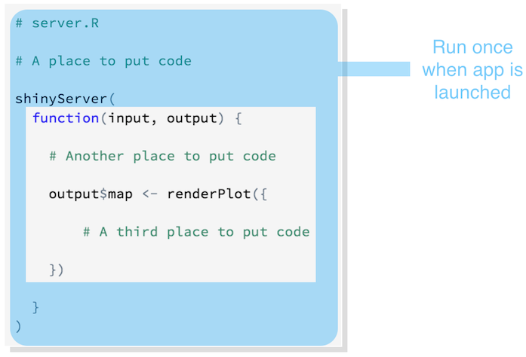
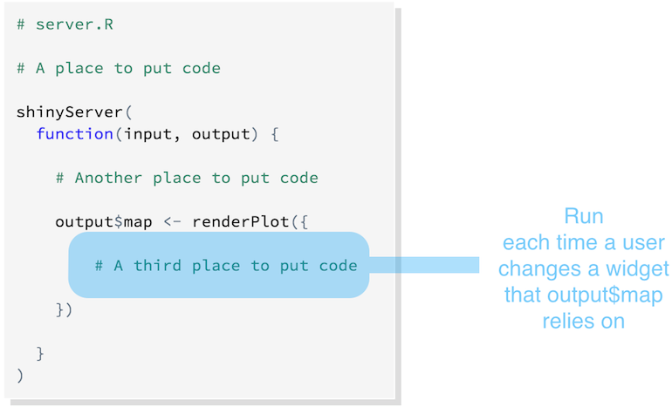
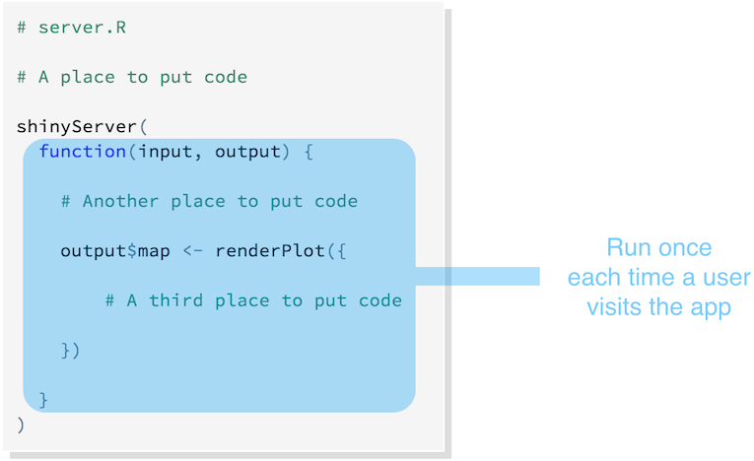
Placement of Code
Notes:
Shiny will execute all of these commands if you place them in your server.R script. However, where you place them in server.R will determine how many times they are run (or re-run), which will in turn affect the performance of your app.
Shiny will run some sections of server.R more often than others.
Shiny will run the whole script the first time you call runApp. This causes Shiny to execute shinyServer. shinyServer then gives Shiny the unnamed function in its first argument.

Slide 15
Hands On Example
Create Basic Application
Example 2
Advanced UI
Reactive Inputs
Read in data from files

Slide 16
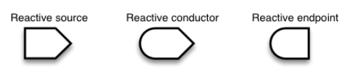

Reactivity
3 Types of objects in reactive programming
Simplest Structure
Source
Endpoint
https://shiny.rstudio.com/articles/reactivity-overview.html
Notes:
It’s easy to build interactive applications with Shiny, but to get the most out of it, you’ll need to understand the reactive programming model used by Shiny.
In Shiny, there are three kinds of objects in reactive programming: reactive sources, reactive conductors, and reactive endpoints, which are represented in the first three symbols we see at the top.
The simplest structure of a reactive program involves just a source and an endpoint – see the 2nd image above.

Slide 17
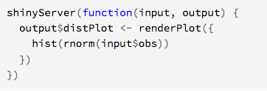

Simple Example
https://shiny.rstudio.com/articles/reactivity-overview.html
Notes:
This simple structure, with one source and one endpoint, is used by the 01_hello example. The server.R code for that example looks something like this:

Slide 18
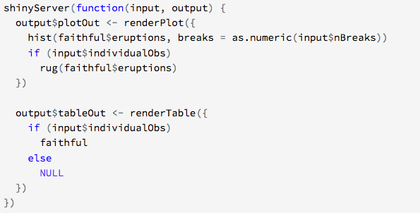
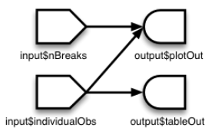
Multiple Sources & Endpoints
https://shiny.rstudio.com/articles/reactivity-overview.html
Notes:
A reactive source can be connected to multiple endpoints, and vice versa. Here is a slightly more complex Shiny application.
In a Shiny application, there’s no need to explicitly describe each of these relationships and tell R what to do when each input component changes; Shiny automatically handles these details for you.
In an app with the structure above, whenever the value of the input$nBreaks changes, the expression that generates the plot will automatically re-execute. Whenever the value of the input$individualObs changes, the plot and table functions will automatically re-execute. (In a Shiny application, most endpoint functions have their results automatically wrapped up and sent to the web browser.)

Slide 19
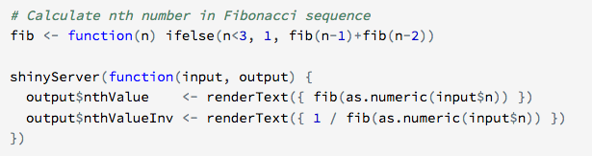
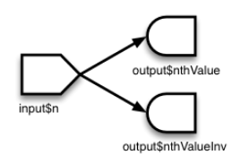
Reactive Conductors
https://shiny.rstudio.com/articles/reactivity-overview.html
Notes:
So far we’ve seen reactive sources and reactive endpoints, and most simple examples use just these two components, wiring up sources directly to endpoints. It’s also possible to put reactive components in between the sources and endpoints. These components are called reactive conductors.
A conductor can both be a dependent and have dependents. In other words, it can be both a parent and child in a graph of the reactive structure. Sources can only be parents (they can have dependents), and endpoints can only be children (they can be dependents) in the reactive graph.
(INEFFICIENT EXAMPLE)
Reactive conductors can be useful for encapsulating slow or computationally expensive operations. For example, imagine that you have this application that takes a value input$n and prints the _n_th value in the Fibonacci sequence, as well as the inverse of _n_th value in the sequence plus one (note the code in these examples is condensed to illustrate reactive concepts, and doesn’t necessarily represent coding best practices):
The fib() algorithm is very inefficient, so we don’t want to run it more times than is absolutely necessary. But in this app, we’re running it twice! On a reasonably fast modern machine, setting input$n to 30 takes about 15 seconds to calculate the answer, largely because fib() is run twice.

Slide 20
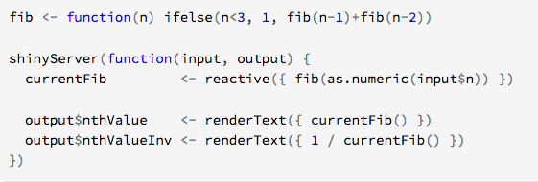
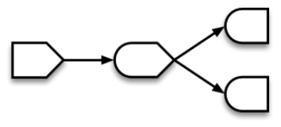
Reactive Conductors
https://shiny.rstudio.com/articles/reactivity-overview.html
Notes:
(EFFICIENT EXAMPLE)
The amount of computation can be reduced by adding a reactive conductor in between the source and endpoints. (See 2nd code Example above).

Slide 21
Application Deployment
Localhost
Shiny Server
Shinyapps.io

Slide 22
Links / Resources
Shiny Home Page
https://www.rstudio.com/products/shiny/
Tutorials (Web and Video)
https://shiny.rstudio.com/tutorial/
Shiny Showcase (Examples)
https://www.rstudio.com/products/shiny/shiny-user-showcase/
Shinyapps.io (Hosting – Free and Paid)
https://www.shinyapps.io/
This Presentation & All Code
https://github.com/cabradbury/shiny-apps-part1

