Slide 1

Shiny Application Development
Part II
Charles Bradbury
Phoenix R Users Group
June 20, 2017

Slide 2
Agenda
Review
ShinyDashboard
Structure
Header
Sidebar
Page
fluidRow(), column()
tabBox() / tabPanel(), infoBox(), valueBox()
Plotly & Shiny
Notes:
Today we are going to cover a brief review, and dive into ShinyDashboard. The standard framework is fun to play with, but for real professional looking dashboards, we need to leverage something with a more mature framework. We’re going to cover some basic elements, structure of the code, headers, footers, sidebars and pages. We will talk about how you add things to a page and the different formats you can use. We will the re-implement our old dashboard into the shinydashboard and use plotly for some more advanced graphs.

Slide 3
Last Time
What shiny is
Structure of an application
Reactive Inputs and Outputs
Basic Examples
Notes:
Last time we covered the basics of shiny, what is is and built a few basic examples. We looked at loading in external data, reactive inputs and outputs and dynamic plots.

Slide 4
shinydashboard
Provides rapid dashboard deployment
Implements bootstrap and responsiveness
Headers, Sidebars and Pages
box(), tabBox()
infoBox(), valueBox()
Layouts
Row-based
Column-based
Mixed
Notes:
Shinydashboard takes care of all the customized stuff you would need to do with the stock shiny() package. It is responsive and implements a bootstrap framework. We’ll see more of this when use use fluidPage().
The framework gives you conventions for creating headers, sidebars and general bodies/pages of content. This is all driven off of out of the box widgets and objects you can build from.
For a basic page, we can create a fluidPage() and then we need somewhere to put our content, so the most basic convention to use is a box(). A box can contain a table, chart, plot, map, text, anything you like.
To implement tabs much like we did the last time in Part I, we have to use a convention in shinydashboard called tabBox() and tabPanels. A tabBox creates to place for one or multiple tabs to go. You can have multiple tabBoxes() if you like.
There are some special “widgets” provided called InfoBoxes() and valueBoxes(). These are used for basic information and can be made dynamic so that colors and icons change depending on the value. They can contain values (hard-coded or dynamic), text, colors and an icon.
infoBox() is a special kind of box that is used for displaying simple numeric or text values, with an icon.
valueBoxes are similar to infoBoxes, but have a somewhat different appearance.
Layouts:
A fluidRow() is a simple row-based layout, this is what we will use.
A fluidRow() with column() specificed is a column-based layout.
You can specify one or the other or both, depending on your layout and what your format is.

Slide 5
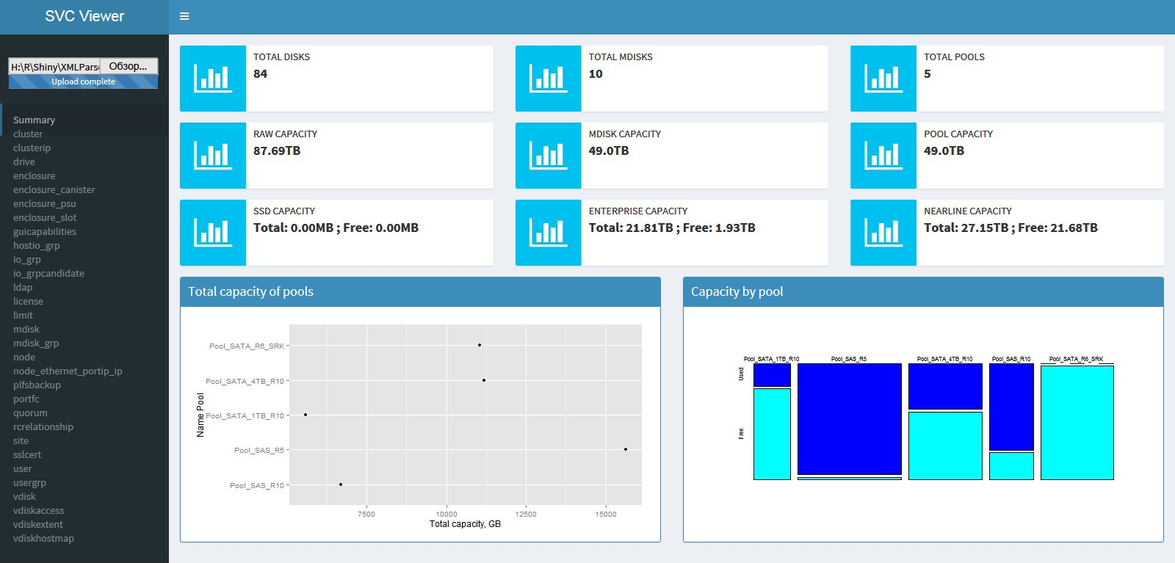
Example

Slide 6
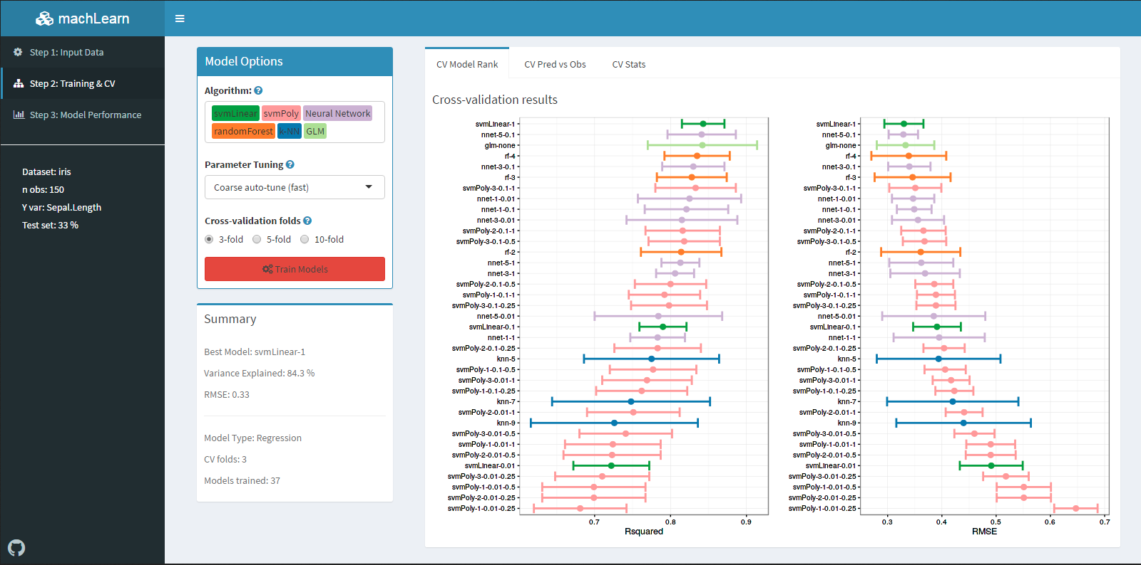
Example

Slide 7
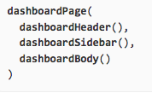
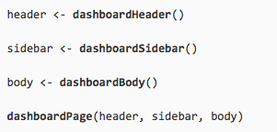
Structure
Basic Structure
More advanced application can be split up to increase readability:

Slide 8
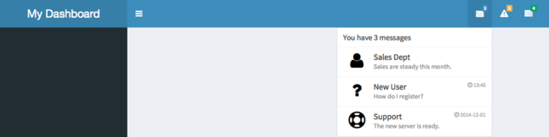
Header
Title and dropdown menus
Message menu
Dynamic Content
Notification Menus
Task Menus
Enable / Disable
Notes:
A header can have a title and dropdown menus.

Slide 9
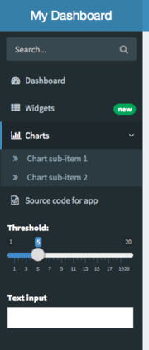
Sidebar
Menu Items and Tabs
Links to switch main content
Control widgets
Search Tools
Dynamic Content
Inputs
Enable / Disable

Slide 10
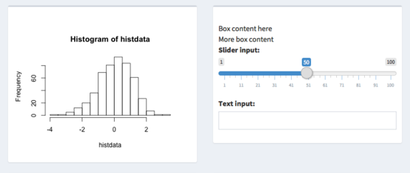
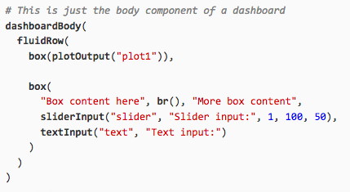
Body
Boxes
Notes:
Boxes are the main building blocks of dashboard pages. A basic box can be created with the box() function, and the contents of the box can be (most) any Shiny UI content.
In a typical dashboard, these boxes would be placed inside a fluidRow() (we’ll see more on dashboard layout later).
Basic boxes
Boxes can have titles and header bar colors with the title and status options. The different possible statuses are shown here.

Slide 11
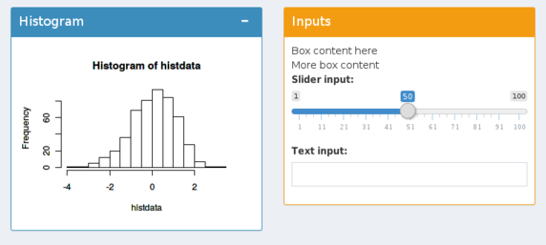
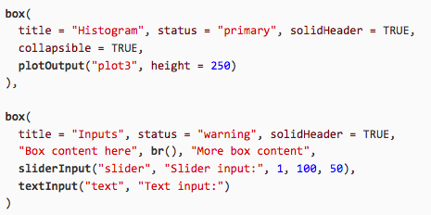
Body
Boxes
Colors
Titles
Notes:
Boxes are the main building blocks of dashboard pages. A basic box can be created with the box() function, and the contents of the box can be (most) any Shiny UI content.
In a typical dashboard, these boxes would be placed inside a fluidRow() (we’ll see more on dashboard layout later).
Basic boxes
Boxes can have titles and header bar colors with the title and status options. The different possible statuses are shown here.

Slide 12
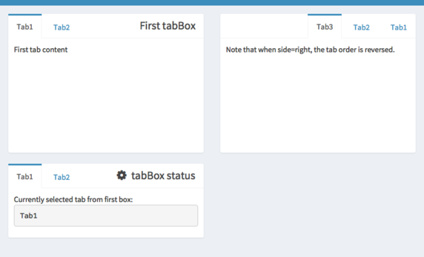
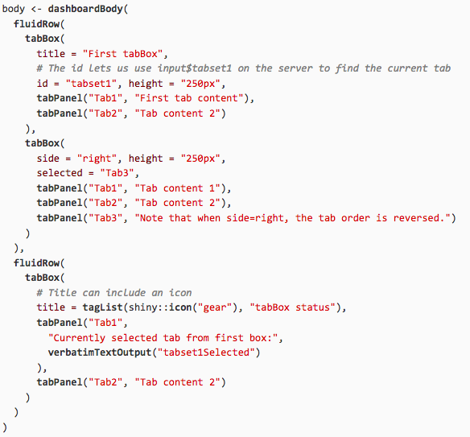
Body
tabBox()
tabPanel()
Notes:
If you want a box to have tabs for displaying different sets of content, you can use a tabBox.
Tabbed boxes
The code to generate this app is in the slide. A tabBox is similar to a tabsetPanel from Shiny in that it takes tabPanels as inputs, allows you to choose which tab is selected, and can be assigned an id. If id is present, you can access which tab is selected from the server; in the example below, it’s accessed with input$tabset1.
A tabBox also has similarities to a regular box from shinydashboard, in that you can control the height, width, and title. You can also choose which side the tabs appear on, with the side argument. Note that if side="right", the tabs will be displayed in reverse order.

Slide 13
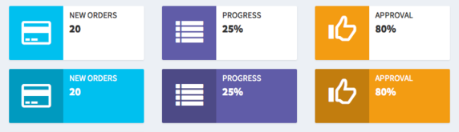

Body
infoBox()
valueBox()
Notes:
If you want a box to have tabs for displaying different sets of content, you can use a tabBox.
Tabbed boxes
The code to generate this app is in the slide. A tabBox is similar to a tabsetPanel from Shiny in that it takes tabPanels as inputs, allows you to choose which tab is selected, and can be assigned an id. If id is present, you can access which tab is selected from the server; in the example below, it’s accessed with input$tabset1.
A tabBox also has similarities to a regular box from shinydashboard, in that you can control the height, width, and title. You can also choose which side the tabs appear on, with the side argument. Note that if side="right", the tabs will be displayed in reverse order.

Slide 14
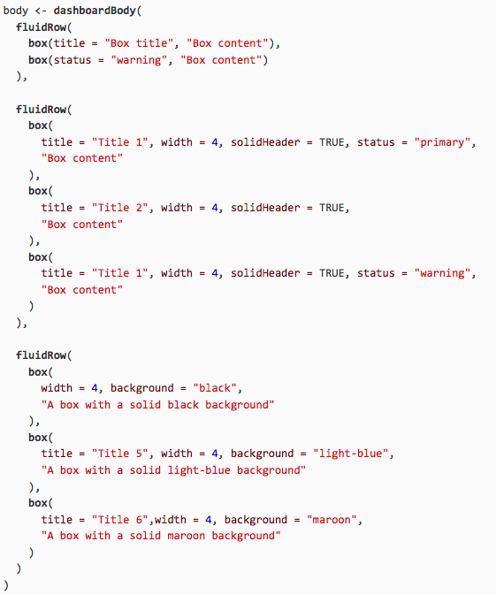
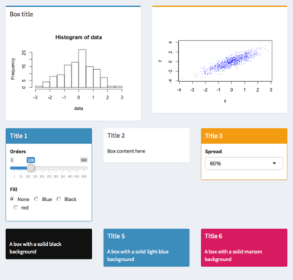
fluidRow()
Notes:
It’s possible to force the boxes to all be the same height, by setting height. In contrast to width, which is set using the 12-wide Bootstrap grid, height is specified in pixels. (This difference is because HTML/CSS layout handles width and height differently. Unfortunately, there isn’t a straightforward way to get equal column heights with Bootstrap.)

Slide 15
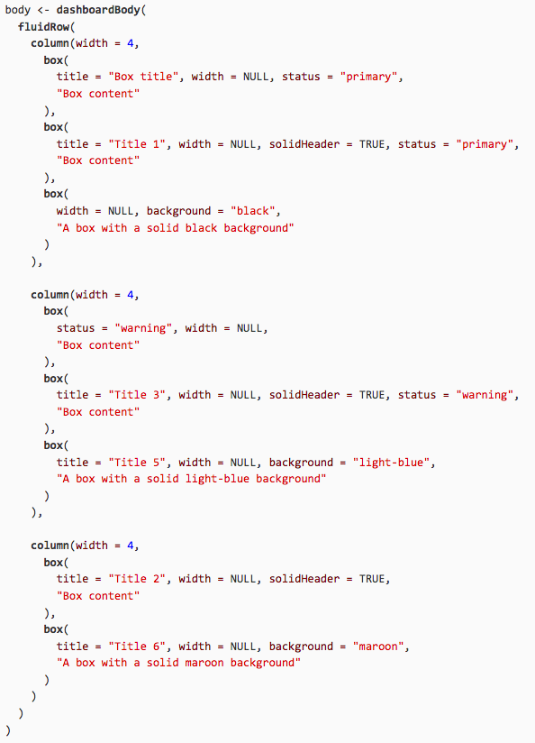
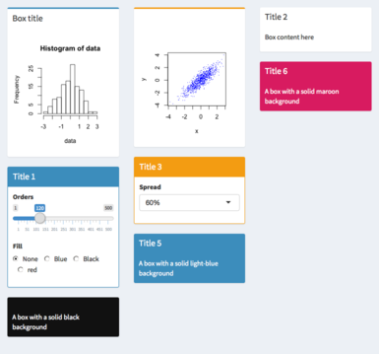
column()
Notes:
With a column-based layout, you first create a column and then place boxes within those columns.

Slide 16
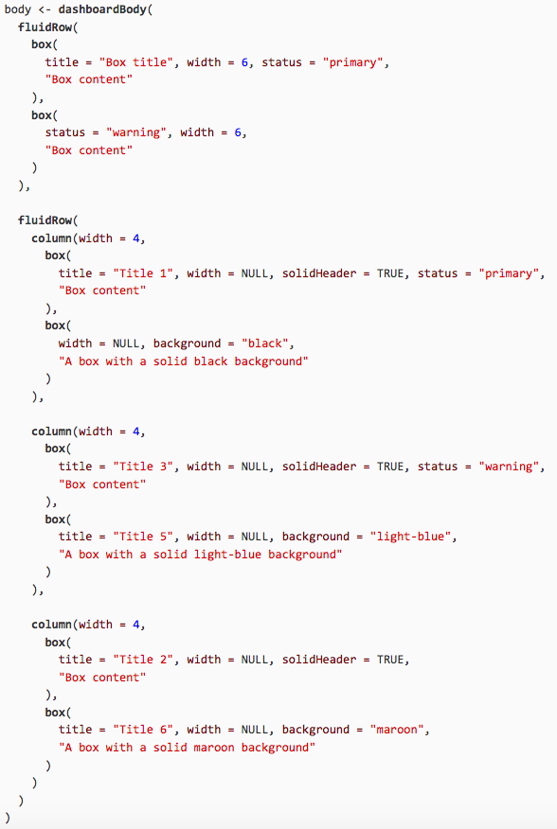
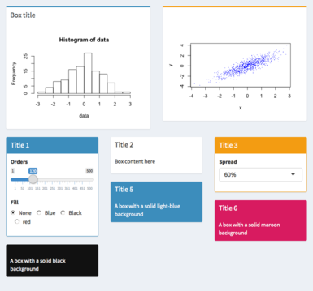
Mixed fluidRow() and columns()

Slide 17
Links / Resources
Shiny Home Page
https://www.rstudio.com/products/shiny/
Tutorials (Web and Video)
https://shiny.rstudio.com/tutorial/
Shiny Showcase (Examples)
https://www.rstudio.com/products/shiny/shiny-user-showcase/
Shinyapps.io (Hosting – Free and Paid)
https://www.shinyapps.io/
Shinydashboard
https://rstudio.github.io/shinydashboard/
This Presentation & All Code
https://github.com/cabradbury/shiny-apps-part2

