Slide 1
Visualization
Why and How

Slide 2
Before you begin your Data Science project
You must understand a few things:
What is the business problem I am trying to solve?
Problem Statement
What is the Outcome I am trying to achieve or predict?
- Outcome variable
What kind of data do I have? Does it have all the information that I want captured to do a thorough analysis? If not, gather more data or wait.
- Data Gathering
Once I have the data, what do I know about the business problem that:
I can generate possible hypotheses that can predict the outcome
- Hypothesis Generation
I can explore possible features that will impact the outcome
- Feature Engineering
I can list one or more methods to use to solve the problem
- Modeling
I can evaluate whether the methods are appropriate and working
- Validation

Slide 3
Problem Definition and Hypotheses Generation
Once I have the data, what do I know about the business problem that:
I can generate possible hypotheses that can predict the outcome
Hypothesis Generation example
MRP of an item is an important factor when customers purchase an item. Similarly Location and Age of a Store determines its Sales.
I can explore possible features that will impact the outcome
Feature Engineering example
Age of a Store and MRP may be factors in purchasing Items. However, Item ID and Outlet ID is not.
I can list one or more methods that I can use to solve the problem
Modeling
Since the prediction is of the Numeric type, we can use a Random Forest Regressor
I can evaluate whether the methods are appropriate and working
Use RMSE Score

Slide 4
Data Load & Preparation
Process to prepare data to be ready for Visualization using Pandas

Slide 5
Data Visualization
Powerful Graphing and Visualizing Capabilities of Matplotlib, Seaborn

Slide 6
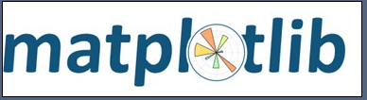
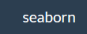
Visualize Data Relationships
Powerful Python Libraries: Matplotlib and Seaborn
Python has powerful libraries for Visualization.
We are going to explore a couple:
Matplotlib and
Seaborn
Matplotlib:
Provides powerful publication quality 2D plots
New tools added to augment Matplotlib:
Matplot3D, Basemap, Canopy
Seaborn:
Developed at Stanford
Statistical visualization built on Matplotlib
High level interface provided to plot statistical measures
https://web.stanford.edu/~mwaskom/software/seaborn/
Sources: Seaborn, Matplotlib

Slide 7
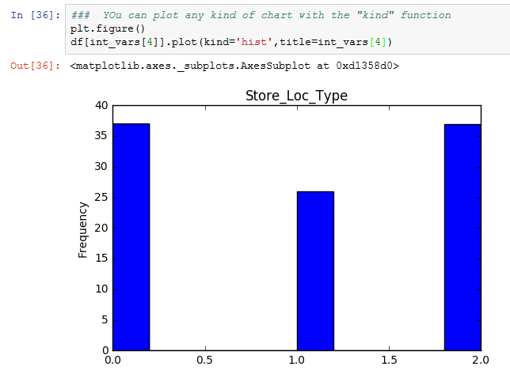
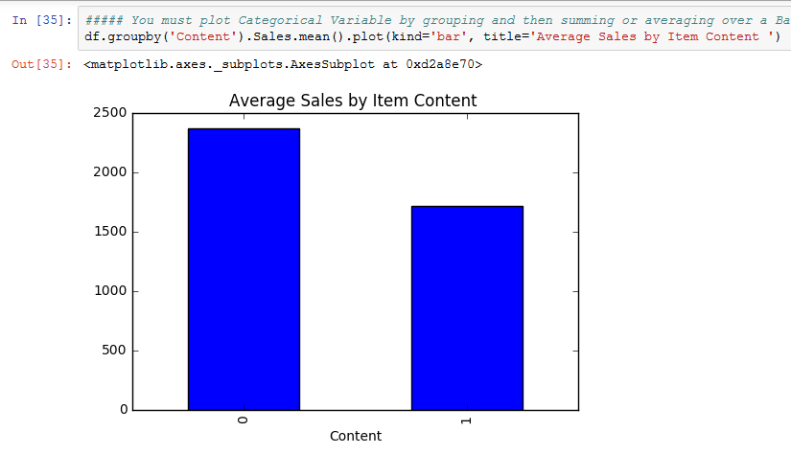
First Classify Variables into Categorical and Continuous
Then you can follow the simple rules below to quickly understand your Data Set
Rule #1
You must plot Continuous Variables through Histograms
plt.figure()
df[int_vars[4]].plot(kind='hist')
Rule #2
You must plot Categorical Variables by grouping and then summing or averaging over a Bar Chart
df.groupby('Content').Sales.mean().plot(kind='bar', title='Average Sales by Item Content ')
Rule 3
Your Y Variable must always be a number (numeric)
Your X variable can be any of the below
int_vars = [x for x in list(df) if df[x].dtype=='int64']
cont_vars= [x for x in list(df) if df[x].dtype=='float64']
cat_vars = [x for x in list(df) if df[x].dtype=='object']
print(int_vars,'\n', cont_vars,'\n', cat_vars)

Slide 8
Ram’s Simple Rules to get Started on Visualization
Simple Rules to follow based on my experience
# First Classify your variables into these three kinds of variables:
# Nominal (or Categorical), Numeric and Ordinal (or Ordering)
# Second, use these Data Visualization Rules as Rules of Thumb:
# 1. if Categorical is on X and Categorical on Y, use a SidebySide Bar plot or Stacked Bar Plot or CrossTab plot
# 2. If categorical X and numeric Y, you use a Bar Plot
# 3. If numeric X and numeric Y , use a scatter plot
# 4. If X is categorical and univariate, if levels less than 5, use Pie Chart
# 5. If X is categorical and univariate, if levels greater than 5, use Bar Chart
# 6. If numeric, univariate use a Histogram (min and max values taken into account)
# 7. Use a HeatMap when you have to show degrees of something, such as Correlations among multiple indices
# 8. For a mix of numeric and ordinal variables, use a Correlation Matrix (HeatMap)
# -- Use Pearson Coeff for Correlation when your data is Continuous and Linear
# -- Use Spearman Coeff for Correlation when your data is Ordinal and perhaps NL

