Slide 1
FEATURE SELECTION
Joseph Nelson, Data Science Immersive

Slide 2
Agenda
What is Feature Selection?
Types of Feature Selection
Regularization
Coding Implementation
Scikit-Learn Documentation

Slide 3
What is Feature selection?
Why is it useful?

Slide 4
What is Feature selection?
While there are many potential features that may be used for a test, only some may have predictive power.
Envision text or music data — many features are produced, but only some have predictive power.
Given an n-by-d pattern matrix (n patterns in d-dimensional space), generate an n-by-m pattern matrix where m << d.
There are three types of feature selection: bottom up, top down, and random shuffling.
Selection versus extraction: Selection chooses current features, while extraction produces interactions of current features (linear or non-linear combinations).
Notes:
Images, sound, movies, text, etc all examples of data producing lots of (unnecessary) features

Slide 5
Bottom-up feature selection
This type of feature selection iteratively adds additional features to our model based on performance.
We’ll discuss two types:
1) Sequential forward selection: Starts with an empty set (X=0) and iteratively adds best performing features.
Disadvantage:
Notes:
once a feature

Slide 6
Bottom-up feature selection
This type of feature selection iteratively adds additional features to our model based on performance.
We’ll discuss two types:
1) Sequential forward selection: Starts with an empty set (X=0) and iteratively adds best performing features.
Disadvantage: Once a feature is added, it cannot be discarded. It also does not consider feature interaction.
Notes:
once a feature

Slide 7
Bottom-up feature selection
This type of feature selection iteratively adds additional features to our model based on performance.
We’ll discuss two types:
1) Sequential forward selection: Starts with an empty set (X=0) and iteratively adds best performing features.
Disadvantage: Once a feature is added, it cannot be discarded. It also does not consider feature interaction.
2) Sequential backward selection (SBS): Starts with X=D and iteratively deletes the least significant features.
Disadvantage:

Slide 8
Bottom-up feature selection
This type of feature selection iteratively adds additional features to our model based on performance.
We’ll discuss two types:
1) Sequential forward selection: Starts with an empty set (X=0) and iteratively adds best performing features.
Disadvantage: Once a feature is added, it cannot be discarded. It also does not consider feature interaction.
2) Sequential backward selection (SBS): Starts with X=D and iteratively deletes the least significant features.
Disadvantage: There is a nesting problem (as above), plus it’s computationally more expensive than SFS.
Generalized versions of these searches do the same, but model entire subsets.

Slide 9
Bottom-up feature selection
Sequential floating forward search (SFFS):
Step 1: Inclusion. Use the basic SFS method to select the most significant feature with respect to X and include it in X. Stop if d features have been selected, otherwise go to Step 2.
Step 2: Conditional exclusion. Find the least significant feature k in X. If it is the feature just added, then keep it and return to Step 1. Otherwise, exclude the feature k. Note that X is now better than it was before Step 1. Continue to Step 3.
Step 3: Continuation of conditional exclusion. Again, find the least significant feature in X. If 1) its removal will leave X with at least two features and 2) the value of J(X) is greater than the criterion value of the best feature subset of that size found so far, then remove it and repeat Step 3. When these two conditions cease to be satisfied, return to Step 1.
Notes:
h/t Michigan State

Slide 10
Top-DOWN feature selection
Another way to select features is to impose a global constraint on the model. For example, in the case of text vectorization, we could impose that a feature needs to have a document frequency higher than a certain threshold to be considered relevant.
This is fairly common in text and visual/auditory data.

Slide 11
Random Shuffling feature selection
There are other ways to check if a feature has any predictive power, such as random shuffling. First, we calculate the score of the model, then we randomize the values along that column.
If the feature has any predictive power, this should yield a worse score. On the other hand, if the feature has no predictive power, this will result in no change and we’ll know we can toss that feature.

Slide 12
regularization
Regularization is an example of a top-down technique that works with parametric models (such as logistic regressions and support vector machines). It imposes a global constraint on the values of the parameters that define the model.
The regularized model is found solving a new minimization problem where two terms are present: the term defining the model and the term defining the regularization.

Slide 13
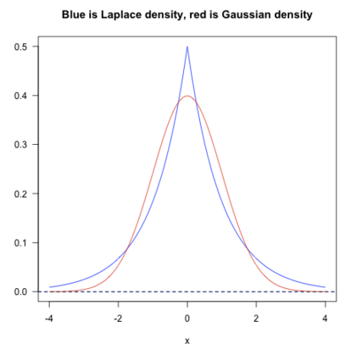
L1 and l2 regularization
Regularization works by adding the penalty associated with the coefficient values to the error of the hypothesis. This way, an accurate hypothesis with unlikely coefficients would be penalized, while a somewhat less accurate but more conservative hypothesis with low coefficients would be penalized less.
Notes:
L1 – Laplacean
L2 – Gaussian
Quora

Slide 14
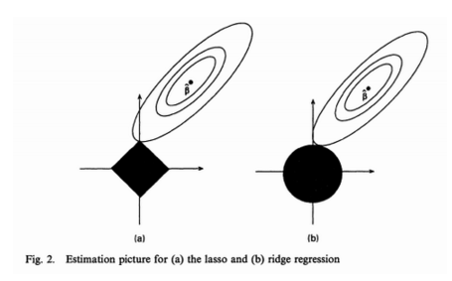
L1 and l2 regularization
L1: Stricter constraints; more angular distribution for inclusion.
L2: Looser constraints; increases inclusion of features.
Notes:
The feasible point that minimizes the loss is more likely to happen on the coordinates on graph (a) than on graph (b) since graph (a) is more angular. This effect amplifies when your number of coefficients increases, i.e. from 2 to 200.

Slide 15
regularization
Regularization allows us to reduce overfitting by generalizing the values we have available in our training set.

Slide 16
feature_selection.GenericUnivariateSelect([...]) feature_selection.SelectPercentile([...]) feature_selection.SelectKBest([score_func, k]) feature_selection.SelectFpr([score_func, alpha]) feature_selection.SelectFdr([score_func, alpha]) feature_selection.SelectFromModel(estimator) feature_selection.SelectFwe([score_func, alpha]) feature_selection.RFE(estimator[, ...]) feature_selection.RFECV(estimator[, step, ...]) feature_selection.VarianceThreshold([threshold])

