Slide 1
Data-Oriented Architectures
Christian Cabrera
University of Cambridge
08/11/2024
Notes:
Good morning, this is the fourth lecture of our course and this time we will focus on the concept of Data-Oriented Architecture what we call DOAs.
We will see how the requirements of our systems or data science pipelines are changing and how this type of architecture can help to address them.

Slide 2
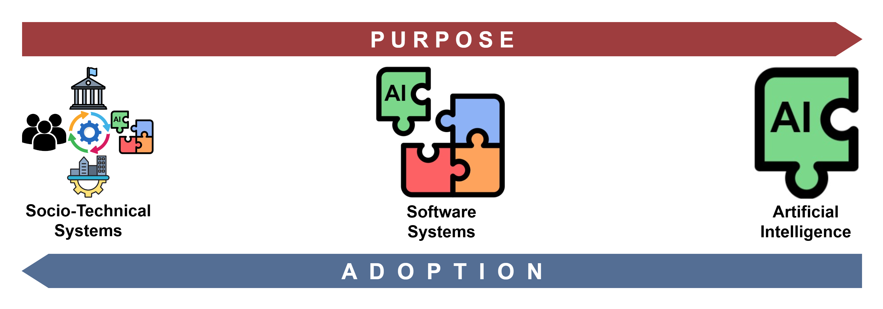
Previously…
The Systems Engineering Approach
Notes:
But before going deeper into DOAs, we should remember that in the last lecture, we talked about how the systems engineering approach can help us to safely integrate AI technologies in the software we write…

Slide 3
Previously…
The Systems Engineering Approach
Systems Thinking: System Views, Agility System, and System Dynamics.
Process Model: Top-Down Analysis, Variant Creation and Problem-Solving Cycle.
Notes:
By following the systems thinking and process model principles we prioritise the problems and the context where our systems will work…

Slide 4
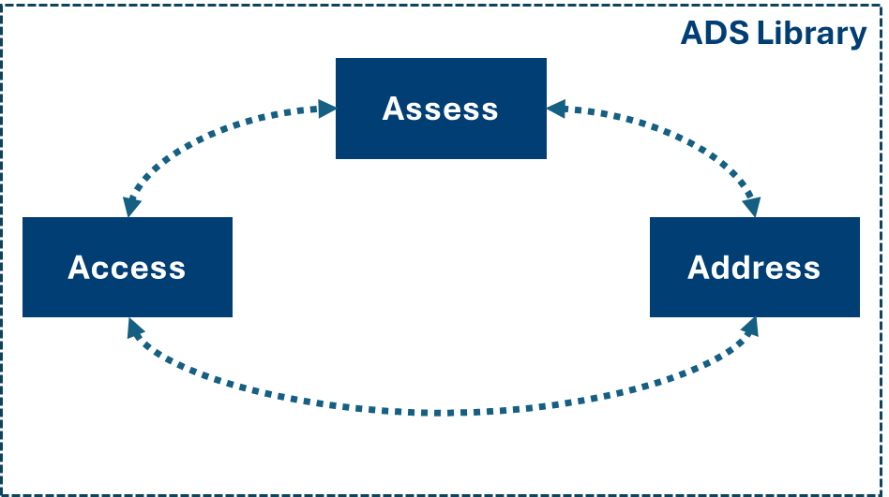
Previously
The Systems Engineering Approach
Notes:
The idea is that socio-technical systems define the purpose of our software and by considering this purpose we select how to integrate the different technologies into our software…

Slide 5
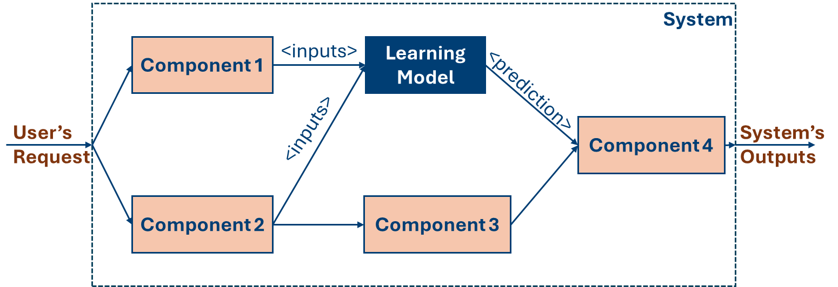
Real-world Deployments
Notes:
We also talked about how systems are designed according to requirements because users’ needs are the ones that define the components of a system and the way they interact. This organization of systems components is known as the architecture of the system. So, if every system satisfies different requirements, they have different architectures…

Slide 6
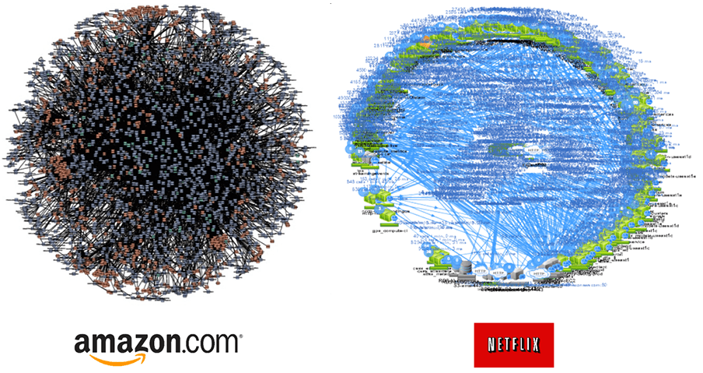
Real-world Deployments
Source: https://www.divante.com/blog/10-companies-that-implemented-the-microservice-architecture-and-paved-the-way-for-others
Notes:
For example, the architecture that supports Amazon is different from the architecture behind Netfilx because the services these platforms provide are different… they have different requirements, different goals, different components and different technologies…

Slide 7
Systems Design
Systems’ design decisions change from system to system…
Notes:
So as every system is different from each other the systems’ design decisions we made also change from system to system…. The question then is how can we create solutions or approaches that can be applied between systems…

Slide 8
Systems Design
Systems’ design decisions change from system to system…
But we can identify common requirements between software systems.
Notes:
The answer is that we can identify common requirements between software systems. These are also known as quality attributes that we want to find in our software…

Slide 9
Systems Design
Systems’ design decisions change from system to system…
But we can identify common requirements between software systems.
Based on these commonalities we can define design patterns and systems architectures.
Notes:
Based on these quality attributes we can define design patterns that we can use to build systems architectures. Design patterns are ways to address repetitive problems. The idea is that if we solved one problem once then we can apply the same kind of solution to solve a similar problem the second time.

Slide 10
Systems Design
Systems in the age of the Internet required:
Separation of concerns
High availability
Scalability
Low Latency

Slide 11
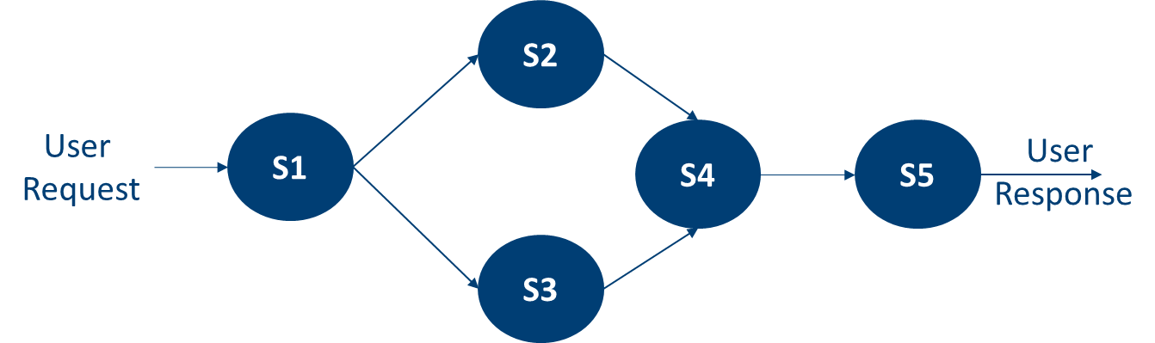
Systems Design
Systems in the age of the Internet required:
Separation of concerns
High availability
Scalability
Low Latency
Service-oriented Architectures (SOAs)
Notes:
The most popular paradigm right now is Service-oriented computing or architectures… The idea behind this paradigm is to encapsulate the capabilities of different components in the system as services…
A service is an atomic functionality of the system that is exposed using APIs that can be consumed by different actors… They can be deployed as microservices using tools like Docker or Kubernetes, or as web services, as we just saw in one of the previous talks…
Once all the services of a system are available, the functionalities of the system are achieved by executing graphs of services like the one in the figure…

Slide 12
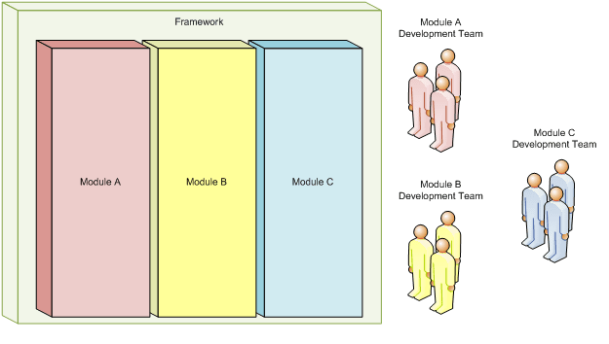
Systems Design
Systems in the age of the Internet required:
Separation of concerns
High availability
Scalability
Low Latency
Service-oriented Architectures (SOAs)
Source: https://dev.to/suspir0n/soc-separation-of-concerns-5ak7

Slide 13
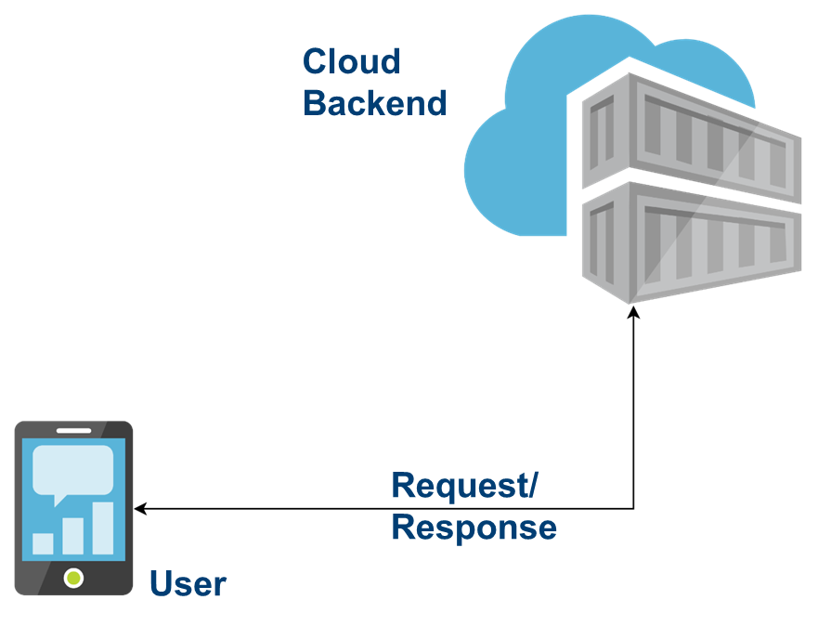
Systems Design
Systems in the age of the Internet required:
Separation of concerns
High availability
Scalability
Low Latency
Service-oriented Architectures (SOAs)

Slide 14
AI Systems Design
Systems in the age of AI are data-driven:
Data availability
Data ownership
Data traceability and monitoring
Super-low latency requirements
Sustainability

Slide 15
AI Systems Design
Systems in the age of AI are data-driven:
Data availability
Data ownership
Data traceability and monitoring
Super-low latency requirements
Sustainability
Service-oriented Architectures (SOAs)
The Data Dichotomy:
“While data-driven systems are about exposing data, service-oriented architectures are about hiding data.” [1]
[1] Stopford B., The Data Dichotomy: Rethinking the Way We Treat Data and Services. https://www.confluent.io/en-gb/blog/data-dichotomy-rethinking-the-way-we-treat-data-and-services

Slide 16
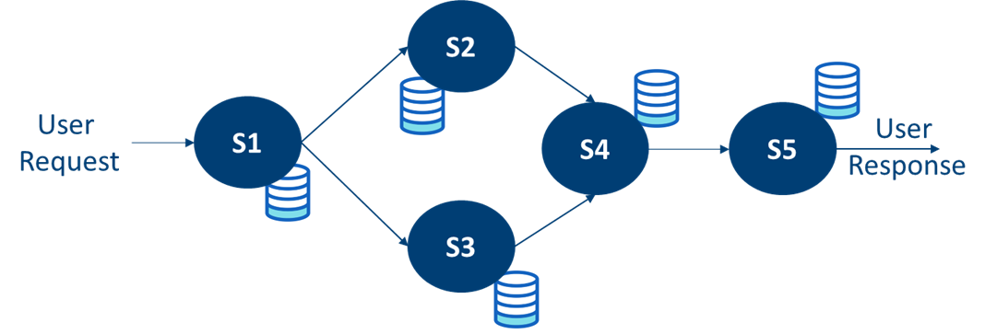
AI Systems Design
The Data Dichotomy:
“While data-driven systems are about exposing data, service-oriented architectures are about hiding data.” [1]
[1] Stopford B., The Data Dichotomy: Rethinking the Way We Treat Data and Services. https://www.confluent.io/en-gb/blog/data-dichotomy-rethinking-the-way-we-treat-data-and-services

Slide 17
AI Systems Design
The Data Dichotomy:
“While data-driven systems are about exposing data, service-oriented architectures are about hiding data.” [1]
We need to design systems prioritising data!
[1] Stopford B., The Data Dichotomy: Rethinking the Way We Treat Data and Services. https://www.confluent.io/en-gb/blog/data-dichotomy-rethinking-the-way-we-treat-data-and-services

Slide 18
Data-Oriented Architectures
Data-first systems
Prioritise decentralisation
Openness

Slide 19
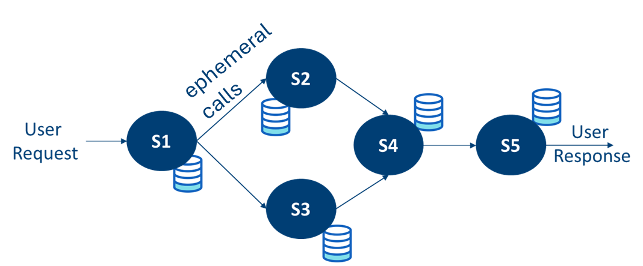
Data-Oriented Architectures
Data-First

Slide 20
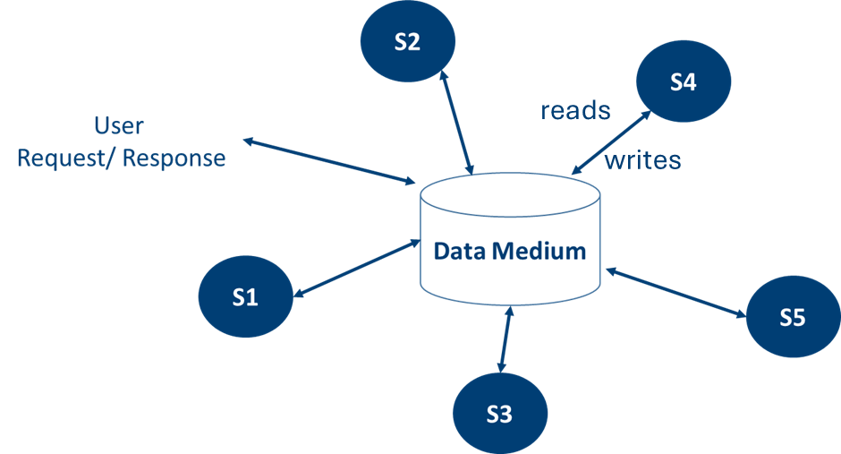
Data-Oriented Architectures
Data-First

Slide 21
Data-Oriented Architectures
Data-First
Data availability
Data traceability and monitoring

Slide 22
Data-Oriented Architectures
Prioritise decentralisation

Slide 23
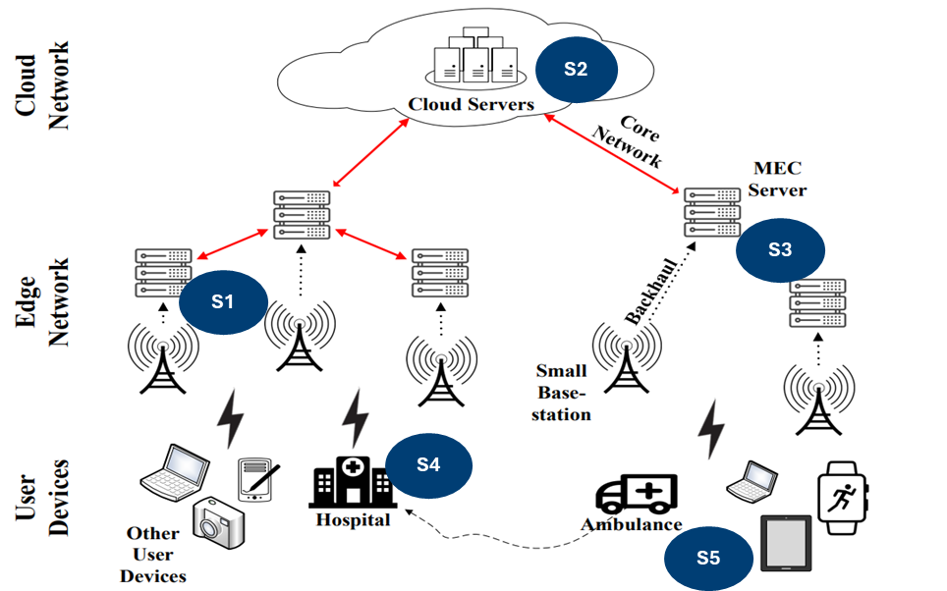
Data-Oriented Architectures
Prioritise decentralisation

Slide 24
Data-Oriented Architectures
Prioritise decentralisation
Super-low latency requirements

Slide 25
Data-Oriented Architectures
Openness
Data ownership
Sustainability

Slide 26
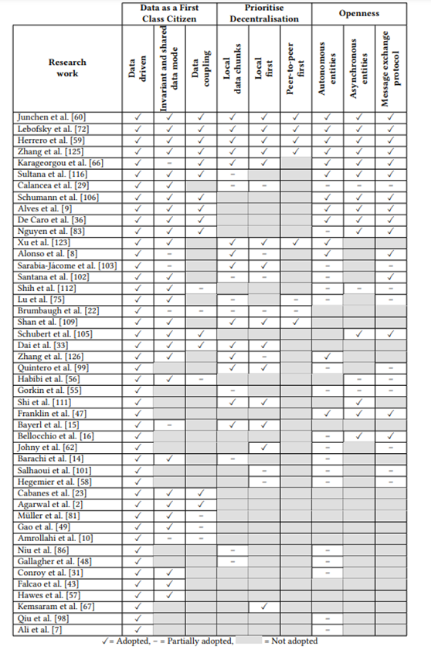
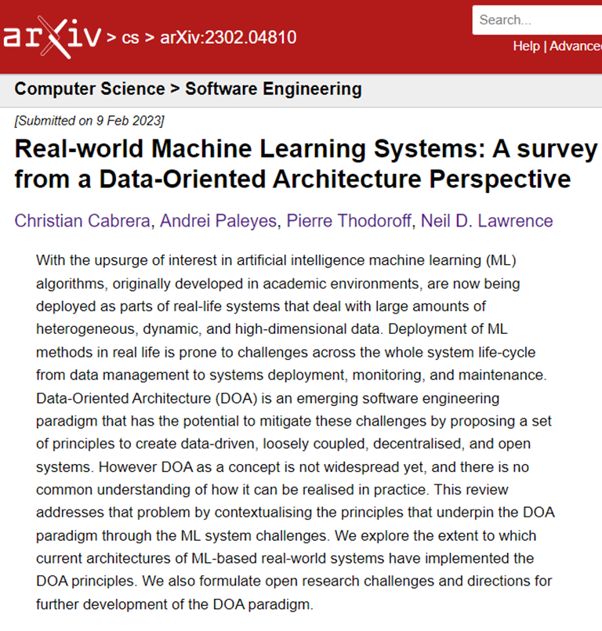
Data-Oriented Architectures

Slide 27
Data-Oriented Architectures
Few projects fully follow DOA principles.
Most of the solutions are centralised and cloud-based.
Databases, streams and message queues enable the data first principle.
Distributed storage and computing technologies for decentralisation.
Asynchronous communication for openness.

Slide 28
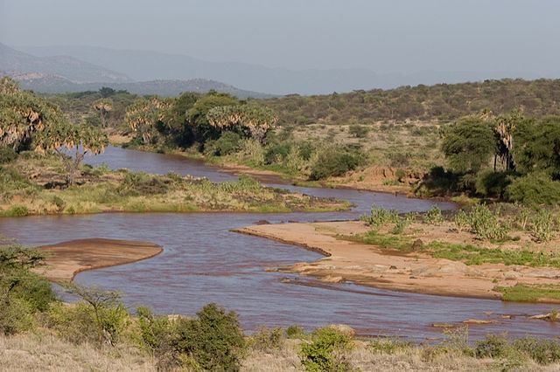
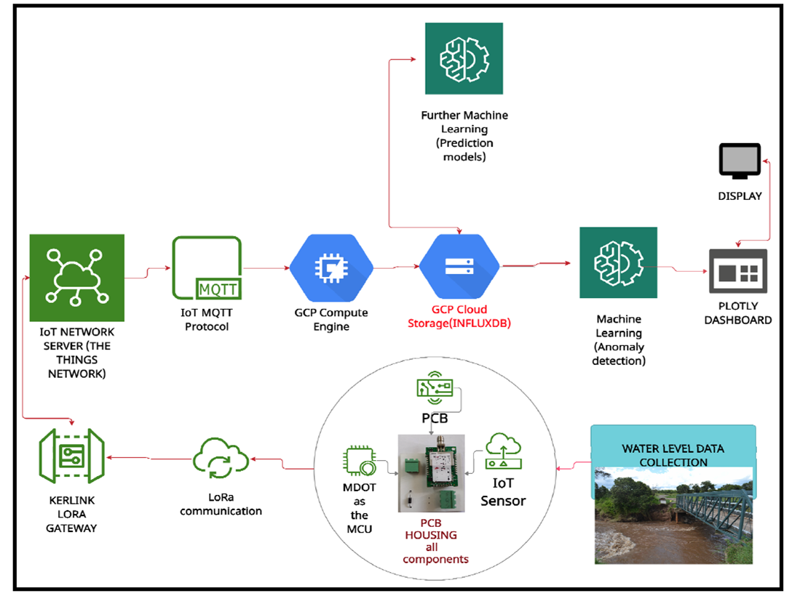
Data-Oriented Architectures
Water level monitoring project at DeKUT [1]
Source: https://en.wikipedia.org/wiki/Ewaso_Ng%27iro
Ewaso Nyiro River - Kenya
[1] Kabi, Jason, and Ciira Maina. "Leveraging IoT and machine learning for improved monitoring of water resources-a case study of the upper ewaso nyiro river." 2021 IST-Africa Conference (IST-Africa). IEEE, 2021.
Notes:
So, let’s have a look at a deployed project to see these principles in practice…
As I said these principles are not new, so we can find them in existing projects…
That is the case of the water level monitoring project developed Dedan Kimathi University of Technology (DEKUT)… We have the chance to know about this project at a Data Science Africa summer school a couple of years ago and then we worked closer with the scientists and engineers behind the project
This project is a very nice example of a data pipeline addressing an important social problem. It is about detecting anomalies in the water level of the eguasoñiro River in Kenia, which impacts people’s life in the region

Slide 29
Data-Oriented Architectures
Water level monitoring project at DeKUT [1]
mDot - (sensor node)
Google Cloud Platform
Anomaly Detection Component
Data Collection Component
Listener Component
subscribes
writes
push
Web server
Visualisation Component
GW
DB
MQTT Broker
reads
publishes
[1] Kabi, Jason, and Ciira Maina. "Leveraging IoT and machine learning for improved monitoring of water resources-a case study of the upper ewaso nyiro river." 2021 IST-Africa Conference (IST-Africa). IEEE, 2021.
Notes:
A clearer version of the diagram is here…
So, the system has a data collection component that is deployed in the river using a mDot sensor node…
This component collects data about the water level and pushes it to an IoT gateway that is close to the river…
The IoT gateway then publishes the data to a MQTT Broker hosted by a web server…
The system has a listener component subscribed to the MQTT broker that gets the data transmitted by the gateway from the sensors…
The listener writes the data in the system’s database…
An anomaly detection component reads that data and applies different ML models to identify anomalies…
The output of the anomaly detection component is then presented to end users using a visualization component…

Slide 30
Data-Oriented Architectures
Water level monitoring project at DeKUT [1]
mDot - (sensor node)
Google Cloud Platform
Anomaly Detection Component
Data Collection Component
Listener Component
subscribes
writes
push
Web server
Visualisation Component
GW
DB
MQTT Broker
Data
First
reads
publishes
[1] Kabi, Jason, and Ciira Maina. "Leveraging IoT and machine learning for improved monitoring of water resources-a case study of the upper ewaso nyiro river." 2021 IST-Africa Conference (IST-Africa). IEEE, 2021.
Notes:
We can see that some of the system components already use a shared data model to communicate between them…
So, this system is already following the “Data First” principle of Data oriented architectures…
The listener and the anomaly detection components communicate with each other using the data medium which is a NoSQL database in this case…
This design decision was made because the architecture is event-driven… so when a new sensor reading happens, the components of the system react to the event…

Slide 31
Data-Oriented Architectures
Water level monitoring project at DeKUT [1]
mDot - (sensor node)
Google Cloud Platform
Anomaly Detection Component
Data Collection Component
Listener Component
subscribes
Openness
writes
push
Web server
Visualisation Component
GW
DB
MQTT Broker
Data
First
reads
publishes
[1] Kabi, Jason, and Ciira Maina. "Leveraging IoT and machine learning for improved monitoring of water resources-a case study of the upper ewaso nyiro river." 2021 IST-Africa Conference (IST-Africa). IEEE, 2021.
Notes:
The system is open to some extent because new sensor nodes and even gateways can be attached using the MQTT broker and the publish/subscribe communication model…
This communication model enables an automatic inclusion of new sensors or data sources…

Slide 32
Data-Oriented Architectures
Water level monitoring project at DeKUT [1]
mDot - (sensor node)
Cloud resources are expensive!
Google Cloud Platform
Anomaly Detection Component
Data Collection Component
Listener Component
subscribes
Openness
writes
push
Web server
Visualisation Component
GW
DB
MQTT Broker
Data
First
reads
publishes
[1] Kabi, Jason, and Ciira Maina. "Leveraging IoT and machine learning for improved monitoring of water resources-a case study of the upper ewaso nyiro river." 2021 IST-Africa Conference (IST-Africa). IEEE, 2021.
Notes:
However, this system still has some problems regarding the resources it uses as its main processing components are deployed in the cloud…
As sensors read more data, more storage and computing are needed but cloud resources are expensive…

Slide 33
Data-Oriented Architectures
Decentralisation
Preprocess data at the gateway level…
Move components from the cloud to the edge…
Water level monitoring project at DeKUT [1]
mDot - (sensor node)
Google Cloud Platform
Anomaly Detection Component
Data Collection Component
Listener Component
subscribes
Openness
writes
push
Web server
Visualisation Component
GW
DB
MQTT Broker
Data
First
reads
publishes
[1] Kabi, Jason, and Ciira Maina. "Leveraging IoT and machine learning for improved monitoring of water resources-a case study of the upper ewaso nyiro river." 2021 IST-Africa Conference (IST-Africa). IEEE, 2021.
Notes:
The “decentralization” principle can help to address the resources problem…
There are two options that we can follow…

Slide 34
Data-First Principle

Slide 35
Data-First Principle
Facilitates data collection processes.
Asynchronous communication fits better when manipulating large data sets.
The Data Medium is a shared model that facilitates monitoring tasks.
The historical state of the systems is available by design.

Slide 36
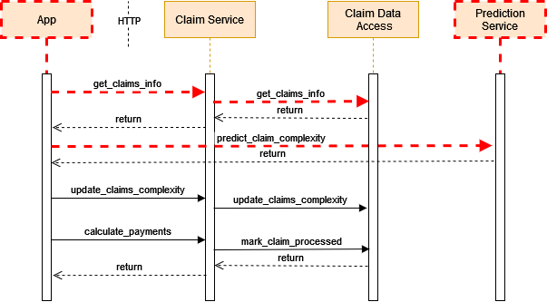
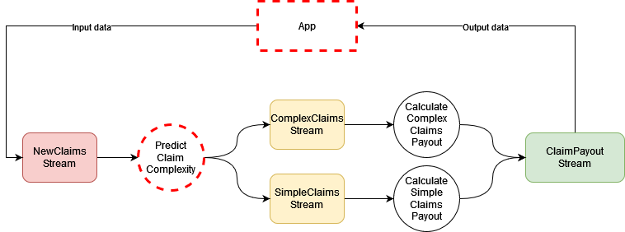
Data-First Principle
DOA vs SOA
Paleyes, Andrei, Christian Cabrera, and Neil D. Lawrence. "An empirical evaluation of flow based programming in the machine learning deployment context." Proceedings of the 1st International Conference on AI Engineering: Software Engineering for AI. 2022.
Notes:
Insurance Claims models a workflow that processes insurance claims. Claims undergo a series of classification routines which affect the choice of the final payout process.
In the baseline, all the classification follows the logic defined by the developer
In the ML-based, the classification is done by a data-driven component that needs to be trained…
In this application, we use ML to replace all internal logic with one classification model.
The FBP version of each application is built with two major building blocks: data streams and stateless processing nodes. A processing node takes one or more streams as an input, performs some operations on them, and then puts the result into outputor internal data streams. Such nodes do not carry internal state, anddo not make external calls to outside services or databases.

Slide 37
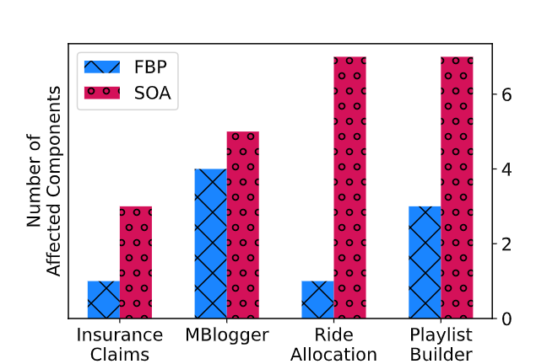
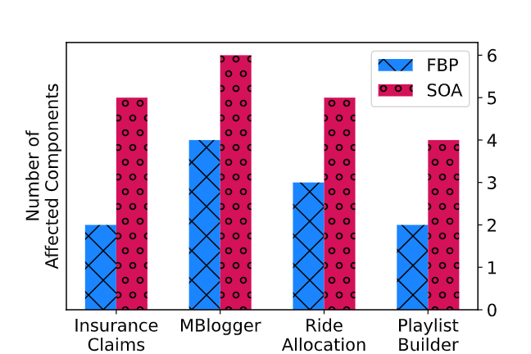
Data-First Principle
DOA vs SOA – Number of Affected Components
From Baseline to Data Collection
From Data Collection to ML
Paleyes, Andrei, Christian Cabrera, and Neil D. Lawrence. "An empirical evaluation of flow based programming in the machine learning deployment context." Proceedings of the 1st International Conference on AI Engineering: Software Engineering for AI. 2022.

Slide 38
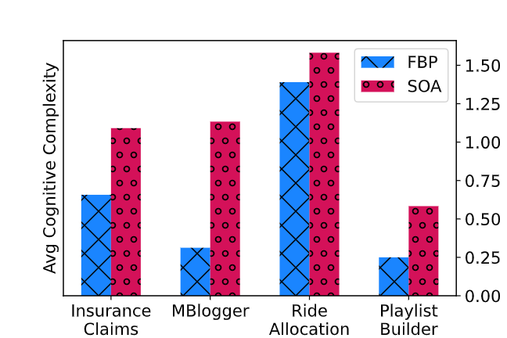
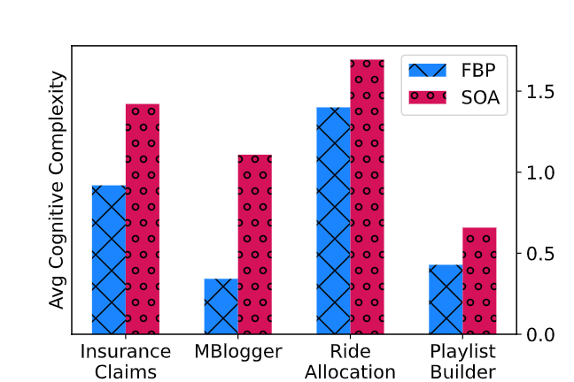
Data-First Principle
DOA vs SOA – Cognitive Complexity
From Baseline to Data Collection
From Data Collection to ML
Paleyes, Andrei, Christian Cabrera, and Neil D. Lawrence. "An empirical evaluation of flow based programming in the machine learning deployment context." Proceedings of the 1st International Conference on AI Engineering: Software Engineering for AI. 2022.
Notes:
Cognitive Complexity measures the complexity of the control flow of code. We use it to assess how easy it is to understand the application code from the human perspective. This initial result also shows that by focusing on data we can overcome intellectual debt as we can understand better our software…

Slide 39
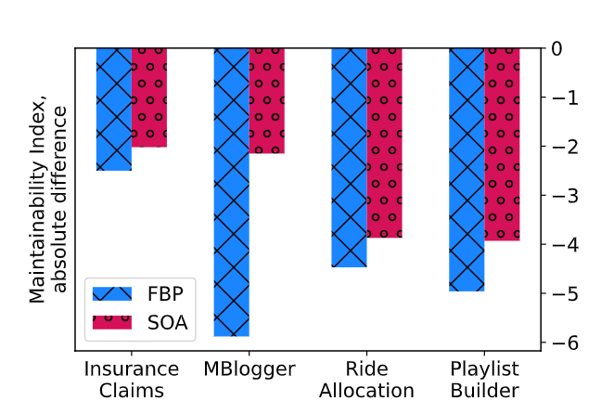
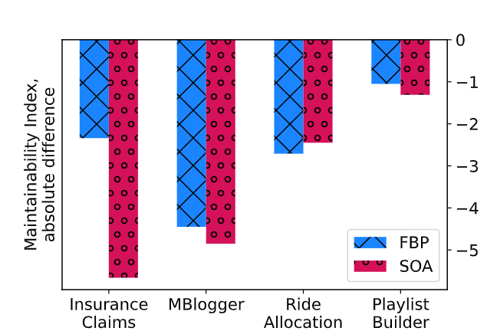
Data-First Principle
DOA vs SOA – Maintainability Index
From Baseline to Data Collection
From Data Collection to ML
Paleyes, Andrei, Christian Cabrera, and Neil D. Lawrence. "An empirical evaluation of flow based programming in the machine learning deployment context." Proceedings of the 1st International Conference on AI Engineering: Software Engineering for AI. 2022.
Notes:
The Maintainability Index measures how easy is to maintain our software. In this case, we are showing the absolute difference between the different stages of our applications. We can see here that the DOA-based solutions have a worse maintainability index when data collection components are added to the baseline. We found that while SOAs are well supported and there are different tools that facilitate the task, flow based programming requires a more complex implementation to gather and format the data…

Slide 40
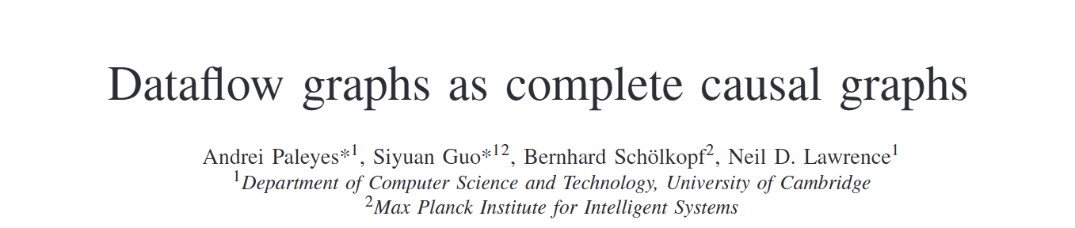
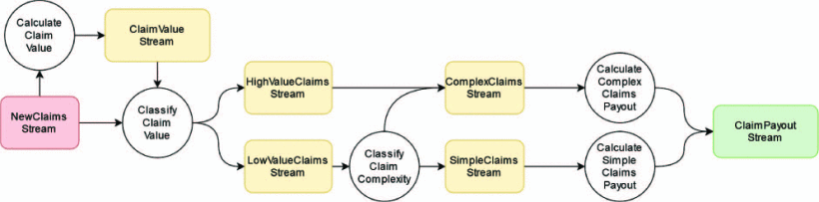
Data-First Principle
DOA and Causality Analysis
Paleyes, Andrei, et al. "Dataflow graphs as complete causal graphs." 2023 IEEE/ACM 2nd International Conference on AI Engineering–Software Engineering for AI (CAIN). IEEE, 2023.
Notes:
Andrei Paleyes, a colleague in our lab, went further with this work and experimented with how these data-oriented implementations can facilitate causality analysis…

Slide 41
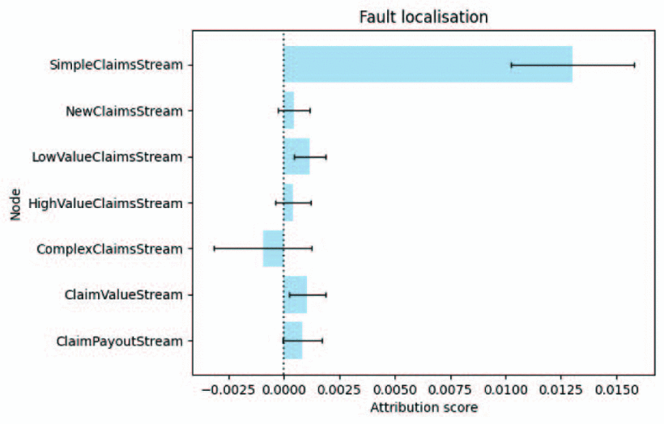
Data-First Principle
DOA and Causality Analysis – Fault localisation
Paleyes, Andrei, et al. "Dataflow graphs as complete causal graphs." 2023 IEEE/ACM 2nd International Conference on AI Engineering–Software Engineering for AI (CAIN). IEEE, 2023.

Slide 42
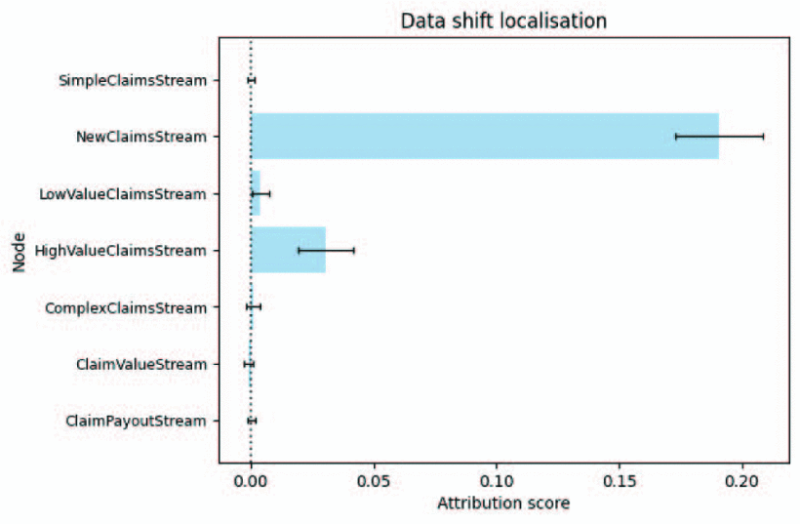
Data-First Principle
DOA and Causality Analysis – Identifying data shifts
50% up on the originally claimed amount.
Paleyes, Andrei, et al. "Dataflow graphs as complete causal graphs." 2023 IEEE/ACM 2nd International Conference on AI Engineering–Software Engineering for AI (CAIN). IEEE, 2023.

Slide 43
Data-First Principle
ADS Library
Assess
Access
Address

Slide 44



Data-First Principle
ADS Library
Assess
Access
Address

Slide 45
Summary
Systems design decisions change between systems, but these usually share requirements.
Similar requirements can be addressed following similar solutions.
Data-driven systems demand to design systems that prioritise data.
Data-Oriented Architectures is a useful paradigm to design data-driven systems.
The Data-First principle is particularly relevant for our data science pipelines.

Slide 46
Many thanks!

