Slide 1
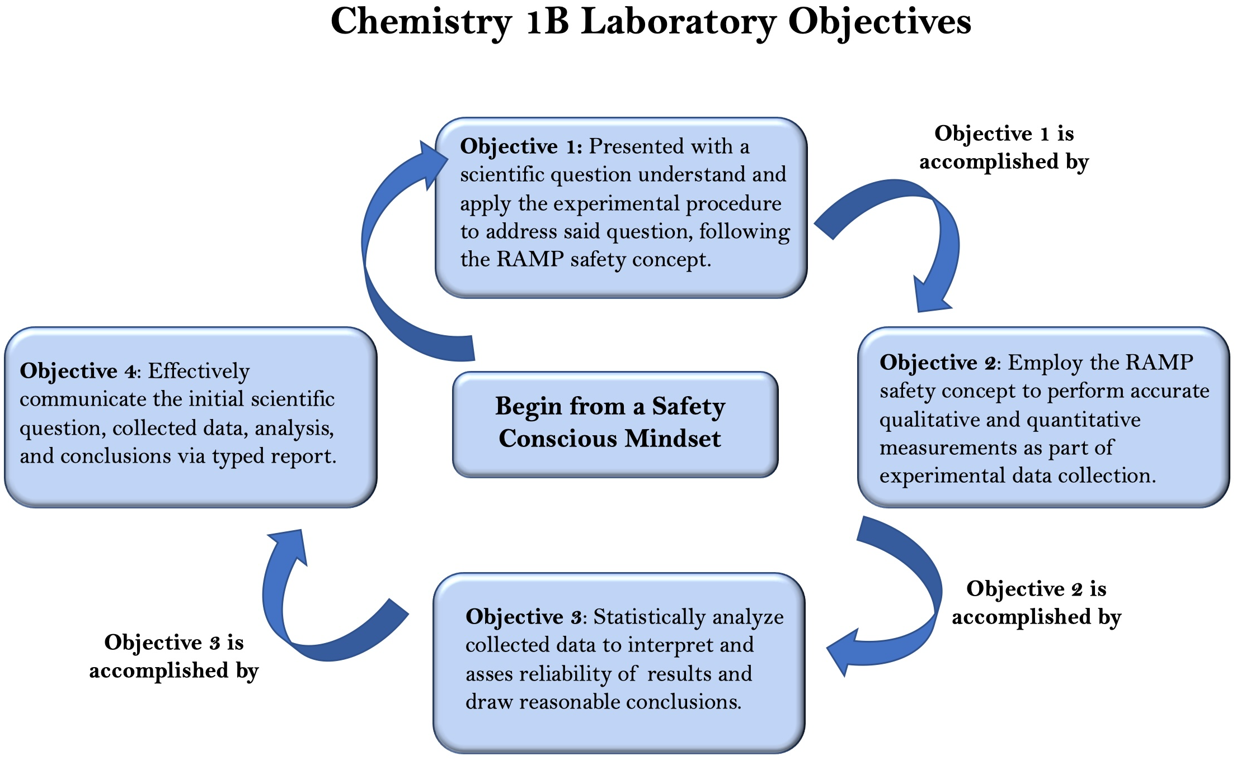

Slide 2
<img class="table" src="img/prereq/table.png"/>

Slide 3

Safety Consciousness Mindset
Recognize Hazards
Assess Risks
Minimize The Hazard
Prepare for Emergencies

