Slide 1

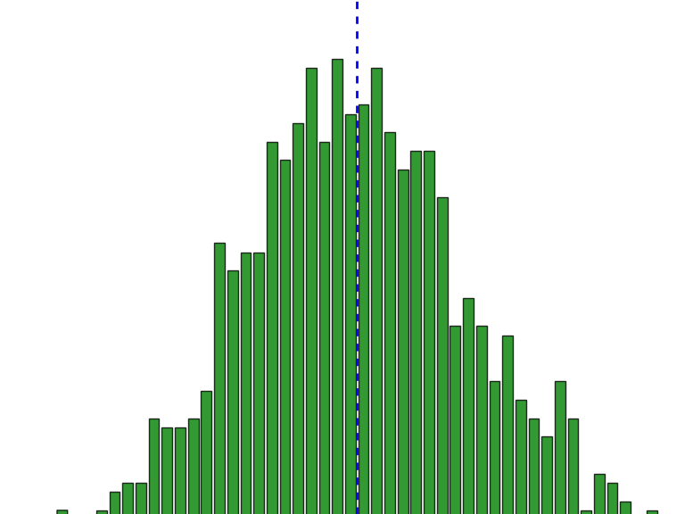
Analyzing S&P 500 ETF Using Python and Monte Carlo Simulation
By: Julian R. Cabrera

Slide 2
Introduction to Experiment
The S&P 500 ETF is seen as a leading indicator of Economic Health and the Benchmark of a typical Investment Portfolio
Using Python, we can aggerate and organize large Datasets such as the S&P 500 ETF more efficiently for statistical analysis and insight
Monte Carlo Simulation with use of Python allows us forecast future prices and other key risk metrics of S&P 500 through the variability of random sampling (10,000 simulations) Historical Returns, to see if a 24- year investment in the S&P 500 ETF has value for the investor

Slide 3
Methodology of Experiment
Visualize Data and Draw Conclusions
Extract S&P 500 ETF Closing prices Data from year 2000
Format Data using Pandas
Generate New Data/Metrics From Database using Numpys
Calculate Metrics from Test Results
Test New Data for Forecasting S&P 500 and Visualize Test Results (Monte Carlo Simulation)

Slide 4
Extract S&P 500 ETF Closing prices Data from year 2000
Extracted Yahoo Finance S&P 500 ETF Closing Prices from Jan 1st 2000 to July 12th 2024
Imported to JupyterLab in CSV File

Slide 5
Methodology of Experiment
Visualize Data and Draw Conclusions
Extract S&P 500 ETF Closing prices Data from year 2000
Format Data using Pandas
Generate New Data/Metrics From Database using Numpys
Calculate Metrics from Test Results
Test New Data for Forecasting S&P 500 and Visualize Test Results (Monte Carlo Simulation)

Slide 6
Format Data using Pandas
Formatted Data in a Data frame using the Pandas Python Library to organize Closing Prices Data in one Column(y-value)
Added the Date Index using Pandas giving the Data a proper Timeline for the x-value(time)

Slide 7
Methodology of Experiment
Visualize Data and Draw Conclusions
Extract S&P 500 ETF Closing prices Data from year 2000
Format Data using Pandas
Generate New Data/Metrics From Database using Numpy
Calculate Metrics from Test Results
Test New Data for Forecasting S&P 500 and Visualize Test Results (Monte Carlo Simulation)

Slide 8
Generate New Data/Metrics From Database using Numpy
Using the Pandas Data frame I created with the Closing Prices and Timeline, I generated new columns of metrics such as Daily Return % Change, Standard Deviation, Mean, etc. of Historical Returns using NumPy

Slide 9
Methodology of Experiment
Visualize Data and Draw Conclusions
Extract S&P 500 ETF Closing prices Data from year 2000
Format Data using Pandas
Generate New Data/Metrics From Database using Numpy
Calculate Metrics from Test Results
Test New Data for Forecasting S&P 500 and Visualize Test Results (Monte Carlo Simulation)

Slide 10
Test New Data for Forecasting S&P 500 and Visualize Test Results (Monte Carlo Simulation)
Using New Metrics such as Mean and Standard Deviation of Historical Returns we can run a Monte Carlo Simulation through Python
Purpose of the Monte Carlo Simulation is to analyze the risk in the S&P through simulating many random Price Paths that account for many variability (best and worst outcomes), visualizing the results through a line plot and distribution will give insight into Future Returns of the S&P 500 ETF 24 years into the future

Slide 11
Methodology of Experiment
Visualize Data and Draw Conclusions
Extract S&P 500 ETF Closing prices Data from year 2000
Format Data using Pandas
Generate New Data/Metrics From Database using Numpy
Calculate Metrics from Test Results
Test New Data for Forecasting S&P 500 and Visualize Test Results (Monte Carlo Simulation)

Slide 12
Calculate Metrics from Test Results
Using the 24-Year Forecasted Monte Carlo Results we can calculate very insightful metrics such as Value at Risk, Max Drawdown and Probability Distributions of Future S&P 500 Price Ranges and Volatility

Slide 13
Methodology of Experiment
Visualize Data and Draw Conclusions
Extract S&P 500 ETF Closing prices Data from year 2000
Format Data using Pandas
Generate New Data/Metrics From Data Frame using NumPy
Calculate Metrics from Test Results
Test New Data for Forecasting S&P 500 and Visualize Test Results (Monte Carlo Simulation)

Slide 14
Visualizing New metrics from Monte Carlo Test Results and pairing them with Previous Visualizations will help us Draw Conclusions about the Risk, Return, and overall Value of a 24-year investment of the S&P 500 ETF
Visualizing Historical Returns Metrics of S&P 500 ETF will provide insight to any Economic Events that have occurred
Visualize Data and Draw Conclusions

Slide 15
Methodology
Visualize Data and Draw Conclusions
Extract S&P 500 ETF Closing prices Data from year 2000
Format Data using Pandas
Generate New Data/Metrics From Data Frame using NumPy
Calculate Metrics from Test Results
Test New Data for Forecasting S&P 500 and Visualize Test Results (Monte Carlo Simulation)

Slide 16
S&P 500 ETF Historical Insights
From Last 24 Years

Slide 17
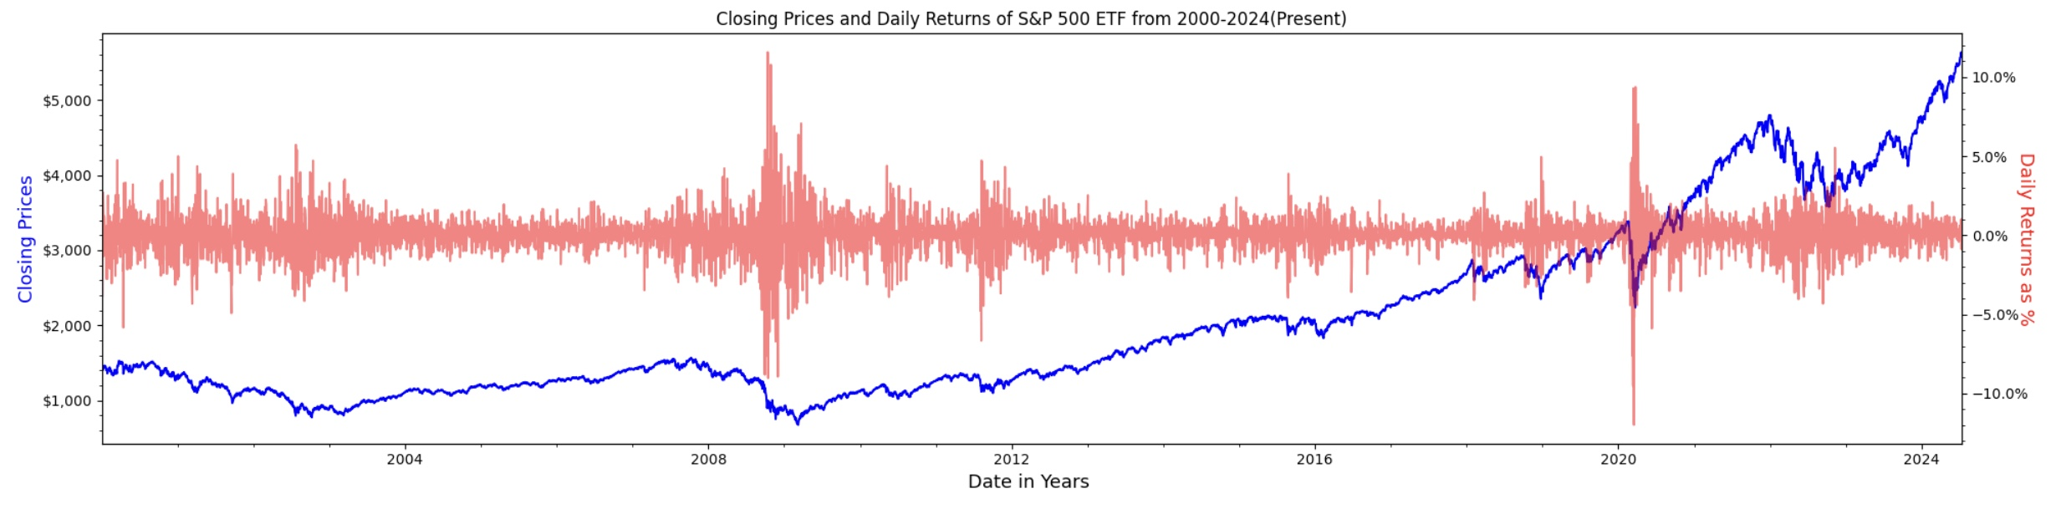
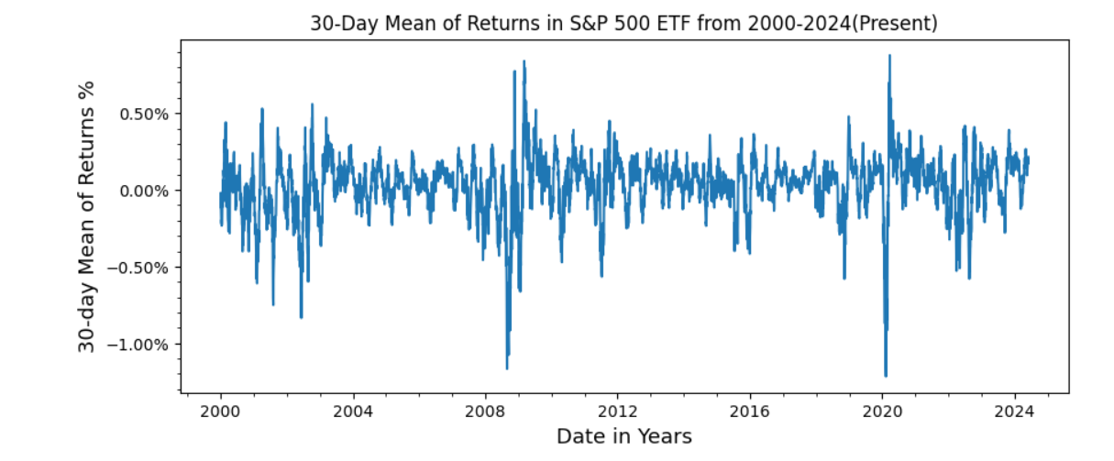

Slide 18

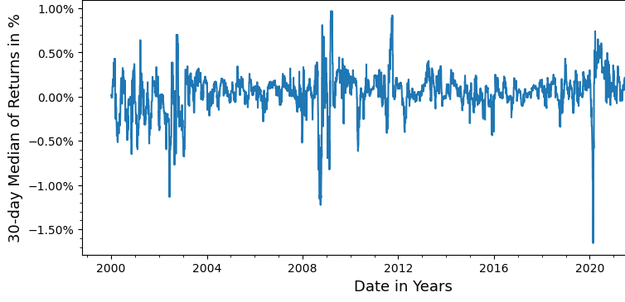
The Mean of the Daily Returns during the year 2020 was Volatile in a Sharp Bearish manner beginning at about 0% and quickly falling to -1%
This was mainly Caused by Covid 19 Pandemic Virus
Pandemic led to increased Unemployment, caused Treasury Bond to Fall, and create Panicked Sentiment in Stock Market

Slide 19
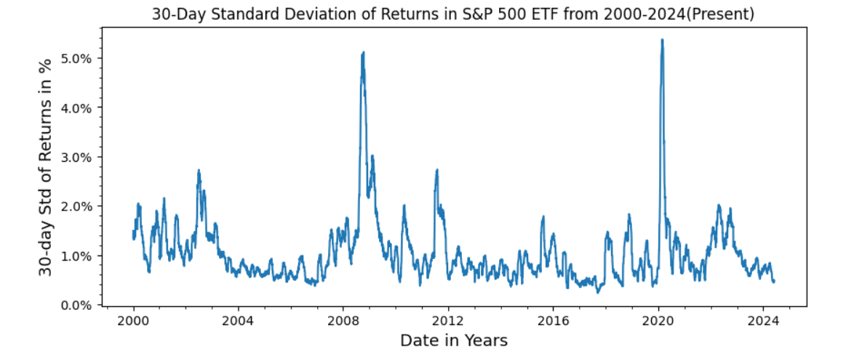

Slide 20
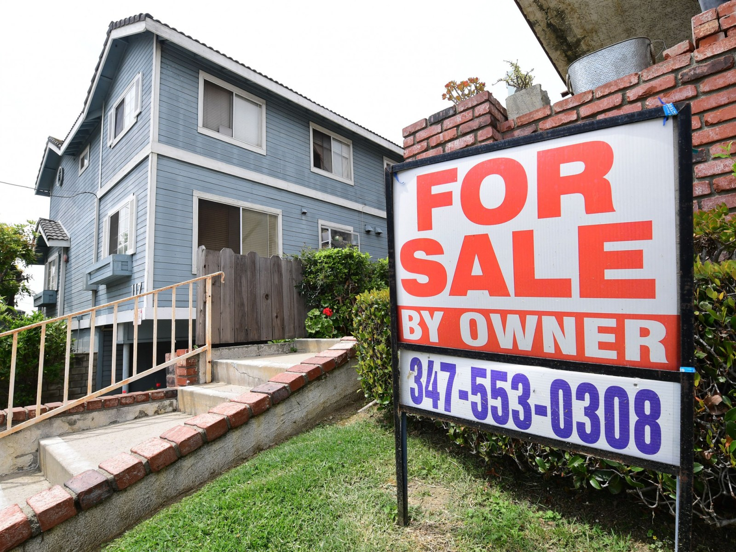
The standard deviation of 30-Day Returns during 2008 spiked from about 1% in the beginning of the year to 5%
This was caused by the 2008 financial crisis that triggered a large economic recession
The Financial Criss was caused by the housing bubble and loss on mortgage backed which created a Bearish Sentiment in the Stock Market

Slide 21
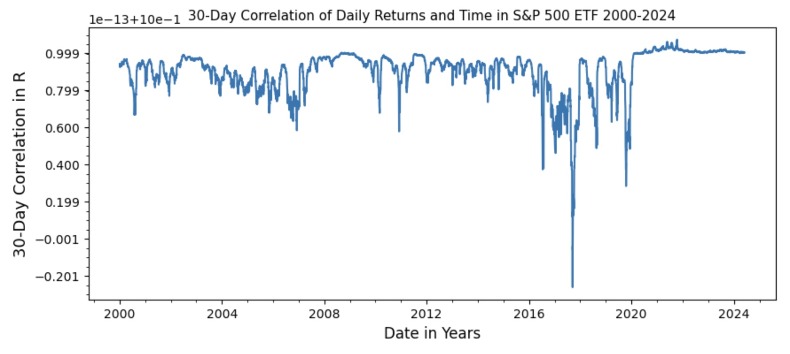

Slide 22

There was sharp downwards spike in 2017-2018 of the Correlation of Daily Returns showing a weak and slightly negative correlation in Daily Returns
Shows an indecisive and consolidated price that showed a challenging year (2017-2018) for S&P 500 and Stock Market.
2018
Consolidation was caused by Feds increasing interest Rates and Q4 sell-off from U.S Trade tension with China that would create Fear of in Economy & Stock Market
2018

Slide 23
Monte Carlo Simulation for S&P 500 ETF 24 years into the Future (2024-2048)
Same timeframe length as S&P 500 ETF Historical Data (2000-2024)

Slide 24
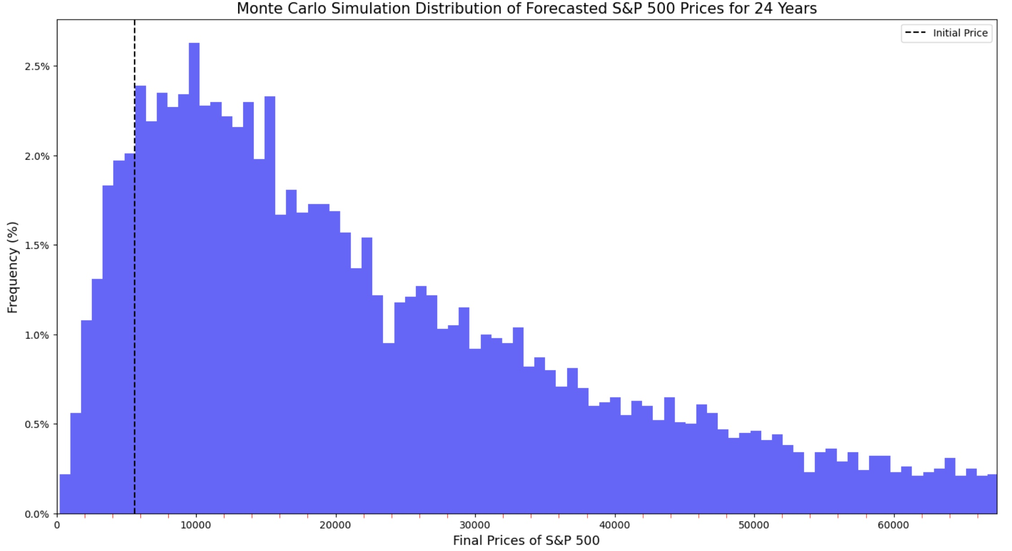

Monte Carlo Distribution of Future Prices
Probability of Price Ranges:
Price Range | Probability
0 - 5615.35 | 7.96%
5615.35 - 15615.35 | 29.53%
25615.35 - 35615.35 | 13.36%
35615.35 - 45615.35 | 8.25%
45615.35 - 55615.35 | 5.52%
55615.35 - 65615.35 | 3.54%
65615.35 - 75615.35 | 2.67%
75615.35 - 85615.35 | 1.89%
85615.35 - 95615.35 | 1.56%
95615.35 - inf | 5.98%
Probability of Return Ranges:
Return Range | Probability
-50% : -25% | 2.55%
-25%: 0% | 3.64%
0%:75% | 12.38%
75%:150% | 12.63%
150%:225% | 10.68%
225%:300% | 8.70%
300%:375% | 6.62%
375%:450% | 5.89%
450%:525% | 5.12%
525%:600% | 4.01%
600%:700% | 4.37%
700%:800% | 3.64%
800%:900% | 2.63%
900%:1000% | 2.06%
Initial Closing Price was 5316.35
$$μ=\text{33632.7}\text{5} σ=39928.95$$
Probability of Volatility Ranges (Standard Deviation):
Max Drawdown : -69.60% Probability of exceeding Max Drawdown with 20% threshold: .01%
Volatility Ranges | Probability
-.8 σ : 1 σ | 89%
-.8 σ : 2 σ | 94%
-.8 σ : 3 σ | 97.4%
-.8 σ : 4 σ | 98.9%
-.8 σ : 5 σ | 99.5%

Slide 25
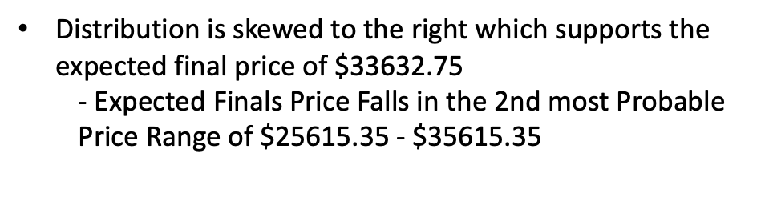
Probability of Price Ranges:
Price Range | Probability
0 - 5615.35 | 7.96%
5615.35 - 15615.35 | 29.53%
25615.35 - 35615.35 | 13.36%
35615.35 - 45615.35 | 8.25%
45615.35 - 55615.35 | 5.52%
55615.35 - 65615.35 | 3.54%
65615.35 - 75615.35 | 2.67%
75615.35 - 85615.35 | 1.89%
85615.35 - 95615.35 | 1.56%
95615.35 - inf | 5.98%
Most Probable Price Range is $5615.35 – $15615.35, indicating Strength for a Profitable Outcome/Return
Distribution is skewed to the right which supports the expected final price of $$\text{33632.7}\text{5}$
- Expected Finals Price Falls in the 2nd most Probable Price Range of $25615.35 - $35615.35

Slide 26
Monte Carlo Distribution of Future Prices
Probability of Price Ranges:
Price Range | Probability
0 - 5615.35 | 7.96%
5615.35 - 15615.35 | 29.53%
25615.35 - 35615.35 | 13.36%
35615.35 - 45615.35 | 8.25%
45615.35 - 55615.35 | 5.52%
55615.35 - 65615.35 | 3.54%
65615.35 - 75615.35 | 2.67%
75615.35 - 85615.35 | 1.89%
85615.35 - 95615.35 | 1.56%
95615.35 - inf | 5.98%
Probability of Return Ranges:
Return Range | Probability
-50% : -25% | 2.55%
-25%: 0% | 3.64%
0%:75% | 12.38%
75%:150% | 12.63%
150%:225% | 10.68%
225%:300% | 8.70%
300%:375% | 6.62%
375%:450% | 5.89%
450%:525% | 5.12%
525%:600% | 4.01%
600%:700% | 4.37%
700%:800% | 3.64%
800%:900% | 2.63%
900%:1000% | 2.06%
Initial Closing Price was 5316.25
$$μ=\text{33632.7}\text{5} σ=39928.95$$
Probability of Volatility Ranges (Standard Deviation):
Max Drawdown : -69.60% Probability of exceeding Max Drawdown with 20% threshold: .01%
Volatility Ranges | Probability
-.8 σ : 1 σ | 89%
-.8 σ : 2 σ | 94%
-.8 σ : 3 σ | 97.4%
-.8 σ : 4 σ | 98.9%
-.8 σ : 5 σ | 99.5%

Slide 27
Probability of Return Ranges:
Return Range | Probability
-50% : -25% | 2.55%
-25%: 0% | 3.64%
0%:75% | 12.38%
75%:150% | 12.63%
150%:225% | 10.68%
225%:300% | 8.70%
300%:375% | 6.62%
375%:450% | 5.89%
450%:525% | 5.12%
525%:600% | 4.01%
600%:700% | 4.37%
700%:800% | 3.64%
800%:900% | 2.63%
900%:1000% | 2.06%
As shown, the most probable outcome is a return between +75% and +100% (profitable)
it is even one of the smaller bin ranges with a range of 75% indicating its confidence
Overall, skew indicates strength in a profitable outcome, given about 79% of the distribution falling in the 0% - +1000% return range
- Avg. Expected Return(Mean) : 280%

Slide 28
Monte Carlo Distribution of Future Prices
Probability of Price Ranges:
Price Range | Probability
0 - 5615.35 | 7.96%
5615.35 - 15615.35 | 29.53%
25615.35 - 35615.35 | 13.36%
35615.35 - 45615.35 | 8.25%
45615.35 - 55615.35 | 5.52%
55615.35 - 65615.35 | 3.54%
65615.35 - 75615.35 | 2.67%
75615.35 - 85615.35 | 1.89%
85615.35 - 95615.35 | 1.56%
95615.35 - inf | 5.98%
Probability of Return Ranges:
Return Range | Probability
-50% : -25% | 2.55%
-25%: 0% | 3.64%
0%:75% | 12.38%
75%:150% | 12.63%
150%:225% | 10.68%
225%:300% | 8.70%
300%:375% | 6.62%
375%:450% | 5.89%
450%:525% | 5.12%
525%:600% | 4.01%
600%:700% | 4.37%
700%:800% | 3.64%
800%:900% | 2.63%
900%:1000% | 2.06%
Initial Closing Price was 5316.25
$$μ=\text{33632.7}\text{5} σ=39928.95$$
Probability of Volatility Ranges (Standard Deviation):
Max Drawdown : -69.60% Probability of exceeding Max Drawdown with 20% threshold: .01%
Volatility Ranges | Probability
-.8 σ : 1 σ | 89%
-.8 σ : 2 σ | 94%
-.8 σ : 3 σ | 97.4%
-.8 σ : 4 σ | 98.9%
-.8 σ : 5 σ | 99.5%

Slide 29
A
Max Drawdown : -69.60% Probability of exceeding Max Drawdown with 20% threshold: .01%
B
-69.60% is most likely the worst downside Return an investor could face in the S&P 500, a -69.60% return would be very detrimental
Max Drawdown would most likely occur during an economic recession such as the 2008 Housing Crisis where SPY lost 48% of its value from 2008-2009

Slide 30
Monte Carlo Distribution of Future Prices
Probability of Price Ranges:
Price Range | Probability
0 - 5615.35 | 7.96%
5615.35 - 15615.35 | 29.53%
25615.35 - 35615.35 | 13.36%
35615.35 - 45615.35 | 8.25%
45615.35 - 55615.35 | 5.52%
55615.35 - 65615.35 | 3.54%
65615.35 - 75615.35 | 2.67%
75615.35 - 85615.35 | 1.89%
85615.35 - 95615.35 | 1.56%
95615.35 - inf | 5.98%
Probability of Return Ranges:
Return Range | Probability
-50% : -25% | 2.55%
-25%: 0% | 3.64%
0%:75% | 12.38%
75%:150% | 12.63%
150%:225% | 10.68%
225%:300% | 8.70%
300%:375% | 6.62%
375%:450% | 5.89%
450%:525% | 5.12%
525%:600% | 4.01%
600%:700% | 4.37%
700%:800% | 3.64%
800%:900% | 2.63%
900%:1000% | 2.06%
Initial Closing Price was 5316.25
$$μ=\text{33632.7}\text{5} σ=39928.95$$
Probability of Volatility Ranges (Standard Deviation):
Max Drawdown : -69.60% Probability of exceeding Max Drawdown with 20% threshold: .01%
Volatility Ranges | Probability
-.8 σ : 1 σ | 89%
-.8 σ : 2 σ | 94%
-.8 σ : 3 σ | 97.4%
-.8 σ : 4 σ | 98.9%
-.8 σ : 5 σ | 99.5%

Slide 31

Probability of Volatility Ranges (Standard Deviation):
67% 22% 6% 2.56% 1.14% .49%
Volatility Ranges | Probability
-.8 σ : 1 σ | 89%
-.8 σ : 2 σ | 94%
-.8 σ : 3 σ | 97.4%
-.8 σ : 4 σ | 98.9%
-.8 σ : 5 σ | 99.5%
$$μ=\text{33632.7}\text{5} σ=39928.95$$
The Lognormal Distribution is Skewed to the Right because that Highly Volatile(larger std.) Closing Prices would only produce Positive Closing Prices which can be seen on the right-end tails
- S&P 500 Prices are lognormally distributed due to non-negative Closing Prices
The Distribution Suggests that about 89% would fall in the the Volatility Range of -.8σ : 1 σ which shows lower Volatility than a normal distribution having 26% less fall within -.8 σ : 1 σ at 63%
- This Indicates Low Volatility of Closing Prices which weakens variability for large upside potential as you can see with the small % Frequency on the Right-End Tails

Slide 32
Distribution of Future Prices
Probability of Price Ranges:
Price Range | Probability
0 - 5615.35 | 7.96%
5615.35 - 15615.35 | 29.53%
25615.35 - 35615.35 | 13.36%
35615.35 - 45615.35 | 8.25%
45615.35 - 55615.35 | 5.52%
55615.35 - 65615.35 | 3.54%
65615.35 - 75615.35 | 2.67%
75615.35 - 85615.35 | 1.89%
85615.35 - 95615.35 | 1.56%
95615.35 - inf | 5.98%
Probability of Return Ranges:
Return Range | Probability
-50% : -25% | 2.55%
-25%: 0% | 3.64%
0%:75% | 12.38%
75%:150% | 12.63%
150%:225% | 10.68%
225%:300% | 8.70%
300%:375% | 6.62%
375%:450% | 5.89%
450%:525% | 5.12%
525%:600% | 4.01%
600%:700% | 4.37%
700%:800% | 3.64%
800%:900% | 2.63%
900%:1000% | 2.06%
Initial Closing Price was 5316.25
$$μ=\text{33632.7}\text{5} σ=39928.95$$
Probability of Volatility Ranges (Standard Deviation):
Max Drawdown : -69.60% Probability of exceeding Max Drawdown with 20% threshold: .01%
Volatility Ranges | Probability
-.8 σ : 1 σ | 89%
-.8 σ : 2 σ | 94%
-.8 σ : 3 σ | 97.4%
-.8 σ : 4 σ | 98.9%
-.8 σ : 5 σ | 99.5%

Slide 33
Risk Analysis and Return Comparison

Slide 34
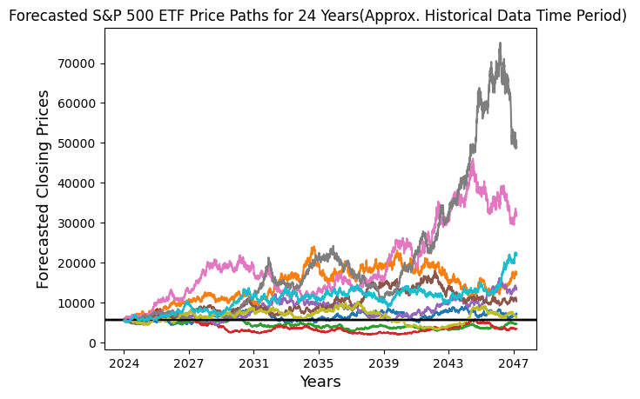
Value at Risk and Conditional Value at Risk
Over 10,000 Simulations
Value at Risk : -50.37%
-suggests 95% chance that initial closing Value of 5316.25 does not lose more than 50.37% (-2855) after 24 years
Conditional Value at Risk : -64.64%
- an average loss of - 64.64% if the loss exceeds the Value at Risk Threshold of - 50.37% after 24 years
***10 Price Paths Shown***

Slide 35
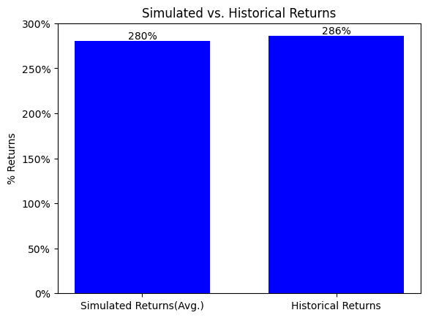
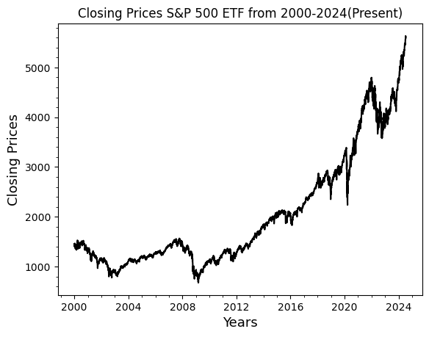
Comparing Simulated Returns vs. Historical Returns
***Both Returns have a 24 Year timeframe ***
On average, Simulated Returns closely followed the trend set by the Historical Returns over 10,000 simulations/price paths
S&P 500 ETF Historical Returns from 2000-2024 only outperformed Simulated Returns by 6%
***10 Price Paths Shown***

Slide 36
Investment Conclusions

Slide 37
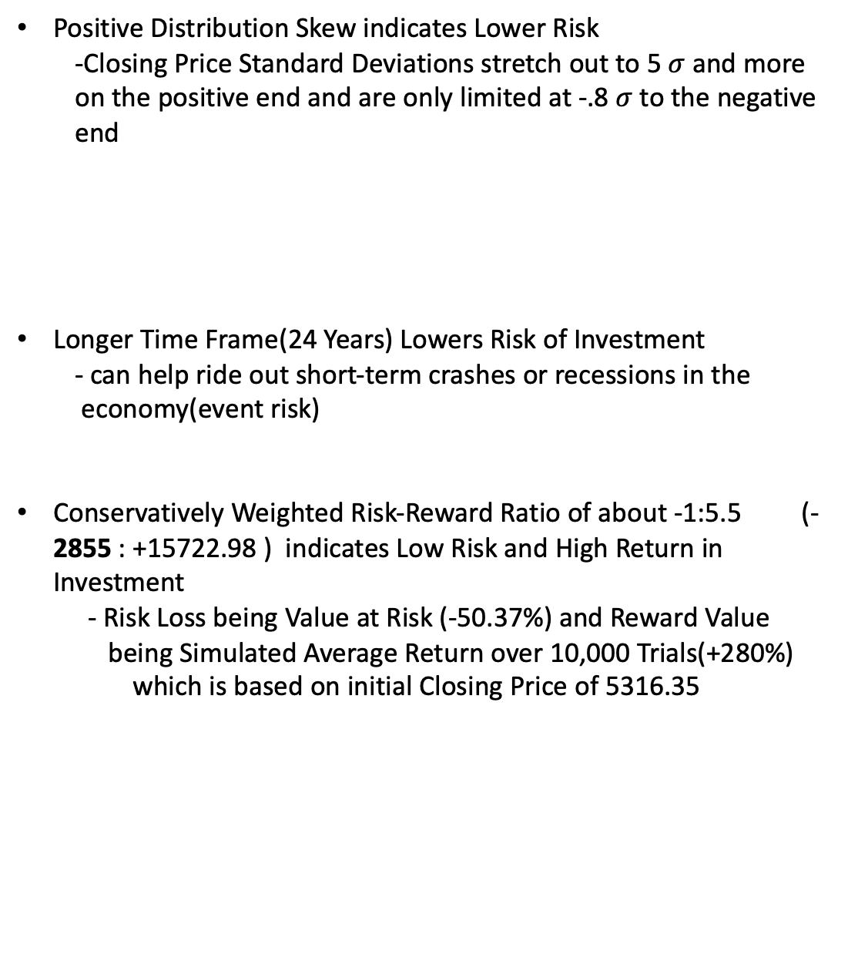
Investment Risk Conclusion
Positive Distribution Skew indicates Lower Risk
-Closing Price Standard Deviations stretch out to 5 $σ$ and more on the positive end and are only limited at -.8 $σ$ to the negative end
Longer Time Frame(24 Years) Lowers Risk of Investment
- can help ride out short-term crashes or recessions in the economy(event risk)
Conservatively Weighted Risk-Reward Ratio of about -1:5.5 (- 2855 : +15722.98 ) indicates Low Risk and High Return in Investment
- Risk Loss being Value at Risk (-50.37%) and Reward Value being Simulated Average Return over 10,000 Trials(+280%) which is based on initial Closing Price of 5316.35
Investment Risk in the S&P 500 ETF for the next 24 Years is low

Slide 38
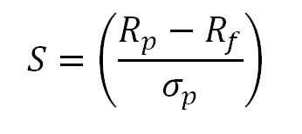
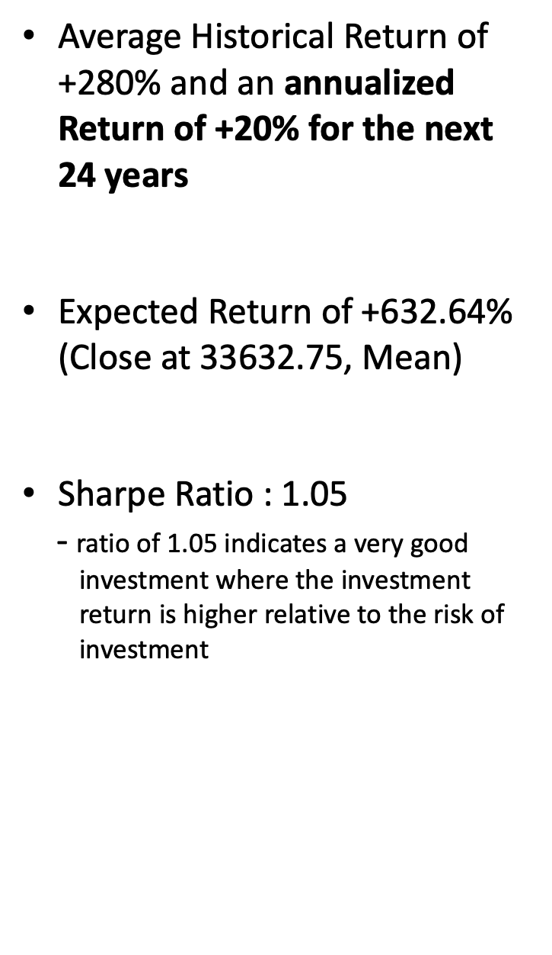
Return Profile Conclusion
Average Historical Return of +280% and an annualized Return of +20% for the next 24 years
Expected Return of +632.64% (Close at $\text{33632.7}\text{5, }\text{Mean}$)
Sharpe Ratio : 1.05
- ratio of 1.05 indicates a very good investment where the investment return is higher relative to the risk of investment
Returns are Moderately High for 24-year Investment in the S&P 500 ETF

Slide 39
Investment Value Conclusion
A 24–Year Investment in the S&P 500 ETF appears to have Great Value for an Investor
Simulated Investment Risk is moderately low
Simulated Historical Returns are Moderately High and confirms continuation of a Bullish S&P 500
S&P 500 will continue to carry diversification in 500 different companies which can optimize risk and return for the investor

Slide 40
Economic Event Investor Assurance
Reminder:
Economic Events and Crashes are accounted for in the Simulation Results and Metrics by using the Mean and Standard Deviation Of 24-year Historical Returns in the Monte Carlo Simulation Programming
Realistically Tested

Slide 41
Thank you!

