Slide 1

Airline Safety
and
Public Perception
January 24, 2021
Christopher Briggs
Airline Corp, Inc.

Slide 2
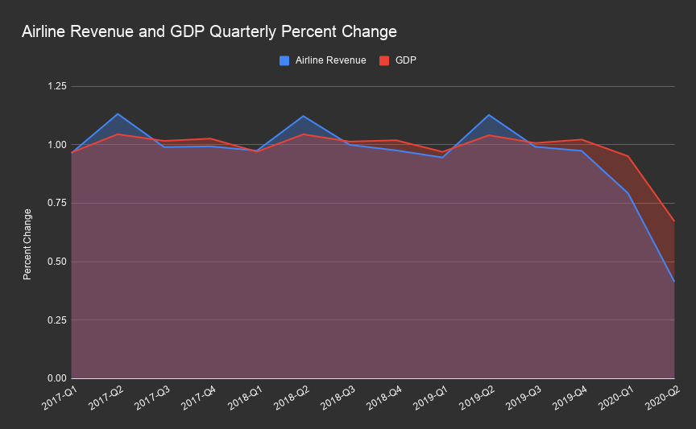
Revenue traditionally tracks GDP, but has fallen below even GDP's dive this year.

Slide 3
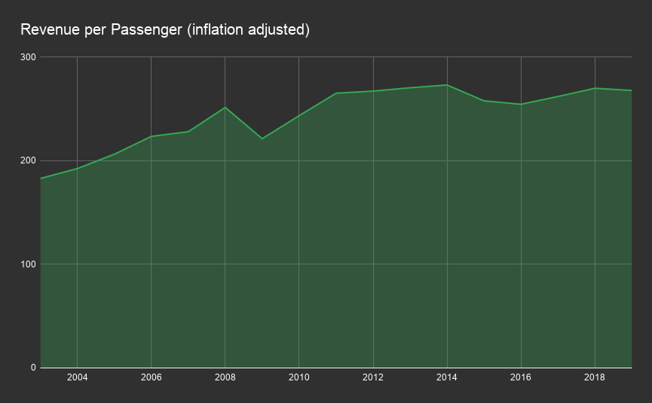
The revenue per passenger has been on a generally positive trend, even adjusting for inflation

Slide 4
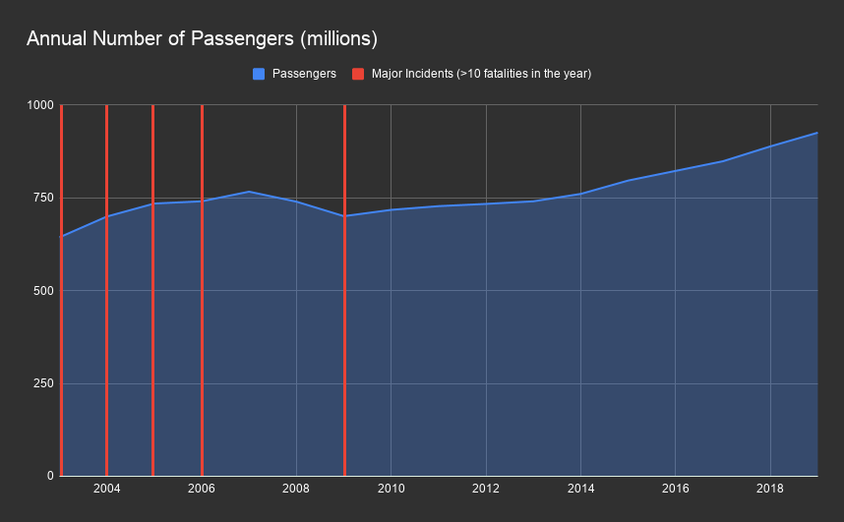
Years with higher number of fatalities apparently do not predict drops in ridership, so the public relations problem is strictly one of perception.

Slide 5
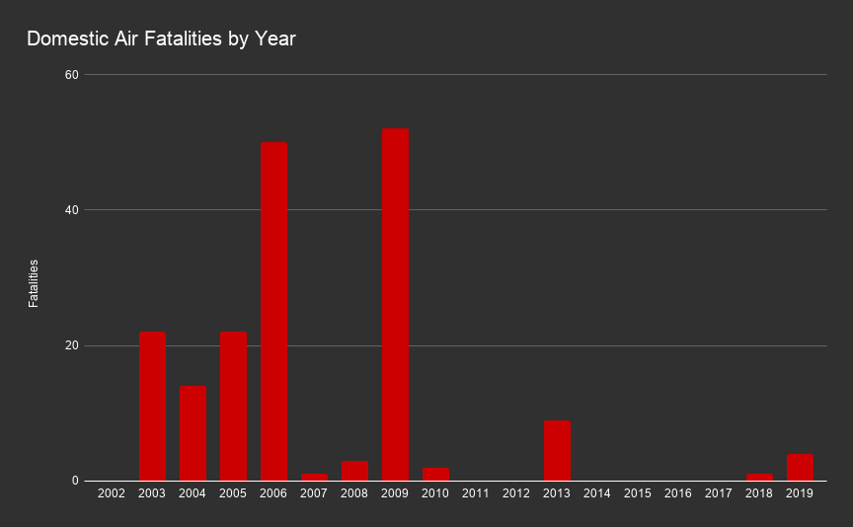
We must communicate carefully. Showing raw facts such as fatalities per year without context can look spiky and alarming.

Slide 6

People trust cars. Aviation safety compares very favorably to cars. We can communicate this in a straightforward way.

Slide 7
Proposed Actions
Three-pronged outreach
Establish a blog presence propagating simple, aggregate safety information.
Produce infographics to be posted in airport terminals, corporate offices.
Record a short presentation for dissemination on the web, social media.

