Slide 1
Chapter 1.1 - Functions
Accompanying PowerPoint

Slide 2
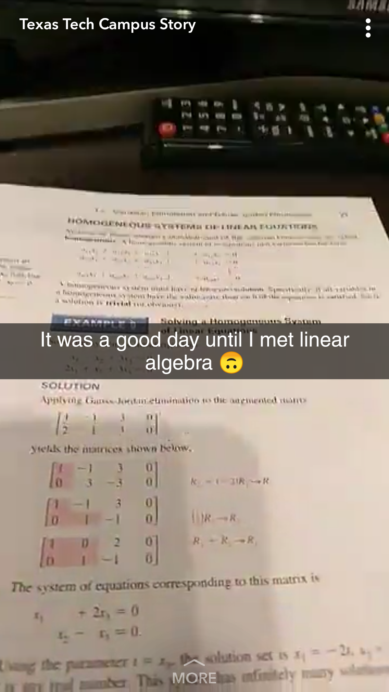

Slide 3
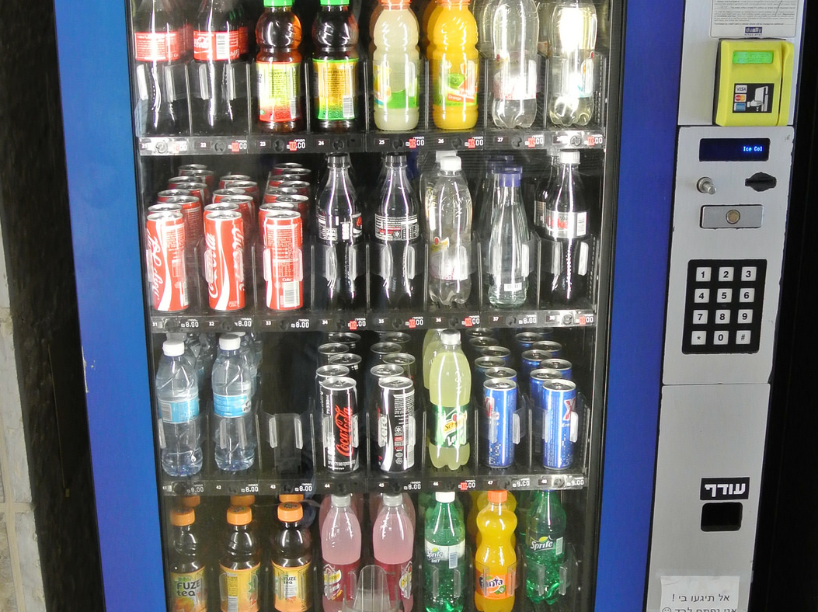
The Vending Machine Example
Suppose we take a trip to the vending machine in the SUB.
You decide that you want to purchase one can of Coca-Cola.
You look and see which label the can of Coca-Cola corresponds to.
You input the value on the keypad.
The vending machine dispenses one can of Coca-Cola.

Slide 4
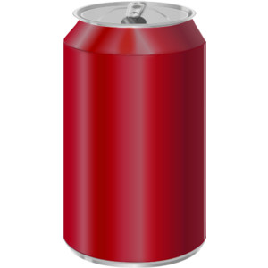
The Vending Machine Example
A vending machine is an example of a function.
You give it some input (i.e., money and the desired item label on the keypad).
It outputs one item of what you chose.

Slide 5
The Vending Machine Example (Part 2)
Suppose your friend also wants Coca-Cola.
The machine just dispensed Coca-Cola for you.
However, upon inputting the same label onto the keypad, your friend receives a can of Sprite.
What happened?

Slide 6

The Vending Machine Example (Part 2)
Input on keypad:
B2

Slide 7
The Vending Machine Example (Part 2)
In this instance, we’d say the vending machine is not functioning.
In mathematics, we say a relation is NOT a function if it outputs two different values for the same input.

Slide 8
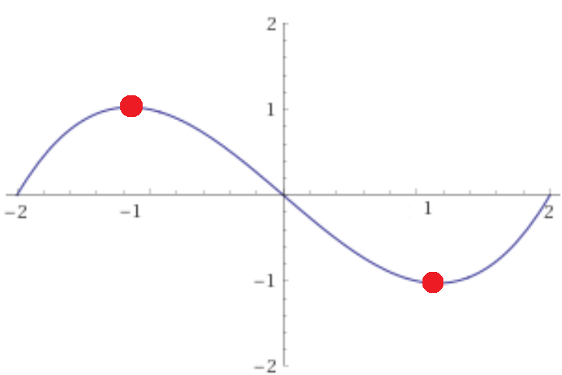
Determine the values from the graph of g(x):
g(-1)
g(0)
2g(1)
3g(1) – 4g(-1)

